Slide 1
Stock Market Analysis Dashboard
Created by Priyanka Chandrashekhar Meti

Slide 2
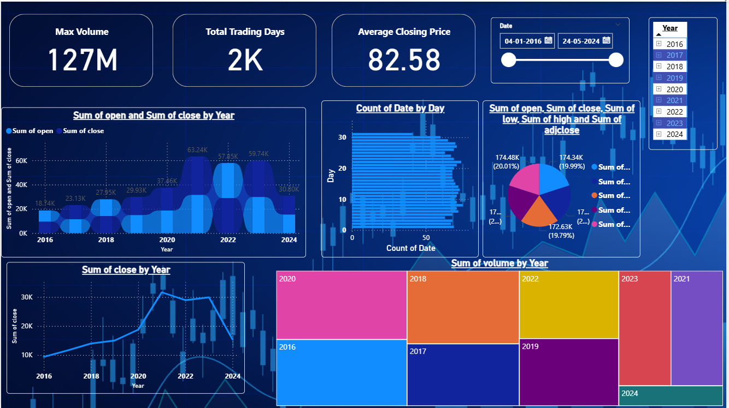
Dashboard Overview

Slide 3
Key Performance Metrics
• Max Volume: 127M
• Total Trading Days: 2K
• Average Closing Price: 82.58
• Date Range: 04-01-2016 to 24-05-2024

Slide 4
Yearly Performance Summary
• Open and Close values show consistent growth from 2016 to 2024.
• Highest market activity recorded during 2020–2022.
• Volume distribution indicates strong spikes in 2020 and 2018.
• Line and treemap charts together reflect market volatility trends.

Slide 5
Insights & Observations
• The market shows peak trading activity in 2020.
• Closing prices steadily increased, indicating strong market performance.
• High consistency in day-by-day trading volume.
• Pie chart reflects balanced distribution across open, close, high, and low values.

Slide 6
Conclusion
This dashboard provides a complete overview of stock performance over the years.
It highlights trends, volume distribution, trading activity, and price fluctuations.

