Slide 1

Wipro internship(velocity program)
Java-GCP(wipro_velocity_gcp_ip_apr_cII)
Batch : 6
1

Slide 2
Shop for home
Group Members
Jayasree Nallamothu
Priyanka Dandupati
Beera Hema Sundar Chinna Rao
Nandini Pothuraju
Group Mentor:
Parth Shukla
2

Slide 3

Technologies:
Eclipse 2021-12
MySQL Workbench
Spring Boot
MySQL
Jdk 8
Vscode

Slide 4


G o A l s
Selling Products Online
Manage Products In Various Categories
Maintain Admin panel
Maintain User Profiles

Slide 5
Shop For Home
ShopForHome is a popular Store in the market for shopping the home décor stuff .Due to Covid 19 all the offline shopping stopped. So, the store wants to move to the online platforms and wants their own web application.
There are 2 users on the application: -
User
Admin
Online shopping or shopping is a form of electronic commerce which allows consumers to directly buy goods or services from a seller over the internet using a web browser.
It is a B2C process i.e. business to computer ecommerce.
Online customers must have access to the internet and a valid method of payment in order to complete a transaction.
Online stores are usually available 24 hours a day and many consumers in Western countries have Internet access both at work and at home.

Slide 6
Online shopping Vs. Traditional Shopping
Online Shopper
1.I want to buy a dress let’s checkout online.
2.Easy to find best online stores.
3.Searching online styles.
4.I got a best coupon to shop.
5.Wow, Good discount
6.Hooray! Got it. Traditional Shopper
1.I want to buy handbag lets go out
2.Time to find out best store.
3.Oh,I got stucked in traffic
4.I found a shop at least
5.Salesman says no discount.
6.No Home delivery..

Slide 7
Advantages
Convenient.
No need for vendor and no pressure to buy.
“Infinite Shelf Space” available.
Able to compare product prices and features.
Disadvantages
Not able to touch or ty.
Shipping and handling cost is more.
Credit/Debit card insecurity.
Take much time if connection is slow.
Returning goods is difficult.
Actual product may differ.
Availability of internet is a must.
7

Slide 8
Features
User Stories –
User can login, Logout and Register into the application.
User can see the products in different categories.
User can sort the products.
User can add the products into the shopping cart.
User can increase or decrease the quantity added in the cart.
User can add “n” number of products in the cart.
User can get the Wishlist option where I can add those products which I want but don’t want to order now.
As a user I should get different discount coupons.

Slide 9
Admin Stories –
Admin can login, Logout and Register into the application.
Admin can perform CRUD on Users.
Admin can Perform CRUD on the products.
Admin has bulk upload option to upload a csv for products details
Admin is able to get the stocks.
Admin gets mail if any stock is less than 10.
Admin can get the sales report of a specific duration.
Admin is able to set the discount coupons for the specific set of users

Slide 10


Modules:
Customer Module
Product Module
The admin can login the system
Admin can create categories
Admin can upload products
Admin can create coupons
The Admin can create subcategories
Admin can upload product features
The buyers can login the system
The buyers can order a product
The buyers can search for a particular product
Buyer can apply coupons
Order Module
Cart Module
10

Slide 11
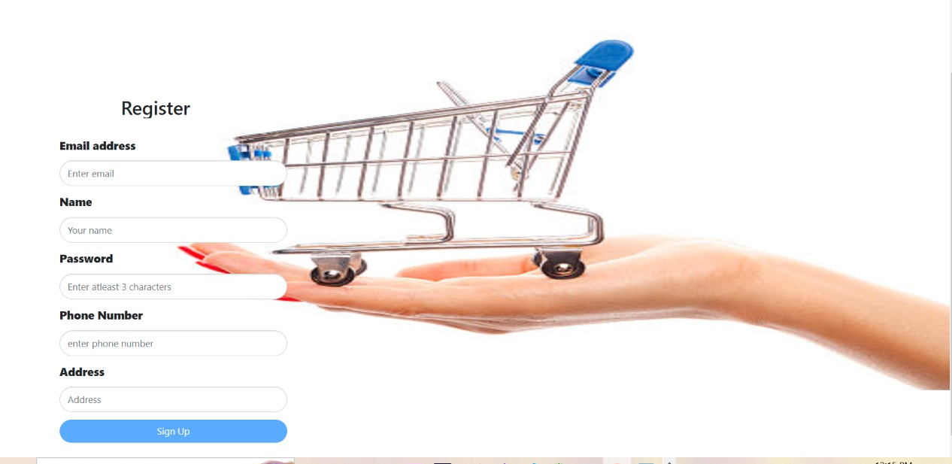
Register page:New user can register through the below page.

Slide 12
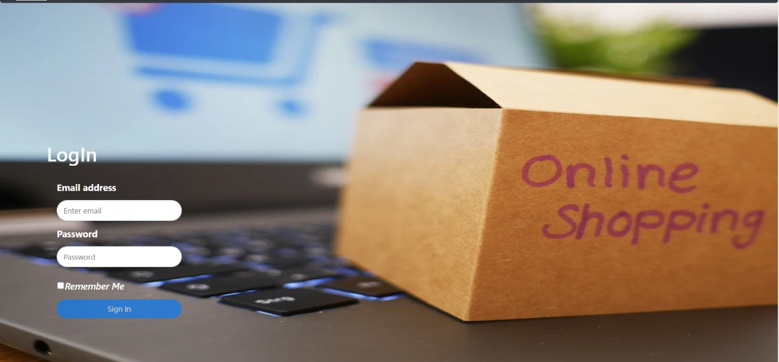
Login page: User will be able to login into the website through this page.

Slide 13
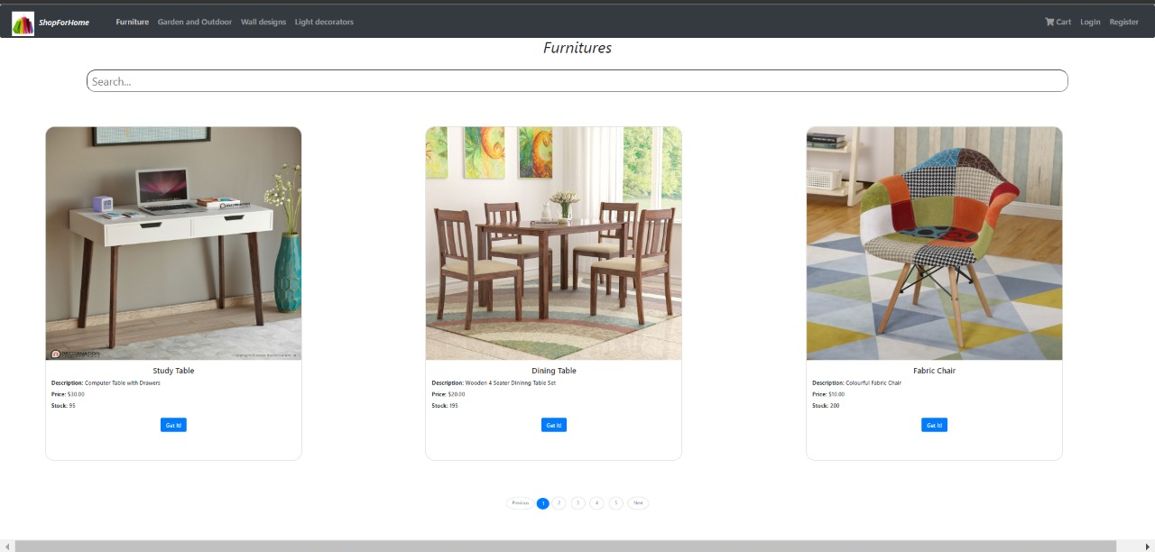
Categories: Furniture, Garden and Outdoor, Wall designs, light decorations are the categories available for a user purpose.

Slide 14
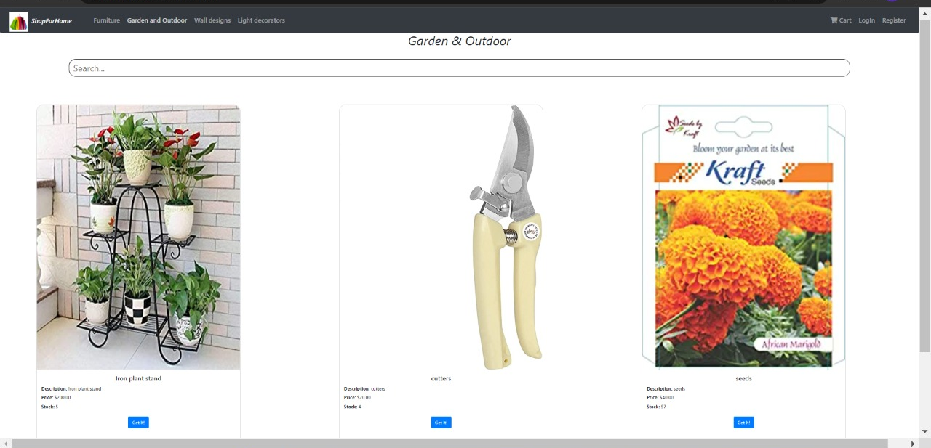

Slide 15
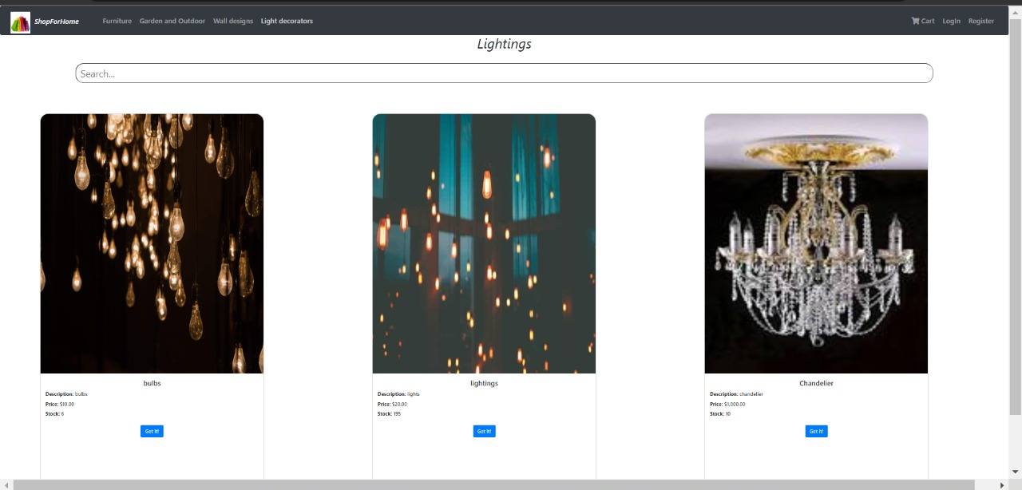

Slide 16
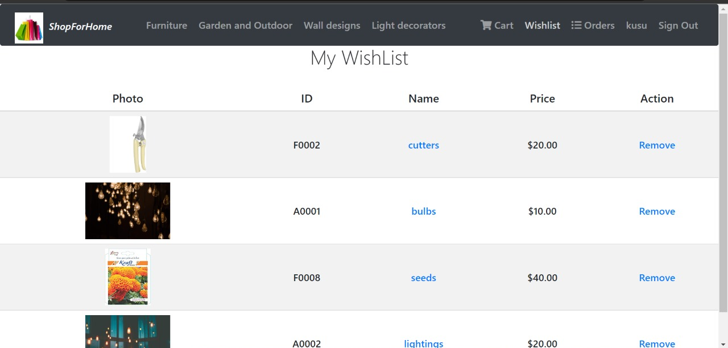
Wishlist: A user will be able to wishlist the items they want for later purchase.

Slide 17
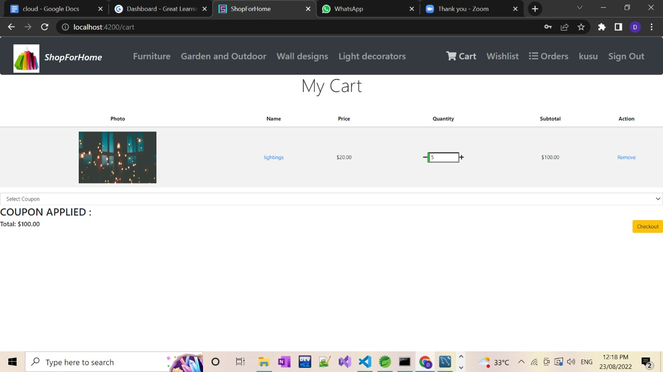
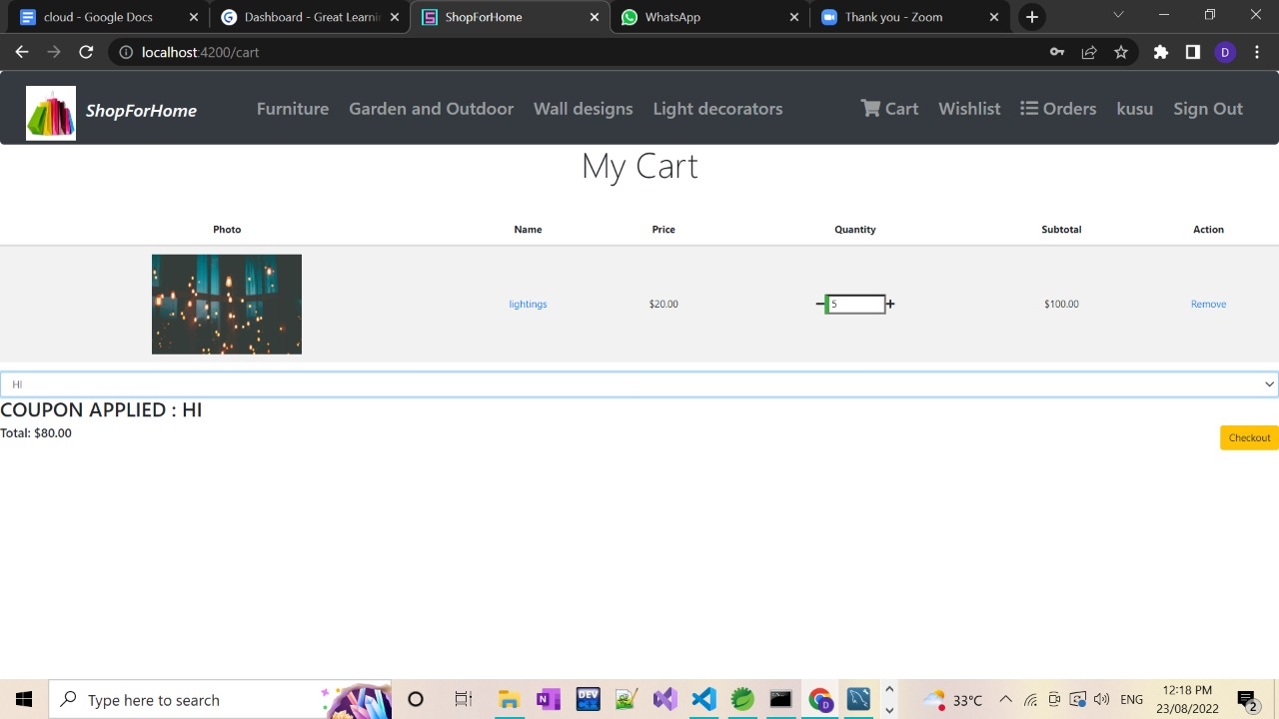
Cart: Orders are placed through my cart page and Specific coupons will be available for a user that can be applied while checking out.

Slide 18
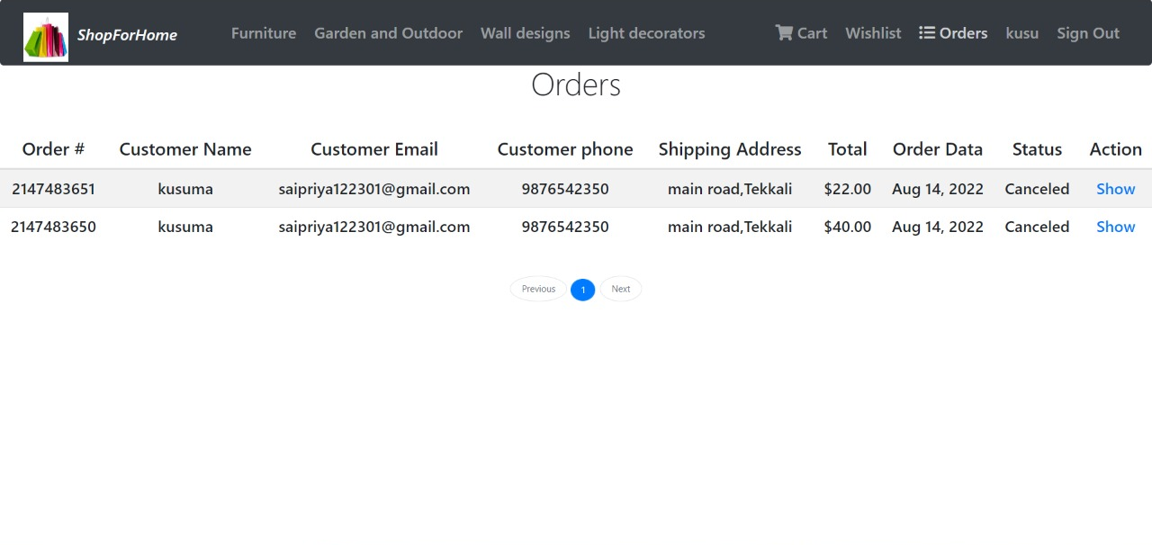
Orders Placed: This page is displayed at admin end which shows the orders that are placed.

Slide 19
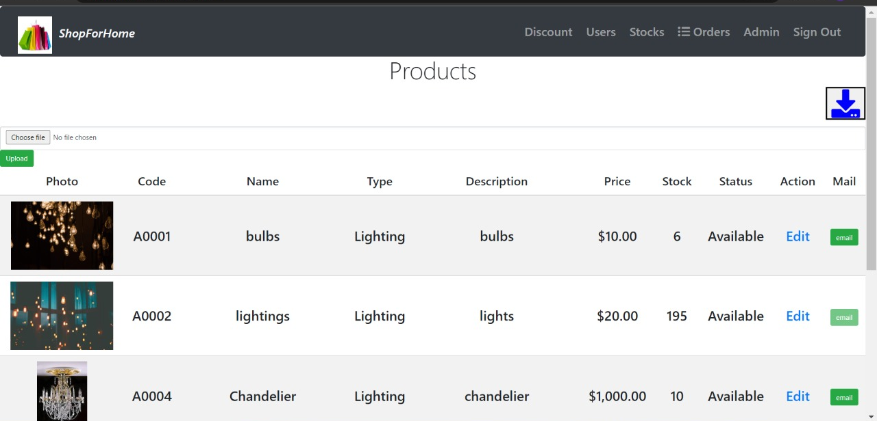
Products List: Products and stocks list displayed at admin end and allows admin to upload bulk files.

Slide 20
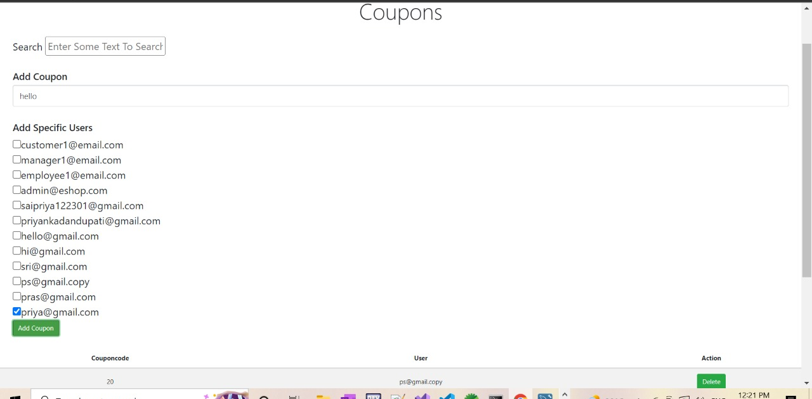
Coupons: At admin end, admin will be able to add specific coupons to specific users.

Slide 21
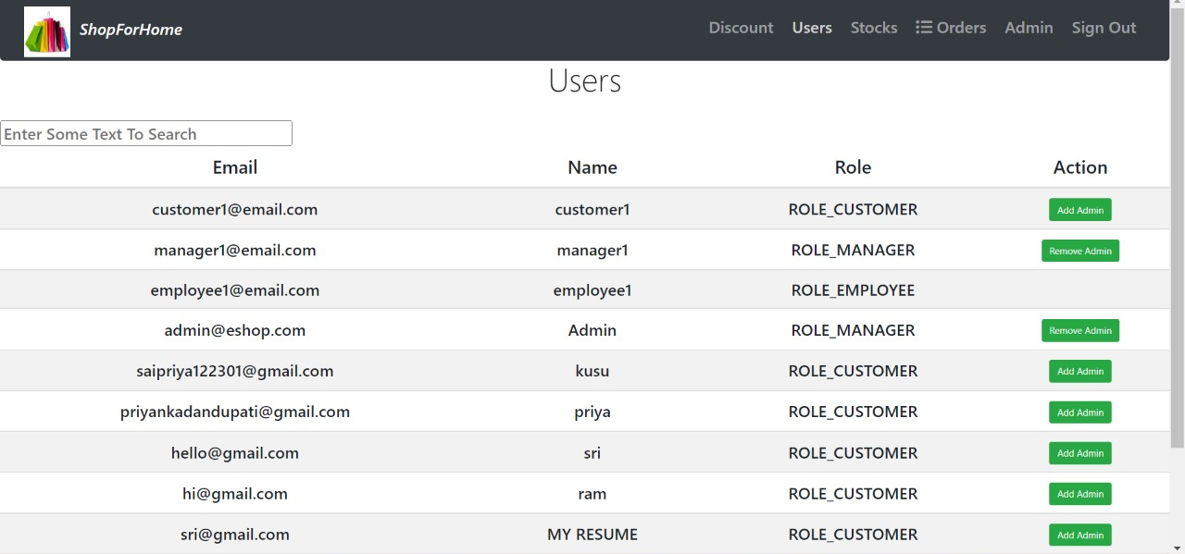
Users List: At admin end, admin is capable of making any user as admin and can also remove them as admins.

Slide 22
Thank you!
https://www.wipro.com/

