Slide 1
Radiogrammetric Measurement Of Third Metacarpal Bone From Hand Radiogram Using
Active Contour Model
Submitted by:-
Priyanka-16CS13F

Slide 2
OVERVIEW
Osteoporosis disease is caused by reduction in bone mass and strength.
Diagnosis of osteoporosis is measurement of bone mineral density (BMD) using Dual X-ray Absorptiometry (DXA).
DXA is expensive and not widely available in developing countries.
Geometric measurements like cortical length , cortical width and thickness etc. of metacarpal bone are measured .
In this project, I have done segmentation of third metacarpal bone from hand
radiograph and radiogrammetric measurements using active contour model (chan-
vese model).
Cortical width and thickness are measured from the endosteal and
periosteal edges of the metacarpal bone using which bone indices which help in
diagnosis of osteoporosis can be computed.

Slide 3
ACTIVE CONTOUR METHOD
Edge detection: The process of labelling the locations in the image where the grey level’s rate of change is high.
Edge integration: The process of combining local and perhaps soarse and non-contiguous edge data into meaningful long edged curves for segmentation.

Slide 4
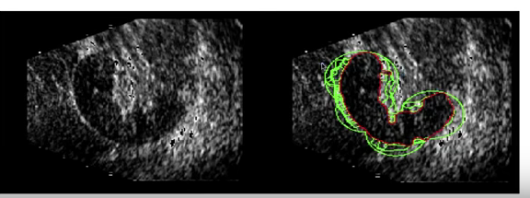

Slide 5
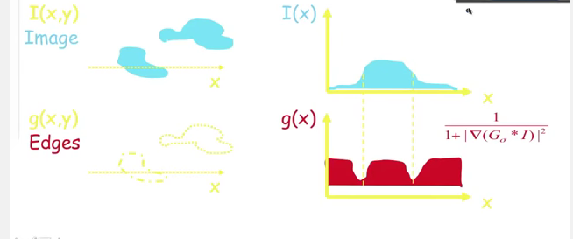

Slide 6
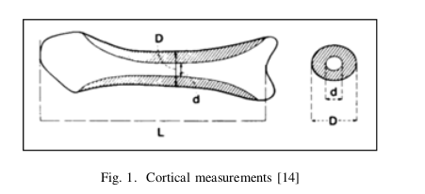
RADIOGRAMMETRY
CALCULATIONS TO BE DONE FROM THE OBTAINED SEGMENTED IMAGE
cortical width, D
medullary width, d
cortical thickness, T = D − d
cortical area, A = πT D(1 −T/D)
length of the bone, L

Slide 7
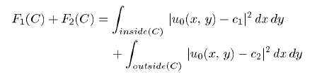
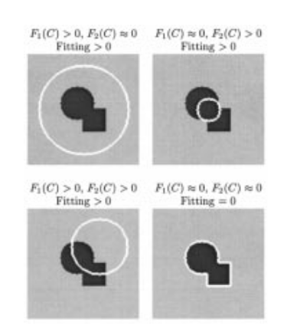
IMAGE FITTING

Slide 8
FLOW CHART
RADIOGRAMMETRIC IMAGE
IMAGE ENHANCEMENT
SEGMENTATION OF THIRD
METACARPEL
IMAGE DENOISING USING
BM3D
DETECTION OF ENDOSTEAL
AND PERIOSTEAL EDGES
THRESHOLDING USING
NIBLACK
RADIOGRAMMETIC
MEASUREMENTS
MANUAL CONTOUR
PLACEMENT

Slide 9
OUTPUT-1
XOR
=

Slide 10
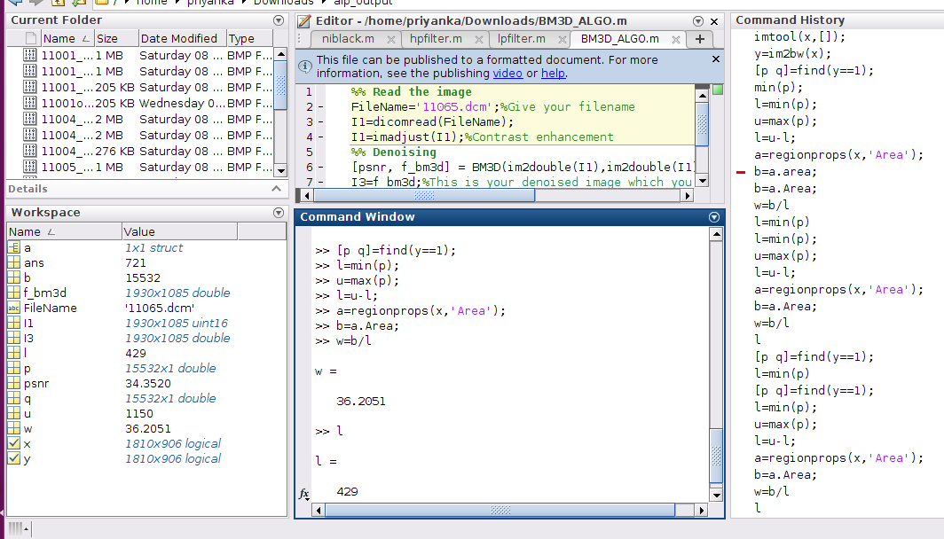
FINDING LENGTH & WIDTH

Slide 11
Dimentions Calculation
Pixel dimension=0.144 mm
No. of pixels in length= 429
No.0f pixels in width 36.2051
Length = 429 * 0.144 = 61.776 mm = 0.617 cm
Width = 36.2051 * 0.144 = 5.21353 mm = 0.521 cm

Slide 12
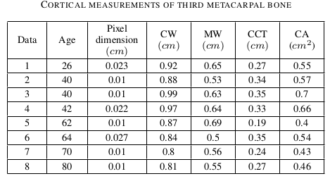
COMPARISON WITH STANDARD TABLE TO DETECT THE DISEASE
Combined cortical thickness (CCT)
Cortical area (CA)
Cortical width (CW), D
Medullary width (MW),d

Slide 13
REFERENCES
Fully Automated Radiogrammetric Measurement of Third Metacarpal Bone from Hand Radiograph, Anu Shaju Areeckal, Sumam David S, Michel Kocher, Nikil Jayasheelan, Jagannath Kamath.
Active Contours Without Edges, Tony F. Chan, Member, IEEE, and Luminita A. Vese

