Slide 1
Dedup
Members:
Pratik Chavan
Pratik Kadam
Priyanka Donta
Terance Barretto

Slide 2
Objective
Understanding the structure of the cost for different healthcare services for all the states in United States of America
Working remotely and collaborating and create a data warehouse using Cloud Infrastructure
Check the number of providers per state
Comparing Inpatient and Outpatient revenue for Providers

Slide 3
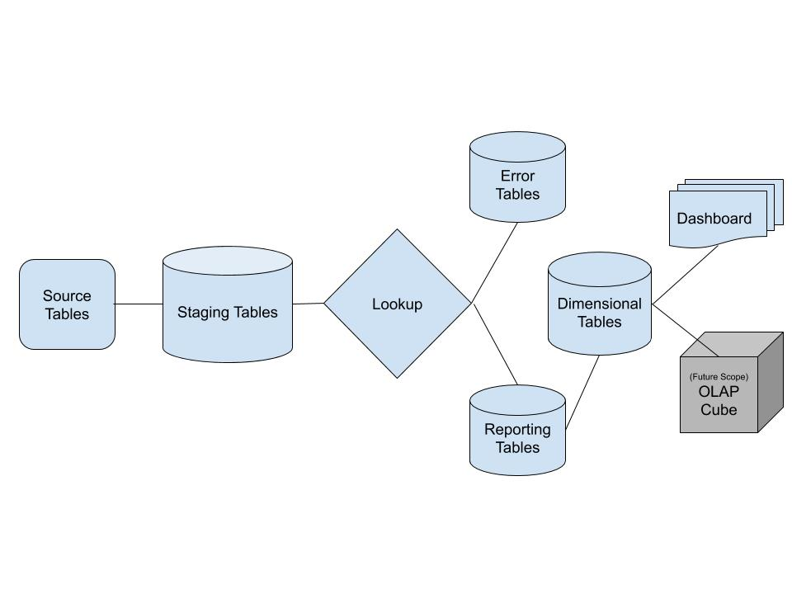
Data Model

Slide 4
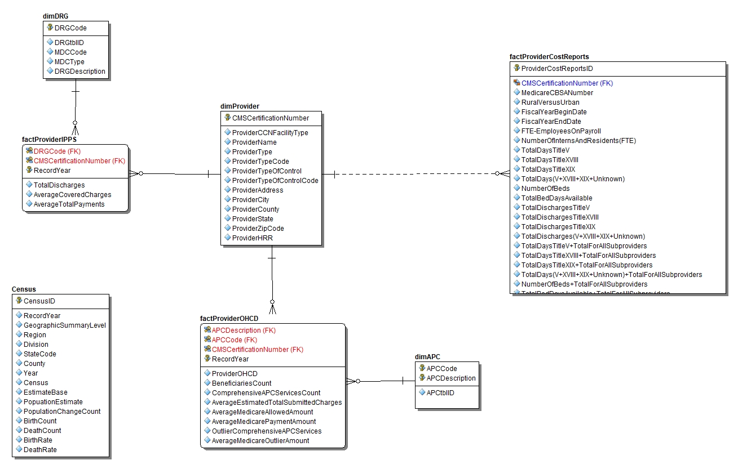
ER Diagram

Slide 5
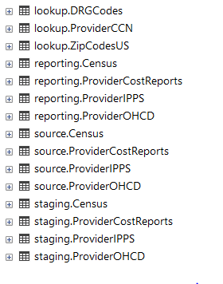
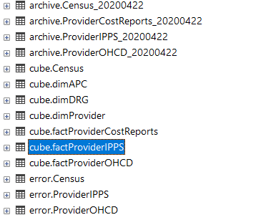
Tables created
Schemas: Archive: TableName + Date of Archive
Cube: Dimensional Tables
Error: Store errors generated during Lookups
Staging: To move data from source and store with proper data types
Source: To load source flat files
Reporting: To have reporting tables for SQL Queries

Slide 6
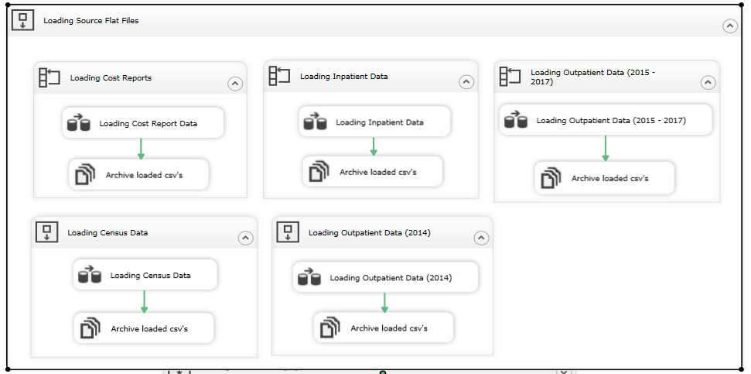
SSIS Control Flow

Slide 7
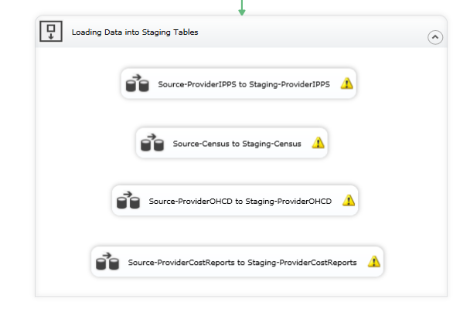
SSIS Control Flow

Slide 8
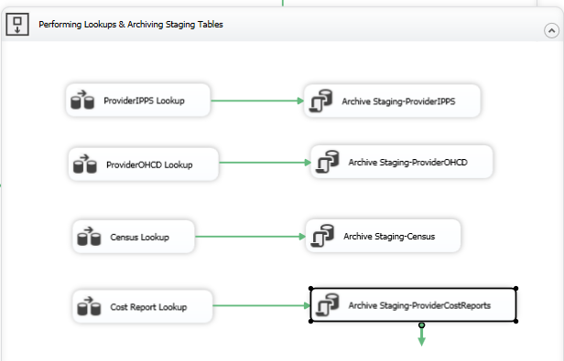
SSIS Control Flow

Slide 9
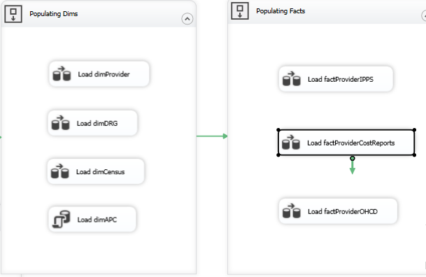
SSIS Control Flow

Slide 10
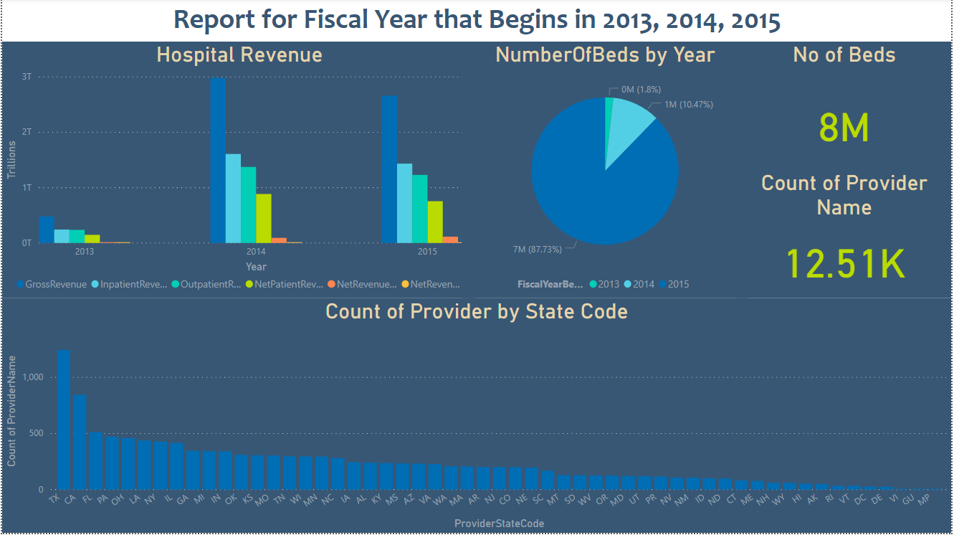
Dashboard

Slide 11
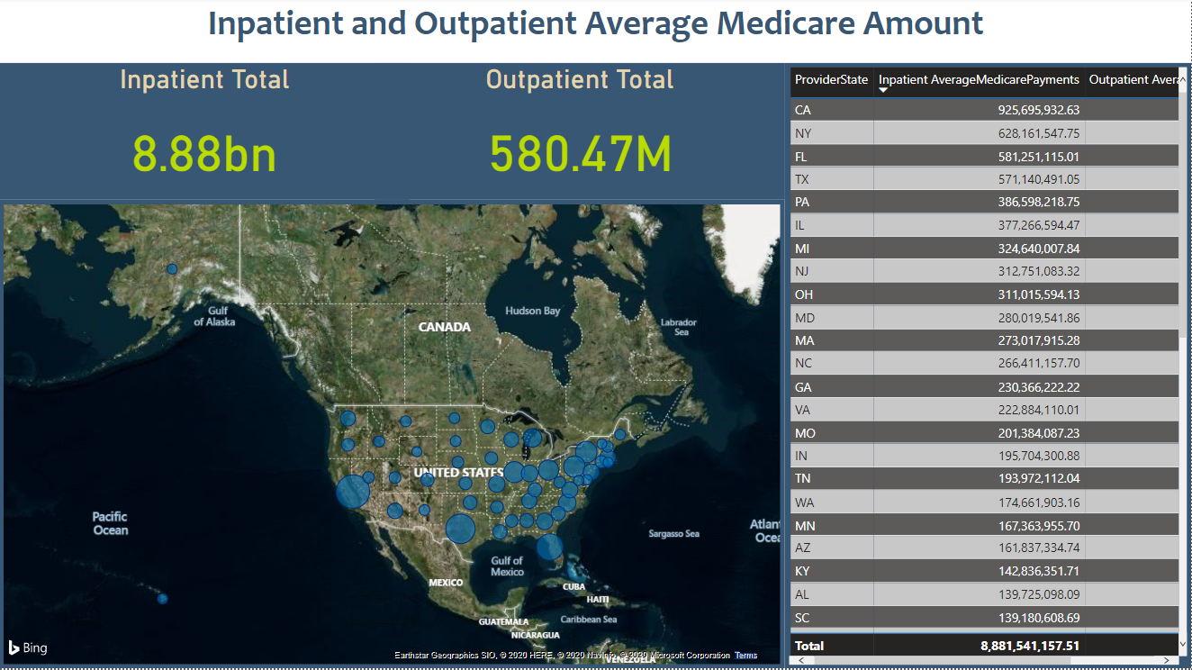
Dashboard

Slide 12
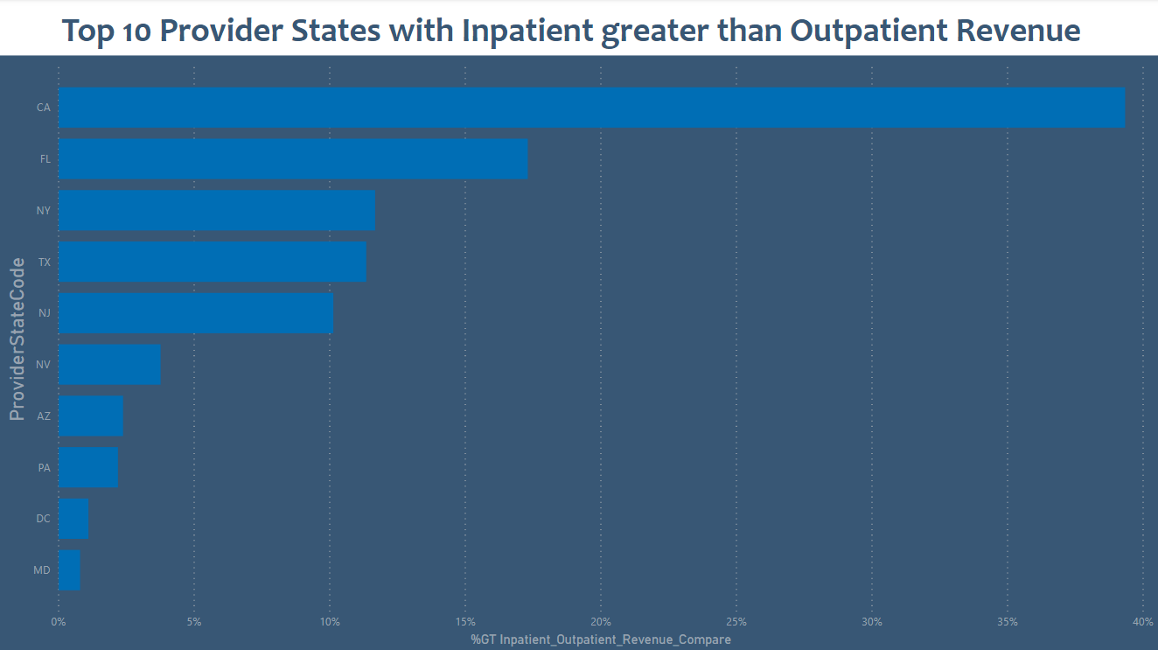
Dashboard

Slide 13
Pain Points
Less compute resources available on Azure due to Cost Constraint
Unavailability of source of truth lookups for APCCodes etc.
Data structure change for Outpatient Prospective Payment System after 2014
Aligning on the business rules and dimensional model

Slide 14
Future Scope
Improve dimensional model
Move flat file loading to Azure to unable all-cloud infrastructure
Improve lookup tables with better data sources
Implement a cube based of the dimensional model

Slide 15
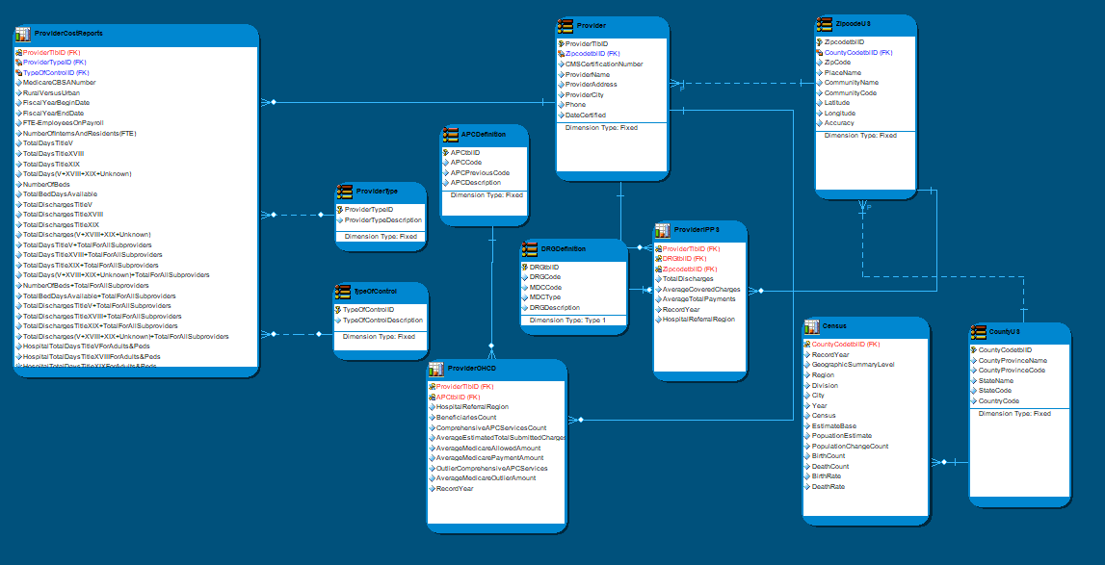
Future Scope

Slide 16
Conclusion
Built a data warehouse for healthcare Provider data using SSIS
Created dashboard on Power BI to visualize statewise Provider data and Inpatient, Outpatient Revenue

