Slide 1

Store Item Demand Forecasting
Priyanka Dilip Shinde
Kunwar Rajesh Chopra
Sahil Sanjay Gadge

Slide 2
GOAL
The objective of this notebook is to predict 3 months of item-level sales data at different store locations.
Main focus is to implement different type of Algorithms with hyperparameter tuning and compare there results with each other to determine the best model for the forecasting.

Slide 3
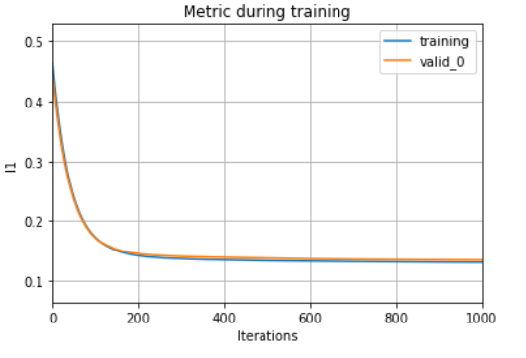
APProach_1: LightGBM
LightGBM is a gradient boosting framework based on decision trees to increases the efficiency of the model and reduces memory usage.
We are trying to implement LIGHTGBM because of the following features:
          Higher accuracy and a faster training speed
          Low memory utilization
          Comparatively better accuracy than other boosting algorithms and handles overfitting much better while working with smaller datasets
          Parallel Learning support
          Compatible with both small and large datasets
Following is the metric Evaluation for Light GBM

Slide 4
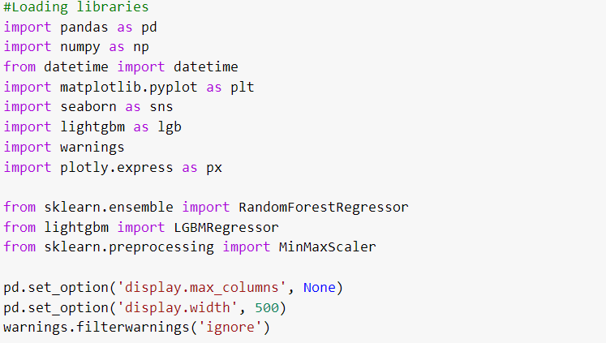
Libraries:

Slide 5
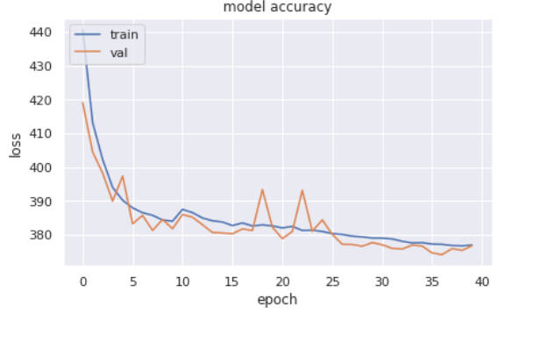
APProach_2: Deep Learning
In Deep Learning we are trying to implement CNN, LTSM, respectively and combined.
We tried to implement CNN and LTSM combined because this model can support very long input sequences that can be read as blocks or subsequence by the CNN model, then pieced together by the LSTM model.
While using a hybrid CNN-LSTM model, we will further divide each sample into further subsequences. The CNN model will interpret each sub-sequence and the LSTM will piece together the interpretations from the subsequences.
Following is the metric Evaluation for CNN-LSTM

Slide 6
APProach_3: Prophet
Facebook Prophet is an open-source algorithm for generating time-series models that uses a few old ideas with some new twists.
It is particularly good at modeling time series that have multiple seasonalities and doesn’t face some of the mentioned below drawbacks of other algorithms.
Traditional time series models like ARIMAX have many stringent data requirements like stationarity and equally spaced values. Other time series models like Recurring Neural Networks with Long-Short Term Memory (RNN-LSTM) can be highly complex and difficult to work with if you don’t have a significant level of understanding about neural network architecture.
In its essence, this library utilizes the additive regression model y(t) comprising the following components:
    y(t)=g(t)+s(t)+h(t)+ϵt
    where,
    Trend g(t) models non-periodic changes.Seasonality s(t) represents periodic changes
    Holidays component h(t) contributes information about holidays and events
    The error term ϵ(t) represents information that was not reflected in the model. Usually it is modeled as normally distributed noise.

Slide 7
Conclusion:
In this notebook we successfully implemented 3 approaches to solve time series problem and saw how such algorithms can forecast future.
  lightGBM worked best for this dataset.
  Deep Learning also worked well and it might have worked even better with bigger and complex models.
  Approach using Facebook Prophet was easy and fast to implement.

Slide 8
    THANK YOU !

