Slide 1
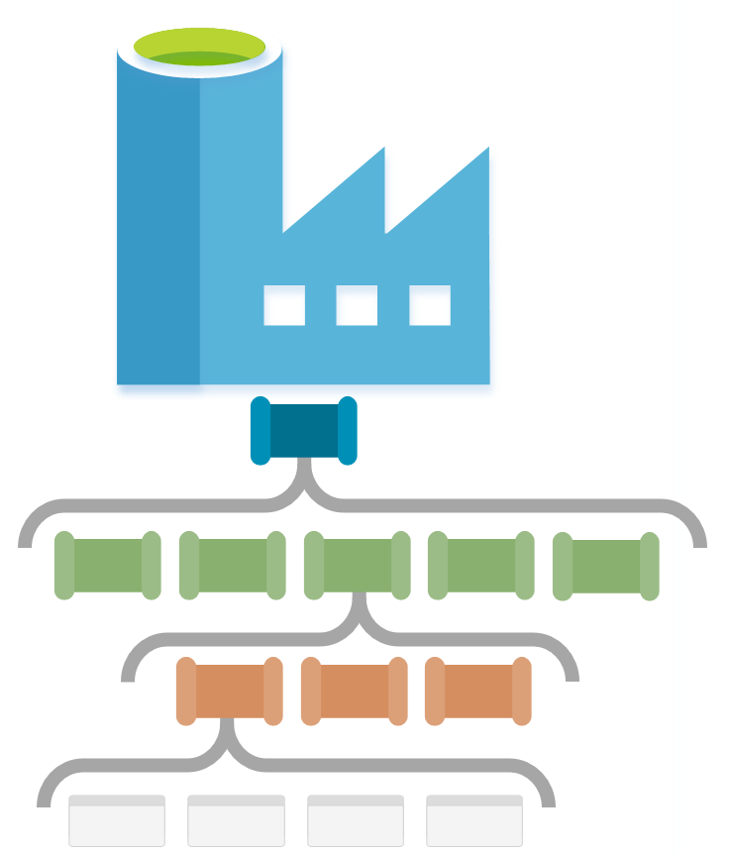
ADF Sync Pipeline Structure

Slide 2

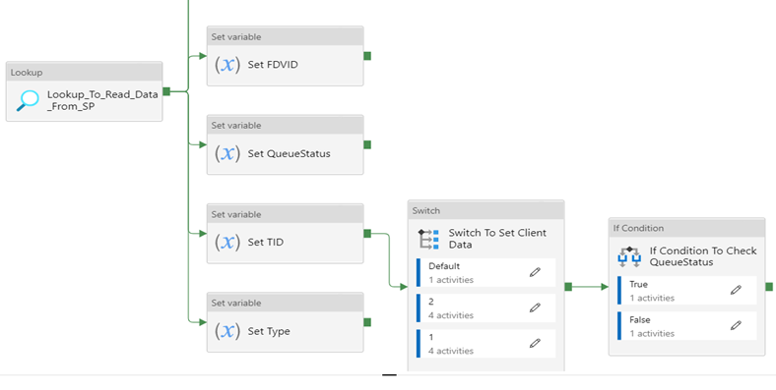

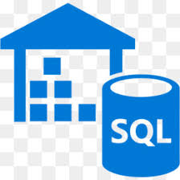

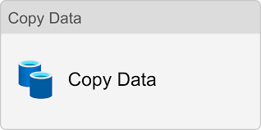

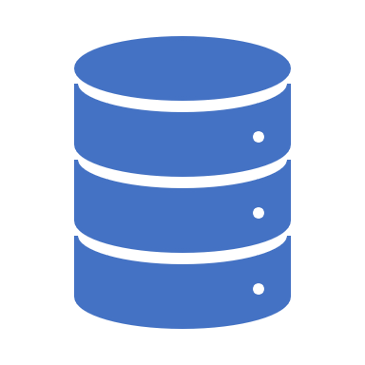


Stored Procedure o/p
Azure Data Factory
Parameterized Pipeline
SQL
Azure SQL
Azure SQL DB
(Table Data)
SQL Server
Linked Service
Parameterized Dataset
Copy Activity
Parameterized Dataset
Linked Service
Azure Database

