Slide 1
BIG MART SALES PREDICTION
Sales Prediction Using XGBoost Regressor
Presented by Priyanka Gunjal
1

Slide 2
Project Overview
End-to-end machine learning regression workflow
• Predict Item_Outlet_Sales using product and outlet-related features.
• Load and explore the Big Mart dataset in Python / Google Colab.
• Handle missing values and encode categorical features.
• Train an XGBoost Regressor and evaluate it using the R² score.
2

Slide 3
Objective
What the project aims to achieve
• Build a regression model for predicting Item_Outlet_Sales.
• Prepare the Big Mart dataset for machine learning.
• Convert categorical information into numerical form.
• Train the XGBoost Regressor model and evaluate predictions.
3

Slide 4
Dataset
Big Mart Sales dataset used in the notebook
TRAINING DATA
TEST DATA
TARGET
8,523 rows
5,681 rows
Item_Outlet_Sales
Train.csv
Test.csv
Regression target
• Features include item attributes, outlet information, visibility, MRP and establishment details.
4

Slide 5
Technologies Used
Tools and libraries used in the notebook
• Python — implementation language
• Pandas and NumPy — data handling and numerical operations
• Matplotlib and Seaborn — data visualization
• Scikit-learn — preprocessing, splitting and evaluation
• XGBoost — regression model
• Google Colab — notebook execution environment
5

Slide 6
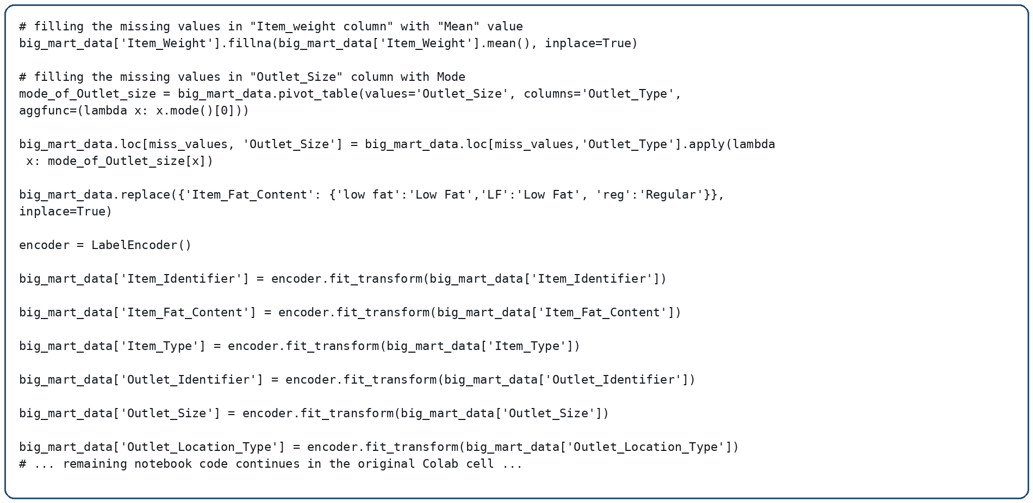
Data Preprocessing
Actual notebook code — resized to stay inside the slide
6

Slide 7
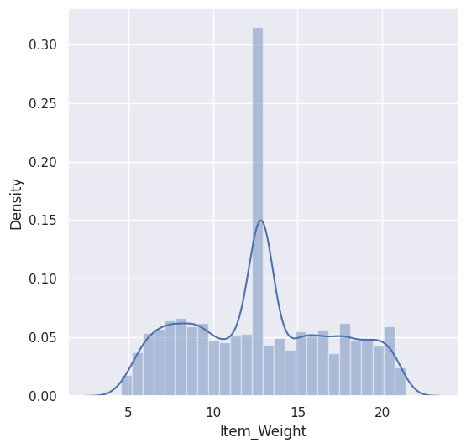
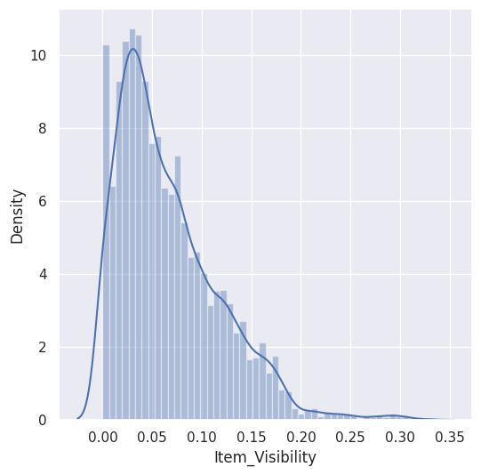
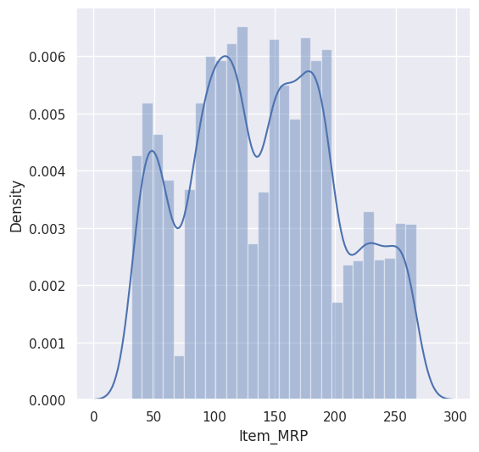
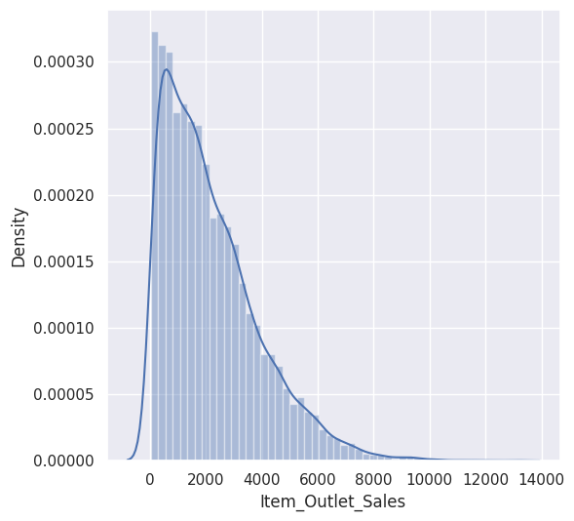
Exploratory Data Analysis
Actual graphs generated by the notebook
7

Slide 8
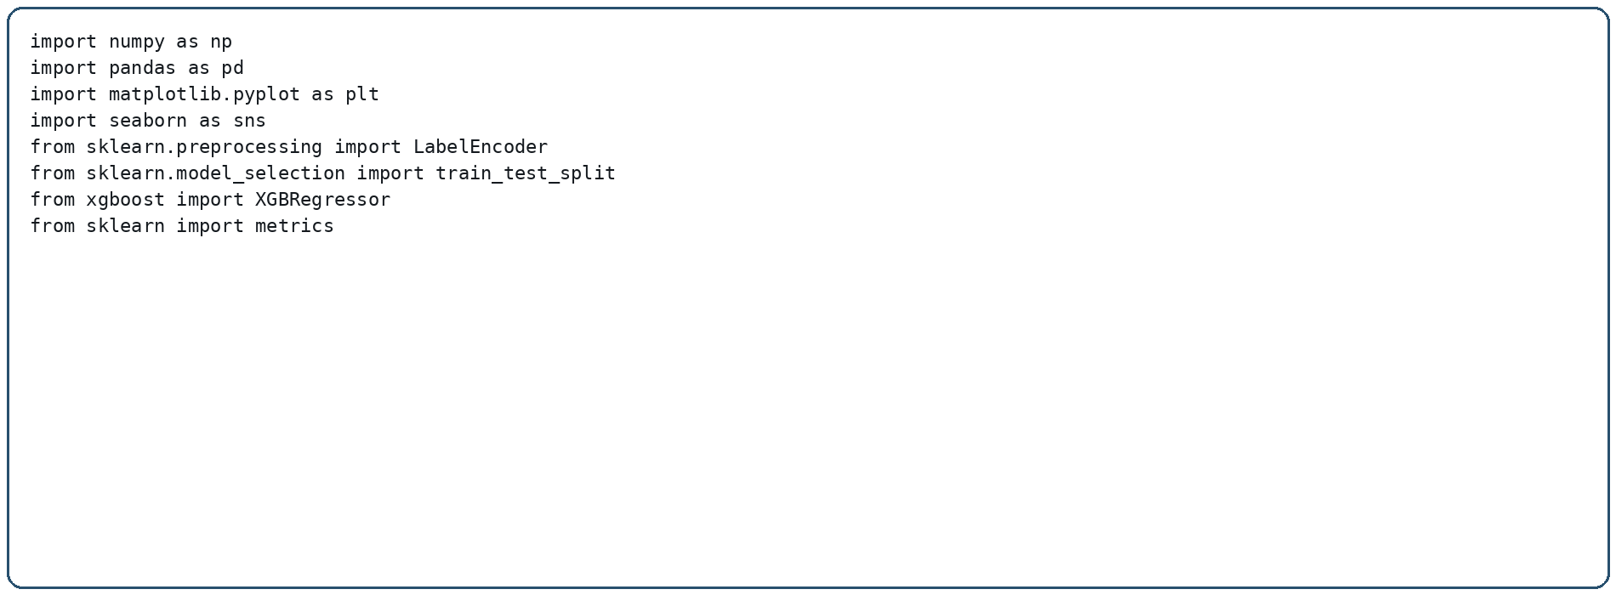
Categorical Encoding
Actual notebook code for data normalization and encoding
• LabelEncoder is used to convert categorical columns into numerical values before model training.
8

Slide 9
Project Workflow
From raw data to sales prediction
• Dataset → DataFrame creation
• Data exploration → Missing-value handling
• Categorical encoding → Feature / target separation
• Train-test split → XGBoost Regressor
• Prediction → R² evaluation
9

Slide 10
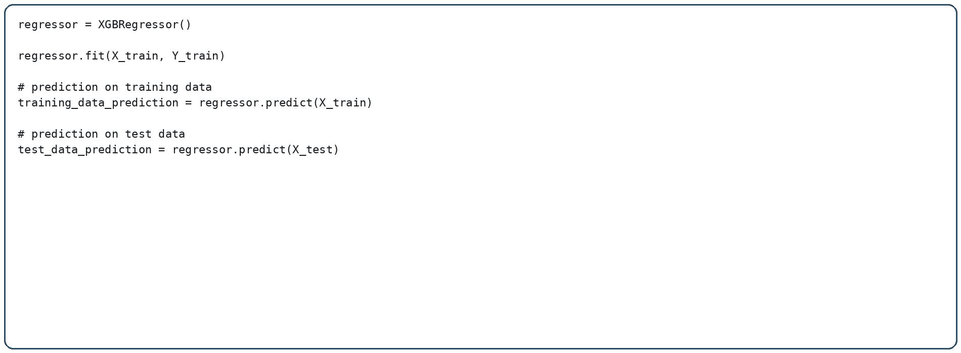
XGBoost Regressor Model
Actual notebook code
• The model learns the relationship between the prepared input features and Item_Outlet_Sales.
10

Slide 11
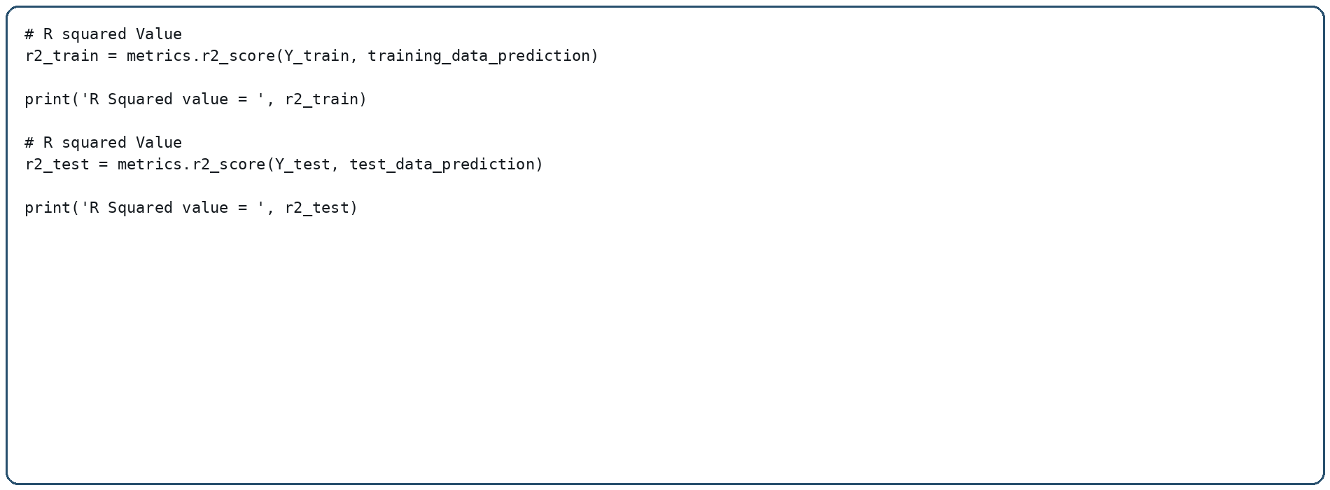
Model Evaluation
Actual notebook evaluation code and results
TRAINING R²
0.8751
Exact notebook value: 0.8750519939334624
TESTING R²
0.5156
Exact notebook value: 0.5155979721907443
11

Slide 12
Results & Key Findings
Observed results from the notebook
• Training R² score: 0.8750519939334624
• Testing R² score: 0.5155979721907443
• Rounded values: 0.8751 (training) and 0.5156 (testing)
• The complete notebook workflow was executed using the Big Mart Sales dataset.
12

Slide 13
Conclusion
Project summary
• Big Mart sales prediction was implemented using XGBoost Regressor.
• The project covered data preparation, missing-value handling, encoding and model training.
• The model was evaluated using the R² metric on training and testing data.
• The notebook demonstrates a complete regression-based sales prediction workflow.
13

Slide 14
Future Scope & Project Resources
Possible next steps
• Perform hyperparameter tuning and feature engineering.
• Compare additional regression algorithms.
• Improve model performance and visualization.
• Build a simple sales prediction interface.
• Project notebook: Big_Mart_Sales_Prediction(1).ipynb
14

