Slide 1
GIT
Introduction / Key Concepts
Git Installation and Setup
The Basic Commands
Comparing
Branching and Merging
GitHub Introduction
Tools Setup ( Text Editor, Compare , Merge Tool )

Slide 2
Why source control
Backup / Archive
Versioning / History
Undo Changes
Comparing
Collaboration / Teamwork
Isolation of changes
Experimentation
Code Review

Slide 3
Who needs source control ?
Software developer /engineers / Programmers
Freelancers
Web Designers
Graphic Artist
Share code / Open Source

Slide 4
Source control Options
Centralized
Free : Subversion, CVS
Commercial : ClearCase, Perforce, Team foundation server (TFS)
Required connection to centralized server for most operations
Decentralized/Distributed
Mecurial
GIT
Most operations are local
Central Server not require

Slide 5
What is Git
Distributed source control system
Scale Massively
Open Source
It was initially developed for linux project requirement
Most operations are local, so fast
Active Community
Most popular among the version control

Slide 6
Git Installation
Windows
Git for windows (git-scm.com)
Google chrome
Create GITHUB account

Slide 7
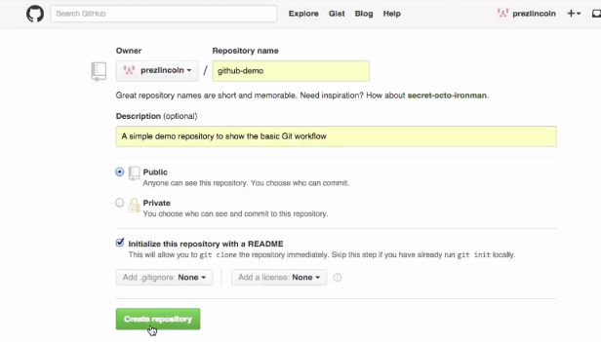
Create a repository on GitHub

Slide 8
To check git installed
Git version
On the local system create directory
Create a directory
Mkdir projects
Configure email ID and User name
Git config –global user.name “vicky seth”
Git config –global user.email “email id”
To check user configure properly
Git config –global --list

Slide 9
Cloning a Repository
Git clone https.................
When we clone an empty repository only file it has is Readme.md
Git status
It will give you information of the branch you are in
Master branch is the default branch created
It will also give information if branch is up to date or not

Slide 10
Create a file
Echo “test git quick start demo”>> start.txt
Git status
this will show untracked files (working directory)
Git add filename ( staging area )
Now if we do git status – it will show new file in the staging area which git describes as changes to be committed
Now to move from staging area to repository
Git commit –m “message of your choice”
Now again if we do git status – it will show working directory clean
Last step to upload files to Remote repository
Git push origin master
It will ask for Email ID and password

Slide 11
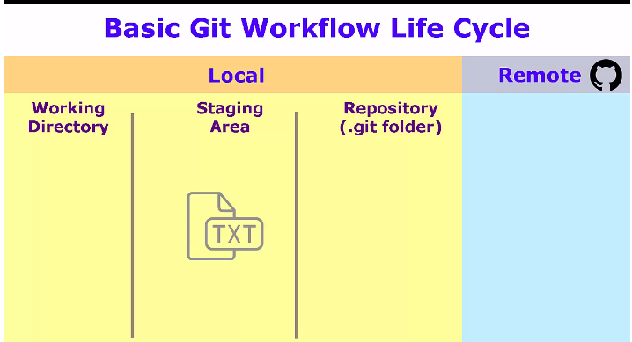
Git Workflow life Cycle
Git add
Git commit
Git Push

Slide 12
Configure Notepad++
https://notepad-plus-plus.org/
Download
Configure it with system variable
Open CMD – Notepad++
To configure it with GitBash
Create bash alias –
notepad++ .bashrc
alias npp='notepad++.exe -multiInst -nosession‘
Git config –global core.editor “notepad++.exe -mutiInst -nosession”
Npp .gitconfig
Notes:
Npp – short form of notepad++

Slide 13
Git Real Project
http://www.initializr.com/
Bootstrap – download it
Now you have the unzip version of the file downloaded
Go to Git Bash – unzip the file
unzip ~/Downloads/initializr-verekia-4.0.zip
Ls ( it will show initializr folder )
Now re-name this folder with more practical approch
Mv initializr web-project1
Ls –lah
Now initialize with git
Git init ( now if I do ls –lah, will get .git folder created )
Git status ( show all the files which are ready to move to staging area )
Git add . ( period will recursively add all the files )
Git commit –m “ “( move files from staging to repository)
To remove project from git
Remove the .git folder
Rm –rf .git
To remove the project
Rm –rf web project

Slide 14
Fork

Slide 15
Undo the changes
Working Directory
Edit the file , remove the file
Staging directory
git checkout -- <file name>
Repository
"git reset HEAD <file>

Slide 16
GIT Logs
Git help log (if you are on windows it will bring out web browser for you )
Git log ( this will give history in reverse order ,SHAH1)
Git log –abbrev-commit ( to shorter commit message )
Git log –oneline –graph –decorate ( useful command)
Git log a212...a2aw
Git log –since=“3 days ago”
Git show ( first 4-6 character of commit )
Notes:
--

Slide 17
GIT Alias
git log --all --graph --decorate --oneline
git config --global alias.hist "log --all --graph --decorate --oneline“ ( alias hist created )
Git hist ( will show desire output )
notepad++ ~/.gitconfig ( to check all alias created )

Slide 18
GIT Ignore
Create .gitignore file
Git Ignore Pattern Example
Specific File: Myfile.ext
File Pattern: *.ext
Folder: my-folder/

Slide 19
GIT DIFF Compare / Merge Tool
P4merge from perforce
http://www.perforce.com
https://www.perforce.com/downloads/visual-merge-tool
Set environment variable
Restart Gitbash
Configure Git to use P4merge as Diff tool
git config --global diff.tool p4merge
git config --global difftool.p4merge.path "C:/Program Files/Perforce/p4merge.exe”
git config --global difftool.prompt false
git config --global --list

Slide 20
Configure Git to use P4merge as Merge tool
git config --global merge.tool p4merge
git config --global mergetool.p4merge.path "C:/Program Files/Perforce/p4merge.exe"
git config --global mergetool.prompt false
git config --global –list
Git difftool HEAD file name
git difftool db330de 1d6c4a6
git difftool head head^
git difftool master origin/master

Slide 21
Branches
Git branch –a ( will show all the branches )
Git branch mynewbranch ( will create new branch with name mynewbranch)
Git checkout mynewbranch ( it will switch the branch )
Git branch –m oldname newname ( rename the branch )
Git branch –d branchname ( to delete a branch )
git diff ( to check changes in 2 branch )
git difftool master newbranch1
To merge changes with master – switch to master brach and type
Git merge newbranch1

