Slide 1
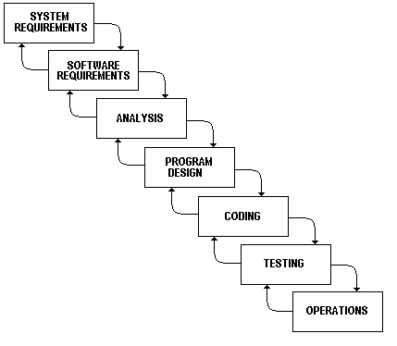
Waterfall Module
Each phase must be completed before next phase is begin

Slide 2
Agile
Delivery with in week rather than in months
Changes can be made in late production as well
Developer spends more time in coding rather then in documentation
Agile work in chunks like developer create a code, give it to customer.
Customer check and gives his/her input and accordingly developer make changes.

Slide 3
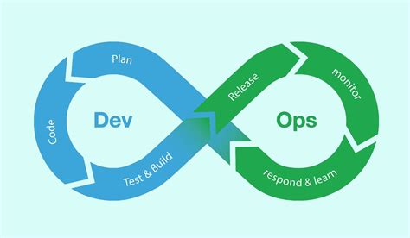
Devops
Dev means Deployment
Ops means Operations
Devops is not a tool
Devops is practice or culture

Slide 4
Devops
Devops is the set of practices, where development and engineers participate together in the entire application life cycle, from design, development, testing and finally to the production support.
Devops is not a tool. It is an approach and it is a culture with objective of SDLC by bringing developer and operation closer
It emphasize communication, collaboration and integration between developers and IT operations.

Slide 5
Devops is build on the concepts of Agile Methodology. It identifies the importance of extending agile principle beyond development by including operations and all other functions that supports application development life cycle.
Management : Devops is the development and operation collaboration
Operation : Devops is treating your infrastructure as code
Developer : Devops is a feature switches
Devops engineer : Devops is using automation

Slide 6
DevOps Contn….
Code is written in very small chunks vs large build
Deployments happen in days/hrs vs week/month
Development environment is identical to production
Rapid iteration improves speed to react market needs
Developing configuration management code to build infra at scale
Realtime application performance monitoring to know the impact of each code changes makes

Slide 7
Why DepOps adaptation
Shorter development cycles and faster innovations.
Improve communication and collaboration
Increase efficiency and reduced maintenance
Reduced deployment failure, rollbacks and less recovery time
Eliminate downtime

Slide 8
DevOps Implementation
DevOps will be completely achieved if every aspects of the below 5 phases are completed automated.
Collaborative Development
Continuous Testing
Continuous Integration
Continuous Delivery and Deployment
Continuous Monitoring

Slide 9
Collaborative Development
This is the phase which involves planning and coding of the software application’s functionality.
Code can be written in any language but it is maintained by version control tools.
Tools like
AWS CodeCommit
Git/GitHub
Bitbucket
S3

Slide 10
Continuous Testing
It is the process of executing the automated tests as part of software delivery pipeline in order to obtain feedback on the business risks on the basis of software risk associated with a software release.
Tools like
AWS CodeBuild
Junit
Selanium
HP load balancer

Slide 11
Continuous Integration
It is the practice of the developers to check-in the code into the repository integrate and test it very frequently.
With the help of CI you can detect the problems early, fix them
Tools
Teamcity - .net
Jenkins - java & php
CodePipline

Slide 12
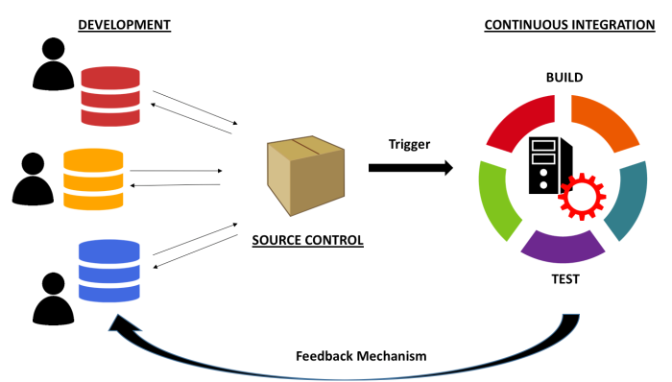
Continuous Integration contn..

Slide 13
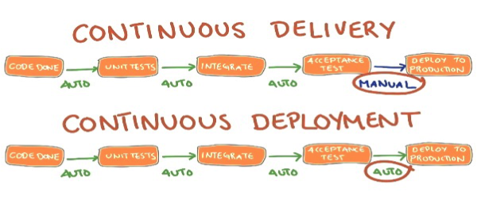
Continuous Delivery and Deployment
Continuous Delivery means that artifacts are built and made ready to be deployed but they can not be deployed without a manual decision by a human being.
Continuous Deployment implies that all the processes are automated

Slide 14
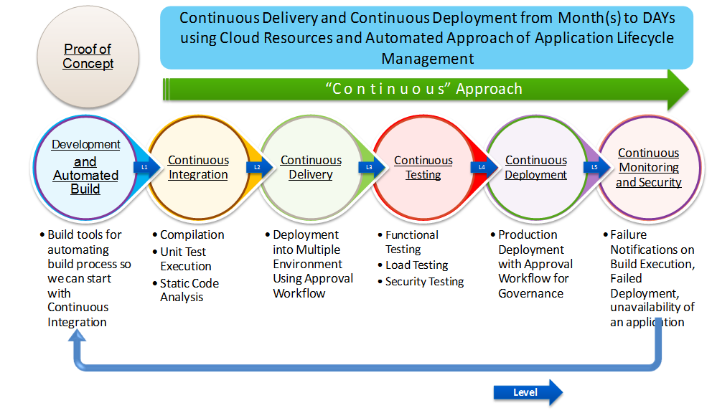
Continuous Monitoring

