Slide 1
ABC Travel company provides concierge services for business travelers. In an increasingly crowded market, they are always looking for ways to differentiate themselves, and provide added value to their corporate customers. They are looking to pilot a web app that their internal customer service agents can use to provide additional valuable information to the traveler during the flight booking process. They want to enable their agents to enter in the flight information and produce a prediction as to whether the departing flight will encounter a 15-minute or longer delay, considering the weather forecast for the departure hour.
PROBLEM STATEMENT

Slide 2
Block diagram
Clean the Data
Analyze the data
Clean and Ingest fresh data to the model
Deploy the model and host it to create a web app
Online Prediction of the flight delay
Ingest Data
Prepare the transformed Dataset
Train/Retrain the ML Model
Generate Insight tables
Visualize the insight tables

Slide 3
Exploratory data analysis

Slide 4
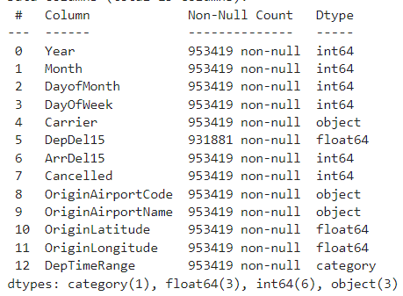
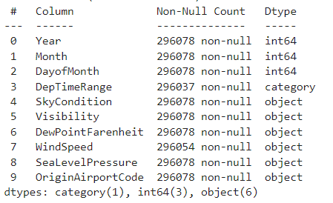
Import both the FlightDetails and WeatherReport CSV datasets – 1. Creating column ‘DepTimeRange’ from ‘CRSDepTime’ 2. Ignore unnecessary columns 3. Remove the duplicate rows

Slide 5
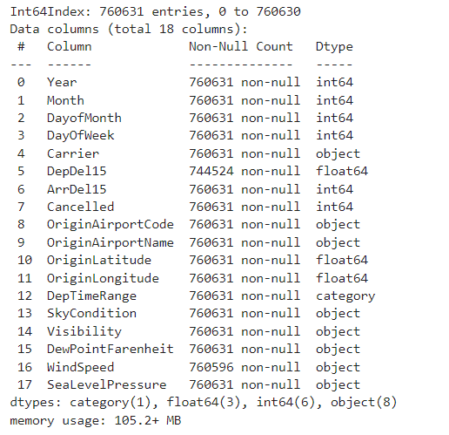
Join the FlightDetails & WeatherReport datasets based on the common columns ('Year’, 'Month’, 'DayofMonth’, 'DepTimeRange’, 'OriginAirportCode’).

Slide 6
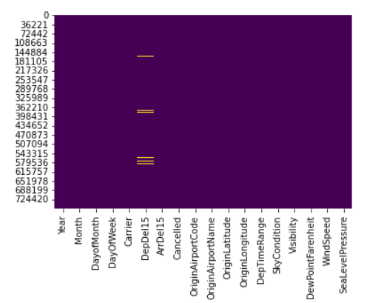
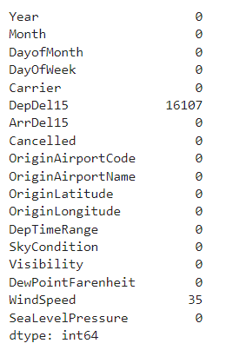
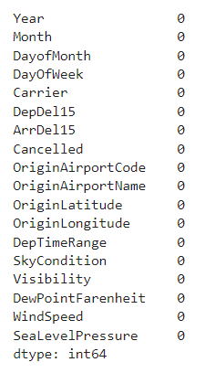
Check for NULL/NaN values.
Fill the null values of ‘DepDel15’ column by 1, since the corresponding records are for the Cancelled Flight (Cancelled = 1)

