Slide 1
Digital Portfolio
STUDENT NAME: Priyanka K
REGISTER NO AND NMID: 2422k0254 and asbru172422k0254
DEPARTMENT: B.sc(computer science)
COLLEGE: Sri vasavi college (SFW)
UNIVERSITY: Bharathiyar University

Slide 2
PROJECT TITLE
PORTFOLIO DESIGN AND LAYOUT

Slide 3


AGENDA
Problem Statement
Project Overview
End Users
Tools and Technologies
Portfolio design and Layout
Features and Functionality
Results and Screenshots
Conclusion
Github Link
3/21/2024 Annual Review

Slide 4
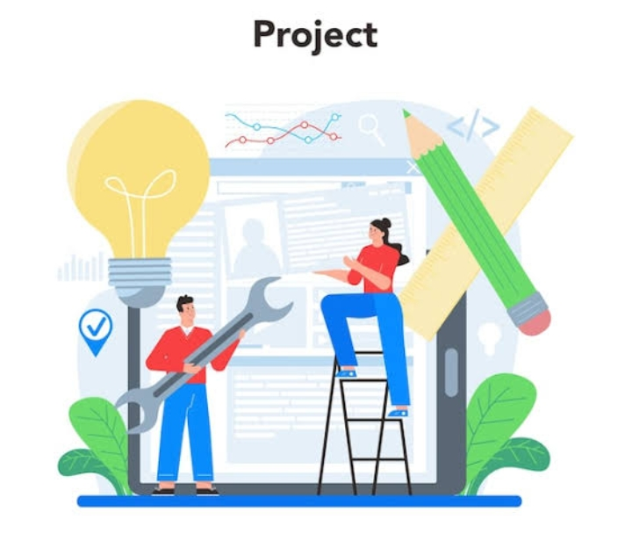
PROBLEM STATEMENT
Problem Statement :
A problem statement clearly explains the issue or challenge that your project is going to solve.
It describes what the problem is, why it exists, and why it is important to solve.
It should be:
Clear and specific
Focused on the gap or difficulty
Showing the importance of finding a solution

Slide 5
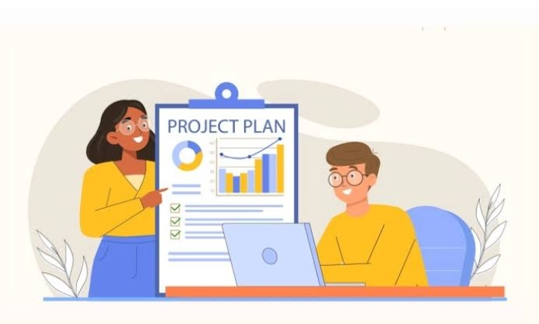
PROJECT OVERVIEW
Project Overview is a short summary that explains what a project is about.
It usually covers:
Purpose / Goal → Why the project is being done.
Scope → What will be included and what will not.
Deliverables → What results or outputs will be produced.
Timeline → Rough schedule or duration.
Team / Stakeholders → Who is involved

Slide 6


WHO ARE THE END USERS?
End users are the people who will finally use the product, system, or service once it is completed.
They are not the developers or testers, but the actual customers or audience who benefit from it.
👉 Example cases:
For a Food Delivery App → End users are the customers who order food.
For a School Management System → End users are students, teachers, and parents.

Slide 7

TOOLS AND TECHNIQUES
Tools and Techniques in a project mean the methods and instruments used to complete tasks and achieve project goals.
Tools → The software, applications, or physical resources you use.
👉 Example: MS Project, JIRA, GitHub, Excel, Zoom.
Techniques → The methods or approaches you apply to do the work.
👉 Example: Brainstorming, Agile methodology, Risk analysis, Flowcharts, Prototyping.

Slide 8

POTFOLIO DESIGN AND LAYOUT
Portfolio Design and Layout means how you arrange and present your information, skills, and work samples in a clear and attractive way.
👉 Simply:
It’s the structure + look of your portfolio (fonts, colors, sections, images, order).
8

Slide 9
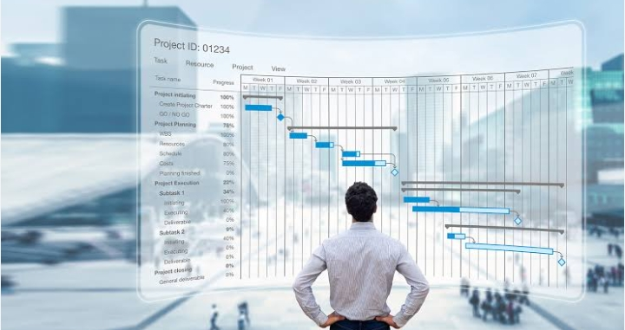
FEATURES AND FUNCTIONALITY
Features and Functionality means the qualities and actions of a product or system.
Features → The special parts or elements it provides. (What it has)
Functionality → The tasks or operations it can perform. (What it does)
👉 Example: In an E-commerce Website
Features → Search bar, Shopping cart, Wishlist.
Functionality → Search for products, Add items to cart, Place an order.

Slide 10
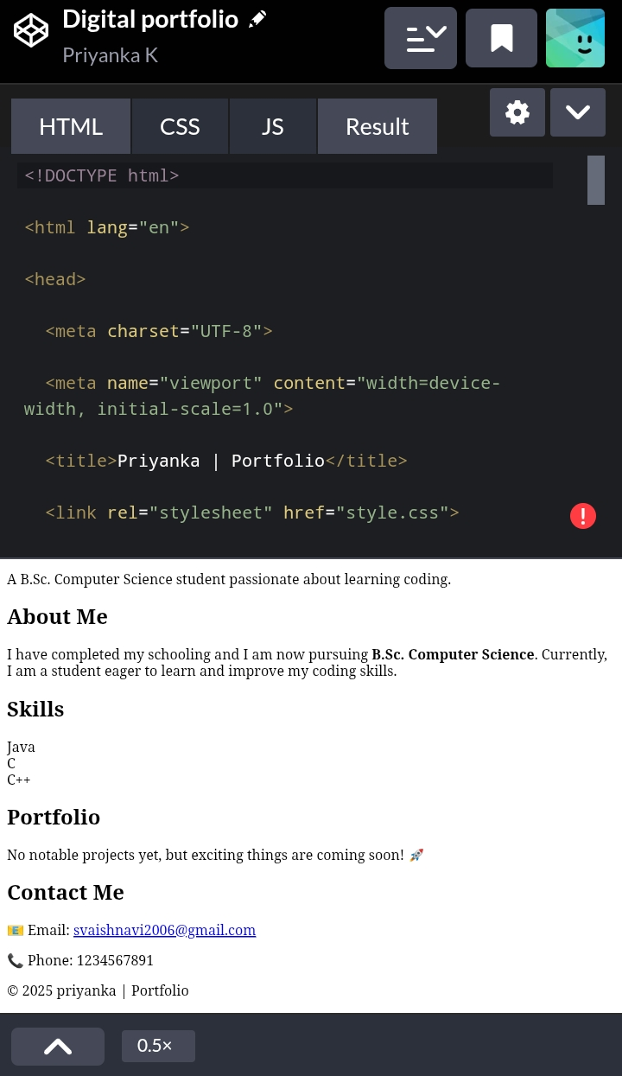
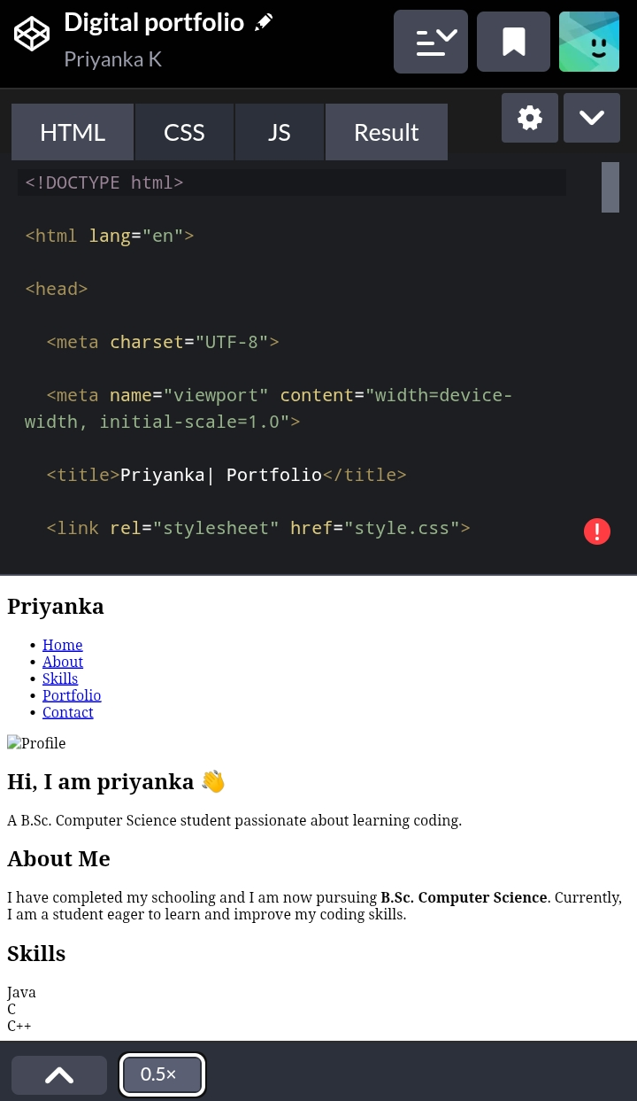
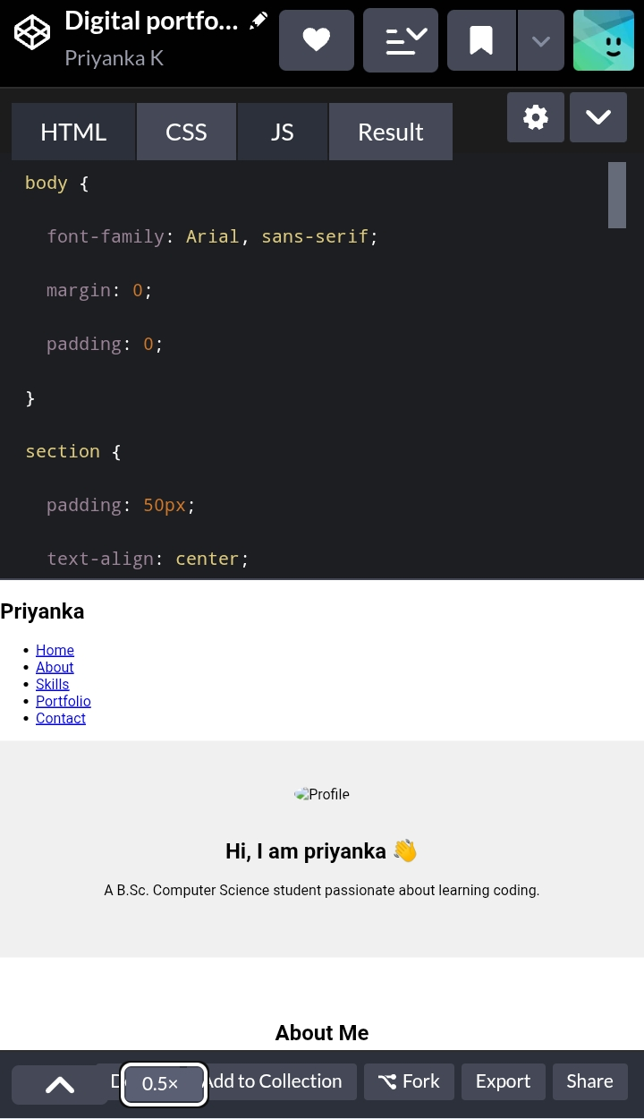
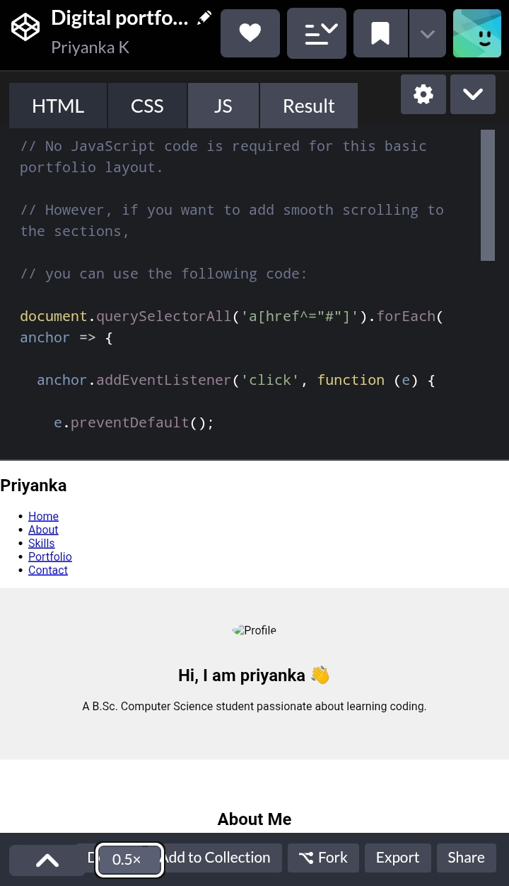
RESULTS AND SCREENSHOTS
3/21/2024 Annual Review
10

Slide 11

CONCLUSION
This portfolio gives a clear idea about the project, its tools, features, and results. It helps to showcase our work effectively and can be used for future reference and improvements.
11

