Slide 1


Unsupervised Anomaly Detection in Cloud Network Traffic
By
Arpita Angad Salunke - 248513
Priyanka Chandrakant Kale - 248532
Mrs. Priyanka Bhor Mr. Rohit Puranik
Project Guide Centre Coordinator

Slide 2
Unsupervised Anomaly Detection in Cloud Network Traffic
Content
Data Source
Data Pre-processing
ML Training
Evaluation
Advantages
Applications
References

Slide 3
Introduction
Objective: The objective of this project is to proactively detect and mitigate cyber threats in cloud network traffic by leveraging unsupervised machine learning techniques.
Data Source: Stanford internet research data Repository.
No. of files: 10 in parquet format
No. of rows: 159640
No. of columns : 22

Slide 4
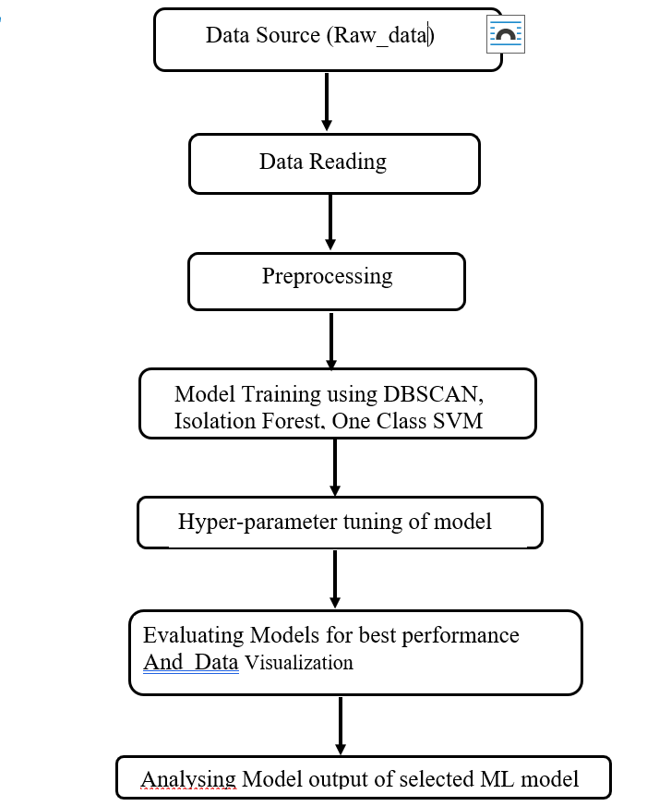
WORKFLOW

Slide 5
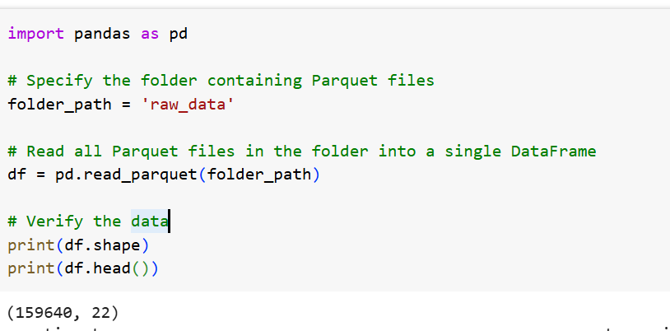
Data reading

Slide 6
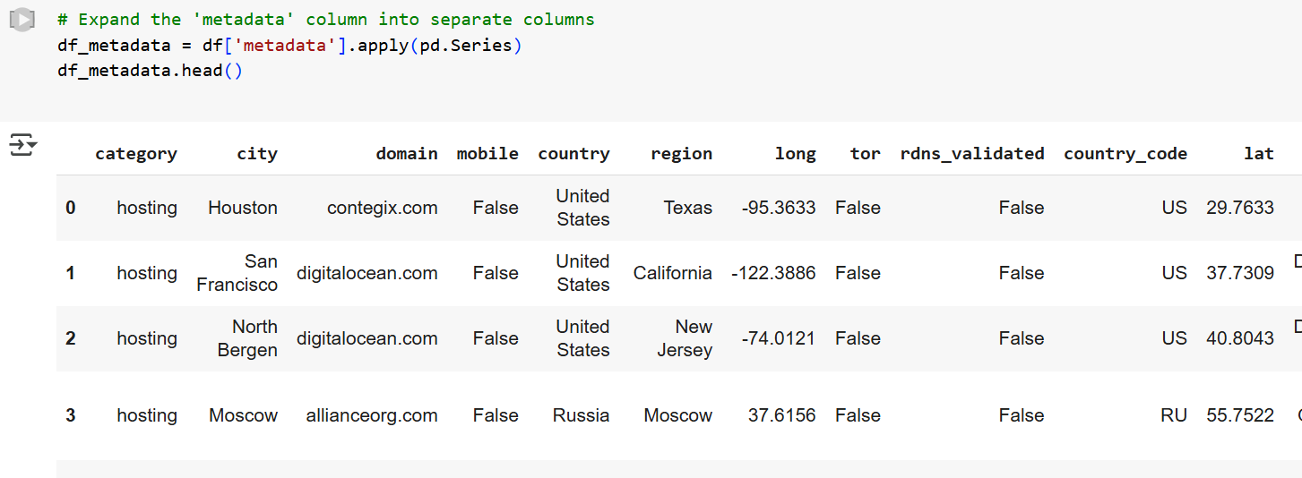
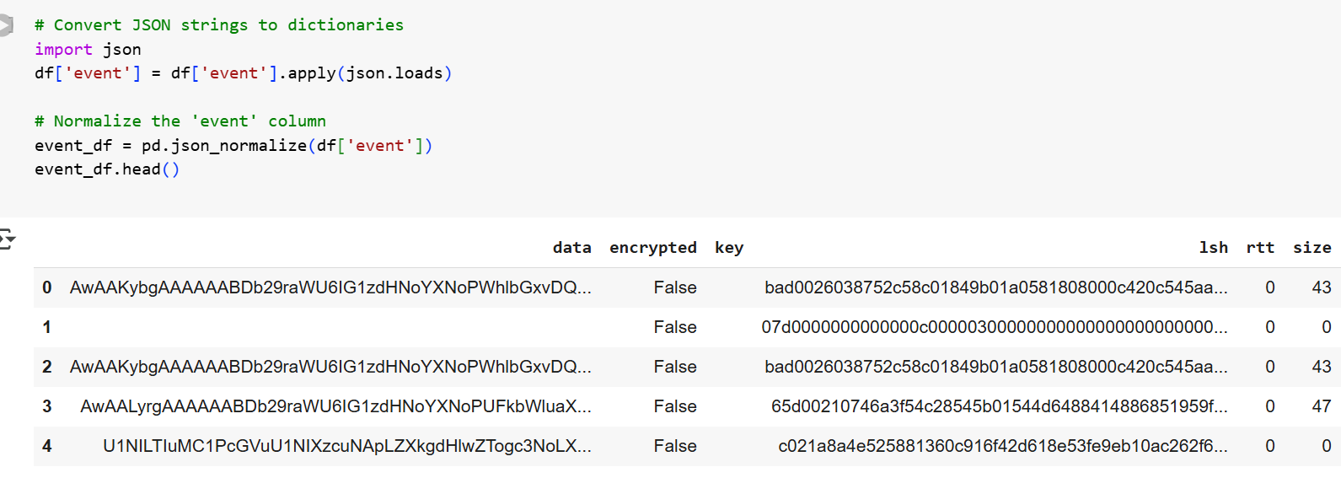
Data Pre-processing
Cleaning: Remove incomplete, corrupted, or irrelevant data.
Processing Column with Python Dictionaries and JSON Strings.

Slide 7
Data Pre-processing
One Hot Encoding
Normalization/Scaling: Normalize features (e.g., packet size, traffic volume) to bring them into a similar range (Standard Scalar).

Slide 8
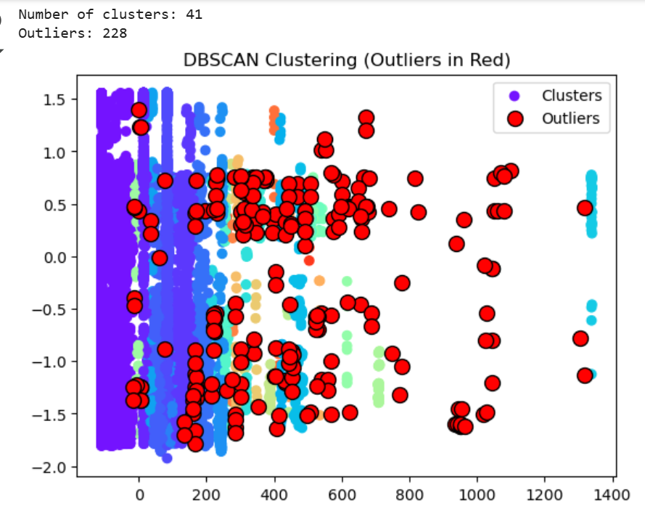
ML Training
1. DBSCAN

Slide 9
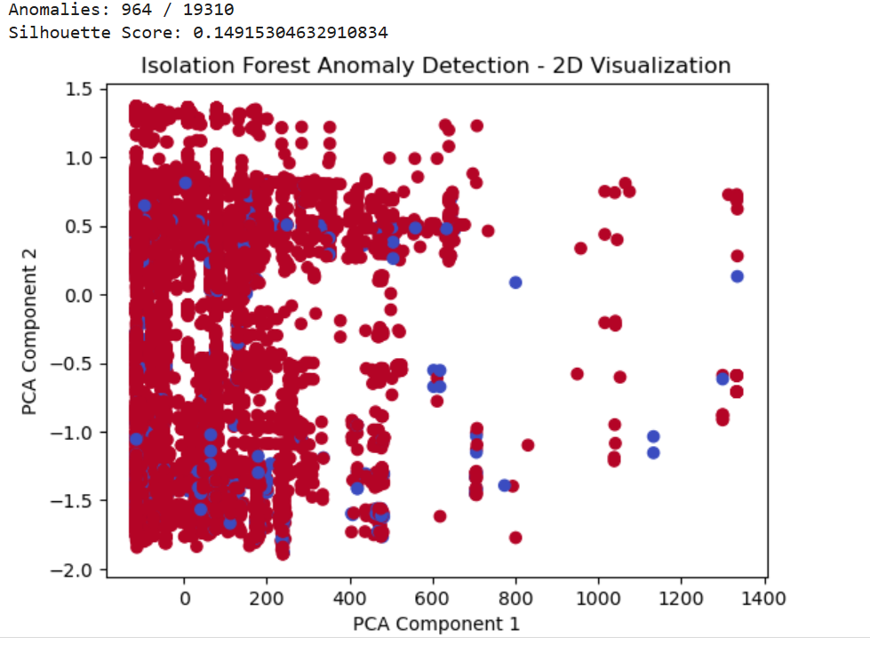
ML Training
2. ISOLATION FOREST

Slide 10
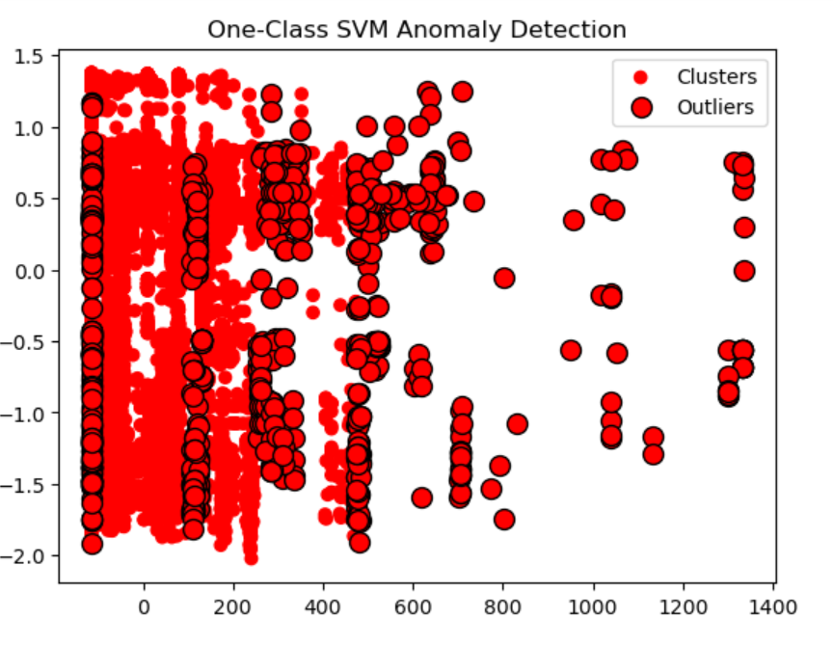
ML Training
3. ONE CLASS- SVM

Slide 11
Model Evaluation and Conclusion
DBSCAN | ISOLATION FOREST | ONE CLASS SVM
0.549 | 0.149 | 0.605
Silhouette Coefficient : evaluates the quality of clustering in unsupervised machine learning. It measures how similar an object is to its own cluster (cohesion) compared to other clusters (separation). The score ranges from -1 to 1

Slide 12
Git Repository
priyankale13/CDAC_ML_Project
Arpitasalunke/Anomaly-Detection

Slide 13
Advantages:-
Proactive Threat Detection: By leveraging unsupervised machine learning techniques like DBSCAN and Isolation Forest, the project enables early identification of anomalies in cloud network traffic, allowing security teams to address potential cyber threats before they escalate.
No Need for Labeled Data: Unsupervised learning techniques do not require labeled datasets, making the system adaptable to new and evolving threats without the need for extensive manual labeling.
Identification of Hidden Patterns: The project uncovers hidden patterns and outliers in network traffic, providing deeper insights into potential security risks that might otherwise go unnoticed.
Scalability: The use of efficient algorithms like DBSCAN and Isolation Forest ensures the solution can handle large volumes of cloud network traffic, making it scalable for enterprise-level environments.
Integration with Existing Systems: The solution can be integrated with existing security tools and frameworks, enhancing their capabilities without requiring significant infrastructure changes.

Slide 14
Applications:-
Threat Hunting: Security teams can use these models to proactively hunt for threats by analyzing historical network traffic data.
Fraud Detection: In addition to cybersecurity, these models can be applied to detect fraudulent activities in cloud environments, such as unauthorized transactions or credential misuse.
Cloud Security Monitoring : Models can help detect misconfigurations, unauthorized access, or abnormal resource usage that could indicate a security breach.

Slide 15
References:-
https://www.python.org/doc/
https://scans.io/study/cloud_watching
https://machinelearningmastery.com/model-based-outlier-detection-and-removal-in-python/
https://scikit-learn.org/stable/api/index.html
https://pandas.pydata.org/docs/reference/index.html#api
https://numpy.org/devdocs/reference/index.html#reference
https://matplotlib.org/stable/api/pyplot_summary.html
https://stackoverflow.com/questions/18837262/convert-python-dict-into-a-dataframe
https://stackoverflow.com/questions/50040470/how-to-parse-a-pandas-column-of-json-content-efficiently
https://machinelearningmastery.com/model-based-outlier-detection-and-removal-in-python/

Slide 16
THANK YOU…

