Slide 1


Hostel management system
presented by
T.Lalasa kusuma-211801370047
M.A.L.priyanka-211801370005

Slide 2

Abstract
This Project “HOSTEL MANAGEMENT SYSTEM” targeted for the College Hostel integrates the transaction management of the Hostel for better control and timely response. This eliminates time delay and paper transactions being marked. The warden is provided with a better control over the transactions like adding the details of new students in the hostel, modifying the details of the students, deleting the students, viewing the students details in the Hostel. This project’s main. The goal of this project is to develop a system for the computerization of the Hostel. The common transactions of the hostel includes the maintenance of mess menu, information about students in the hostel, enrolling of new students and their payments and dues etc are stored into the databases and reports are generated according to the user requirements.

Slide 3
Existing system
It involves hand-written records stored into various registers.
Requires a lot of time as well as manpower .
It is very difficult to maintain or update all the records and retrieve a cThe existing system is a manually maintained system.
ertain data.
The loss or damage of any of the registers leads to the damage of hundreds of records at a time.
Reports need to be generated manually time

Slide 4
proposed system
The new system is computerized version of the existing system.
Provides easy and quick access over the data.
Menu details.
Authorization schemes.
Easy registration.
User friendly.
Admin is easy to change or update the students details.

Slide 5
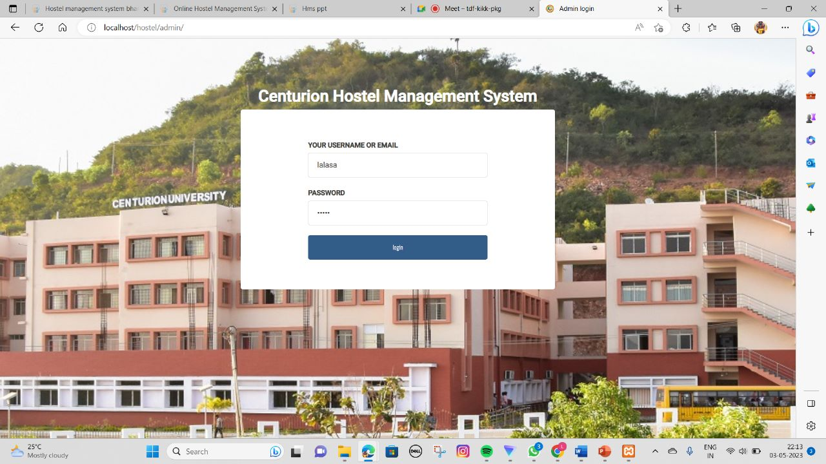
Admin login page

Slide 6
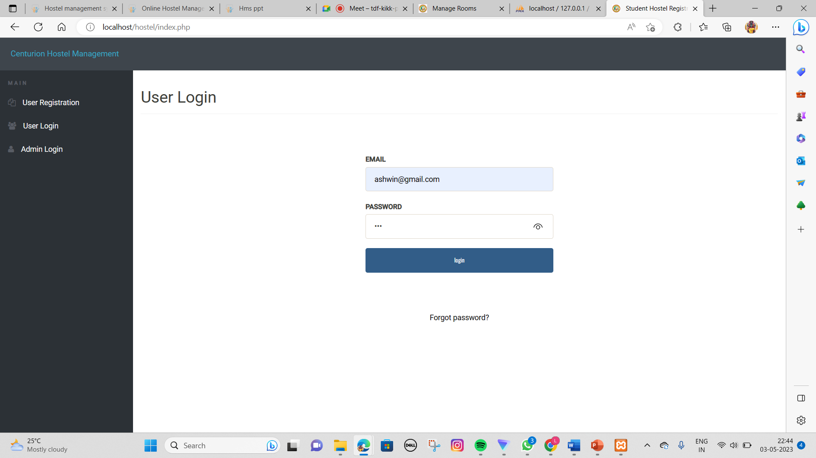
User login

Slide 7
Thank you

