Slide 1
MFA Phase III for Linux Training
Linux R & D Team
February 13, 2017
Presented by Jim Trater

Slide 2
Privileged Accounts
Request a secondary UCAMS account (Solution Center can assist) dedicated to the Workstations PZ
Request IT Privileged Access -> Unix/Linux for RAN (optional demo)
Add the account with wsadduser (demo)
CFEngine run (demo)
Using the privileged account (demo)
All of us need to cleanup non-compliant and unneeded privileged access on clusters and servers!

Slide 3

SSH Client Configuration
Demo SSH server: lemo.ornl.gov
Browse to: https://code-int.ornl.gov/ea/architecture/wikis/mfa/phase3/home

Slide 4
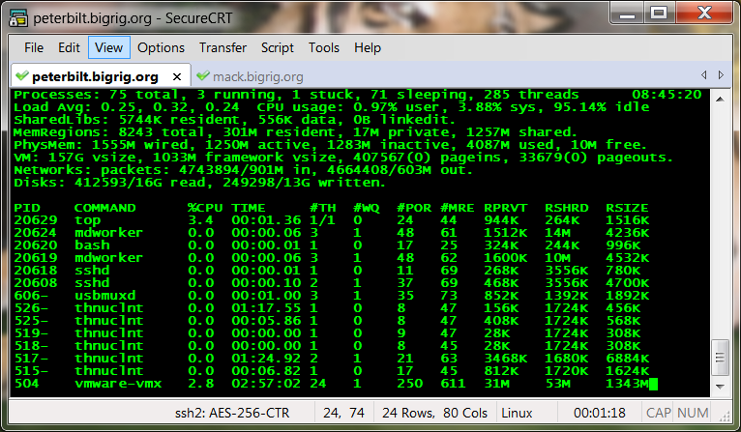
SSH Configuration Demo (Windows)
https://code-int.ornl.gov/ea/architecture/wikis/mfa/phase3/home#ssh-secure-shell

Slide 5
SSH Discussion
SSH Agent versus PKCS11 Module
Use Case | PKCS11 Module | SSH Agent
Can forward credentials to subsequent hosts? | No | Yes
Can connect to multiple machines without retyping PIN? | No | Yes
Offers extra security with PIN prompting for each connection? | Yes | No
Easy to configure on a per connection basis? | Yes | No
Relatively easy to troubleshoot and reliable? | Yes | No

Slide 6

SSH Configuration Demo (Linux & Mac)
https://code-int.ornl.gov/ea/architecture/wikis/mfa/phase3/home#ssh-secure-shell
Notes:
-Agent registration
-Card removal demo

Slide 7

Jump Server as a Fallback
All accounts will allow password authentication if the connection originates from ranlogin01.ornl.gov or ranlogin02.ornl.gov
Citrix and login1 / login2 can also be used, but only for standard (non-privileged) accounts.

Slide 8

Questions?

