Slide 1
Two-Tier Architecture with Disaster Recovery Strategy
Presented by: Mukka Priyanka
Institution: Birla Institute of Technology and Science, Pilani
Supervised by: Urmika Sengupta
Location: Wipro Technologies, Pune

Slide 2
Background
Project Objective:
To design and implement a two-tier architecture focused on disaster recovery using AWS services and DevOps tools.
The solution integrates cloud computing and automation to mitigate risks associated with manual processes and downtime.
Problem Statement:
Traditional disaster recovery and backup procedures are manual, prone to errors, and inefficient in cloud environments.
Businesses require reliable systems that ensure seamless recovery from data loss or system failure, especially in dynamic cloud setups.
Expected Outcome:
Development of a robust system that uses AWS EC2 for application hosting and S3 for data storage.
Integration with AWS Backup for automated disaster recovery, ensuring that data is backed up, stored securely, and recoverable with minimal downtime.

Slide 3
Skills Used
Terraform: Infrastructure as Code tool used to automate the provisioning of cloud resources.
Jenkins: Continuous Integration/Deployment tool for automating testing, building, and deploying code to AWS.
Github: A version control repository that manages code changes, collaboration, and integration with CI/CD pipelines.
AWS (EC2, S3, Backup, SNS):
EC2: Provides scalable virtual servers to host applications.
S3: Object storage for storing application data and backups.
AWS Backup: Automates the backup of data and ensures recovery in case of failure.
SNS: Used for sending notifications and alerts related to backup statuses.
PowerShell: Scripting language for automating various DevOps tasks and AWS operations, ensuring efficient task execution without manual intervention.

Slide 4
Requirements
Hardware Requirements:
EC2 Instance Type: t2.micro with 1 vCPU, 1 GiB RAM.
Storage: 8 GiB Elastic Block Store (EBS) volume attached to EC2 for persistent storage.
Network: Moderate network performance, ideal for low-traffic applications.
Software Requirements:
Terraform: Version 0.12 or higher for IaC.
Jenkins: Version 2.x with updated plugins for CI/CD pipeline automation.
AWS CLI: For interacting with AWS services programmatically.
PowerShell: Version 7.x for scripting infrastructure management tasks.
Services and Tools:
AWS Services: EC2 for application hosting, S3 for data storage, IAM for security, AWS Backup for
disaster recovery, and SNS for notifications.
DevOps Tools: Terraform for automating infrastructure, Jenkins for automating builds and deployments,
and github for version control.

Slide 5
Scope of the Project
Inclusions:
Two-tier architecture design.
Backup, recovery, and automation.
Exclusions:
No application development or detailed performance tuning.

Slide 6
Overview of the Architecture
Tier 1 - Application Server:
The application server is hosted on an EC2 instance.
It handles the business logic and interacts with the data storage layer.
Tier 2 - Data Storage Layer:
Data is stored in an S3 bucket, which provides durable, scalable, and secure object storage.
S3 supports versioning, ensuring that different versions of data are stored.
Disaster Recovery Plan :
AWS Backup: Configured to automatically back up data from S3 to a Backup Vault in the
same region.
Cross-Region Backup: Backup data is replicated to a secondary region to ensure availability
even in case of a regional failure.

Slide 7
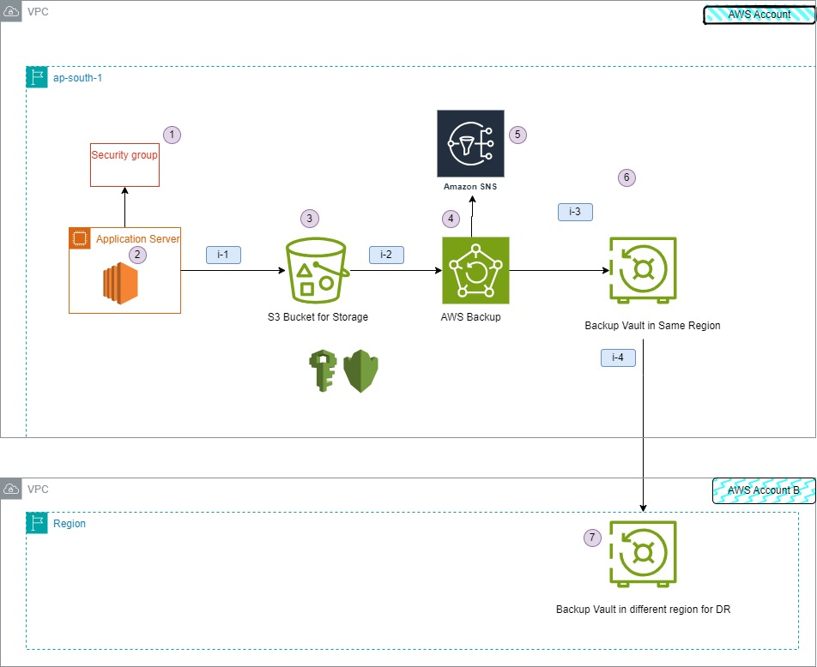
High-Level Design (HLD)

Slide 8
Flow of Design
Step 1: Application Server Interaction with S3:
The EC2 instance (application server) interacts with the S3 bucket to store or retrieve application data.
S3 is used for storing configuration files, user uploads, logs, and other static content.
Step 2: Automated Backups with AWS Backup:
AWS Backup automatically creates backups of data in S3 and stores them in Backup Vaults.
Backup policies define how frequently backups are taken and how long they are retained.
Step 3: Cross-Region Backup for Disaster Recovery:
Backups are replicated to a Backup Vault in another AWS region, providing resilience against regional
outages or failures.
Cross-region replication ensures data is protected in the event of a disaster.
Step 4: Notifications with SNS:
AWS SNS sends notifications to system administrators upon the completion or failure of backups.
Notifications are delivered via email, SMS, or other subscribed endpoints.

Slide 9
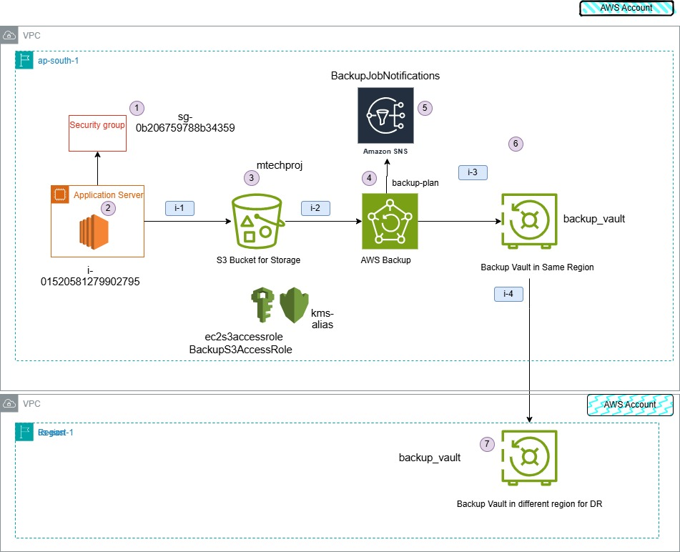
Low level design (lld)

Slide 10
Infrastructure setup
Setup with Terraform:
IAM Roles, EC2, VPC, Security Groups, SNS: Configured secure access, private networking, and real-time notifications for AWS resources.
Backup and Recovery:
S3 Storage & AWS Backup: Automated backup with cross-region replication for resilience and data protection.
CI/CD with Jenkins:
Automated Deployment & Monitoring: Streamlined deployment with Jenkins, ensuring efficient, error-free operations.
Additional Configurations:
IIS Hosting: Website hosted on IIS for stable user access.
PowerShell Task Scheduler: Daily scheduled script hits the website, logs activity, and syncs logs to S3 for secure backups.

Slide 11
Testing and Results
Testing Scenarios:
Backup Automation: Ensured automated backup scheduling for critical data, verifying that backups are stored securely in the cloud and can be retrieved on demand.
Disaster Recovery (DR) Tests: Simulated various disaster scenarios to validate the effectiveness of the DR plan, assessing recovery point and recovery time objectives (RPO/RTO) to minimize potential data loss.
SNS Notifications: Implemented and tested Amazon SNS (Simple Notification Service) notifications for real-time alerts on backup and recovery processes, enabling quick response to any issues.
Outcomes:
Successful Data Restoration: Confirmed the ability to restore deleted or corrupted data fully, maintaining data integrity and minimizing impact on end-users.
Minimal Downtime: DR tests resulted in a streamlined recovery process with negligible downtime, ensuring continuous availability of the application.
Error-Free Process: The entire process executed smoothly, with no critical errors encountered, demonstrating reliability and resilience of backup and recovery mechanisms.

Slide 12
Benefits of the Solution
Enhanced Reliability & Availability: Automated backup/recovery ensures high uptime and fault tolerance.
Data Protection & Integrity: AWS Backup and S3 provide secure, redundant storage, reducing data loss risk.
Cost Efficiency: Automation cuts manual recovery costs; pay-as-you-go services optimize expenses.
Reduced Human Error: Automated processes improve reliability and reduce risks from manual errors.
Improved Recovery & Minimal Downtime: Automated recovery enables fast RTO/RPO, minimizing disruptions.
Security & Compliance: Strong IAM and encryption enhance data security, meeting compliance standards.
Streamlined Operations: DevOps integration simplifies maintenance, freeing IT teams for strategic tasks.
Disaster Resilience: Robust DR strategy supports business continuity and mitigates downtime impact.

Slide 13
COST ESTIMATION
EC2:
A t2.micro instance (On-Demand) it is about $0.0116 per hour, or roughly $8.35 per month
S3:
Storing 100 GB in the Standard Storage class is about $0.023 per GB, or around $2.30/month.
Retrieval of data incurs GET request costs at approximately $0.0004 per 1,000 requests, while PUT costs $0.005 per 1,000 requests.
AWS Backup:
Backup Storage Cost: Approximately $0.023 per GB for Standard S3.
100 GB × $0.023 = $2.30 per month.

Slide 14
Conclusion
Achievements: Developed a secure, resilient two-tier architecture.
Project Benefits:
The detailed design and implementation of this AWS two-tier architecture ensure the application is secure, scalable, and resilient to failures. By integrating DevOps best practices and utilizing AWS services, the architecture supports continuous delivery for streamlined updates, automated backups for data protection, and a comprehensive disaster recovery plan to minimize downtime and data loss in the event of an incident. These features align with the project’s objectives to prioritize data integrity and system reliability, ensuring the application remains dependable and responsive to user needs.

Slide 15
Thankyou…..!!!

