Slide 1

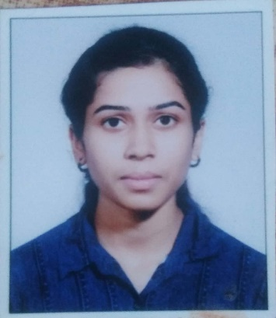


Pallavi R. Hinge
Education and certificates
Bachelor of Engineering in
Mechanical Engineering :
2016-2019
Analyst/Software Engineer
Base Location: MUMBAI
Email ID:
Priyanka.Ramesh-Mule@capgemini.com
Mobile No: +919156095262
Grade: A4
EMP ID-46205915
Skills
Java | Basics, OOPS, Exception Handling, Collections & Generics, Java 8 Features
Spring Framework | Spring MVC. Spring JDBC, , Spring Boot
React | Components, Hooks, Virtual DOM, Routing, Forms & Validation
RDBMS | MySQL,Oracle
UI Technology | HTML 5, CSS, JavaScript
Tools | Git ,GitHub, Postman, Eclipse, Visual Studio code
Manual Testing | Sound knowledge in White Box Testing, Black Box Testing
Add on Skills | Communication , Team management , Problem solving, Adaptability
Strengths
Full Stack Developer
Good Knowledge of java programming.
Achievement
ONLINE FLIGHT BOOKING :
Case study of Flight Booking System along with Spring Boot, HTML5, CSS and React used as User Interface.
•Good with Spring Framework
•Good in developing web pages using HTML, CSS.
•Currently learning on iTransform: Full Stack With React, Spring Boot MS & MongoDB
Four layered architecture which includes a Presentation Layer, Business Layer, Persistence Layer and Database Layer. Exception Layer handled the exceptions.
Full Stack developer with React and Full Stack Java Developer
Hands on experience in developing web pages
using HTML5, CSS3, REACT. Good understanding of Document Object Model (DOM) and DOM Functions.
Proficient in creating Single page Web Application in
REACT with routing.
Check out my work on GitHub
Presentation Title | Author | Date © Capgemini 2017. All rights reserved | 1

