Slide 1
MID-PROJECT : IMPLEMENTING THE LEARNING
DONE BY-
SREEKARA REDDY
PRIYANKA N MAHENDRAKAR

Slide 2
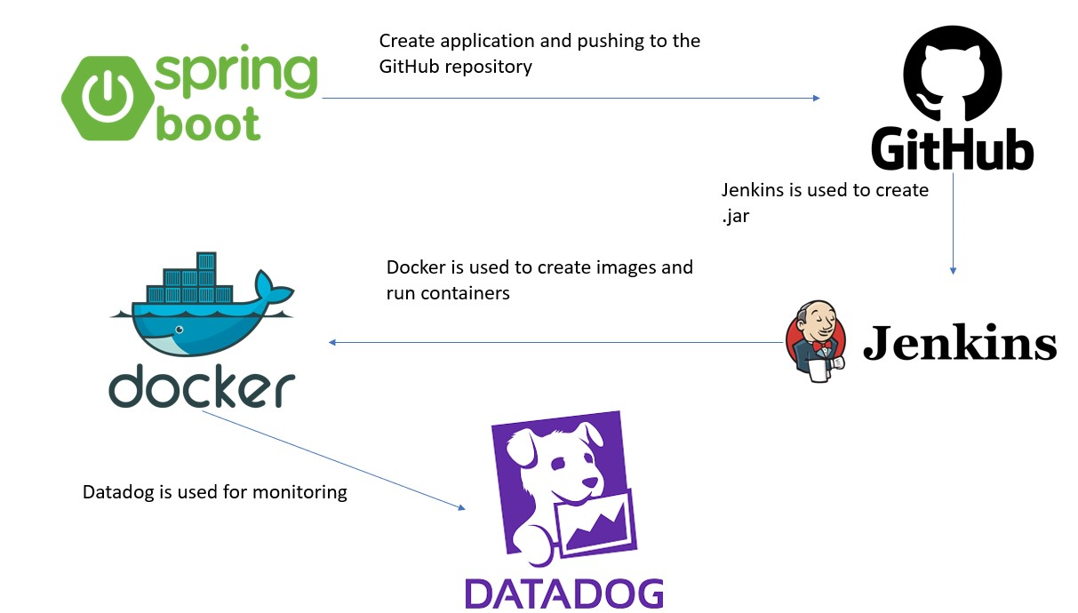
FLOW OF THE PROJECT

Slide 3
Thank you

