Slide 1
Welcome
To
Our
Project

Slide 2
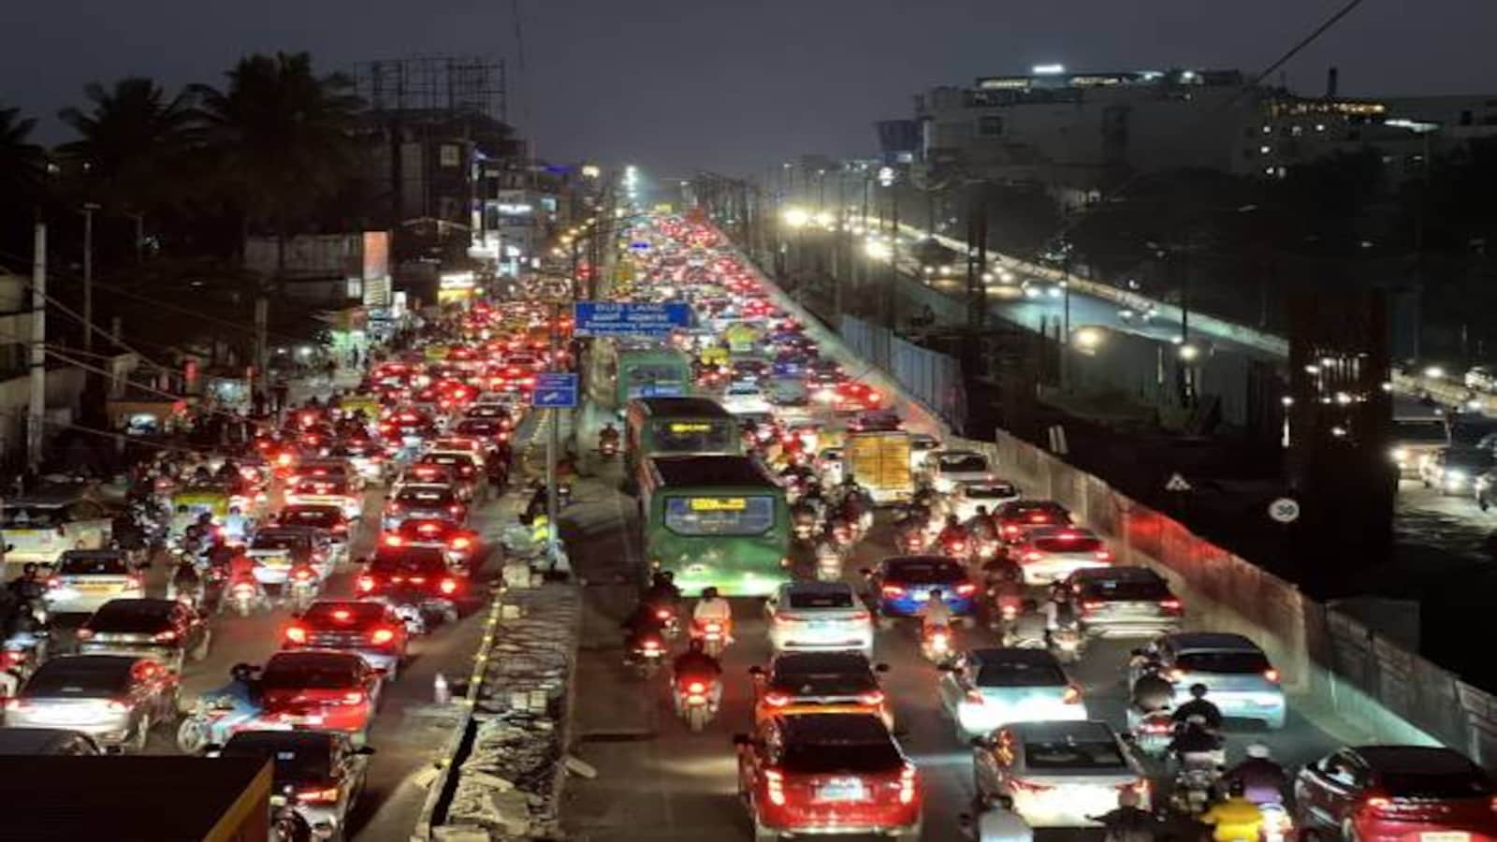
Traffic Prediction dataset
Machine learning Project

Slide 3
Symbiosis Skills and Professional
University (SSPU)
Certificate course in Data Associate
Project :-Traffic Prediction dataset
Guided By :- Ashwini Kakde

Slide 4
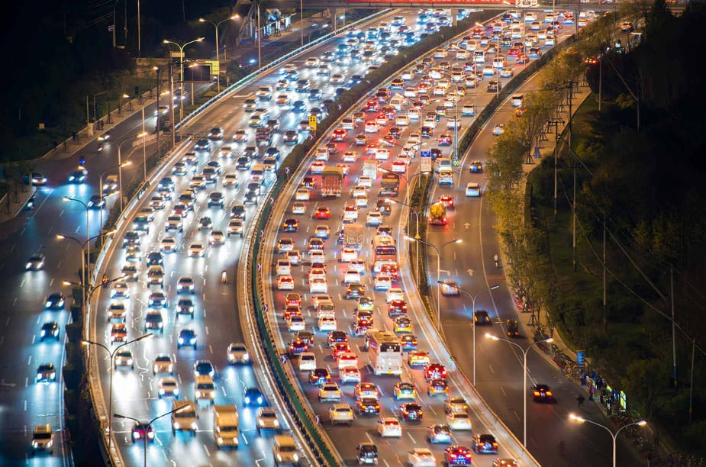
Traffic Prediction dataset
Course :- Data Associate
Represent By
Aashwini Salunke (D-17)
Nehal Jadhav (D-16)
Priyanka Patil (D-16)

Slide 5
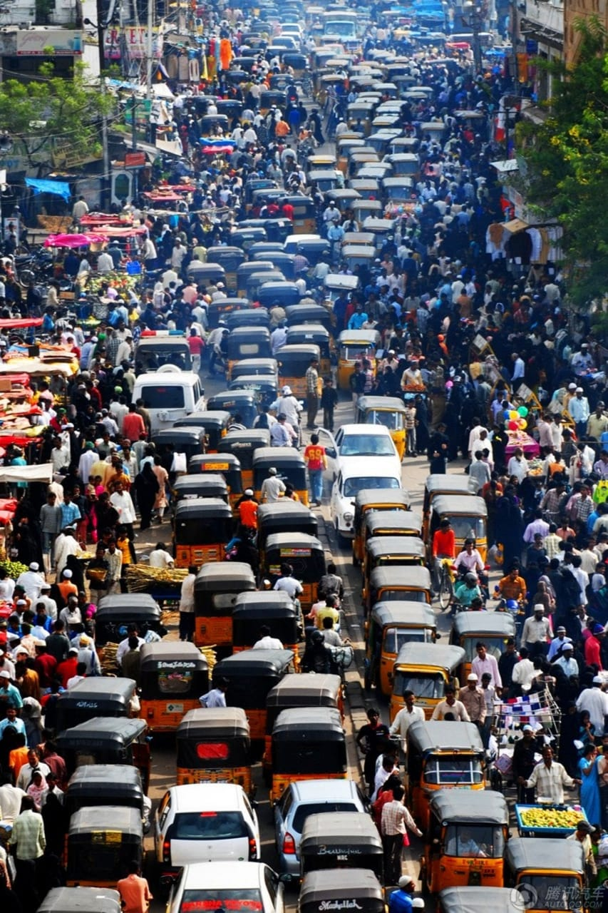
Contents
Introduction
import libraries
Dataset and tools
Data Preprocessing
Algorithms
Advantages and disadvantages
CSV file
Reference

Slide 6
Introduction
Traffic congestion is rising in cities around the world. Contributing factors include expanding urban populations,uncoordinated traffic signal timing and a lack of real-time data.The impacts are significant. Traffic data and analytics company INRIX estimates that traffic congestion cost U.S. commuters $305 billion in 2017 due to wasted fuel, lost time and the increased cost of transporting goods through congested areas. Given the physical and financial limitations around building additional roads, cities must use new strategies and technologies to improve traffic conditions.
The traffic dataset we will observations of the number of vehicles each hour in four different categories:
DateTime
Vehicles ID
3) Day of the week
4) Traffic situation

Slide 7
Libraries
import pandas as pd
import numpy as np
import matplotlib.pyplot as plt
import seaborn as sns from sklearn.model_selection import train_test_split
from sklearn.preprocessing import StandardScaler
from sklearn.linear_model import LogisticRegression
from sklearn.ensemble import RandomForestClassifier
from sklearn.tree import DecisionTreeClassifier
from sklearn.svm import SVC
from sklearn.metrics import confusion_matrix
from sklearn.model_selection import KFold

Slide 8
DataSet and Tools
Dataset from the :- kaggle.com
Tool used:- python.
Numpy:- for numeric data set
Pandas :- for Data analysis
matplotlib:- for Data Visualization
Seabourn:- for Data visulization
Sklearn :- for making statistic of graphics

Slide 9
Supervised machine learning
Types :- Regression and classification
1. Regression: Predict continuous output values (e.g., Linear Regression, Ridge Regression).
2. Classification: Predict categorical output labels (e.g., Logistic Regression, Decision Trees , Random Forest ,Support Vector Machine)

Slide 10
Algorithms
Logistic Regression :- It is used for binary classification problems, where the target variable is categorical (0/1, yes/no, etc.). It predicts the probability of an instance belonging to one of the two classes, using a logistic function to model the probability.
Random ForestClassifier :- An ensemble learning algorithm that combines multiple decision trees to predict the class label of an instance. It's a supervised learning algorithm used for classification problems.
Decision Tree :- It is uses a tree-like model to classify data or predict continuous values. It's a simple, yet effective, algorithm for classification and regression tasks.
Support Vector Machine (SVM) :- Is a powerful supervised learning algorithm in Machine Learning (ML) used for classification and regression tasks. Classification/Regression: Use the trained SVM model to classify new data or predict continuous values.

Slide 11
Cross -Validation
Cross-validation is a statistical technique used to evaluate the performance of a machine learning model by training and testing it on multiple subsets of the available data. It involves:
Dividing the data into k subsets or folds (e.g., 5-10 folds)
Training the model on k-1 folds
Testing the model on the remaining fold
Repeating steps 2-3 for each fold
Averaging the performance metrics
Common types of cross-validation include:-
K-Fold Cross-Validation
Leave-One-Out Cross-Validation (LOOCV)
Stratified Cross-Validation (for imbalanced datasets)

Slide 12
Confusion Matrix
A table used to evaluate the performance of a classification model by comparing predicted and actual classes.
Actual values
Matrix Structure
Purpose
Evaluate model performance
Identify errors (FP, FN)
Improve model accuracy
Positive (1)
Negative (0)
Positive (1)
TP | FP
FN | TN
Predicted Values
Negative (0)
Metrics
Accuracy: (TP + TN) / Total
Precision: TP / (TP + FP)
Recall: TP / (TP + FN)
F1 Score: 2 * (Precision * Recall) / (Precision + Recall)

Slide 13
Algorithms | Accuracy
Logistic Regression | 0.786912
Decision Tree | 1.0
Random Forest | 0.994966
Support Vector Machine (Kernel rbf) | 0.899328

Slide 14
Advantages of Traffic Prediction Dataset
Reduced congestion :- Real-time traffic monitoring and optimization can minimize traffic jams.
Improved safety: - Advanced systems can detect accidents and alert authorities promptly.
Enhanced mobility :- Smart traffic management can prioritize public transport and optimize routes.
4. Environmental benefits :- Reduced congestion leads to lower emissions and improved air
quality.
Increased efficiency :- Advanced systems can optimize traffic signal timings and reduce travel time.
Disadvantages of Traffic Prediction Dataset
High implementation costs :- Setting up advanced traffic management systems can be
expensive.
2. Dependence on technology :- Technical issues can cause system failures.
3. Data privacy concerns :- Collecting and storing traffic data raises privacy concerns.
4. Complexity :- Managing and integrating advanced systems can be challenging.
5. Potential for bias :- Algorithms used in smart traffic management may inadvertently prioritize
certain groups or routes over others.

Slide 15
REFERENCE
Kaggle link :- https://www.kaggle.com/.
https:// www.com.github.

Slide 16
Thank
You

