Slide 1
Blog
Gauri Chavan
Labdhi Shah
Priyanka Paladi RajaGopal

Slide 2
Why Blog?
We all have read blogs and we decided to make it better by adding our perspective to the application by making it more user friendly and user appropriate
Platform for people to showcase and share their interests

Slide 3
Why MEAN Stack Application?
We already knew basics of JavaScript and we wanted to explore more
So we decided to learn new technologies
We are using MongoDB because it is no sql and its easier to structure the data as we want
Express provides us with a robust set of features for web and mobile applications.
Angular2 provides a framework and its easy to design application both Desktop and Mobile.
Node.js is scalable and since its basically JavaScript, we are already comfortable using that for backend.

Slide 4
What have we done so far?
We have done user registration and login
We have used following packages:
bcrypt-nodejs – for encryption of password
body-parser - extract the entire body portion of an incoming request stream and exposes it on request body
Express
Mongoose – Mongoose allows us to have access to the MongoDB commands for CRUD simply and easily
Morgan - Morgan is used for logging request details

Slide 5
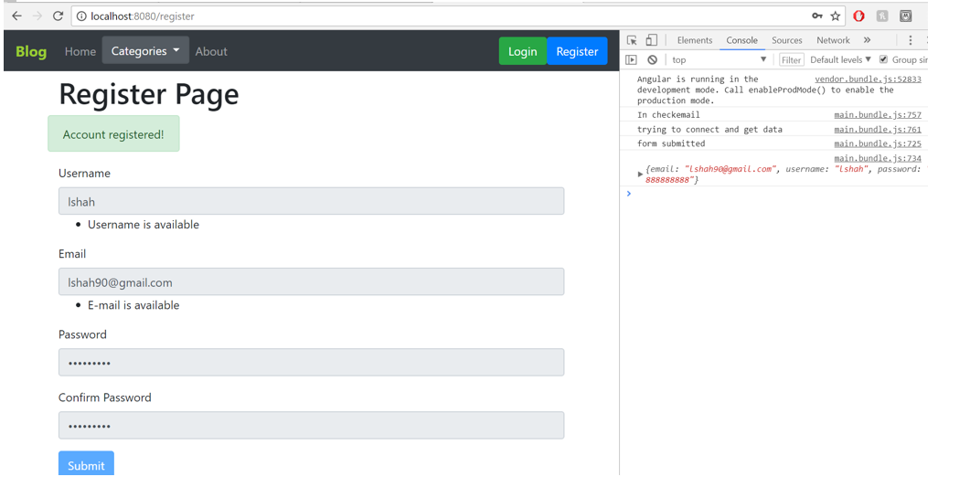
User Registration

Slide 6
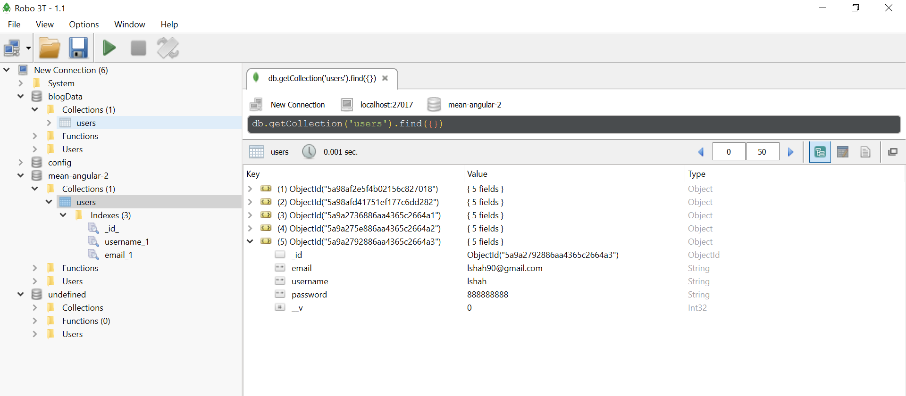
User Registration

Slide 7
What are we planning to add?
We will have blogs based on category
User gets to choose categories of blogs, which would be shown on log In based on his/her preferences
User gets to post blogs and tag them with categories, upload pictures, tag links to make it more descriptive and expressive.
Easy navigation for the users especially while reading it. Users can add their personal profile too which would contain details of his personal interests, his favorite blogs (links), profession.
Users can comment and like the blog posts.
User can view other user profile.

Slide 8
Questions?

Slide 9
Thank You!

