Slide 1

TO-DO Application
Under Guidance of:
Mrs. B.Jyostsna devi
Assistant Professor
Dept Of Cse
Presented By:
P.Priyanka(191FA04033)
G.k.Charan (191FA04013)
Shaik .Tej Munnisa Begum(191FA04415)
Department of Computer Science and Engineering
VFSTR Deemed to Be University
DEPARTMENT OF COMPUTER SCIENCE AND ENGINEERING

Slide 2
INDEX
INTRODUCTION
PROBLEM STATEMENT
SOFTWARE AND HARDWARE REQUIREMENTS
4. WORKING OF TO-DO
4.1.Architecture Of To-Do
4.2.Modules In Application
4.3.Operations involved
5. ADVANTAGES AND FEATURES
SCREENSHOTS
FUTURE SCOPE
2
DEPARTMENT OF COMPUTER SCIENCE AND ENGINEERING

Slide 3

INTRODUCTION
TO-DO List
DEPARTMENT OF COMPUTER SCIENCE AND ENGINEERING

Slide 4
PROBLEM STATEMENT
Social media and other easily accessible online distractions make it hard for us to stay focussed on our tasks and make it difficult for us to do our work efficiently.
Also, constantly switching between tasks may give us false feeling that we are being productive when we are ,in fact ,not .Its more important for us to prioritize tasks and work on those that are most important, rather than focussing on deleting small items from our to do list just for the sake of appearances.
The goal of this app is to help us become more aware of how we spend time in the process of doing those tasks and how productive that time .It can help set some constraints on social media to reduce distractions and track the time we spend working on the to do items.
DEPARTMENT OF COMPUTER SCIENCE AND ENGINEERING

Slide 5
Software Requirements
Visual studio Code
Flutter Technology
Android Studio
Hardware Requirements
8Gb Ram and 64 bit
1 Tb Memory
DEPARTMENT OF COMPUTER SCIENCE AND ENGINEERING

Slide 6
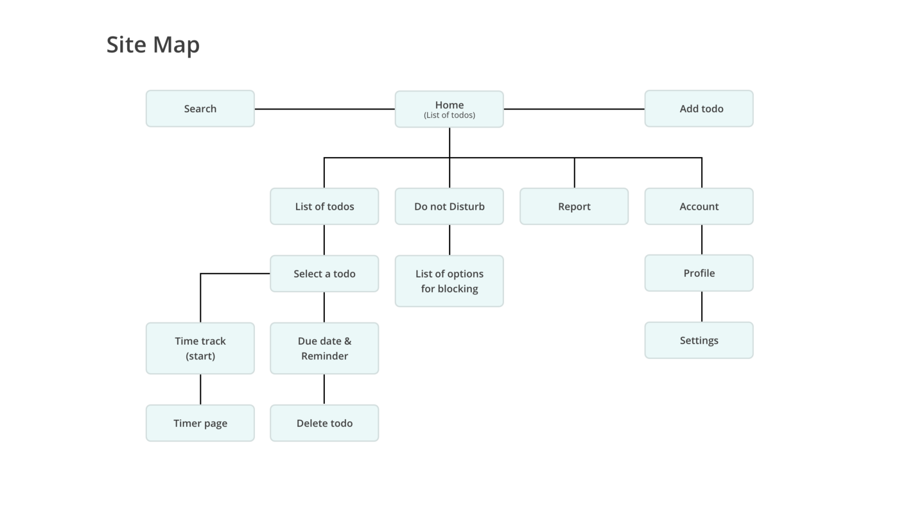
4.WORKING OF TO-DO
4.1 Architecture Of To-Do:
DEPARTMENT OF COMPUTER SCIENCE AND ENGINEERING

Slide 7
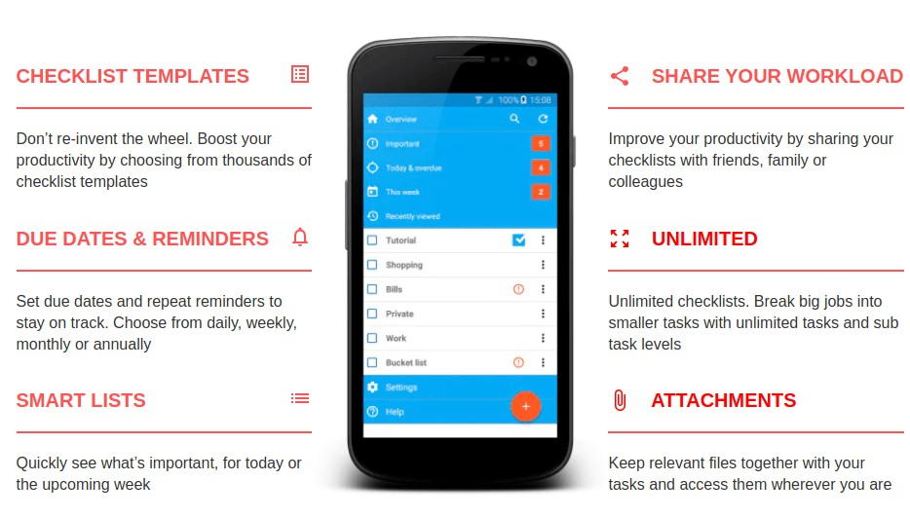
4.2 Modules In Application
ON BOARDING PAGE
LOGIN PAGE
HOME PAGE
ADD TASK PAGE
SETTINGS PAGE
DEPARTMENT OF COMPUTER SCIENCE AND ENGINEERING

Slide 8
4.3.Operations Involved
Create/edit to-do
Delete to-do by swipping
Mark done/not done in list
Filter to-do list by status (all/done/not done)
Change theme (light to dark and vice versa) at runtime
Enable shortcuts to create to-do.
Login/logout.
Register new account.
DEPARTMENT OF COMPUTER SCIENCE AND ENGINEERING
8

Slide 9
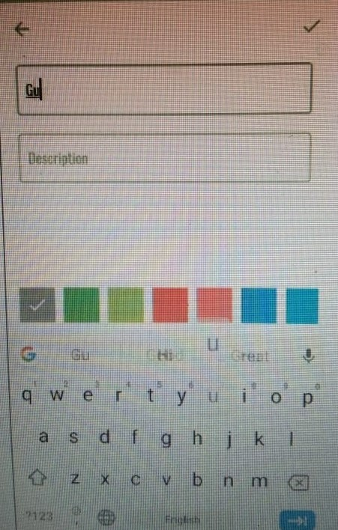
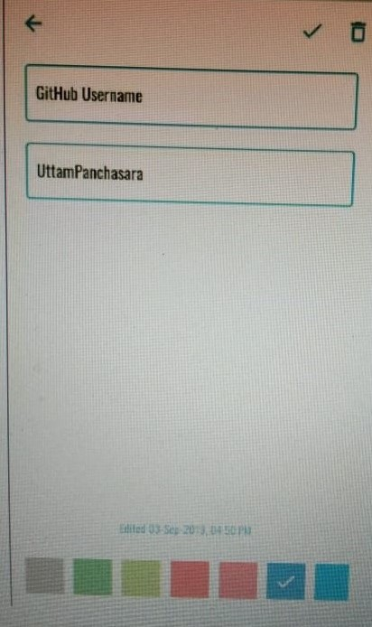
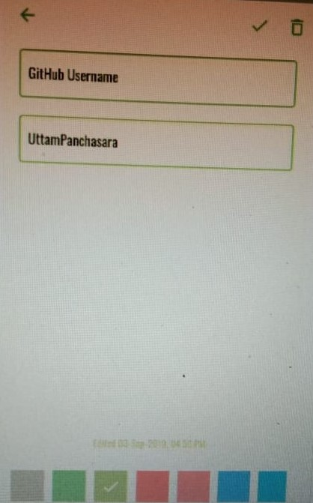
Operations :
CREATE
UPDATE
DELETE
DEPARTMENT OF COMPUTER SCIENCE AND ENGINEERING
9

Slide 10
ADVANTAGES:
Set some constraints on social media, apps, and online distractions.
Make it easy for users to manage to do lists, track time and set constraints in one place.
Add the ability to prioritize tasks via deadline.
Reduce distractions from mobile by allowing device settings to be synced from desktop.
Add the ability to easily add tasks and to search to do lists.
.
DEPARTMENT OF COMPUTER SCIENCE AND ENGINEERING
10

Slide 11
FEATURES:
Add projects
Add labels
Add tasks
Sort tasks time, projects or labels
Swipe to complete or delete task
Edit tasks, projects, labels
Delete projects, labels
Reminder with notification.
Group related tasks together and apply sorting, search filters, and focus
filters.
DEPARTMENT OF COMPUTER SCIENCE AND ENGINEERING
11

Slide 12
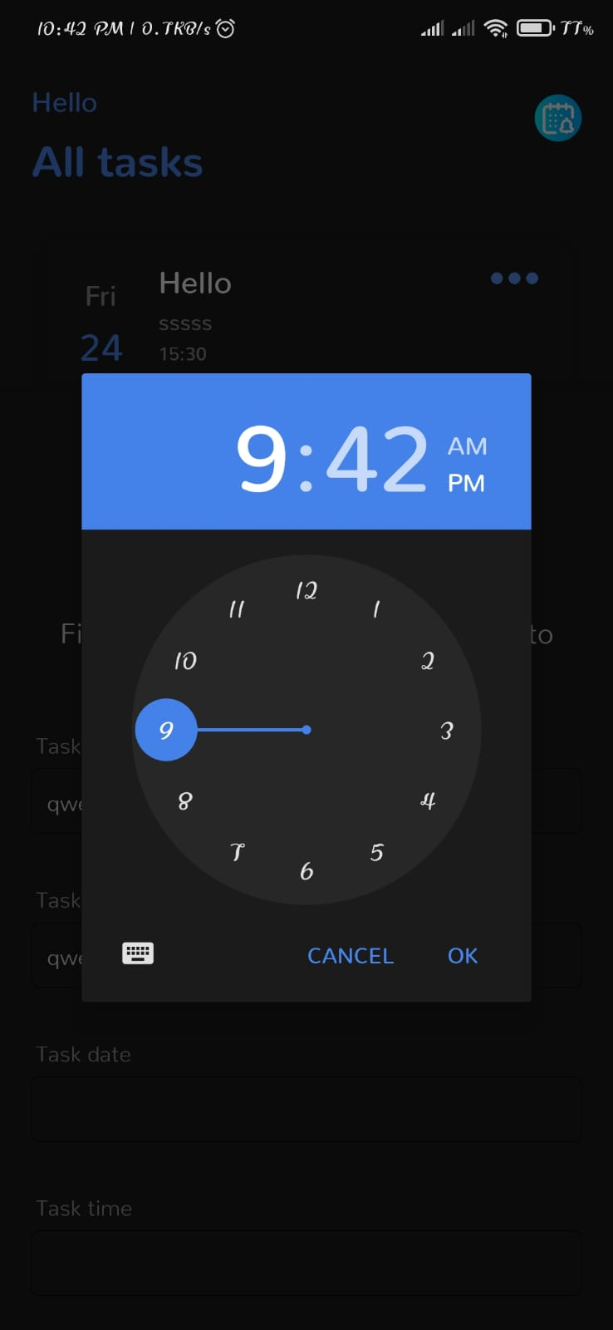
SCREENSHOTS:
DEPARTMENT OF COMPUTER SCIENCE AND ENGINEERING
12

Slide 13
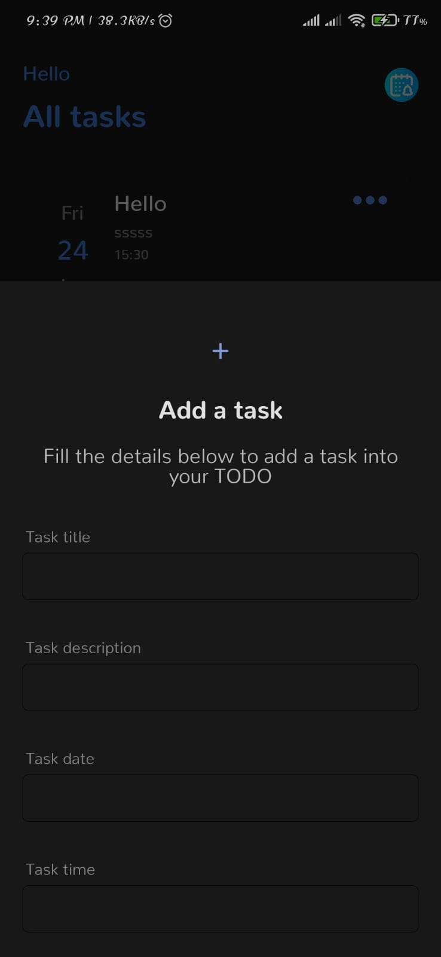
SCREENSHOTS:
DEPARTMENT OF COMPUTER SCIENCE AND ENGINEERING
13

Slide 14
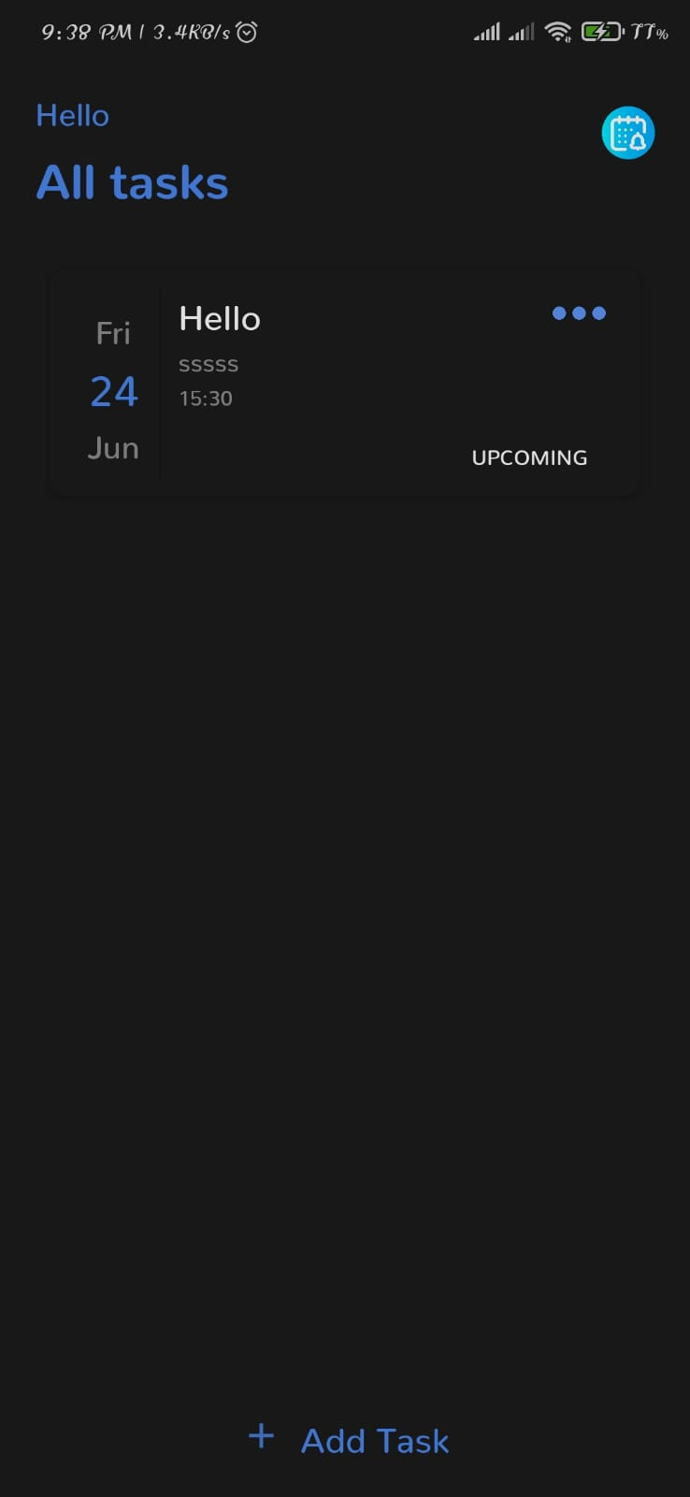
SCREENSHOTS:
DEPARTMENT OF COMPUTER SCIENCE AND ENGINEERING
14

Slide 15
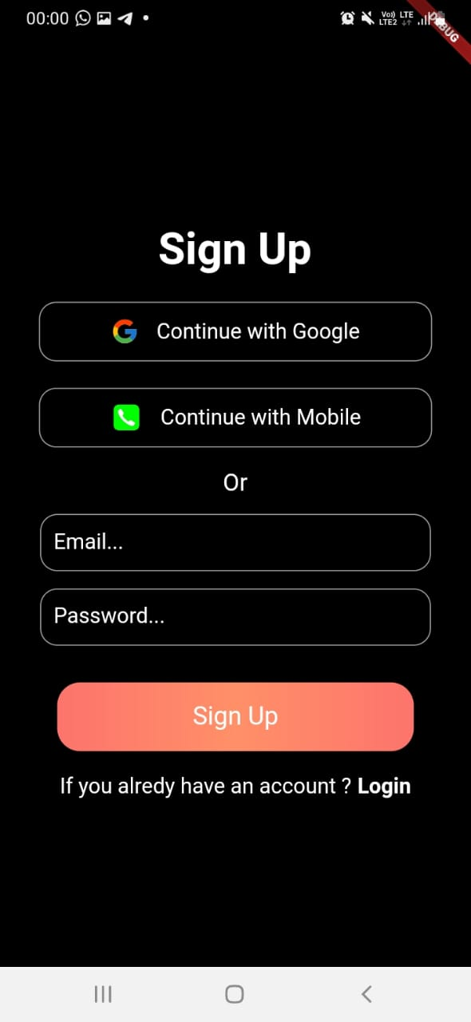
SCREENSHOTS:
DEPARTMENT OF COMPUTER SCIENCE AND ENGINEERING
15

Slide 16
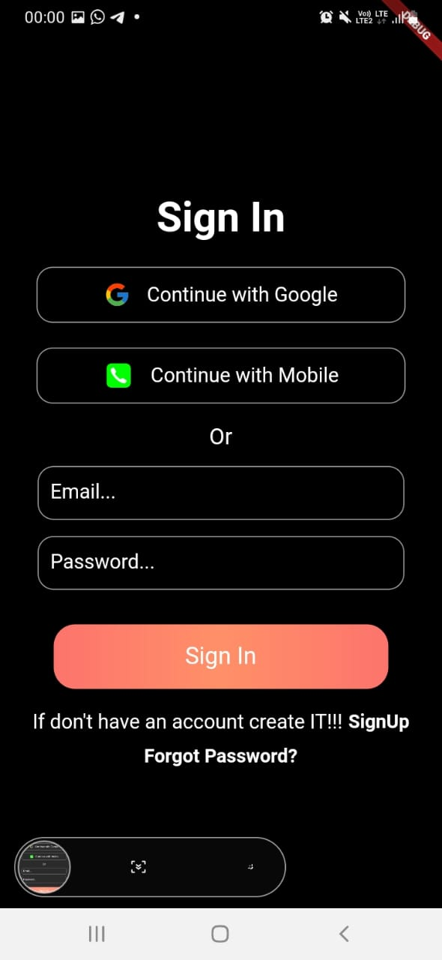
SCREENSHOTS:
DEPARTMENT OF COMPUTER SCIENCE AND ENGINEERING
16

Slide 17
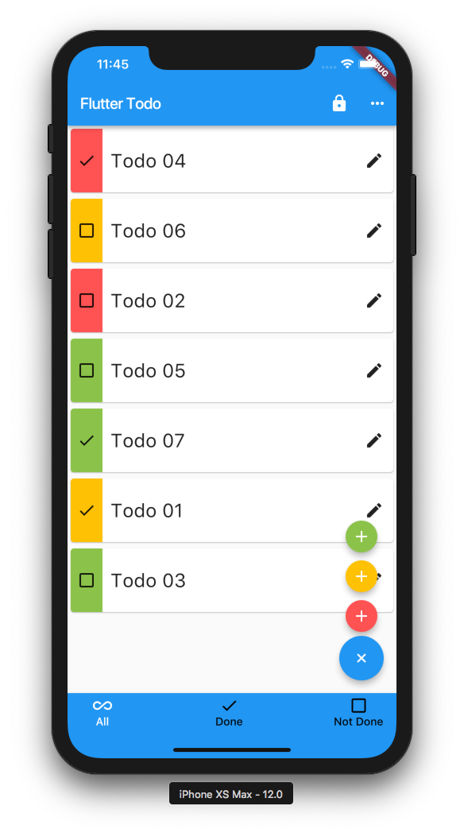
Future scope:
Voice to Text conversion
Creating Groups and sharing resources.
Clock generation with tasks.
Progress Bar
17
DEPARTMENT OF COMPUTER SCIENCE AND ENGINEERING

Slide 18
THANK YOU
18
DEPARTMENT OF COMPUTER SCIENCE AND ENGINEERING

