Slide 1
CPDA Batch 9 │ Hero Vired
US Disaster Declarations
Power BI Capstone Project
Analyzing 71 Years of FEMA Disaster Data | 1953 – 2023
64K+
59
71
Declaration Records
States and Territories
Years of Data
June 2026

Slide 2
CAPSTONE PROJECT — GANTT CHART TRACKER | CPDA Batch 9 · Hero Vired
Task | Start | End | Wk 1 Jun 3–7 | Wk 2 Jun 8–14 | Wk 3 Jun 15–21 | Wk 4 Jun 22–26 | Status
Assign project plan | Jun 2 | Jun 3 | ■ |  |  |  | Complete
Gantt + GitHub setup + Version Control by Learners Plan | Jun 2 | Jun 19 | ■ | ■ | ■ |  | Complete
ETL data cleaning & Modelling | Jun 2 | Jun 6 | ■ |  |  |  | Complete
DAX Calculations & Measures | Jun 8 | Jun 12 |  | ■ |  |  | Complete
E. Scenario & What-If Analysis | Jun 8 | Jun 12 |  | ■ |  |  | Complete
Dashboard UX / Q&A test | Jun 15 | Jun 19 |  |  | ■ |  | Complete
Weekly review call | Jun 6 | Jul 25 | ■ | ■ | ■ | ■ | Complete
Final PPT preparation | Jun 22 | Jul 22 |  |  |  | ■ | Complete
Final GitHub push + README | Jun 23 | Jun 23 |  |  |  | ■ | Complete
Final review call | Jun 24 | Jun 25 |  |  |  | ■ | Complete
Presentation day | Jun 27 | Jun 27 |  |  |  | ■ | Scheduled
■ Active week |  | ■ Complete |  | ■ Recurring |  | ■ Scheduled/Upcoming

Slide 3
AGENDA
What We'll Cover Today
Project Overview
Data Model & ETL
01
02
User Guide, dataset, objectives, scope & team
Power Query transformations, star schema design
Dashboard Walkthrough
Key Findings & Insights
03
04
5 interactive pages with live demos
Trends, hotspots, incident patterns
Scenario Analysis
Conclusions & Q&A
05
06
What-If projections & funding forecasts
Learnings, next steps, open discussion
CPDA Batch 9 │ US Disaster Declarations │ Power BI Capstone │ June 2026

Slide 4
User Guide
01
Dashboard Overview
04
Dashboard Navigation
02
045
Data Source
What-If-Parameter
03
Troubleshooting
06
Best Practices
CPDA Batch 9 │ US Disaster Declarations │ Power BI Capstone │ June 2026

Slide 5

PROJECT OVERVIEW
FEMA Disaster Declarations | 1953 – 2023
About This Project
Dataset at a Glance
Analyzed 64,092 FEMA disaster declaration records spanning 71 years (1953–2023)
64,092
4,700+
Built an end-to-end Power BI solution with data ingestion, ETL, star-schema modeling, and interactive reporting
Total Declaration Records
Unique Disaster Events
Covers all 59 US states and territories, including Puerto Rico, Virgin Islands, and Guam
59
22.8
States & Territories
Avg. Disaster Duration (Days)
Dashboard includes 5 interactive pages: Overview, Geographic Analysis, Temporal Trends, Incident & Program Insights, and Scenario Insights
What-If scenario modeling enables projection of future disaster counts and funding needs
93%
17,171
PA Program Activation Rate
Severe Storm (Most Frequent)
CPDA Batch 9 │ US Disaster Declarations │ Power BI Capstone │ June 2026

Slide 6





ETL PIPELINE & POWER QUERY
Data Transformation & Derived Columns
1
2
3
Ingest CSV
Standardize Text
Derive Columns
Load 64,092 rows from FEMA CSV. Convert ISO-8601 date strings to Power BI date types.
Trim & Proper-case: state, designated_area, incident_type. Map DR→Major Disaster, EM→Emergency, FM→Fire Management.
DisasterDuration (days), TimeToDeclaration (days), DeclarationYear, DeclarationMonth, DeclarationMonthName.
4
5
6
FIPS Validation
Group Rare Types
Load to Model
Flag FIPS codes outside 1000–99999 range. Statewide records (e.g. 13000) retained as valid.
Incident types with count < 50 consolidated into 'Other' to reduce slicer cardinality.
Clean data loaded into star schema with verified relationships and optimized column types.
CPDA Batch 9 │ US Disaster Declarations │ Power BI Capstone │ June 2026

Slide 7

CHALLENGES & SOLUTIONS
What We Encountered & How We Solved It
Missing incident end dates in 8,410 records (13%)
→
Used DATEDIFF with null handling; excluded null durations from average calculations
ISO-8601 date strings with timezone caused type errors
→
Applied Table.TransformColumnTypes to convert all date columns consistently
Rare incident types created slicer clutter
→
Grouped low-frequency types (count < 50) into 'Other' category in Power Query
FEMA codes (DR, EM, FM) were cryptic for business users
→
Mapped to readable labels: Major Disaster, Emergency, Fire Management via M code
COVID-19 spike skewed temporal trend charts
→
Added year-range slicer so users can filter 2020 in/out for clean trend analysis
CPDA Batch 9 │ US Disaster Declarations │ Power BI Capstone │ June 2026

Slide 8
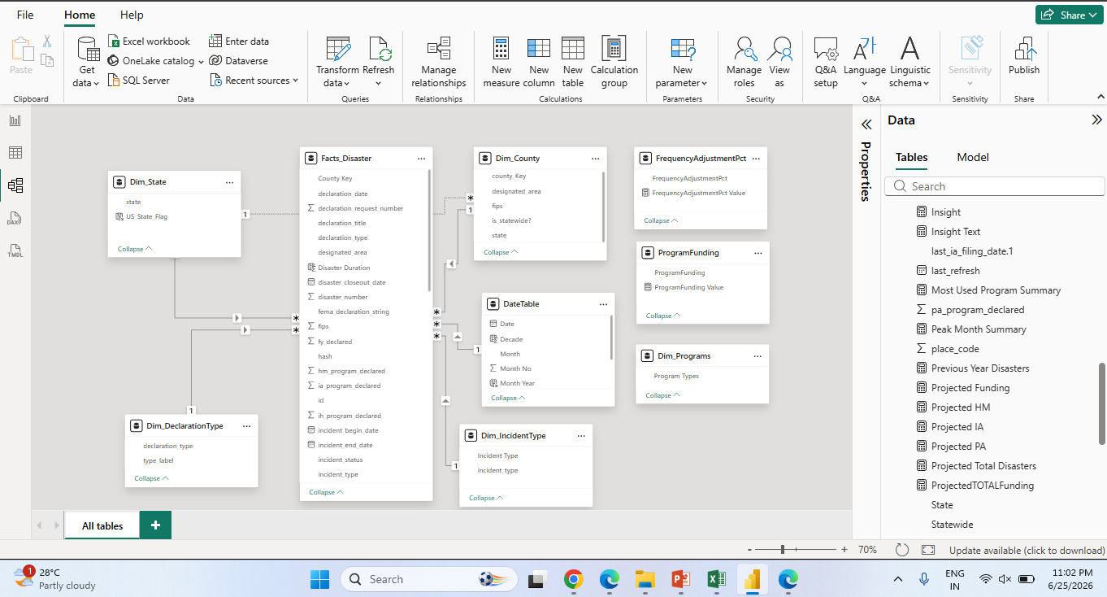
DATA MODEL & STAR SCHEMA
Power BI Relationship View | Fact + Dimension Tables
Key Tables
Facts_Disaster
Core fact table with all 64K declaration records
Dim_State
State lookup with US State flag images
Dim_IncidentType
Incident categories (Storm, Hurricane, Flood...)
Dim_DeclarationType
DR, EM, FM declaration type labels
Dim_County
County geography with FIPS codes
All relationships: 1-to-Many | Single cross-filter direction | Star schema design optimized for DAX time intelligence and slicers
DateTable
Time intelligence (Year, Quarter, Month)
CPDA Batch 9 │ US Disaster Declarations │ Power BI Capstone │ June 2026

Slide 9
DAX MEASURES & CALCULATIONS
Core Measures Powering the Dashboard
Total Disasters
Core KPI
Avg Duration (Days)
Core KPI
COUNT(Facts_Disaster[disaster_number])
AVERAGEX(FILTER(Disaster, NOT ISBLANK([DisasterDuration])), [DisasterDuration])
YoY Change %
Time Intel
State Disaster %
Geographic
DIVIDE(CurrentYear - PriorYear, PriorYear) via DATEADD
DIVIDE([Disasters by State], CALCULATE(COUNTROWS, ALL(DimState)))
Projected Total
Scenario
Projected PA Funding
Scenario
ROUND(BaseCount * (1 + [FrequencyAdjPct Value]), 0)
AdjPA * [Avg PA Cost Per Disaster] (baseline $5M/disaster)
CPDA Batch 9 │ US Disaster Declarations │ Power BI Capstone │ June 2026

Slide 10
SECTION 02
Dashboard
Walkthrough
5 Interactive Pages | 60+ Visual Components | Live Slicers & Filters

Slide 11
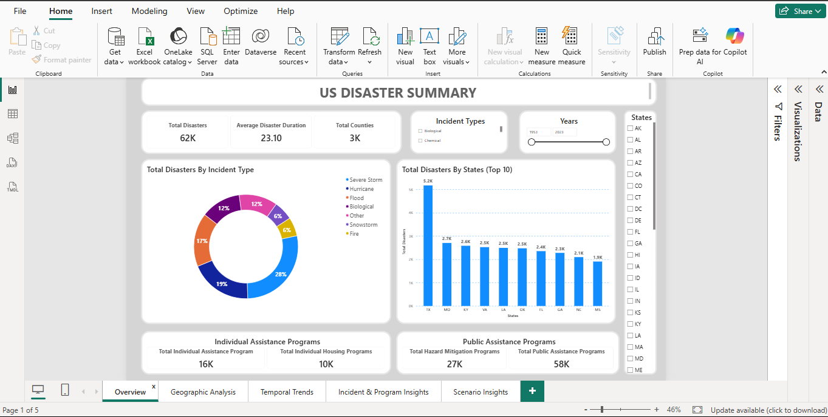





PAGE 1: OVERVIEW DASHBOARD
Executive KPIs & Summary Visuals
Key Highlights
62K
Total Disasters
23.1
Avg. Duration (Days)
3K
Total Counties Affected
16K
IA Programs Declared
58K
PA Programs Declared
💡 Severe Storm (28%) is the leading disaster type. TX leads with 5,173 declarations. Public Assistance activated in 93% of all declarations.
CPDA Batch 9 │ US Disaster Declarations │ Power BI Capstone │ June 2026

Slide 12
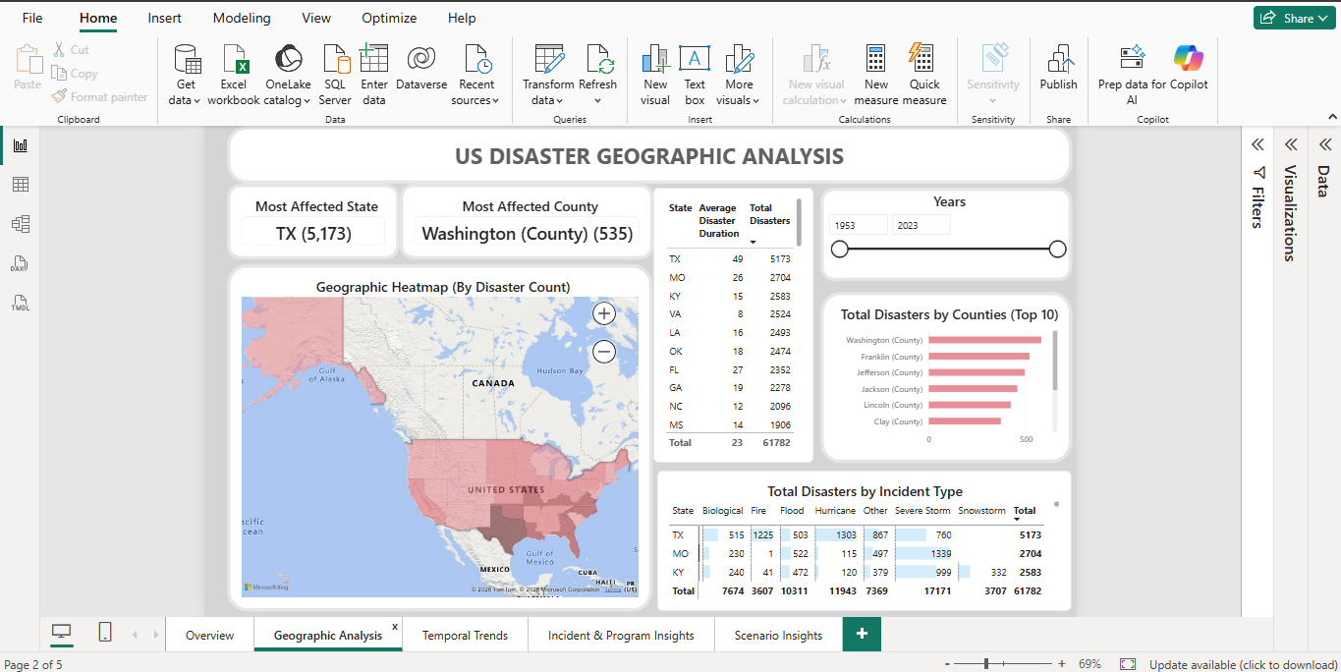
PAGE 2: GEOGRAPHIC ANALYSIS
State & County Heatmaps | Regional Disaster Distribution
Top Geographic Insights
Most Affected State
TX (5,173)
Most Affected County
Washington (535)
Top Disaster Type TX
Hurricane (1,303)
Total States w/ Data
59 States/Terr.
💡 Southern & Gulf states (TX, MO, KY) dominate disaster counts. Washington County is the single most-affected county nationwide.
CPDA Batch 9 │ US Disaster Declarations │ Power BI Capstone │ June 2026

Slide 13
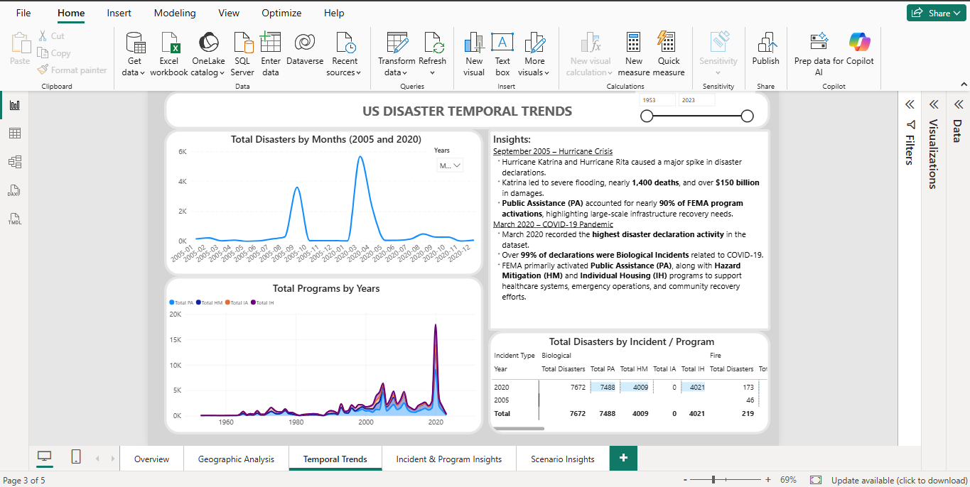
PAGE 3: TEMPORAL TRENDS
Yearly & Monthly Disaster Patterns | 2005 vs 2020 Spotlight
Key Historical Events
Sept 2005 — Hurricane Crisis
Katrina & Rita caused a spike in declarations. ~1,400 deaths, $150B+ in damages. PA accounted for ~90% of FEMA activations.
March 2020 — COVID-19 Pandemic
Highest declaration activity on record. 99%+ of declarations: Biological Incidents. FEMA activated PA, HM, and IH programs at scale.
💡 Two peak events dominate the dataset: 2005 Hurricane season and 2020 COVID-19 pandemic — both required unprecedented federal disaster response.
CPDA Batch 9 │ US Disaster Declarations │ Power BI Capstone │ June 2026

Slide 14
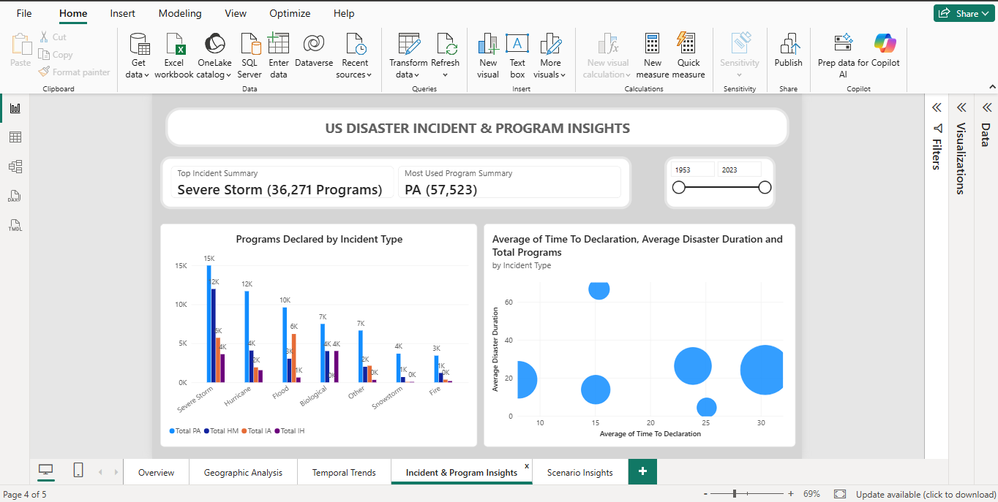
PAGE 4: INCIDENT & PROGRAM INSIGHTS
Program Activation by Incident Type | Time-to-Declaration Analysis
Program Highlights
Top Incident
Severe Storm
36,271 programs declared
Most Used
PA Program
57,523 total activations
Longest Dur.
Biological
Fastest Decl.
Snowstorm
~12 days to declaration
💡 Severe Storms trigger the most PA program activations. Biological incidents (COVID) have the longest average duration at 68 days.
CPDA Batch 9 │ US Disaster Declarations │ Power BI Capstone │ June 2026

Slide 15
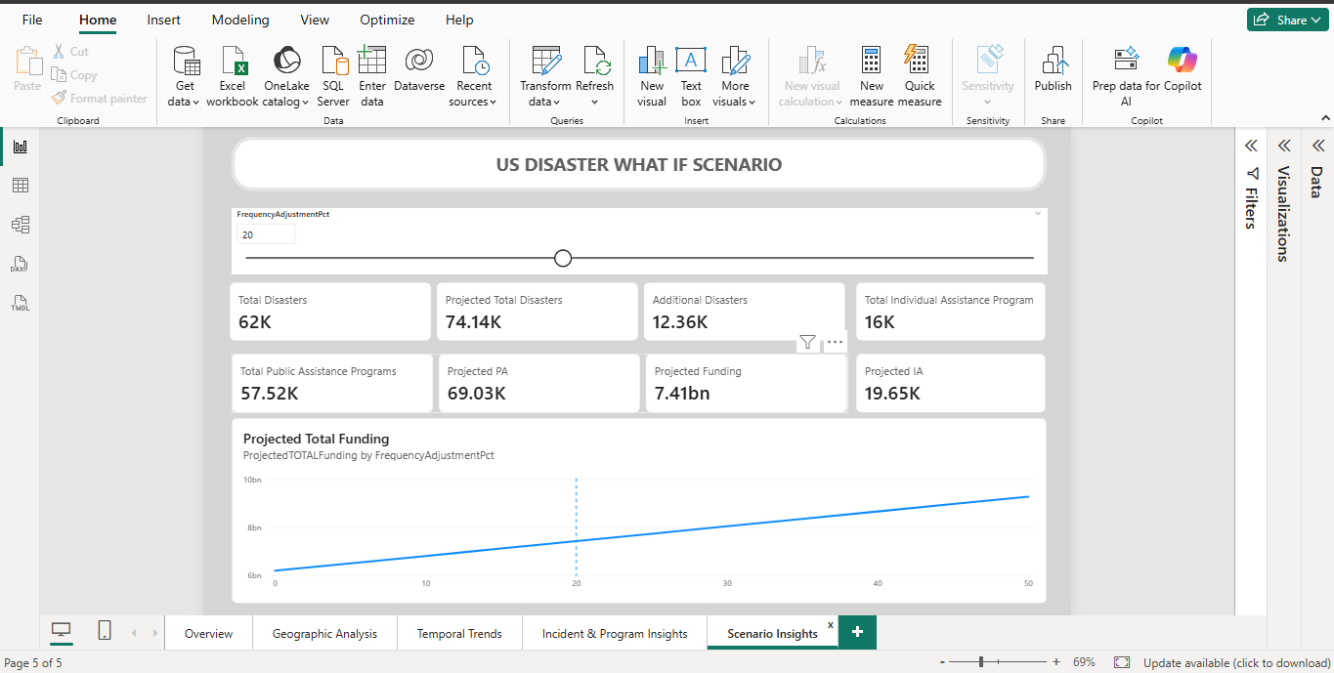
PAGE 5: SCENARIO INSIGHTS — WHAT-IF
Frequency Adjustment Slider | Projected Funding & Disaster Forecasts
Scenario at 20%
Frequency Adjustment Pct
Total Disasters
74.14K
Additional Events
+12.36K
Total PA Programs
69.03K
Projected Funding
$7.41 bn
💡 At a 20% frequency increase: projected 74K+ disasters, $7.41 billion in PA funding required. The What-If model enables planners to prepare for climate-driven disaster escalation.
Projected IA
19.65K
CPDA Batch 9 │ US Disaster Declarations │ Power BI Capstone │ June 2026

Slide 16

KEY FINDINGS & INSIGHTS
Summary of Major Discoveries from the Analysis
01
Severe Storms Dominate
02
Geographic Concentration
28% of all declarations (17,171) are Severe Storm events — the single largest incident category. Texas alone accounts for 1,303 hurricane declarations.
Texas (5,173 events) leads all states — nearly double Missouri (2,704). Southern Gulf states consistently face the highest disaster risk.
03
Pandemic Spike 2020
04
PA is the Primary Program
March 2020 recorded the all-time highest monthly declaration count. 99%+ were COVID-19 Biological Incidents requiring PA, HM, and IH activation.
Public Assistance activated in 93% of all declarations (57,523+). Individual Assistance activated in only 27%, highlighting infrastructure-first response.
05
Fast Response Matters
06
Funding Scales Sharply
Average time to declaration is 25.5 days. Snowstorms and Hurricanes show the fastest federal response times (~12–15 days).
A 20% increase in disaster frequency projects an additional $1.2 billion in PA funding (to $7.41 billion total), underscoring climate cost exposure.
CPDA Batch 9 │ US Disaster Declarations │ Power BI Capstone │ June 2026

Slide 17


CONCLUSIONS & NEXT STEPS
Summary of Learnings & Future Directions
Conclusions
Next Steps
Power BI enables end-to-end analysis of large government datasets with minimal code
Publish to Power BI Service for cloud-based sharing and automatic refresh
Star schema + DAX time intelligence unlocked 70 years of trend analysis in one click
Integrate real-time FEMA API to auto-update with new disaster declarations
Geographic heatmaps revealed clear regional risk concentration in Southern US
Add ML forecasting visual (decomposition tree) for disaster prediction
The What-If slider transforms static reports into dynamic planning tools for policymakers
Configure Row-Level Security (RLS) for state emergency management teams
COVID-19 demonstrates how non-weather events can overwhelm federal disaster systems
Extend What-If model with climate change multipliers (NOAA projections)
CPDA Batch 9 │ US Disaster Declarations │ Power BI Capstone │ June 2026

Slide 18
WHO DID WHAT
Week | Milestone/Deliverables | Learners
Week 1 | Kickoff: Project Management, GitHub Project Initiation, and Scrum | Priyanka Sarvesh
 | Import CSV B.1 & B.2 Cleaning: Cleaning dates, categories, FIPS | Sarvesh
 | C.1 Initial Data Model: Setting up tables. | Priyanka
Week 2 | DAX Calculations: Developing duration, aggregated metrics E.1 Scenario Setup: Building What-If parameters | Subhra
 | F.1 UI Skeleton: Drafting Overview, Geographic, and Temporal pages. | Sarvesh
Week 3 | Visualization Refinement: Finalizing all pages & interactivity | Priyanka
 | QA: Verifying measures and optimizing | Sarvesh
 | Presentation | Subhra
 | Technical Write-Up | Dipti
Week 4 | Final Allignment with the team | All

Slide 19
Thank You!
Questions & Open Discussion
US Disaster Declarations | Power BI Capstone | CPDA Batch 9
Presented by: Group 1 │ Hero Vired │ June 2026
Q & A →
15 min discussion

