Slide 1


EVENT DETECTION AND LOCALIZATION FOR SPARSELY POPULATED OUTDOOR
ENVIRONMENT USING SEISMIC SENSOR
(Paper ID:7)
Priyankar Choudhary, Neeraj Goel, Mukesh Saini
Indian Institute of Technology Ropar, INDIA
September 26, 2020

Slide 2
Introduction
Detection and Localization
Sparsely populated
Seismic sensor
How detection/localization is performed ?
Visual methods (eg. CCTV Camera)
Non-visual methods
Notes:
Definition: It is a process of continuous observing or monitoring the a place, target, a group of targets, or ongoing activity in order to gather meaningful information:
Why? Surveillance help deter emergency situations (theft and crime), allow you to monitor behaviour/activity, allows us to decide proactive/reactive response for a critical situations
Camera based surveillance
Non camera based surveillance

Slide 3
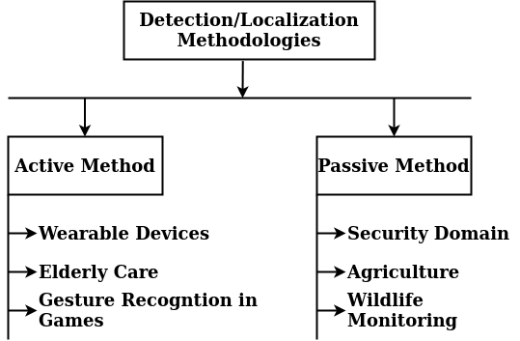
We focus on Passive/Device-free Methods for detection and localization.
Schultheiss PM, Wagner K. Active and passive localization: Similarities and differences. In Underwater Acoustic Data Processing 1989 (pp. 215-232). Springer, Dordrecht.
Notes:
Active Surveillance : In active methodology of surveillance, a target supports the surveillance mechanism by carrying a device with itself. The device collects the vital parameters required for surveillance from surrounding or target body.
Passive Surveillance: Target does not want itself to be monitored, thus does not support surveillance system (Security Domain, In Agriculture, protection of crop field from stray animal

Slide 4
Motivation
Military and civil applications (Outdoor Environment)
No need to associate a device/tag with target body (Passive)
To analyze and understand the effect of a target
Privacy preservation
Notes:
Device free surveillance using non-visual sensors have various military and civil applications in outdoor environment
Military : Camp Protection, Personnel detection, perimeter protection Civil : Agricultural Application : Field protection from stray animal
In some cases it is hard to attach device to target body...Wildlife monitoring
Orientation of a target, speed, shape Mobility of a target: Moving speed, width of a target (width of man vs horse example)

Slide 5
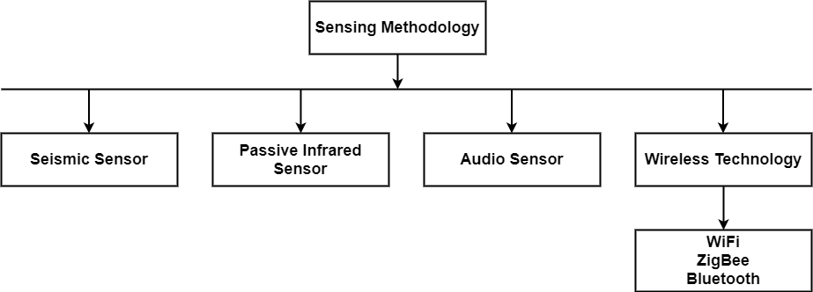
Available Techniques
Notes:
A lot of sensors are available to sense a target in the monitored area. But we will discuss only four methodologies which are
ZigBee 802.15.4 Bluetooth 802.15.1 WiFi 802.11 b/g/n
Now we will go through the related literature one by one for each sensing methodology. Then we will see the research gaps.
Acoustic seismic rf detector, magnetic(B-field), chemical sensor,

Slide 6
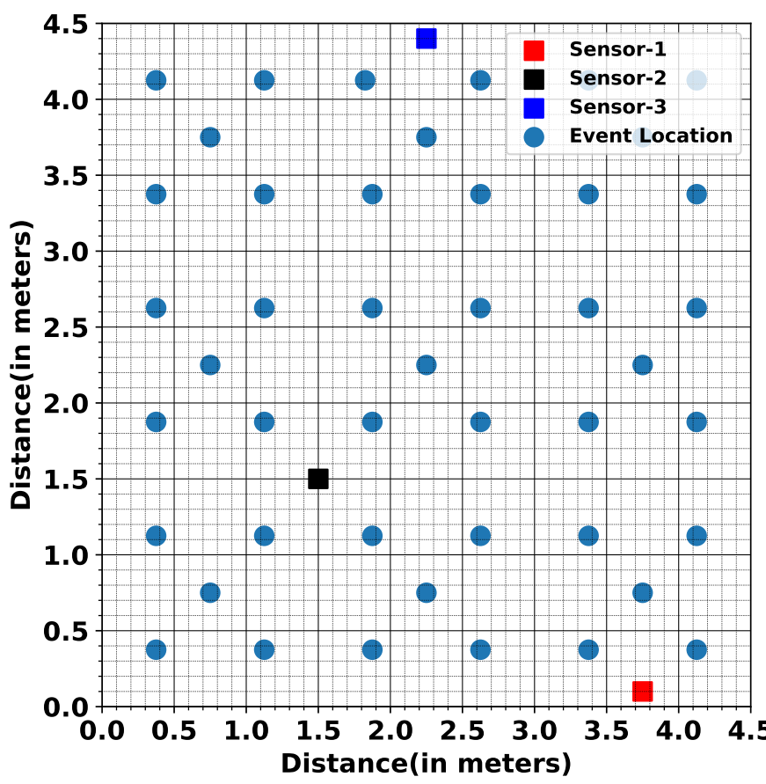
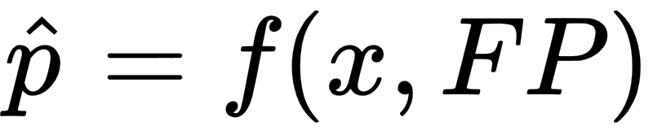
Problem Statement
Area A
Sensors M = 3
Locations L = 45
Explore methods of representing FP, fingerprint of Area
Explore possibilities of mapping function f
Notes:
20.25 m²
The offline phase of fingerprinting is designed for learning the nature at each reference point
Explore methods of collecting FP, fingerprint of Area
Explore methods to extract features from fingerprints of Area
Explore possibilities of mapping function f

Slide 7
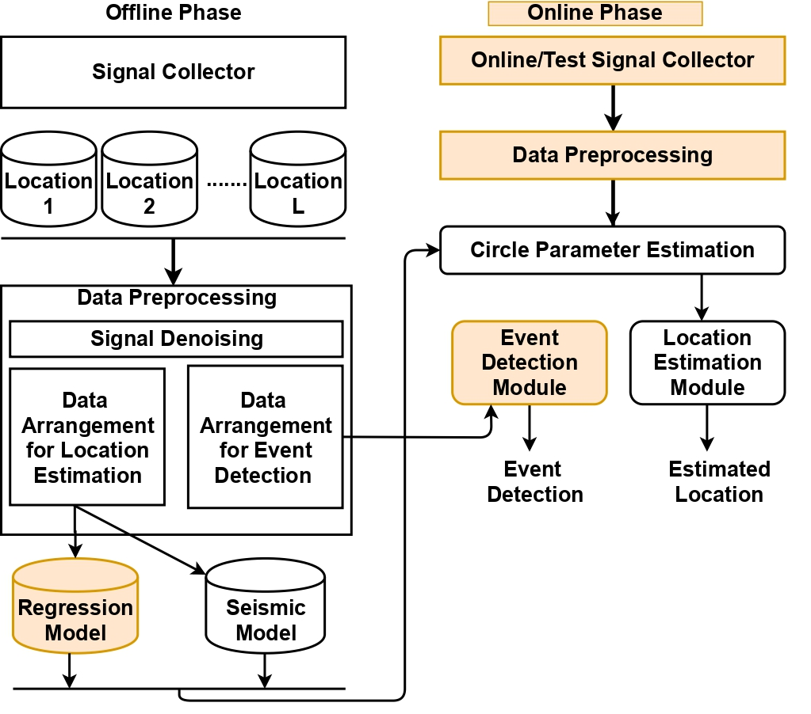
Approach 1
Data Preprocessing (Offline)
Circle Parameter Estimation
Regression
Seismic Property
Location Estimation
Notes:
The Preprocessor module is used to transform sensor readings into required format for regression model and seismic model

Slide 8
Offline Data Preprocessing
Data preprocessing involves the following steps:
Average Noise Computation
Data collection for some activity
Signal denoising
Batch construction
Mean value computation

Slide 9
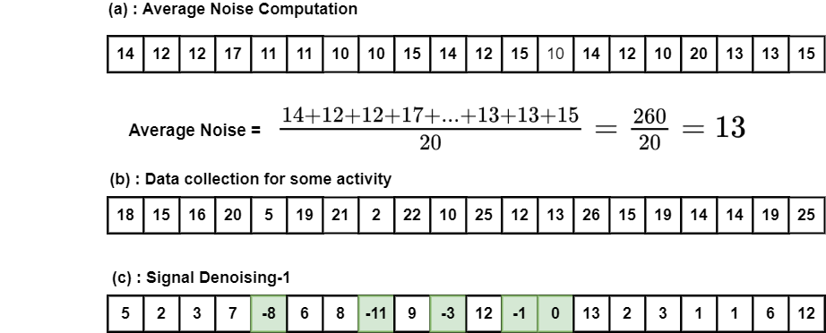

Slide 10
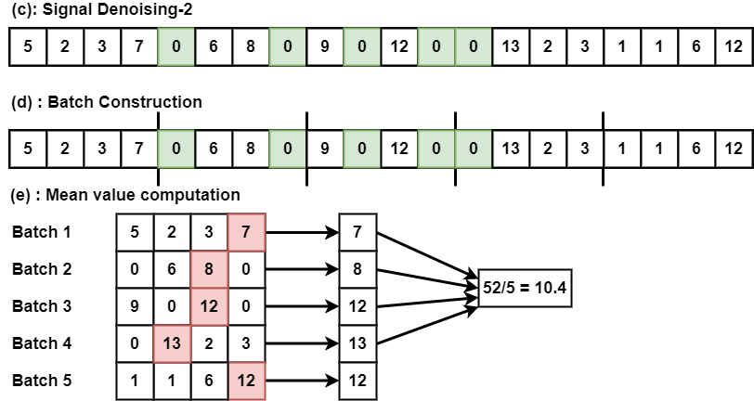
Notes:
Why do we divide data into batch ?
We assume in one batch at least one event happens.
Why do we take maximum?
We want to extract the maximum impact reading with respect to an event within a batch
What is the average of maximum impact of that event.

Slide 11
Input Matrix Construction
At the end of above steps, we get a matrix of size M x L
Each row of matrix is associated with i^{th} location
Create tuple <E, d>
E is the average energy at distance d
d is distance of event from the sensor

Slide 12
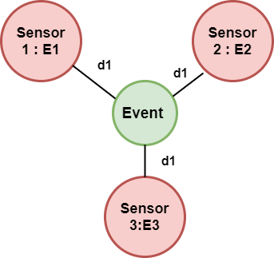




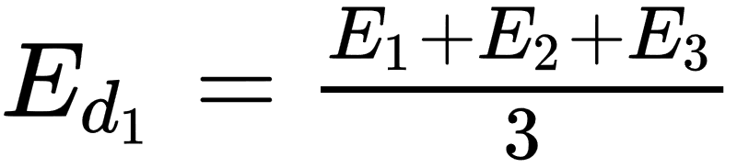

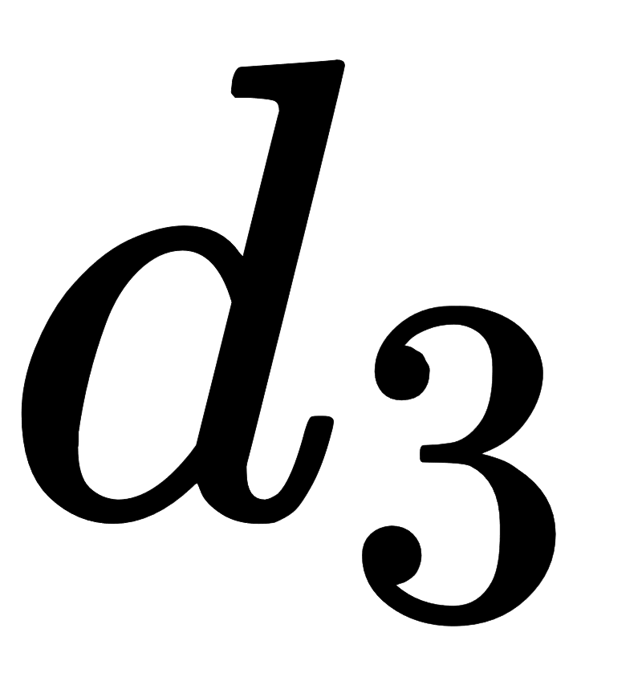


Data Preprocessing & Arrangement
… | ...
Energy-Distance Tuple

Slide 13
Circle Parameters Estimation: Regression
What are circle centers ?
Location of sensors (Known)
What are Radii ?
Distance of an event from sensors. (Unknown)

Slide 14


Circle Parameters Estimation: Regression
How Radii is Estimated?
We train a Decision Tree based Regression¹. on <Energy-Distance> tuple
Independent Variable = Energy values
Dependent Variable = Distance from an event
¹Cappelli C, Mola F, Siciliano R. Selecting Regression Tree Models: A Statistical Testing Procedure. In Advances in Classification and Data Analysis 2001 (pp. 249-256). Springer, Berlin, Heidelberg.

Slide 15
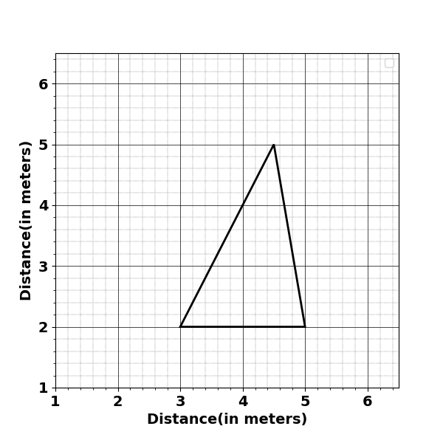
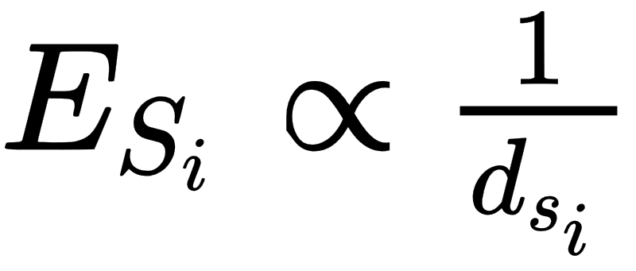
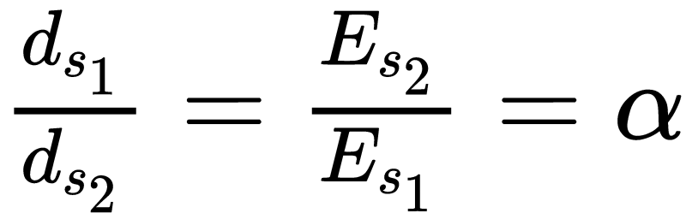
Circle Parameters Estimation: Seismic Property
Event Location (x,y) = (4.3,5)
d_{s1}
d_{s2}
s₁
s₂
Succi GP, Prado G, Gampert R, Pedersen TK, Dhaliwal H. Problems in seismic detection and tracking. In Unattended Ground Sensor Technologies and Applications II 2000 Jul 21 (Vol. 4040, pp. 165-173). International Society for Optics and Photonics.
Notes:
The relation between seismic sensor reading and distance of an event from a sensor is as follows:

Slide 16
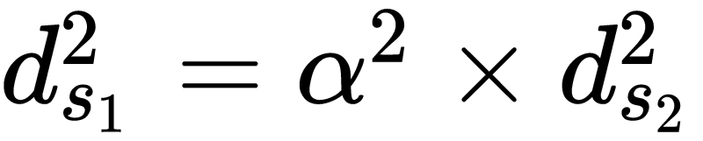
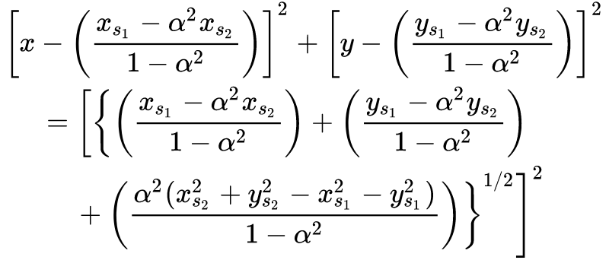
Circle Parameters Estimation: Seismic Property

Slide 17
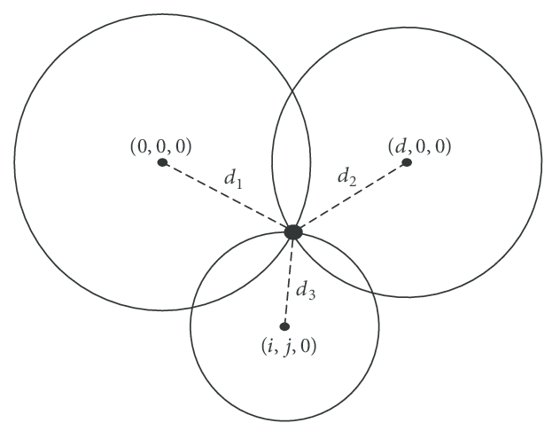
Location Estimation
Idea: Intersection of three circle can be estimated location of a target.

Slide 18
Location Estimation
Problem : Circle drawn with estimated radius may or may not intersect
Solution : Proposed heuristic for location estimation
When two circles do not intersect
When any two circles intersect

Slide 19
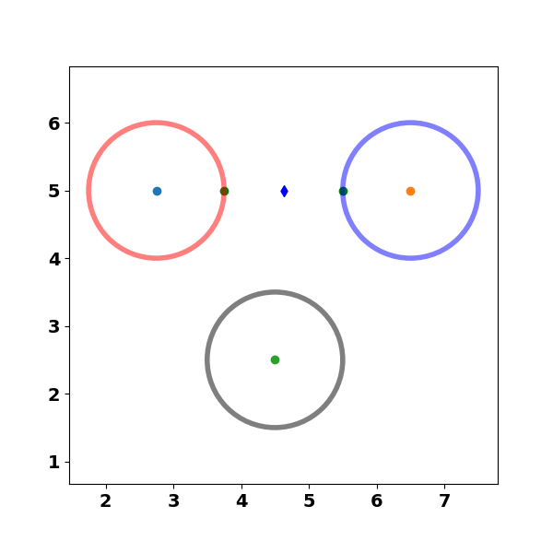
Location Estimation:When two circles do not intersect
Closest pair of points on circle-1 & circle-2
Circle-1
Circle-2
p1
p2
Effective Point
Circle-3
Notes:
Midpoint of the line joining points p1 & p2 i.e. effective points
Each pair of circle produce one effective point
Centroid of three effective points is estimated location of a target/event

Slide 20
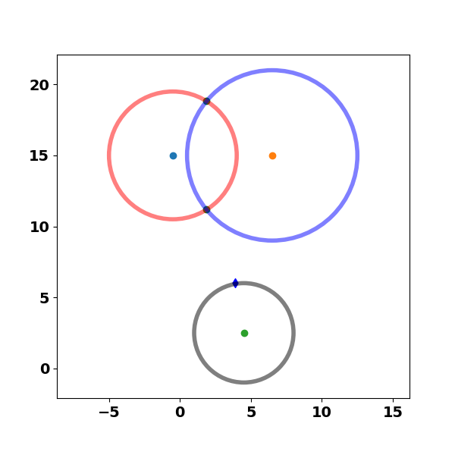
Location Estimation: When two circles intersect
ip2-Intersection Point-2
Circle-1
Circle-2
ip1-Intersection Point-1
Effective Point
p3
Circle-3
Notes:
Identify which intersection point i.e. ip1 and ip2, is the closest to any point on circle-3
The midpoint of line joining ip1 and p3 is one of the effective point
Centroid of three effective points is estimated location of a target/event

Slide 21
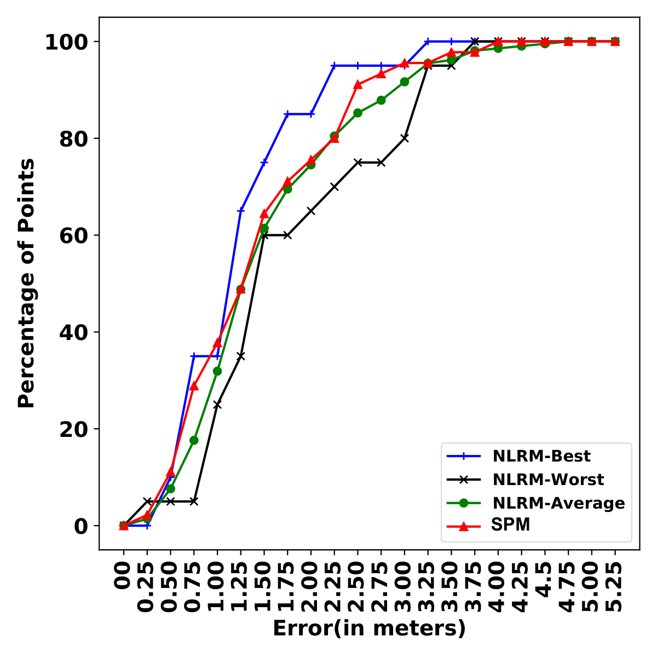
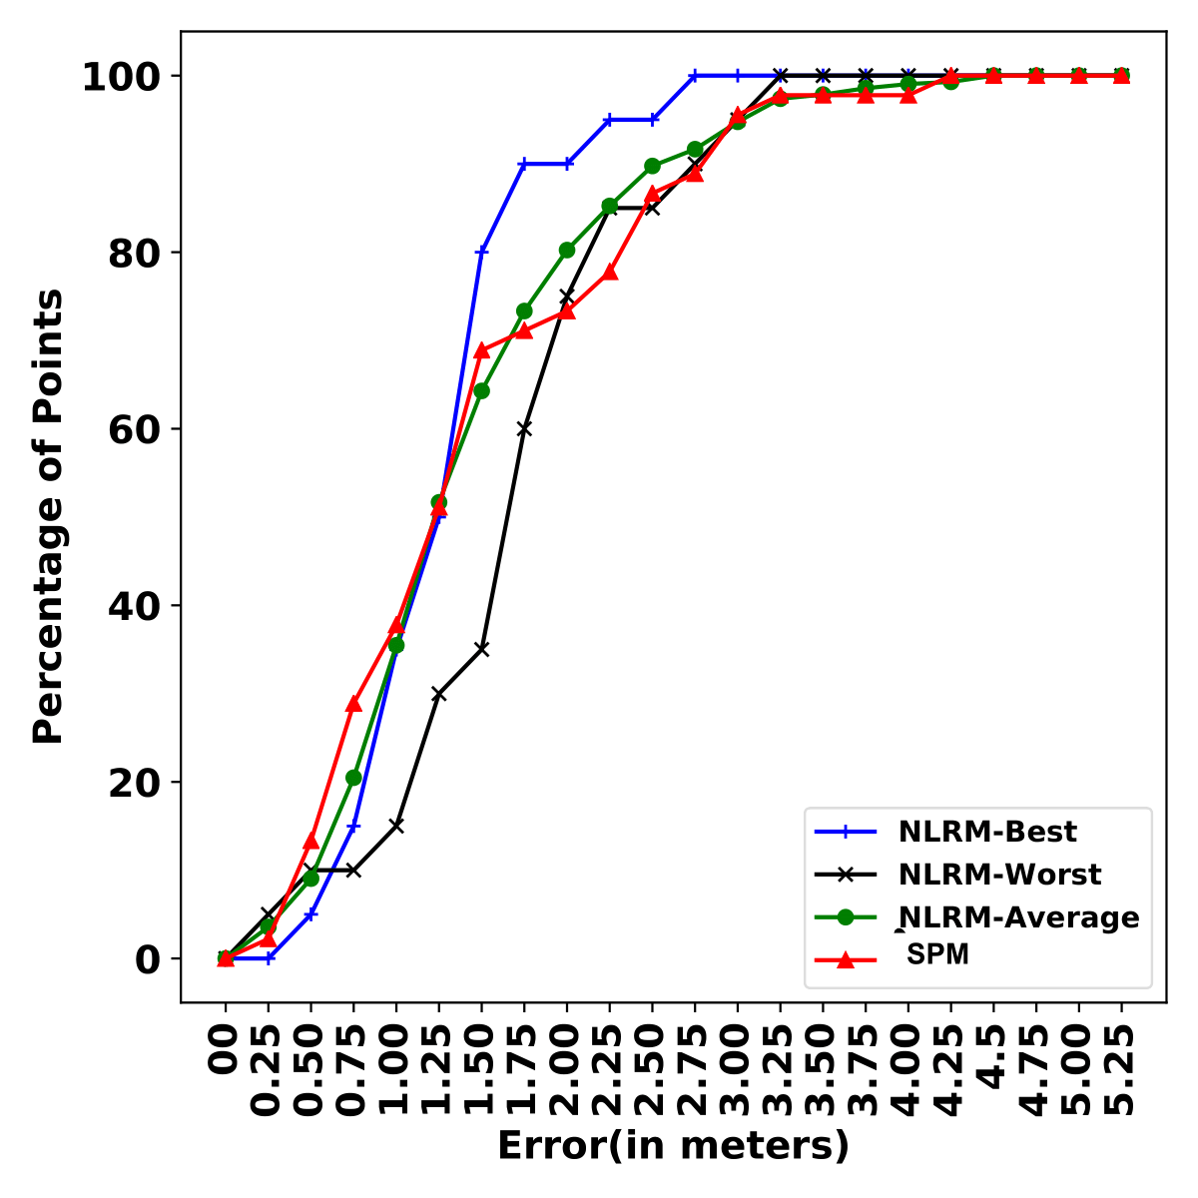
Localization Results
Batch Size = 5 Samples
Batch Size = 10 Samples
Notes:
Below 1 meter=== almost 40 % of points
Below 1.25 meters == almost 50 % of points
Below 1.5 meters == almost 62 % of points

Slide 22
Localization Results
Window Size (seconds) | NLRM (meters) |  |  | SPM (meters)
 | Best Performance | Worst Performance | Average Performance
0.5 | 1.19 | 1.9 | 1.5 | 1.38
1.0 | 1.23 | 1.64 | 1.39 | 1.40
1.5 | 1.22 | 1.75 | 1.37 | 1.26
2.0 | 1.13 | 1.73 | 1.36 | 1.32
Average Performance | 1.19 | 1.70 | 1.40 | 1.34

Slide 23
Future directions
Exploring more on seismic sensors
Cost-performance trade-off
Activity recognition and tracking
Using Audio and PIR sensors for localization
Unified testbed environment
Using Hybrid sensors and data fusion
Notes:
Performance : Localization Accuracy
Cost: operational Cost & Installation Cost
Unified testbed environment: so that we can evaluate the performance of each modality in uniform settings

Slide 24
Questions?

Slide 25
References
Succi GP, Clapp D, Gampert R, Prado G. Footstep detection and tracking. In Unattended Ground Sensor Technologies and Applications III 2001 Sep 27 (Vol. 4393, pp. 22-29). International Society for Optics and Photonics.
Anghelescu P, Iana GV, Tramandan I. Human footstep detection using seismic sensors. In2015 7th International Conference on Electronics, Computers and Artificial Intelligence (ECAI) 2015 Jun 25 (pp. AE-1). IEEE.
Koç G, Yegin K. Footstep and vehicle detection using seismic sensors in wireless sensor network: Field tests. International Journal of Distributed Sensor Networks. 2013 Oct 27;9(10):120386.
Jin X, Gupta S, Ray A, Damarla T. Symbolic dynamic filtering of seismic sensors for target detection and classification. In Proceedings of the 2011 American Control Conference 2011 Jun 29 (pp. 5151-5156). IEEE.
Damarla T, Mehmood A, Sabatier J. Detection of people and animals using non-imaging sensors. In14th International Conference on Information Fusion 2011 Jul 5 (pp. 1-8). IEEE.
Sundaresan A, Subramanian A, Varshney PK, Damarla T. A copula-based semi-parametric approach for footstep detection using seismic sensor networks. In Multisensor, Multisource Information Fusion: Architectures, Algorithms, and Applications 2010 2010 Apr 28 (Vol. 7710, p. 77100C). International Society for Optics and Photonics.
Pan S, Bonde A, Jing J, Zhang L, Zhang P, Noh HY. Boes: building occupancy estimation system using sparse ambient vibration monitoring. In Sensors and Smart Structures Technologies for Civil, Mechanical, and Aerospace Systems 2014 2014 Apr 10 (Vol. 9061, p. 90611O). International Society for Optics and Photonics.
Pan S, Wang N, Qian Y, Velibeyoglu I, Noh HY, Zhang P. Indoor person identification through footstep induced structural vibration. InProceedings of the 16th International Workshop on Mobile Computing Systems and Applications 2015 Feb 12 (pp. 81-86).

Slide 26
Xu T, Wang N, Xu X. Seismic Target Recognition Based on Parallel Recurrent Neural Network for Unattended Ground Sensor Systems. IEEE Access. 2019 Aug 14;7:137823-34.
Damarla R, Ufford D. Personnel detection using ground sensors. In Unattended Ground, Sea, and Air Sensor Technologies and Applications IX 2007 May 1 (Vol. 6562, p. 656205). International Society for Optics and Photonics.
Mukhopadhyay B, Anchal S, Kar S. Person Identification using Seismic Signals generated from Footfalls. arXiv preprint arXiv:1809.08783. 2018 Sep 24.

