Slide 1
DATA ANALYST PORTFOLIO PROJECT
AIRBNB MARKET INTELLIGENCE
& PRICING ANALYSIS
Data-Driven Analysis of Listings, Pricing, Customer Sentiment & Host Performance
Python | Pandas | NumPy | Power BI | Power Query | DAX
An end-to-end data analytics project that transforms Airbnb listing and review data into actionable insights on pricing, neighbourhood performance, customer sentiment and host behaviour.
ANALYTICAL PIPELINE
Raw Data
→
Data Cleaning
→
EDA
→
Data Model
→
Power BI
→
Business Insights
1 / 10

Slide 2
Problem Statement & Objectives
Why this analysis matters, and what it set out to answer
OBJECTIVES
PROBLEM STATEMENT
Analyze listing and pricing patterns
Airbnb hosts and marketplace stakeholders need reliable data-driven insights to understand pricing patterns, neighbourhood differences, room-type performance, customer sentiment and host performance.
1
Compare neighbourhood and room-type performance
2
The objective is to transform raw Airbnb listing and review data into a structured analytical solution that supports better pricing and marketplace decisions.
Analyze customer review sentiment
3
BUSINESS QUESTIONS
Compare Superhost and non-Superhost performance
4
• Which neighbourhoods command higher prices?
• How does room type affect pricing?
Analyze host portfolio concentration
5
• What factors are associated with listing prices?
• Do Superhosts show stronger customer engagement?
Build an interactive Power BI decision-support dashboard
• What does customer sentiment reveal?
6
• How concentrated is the host market?
Generate actionable business recommendations
7
2 / 10

Slide 3
Data Sources & Data Preparation
Two source datasets, cleaned into one analytical model
LISTINGS DATA
REVIEWS DATA
DATA PREPARATION PIPELINE
Raw Airbnb Data
• Listing ID
• Listing ID
↓
• Host information
• Review date
Data Profiling
• Neighbourhood
• Reviewer information
↓
Missing Value Handling
• Room type
• Review comments
↓
• Property type
• Sentiment
Data Type Conversion
• Price
• Sentiment score
↓
Price Cleaning
• Guest capacity
↓
• Availability
Outlier Identification
↓
• Minimum nights
Review Sentiment Processing
• Review metrics
↓
Clean Analytical Dataset
• Host attributes
Data preparation focused on improving consistency, analytical reliability and downstream dashboard performance.
TOOLS
Python • Pandas • NumPy • Matplotlib • Seaborn • Power Query
3 / 10

Slide 4
Project Methodology & Data Model
From business problem to validated business recommendations
METHODOLOGY
STAR SCHEMA DATA MODEL
1
Business Problem
6
Data Modeling
dim_neighbourhood
2
Data Understanding
7
DAX Measures
3
Data Cleaning
8
Power BI Dashboard
dim_room_type
fact_listings
dim_host
4
EDA
9
Validation
fact_reviews
5
Sentiment Analysis
10
Recommendations
dim_date
fact_listings: Listing-level analytical data
fact_reviews: Customer review & sentiment data
dim_host / dim_neighbourhood / dim_room_type / dim_date: Descriptive dimensions
Star-schema modeling was used to improve filtering, measure reuse and analytical scalability. | Power Query → Transformation DAX → Measures Power BI → Visualization
4 / 10

Slide 5
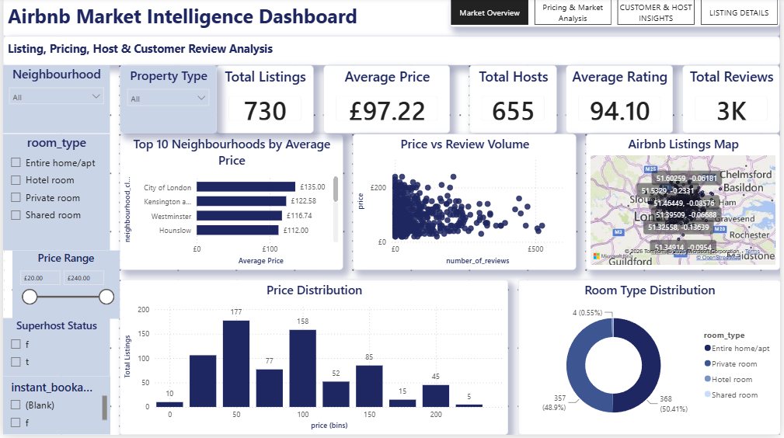
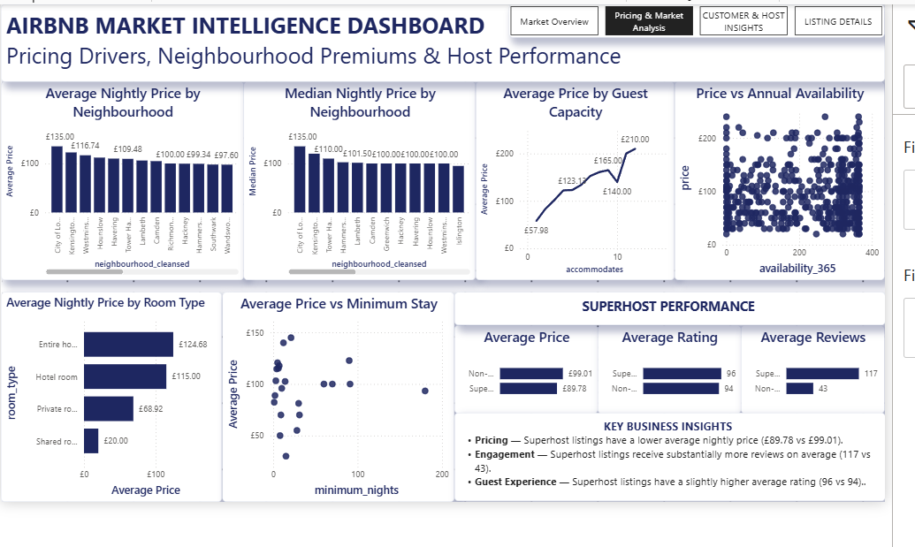
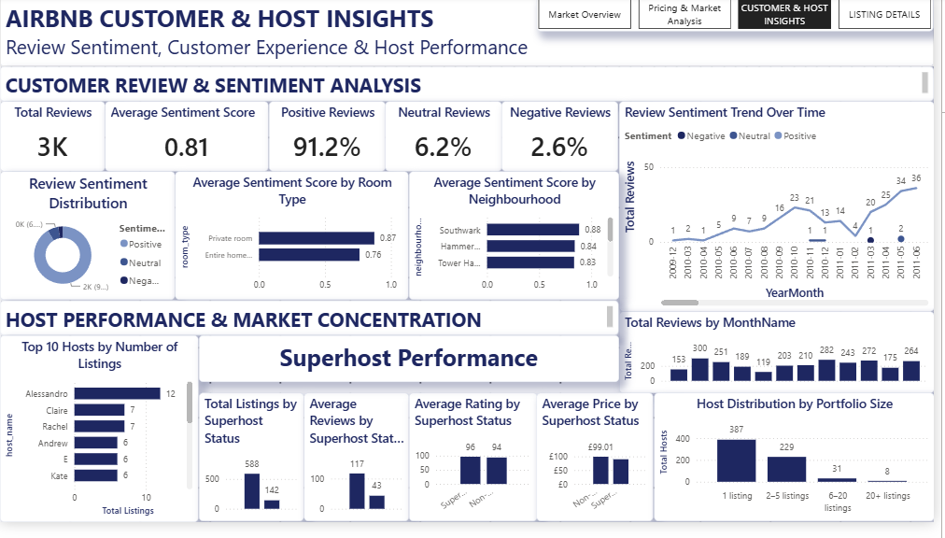
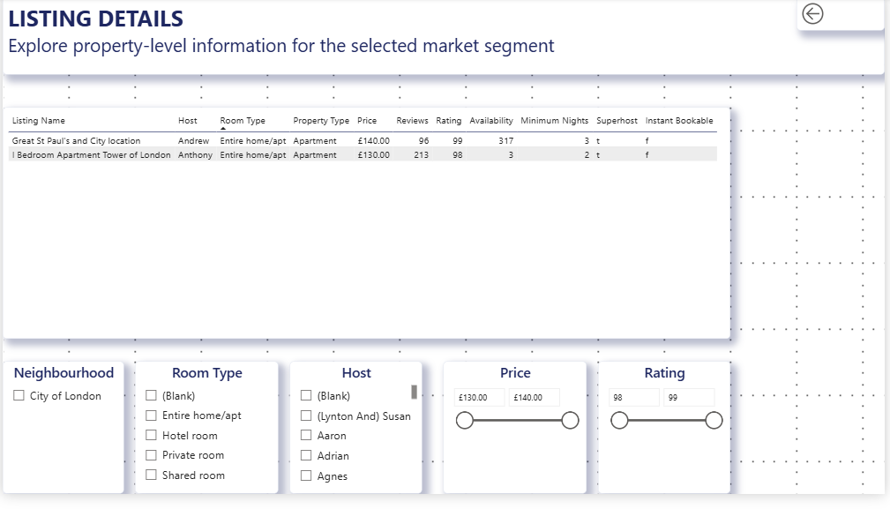
Interactive Power BI Dashboard
4 connected pages — real screenshots from the working dashboard
TECHNICAL DASHBOARD FEATURES
✓ Interactive slicers
✓ Cross-filtering
✓ Page navigation
✓ Report-page tooltips
01 — Market Overview
02 — Pricing & Market Analysis
✓ Drill-through
✓ DAX measures
✓ Data model relationships
✓ Geographic analysis
“Designed as an interactive decision-support dashboard rather than a static reporting page.”
03 — Customer & Host Insights
04 — Listing Details
5 / 10

Slide 6
Market Overview & Pricing Insights
Market Overview dashboard page — KPIs and headline pricing patterns
DASHBOARD KPIS
Total Listings
730
Average Price
£97.22
Total Hosts
655
Average Rating
94.10
Total Reviews
3K
ROOM TYPE PRICING
Entire home/apt
£124.68
Hotel room
£115.00
Private room
£68.92
Shared room
£20.00
City of London shows the highest visible average nightly price (~£135). Pricing varies significantly by neighbourhood and room type, so hosts should use segment-level benchmarks rather than relying only on the citywide average.
6 / 10

Slide 7
Pricing Drivers & Host Performance
Pricing & Market Analysis dashboard page
SUPERHOST PERFORMANCE
Metric
Non-Super
Superhost
Avg. Price
£99.01
£89.78
Avg. Rating
94
96
Avg. Reviews
43
117
Superhost listings show substantially higher review volume and slightly higher ratings, while their average nightly price is lower in this dataset.
Neighbourhood, room type and property characteristics are associated with meaningful differences in listing prices.
Pricing and host-performance analysis should be evaluated together rather than using price as the only indicator of listing performance.
7 / 10

Slide 8
Customer Sentiment & Host Market Insights
Customer & Host Insights dashboard page
SENTIMENT KPIS
Total Reviews
3K
Avg. Sentiment Score
0.81
Positive
91.2%
Neutral
6.2%
Negative
2.6%
HOST PORTFOLIO SIZE
1 listing
387
2–5 listings
229
6–20 listings
31
20+ listings
8
The analyzed review dataset is strongly positive, with 91.2% of reviews classified as positive.
Customer sentiment provides a strong view of guest experience, while host concentration reveals the structure of marketplace participation.
8 / 10

Slide 9
Key Insights & Business Recommendations
Observation → Implication → Recommendation
Location
Room Type
Superhost Engagement
Customer Sentiment
Pricing Strategy
OBSERVATION
OBSERVATION
OBSERVATION
OBSERVATION
OBSERVATION
City of London has the highest visible average nightly price.
Entire home/apt listings command substantially higher average prices than private and shared rooms.
Superhost listings average ~117 reviews vs. 43 for non-Superhosts.
91.2% of reviews are classified as positive.
Prices vary across neighbourhoods, room types and listing characteristics.
IMPLICATION
IMPLICATION
IMPLICATION
IMPLICATION
IMPLICATION
Location contributes to meaningful pricing differences.
Different room types operate in different pricing segments.
Superhost listings show stronger customer engagement in this dataset.
Overall customer sentiment is strongly positive.
A single pricing benchmark can hide local opportunities.
RECOMMENDATION
RECOMMENDATION
RECOMMENDATION
RECOMMENDATION
RECOMMENDATION
Use neighbourhood-specific pricing benchmarks.
Compare listings against similar room types.
Focus on guest experience, responsiveness and service quality.
Identify recurring positive themes and maintain the service factors driving satisfaction.
Use segmented pricing benchmarks based on neighbourhood, room type and property characteristics.
OVERALL BUSINESS RECOMMENDATION
Adopt a segmented, data-driven pricing strategy that combines location, room type, property characteristics, customer engagement and host performance.
9 / 10

Slide 10
Conclusion — From Raw Data to Business Decisions
Raw Data
→
Clean & Transform
→
Explore
→
Model
→
Measure
→
Visualize
→
Validate
→
Recommend
WHAT THIS PROJECT DEMONSTRATES
✓ Business Problem Framing
✓ Data Cleaning
✓ Data Wrangling
✓ Exploratory Data Analysis
✓ Python / Pandas / NumPy
✓ Sentiment Analysis
✓ Power Query
✓ Star Schema
✓ Data Modeling
✓ DAX
✓ KPI Development
✓ Power BI
✓ Interactive Dashboards
✓ Slicers & Cross Filtering
✓ Page Navigation
✓ Report Tooltips
✓ Drill-through
✓ Data Validation
✓ Business Insights
✓ Data-Driven Recommendations
“This project demonstrates the ability to transform raw business data into a structured analytical model, communicate insights through interactive dashboards, and translate findings into actionable business recommendations.”
DATA ANALYST MINDSET: “Don't just report what happened — explain why it matters and what decision should follow.”
10 / 10

