Slide 1
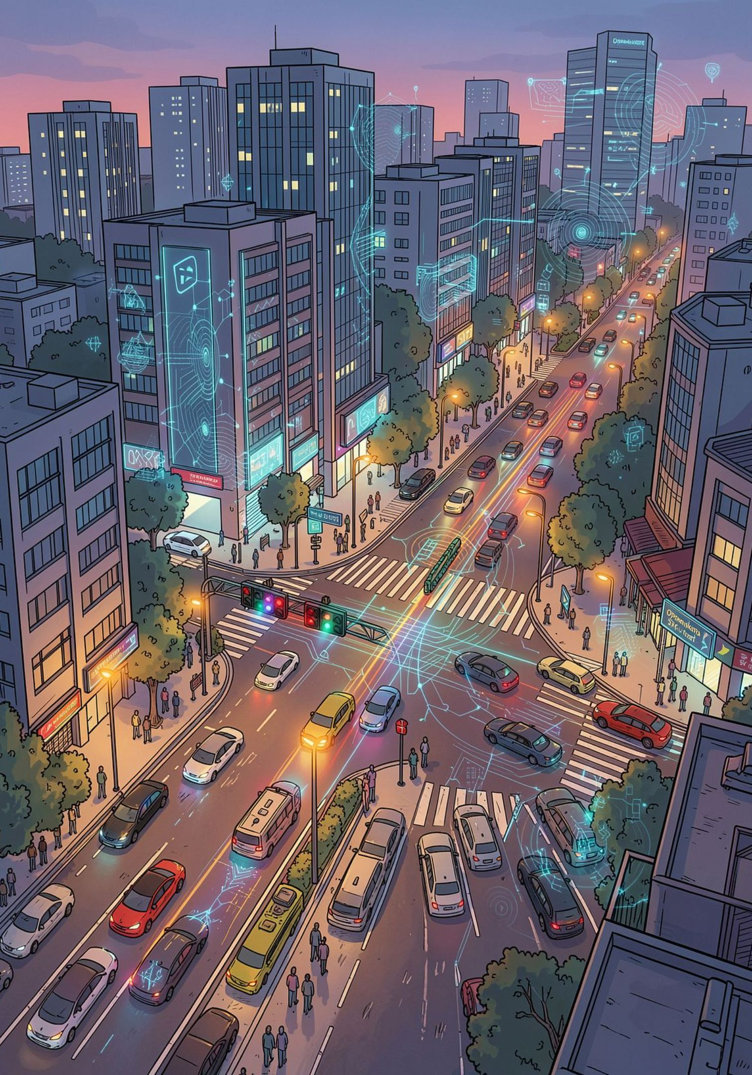
AI-Based Adaptive Traffic Signal Management
AI-Powered Traffic Optimization for Busy Intersections — Oppanakara Street, Coimbatore

Slide 2
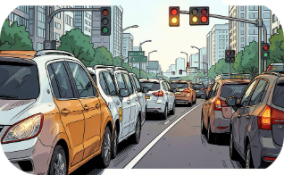
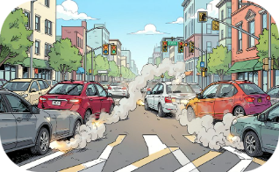
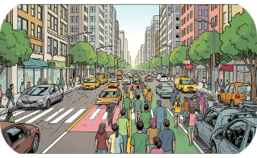
The Problem at Oppanakara Street
Peak-hour congestion
Long waiting times & idling
Uneven traffic flow
Lane-wise demand fluctuates rapidly; static schedules misallocate green time.
Frequent vehicle queues reduce throughput on this key commercial corridor.
Fixed timings cause unnecessary idle time and driver frustration.

Slide 3
Why Adaptive Traffic Signals?
Traditional Fixed Signal Control
AI-Based Adaptive Signal Control
Pre-set cycles based on historical assumptions
Poor responsiveness to sudden demand changes
Inefficient during off-peak and surge events
Responds to real-time observations at the intersection
Dynamically reallocates green-time by demand
Seeks to minimize waiting and smooth flow, lane-wise
Adaptive control prioritizes live traffic patterns at Oppanakara Street rather than fixed schedules.

Slide 4
Project Objectives
Monitor
Detect & Classify
Analyze
Continuously capture traffic conditions at Oppanakara Street.
Identify vehicles, bikes, buses and lane distribution in real time.
Estimate density, queue lengths, and directional flow.
Adapt
Optimize
Dynamically adjust signal timing to current demand to reduce waiting.
Improve movement efficiency while maintaining safety for all road users.

Slide 5
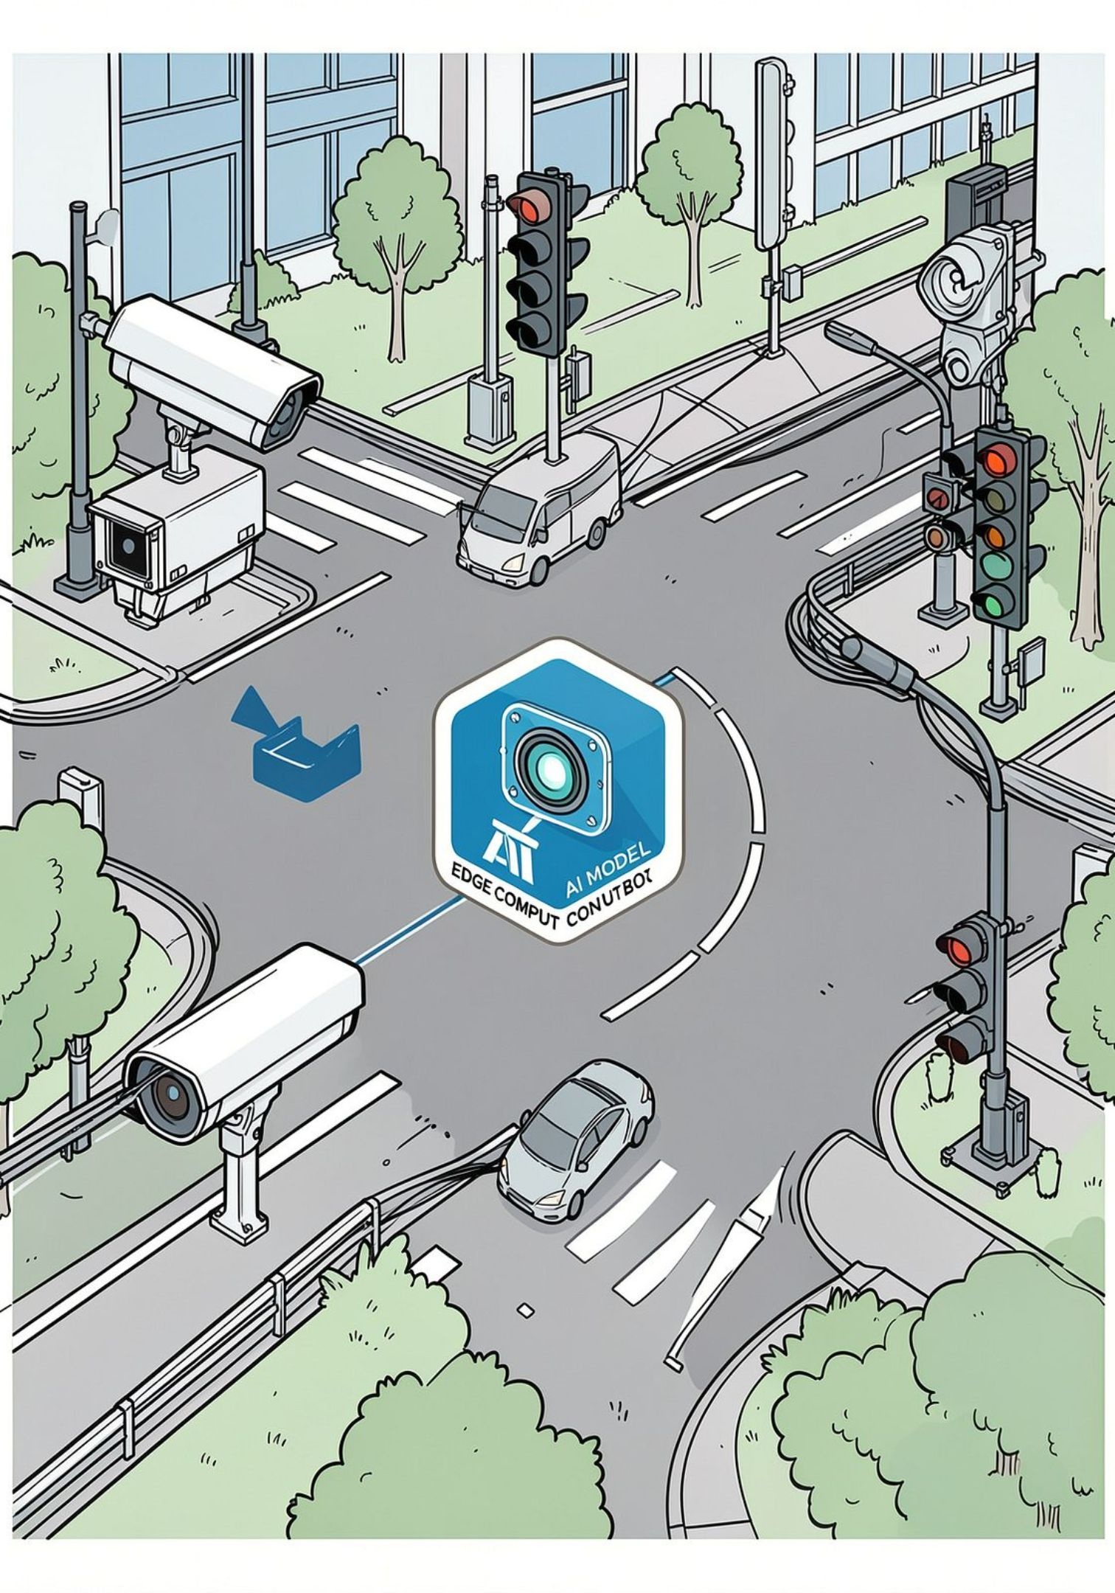
Proposed AI-Based Solution
An on-site sensing and AI processing pipeline observes traffic at Oppanakara Street, classifies vehicles and estimates lane-wise demand, then issues adaptive timing commands to the signal controller to better match green allocation with instantaneous demand.

Slide 6

How the System Works
Observe Traffic
Detect Vehicles
Classify & Analyze
Estimate Flow
Each step runs continuously with short latency to ensure signals react to current conditions rather than historical plans.

Slide 7
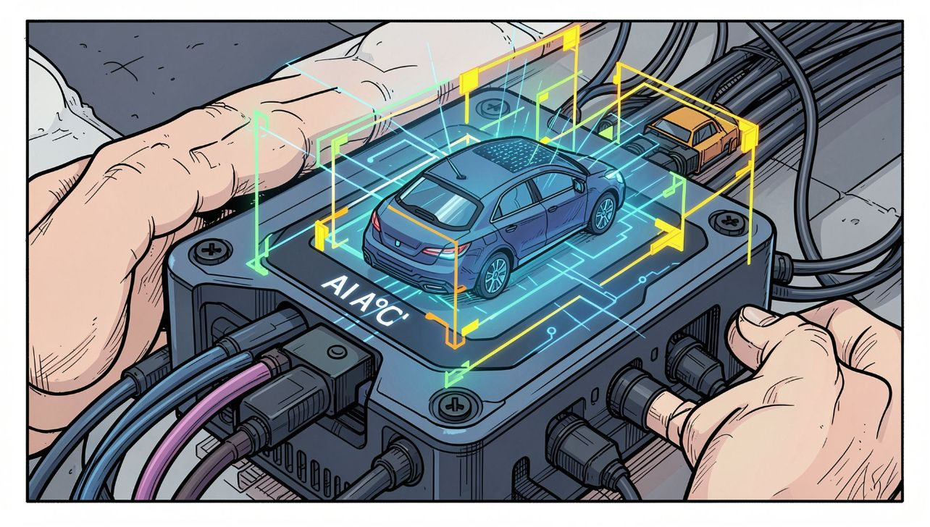
Vehicle Detection & Traffic Analysis
Vehicle detection: bounding boxes and tracking for count and queue length.
Classification: differentiate two-wheelers, cars, buses, and commercial vehicles.
Lane-wise estimation: per-lane density and directional flow.
Temporal analysis: short-term demand trends to avoid oscillation.
Accurate detection and lane-level awareness are prerequisites for safe, effective adaptive timing at Oppanakara Street.

Slide 8
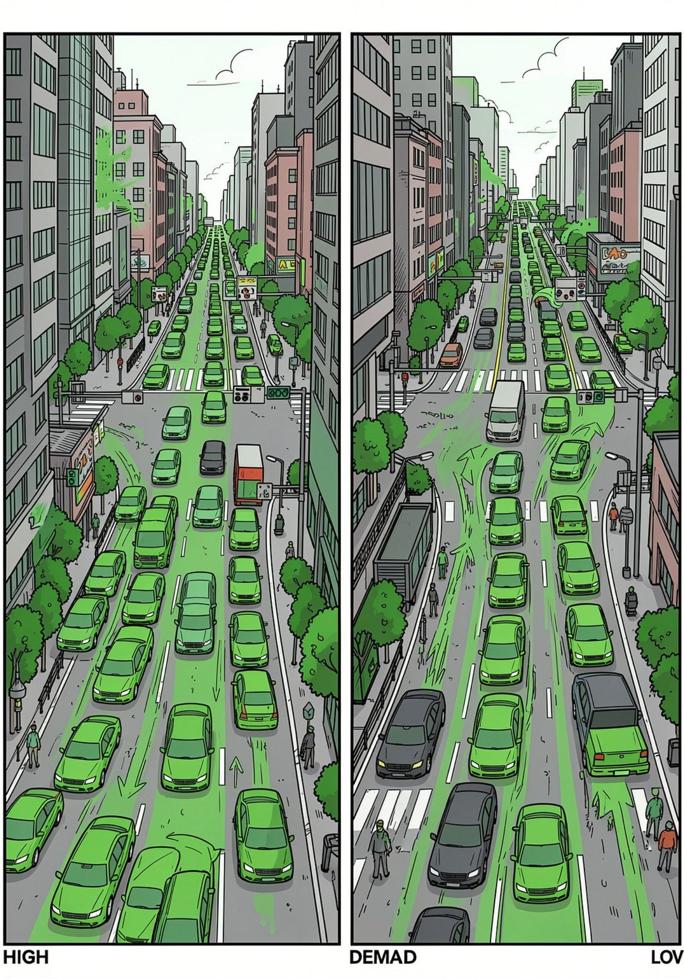
Adaptive Signal Management — Oppanakara Street
High demand
Low demand
AI increases green allocation for congested approaches to clear queues efficiently.
AI reduces unnecessary green time, minimizing idle signal phases and delays for cross traffic.
Operations remain governed by safety constraints and pedestrian crossing requirements; the system optimizes within those limits for Oppanakara Street.

Slide 9





Expected Impact
Lower waiting times (expected)
Reduced congestion (expected)
More responsive green-time allocation reduces average queue durations at peak periods.
Improved throughput during variable demand periods along Oppanakara Street.
Reduced unnecessary idling (expected)
Better utilization of green time
Less idle time at signals lowers fuel waste and local emissions.
Green phases aligned with actual traffic patterns and lane demand.
These are expected outcomes conditional on correct sensing, model performance, and safe signal actuation. No measured values are asserted here.

Slide 10
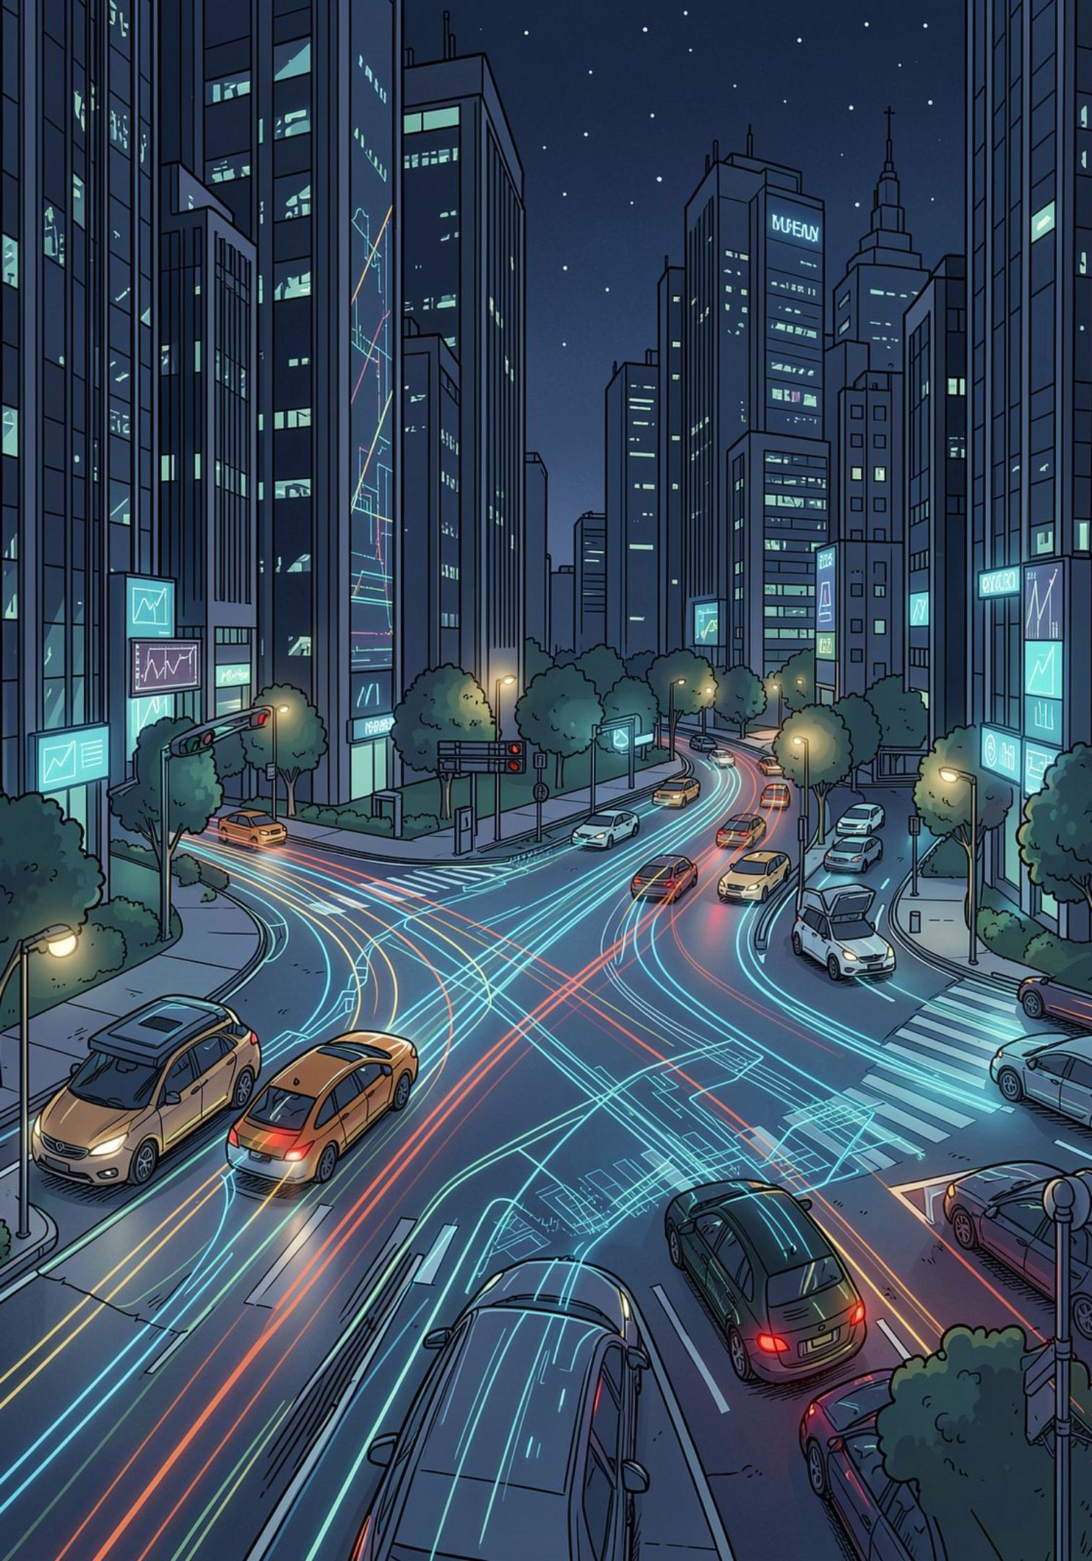
Future Scope & Conclusion
Future Scope
Conclusion
Real-time short-term traffic prediction to anticipate surges.
Advanced AI decision strategies incorporating pedestrian and transit priority.
Integration of additional sensor inputs (e.g., IoT detectors, signalized bus priority) for richer context.
Continuous model refinement from on-site data at Oppanakara Street.
AI-based adaptive signal management offers a practical, responsive approach to reduce congestion and waiting at Oppanakara Street. With careful implementation—robust sensing, validated models, and safety-first signal control—the project can make intersection operation more efficient and better aligned with real traffic demand.

