Slide 1

conversational uI 101
By PRIYANKAR KUMAR, SOFTWARE ENGINEER, MICROSOFT

Slide 2
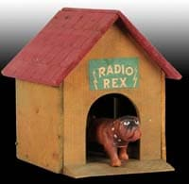
Quick quiz
What’s this?

Slide 3
ANSWER
Radio Rex was the first voice activated toy released in 1911!

Slide 4
QUESTION 2
What happened in the world of voice assistants in October 2011?

Slide 5
ANSWER
Siri was integrated into iPhone4S at its release in October 2011 and the world of voice hasn’t looked back ever since!

Slide 6
BUT WHAT IS A CONVERSTAIONAL UI?
Historically: GUI and Text based interfaces were used
A conversational interface (CUI) is a user interface for computers that emulates a conversation with a real human.
Two main categories: voice assistants and chatbots
The workshop mainly focuses on development for voice assistants

Slide 7
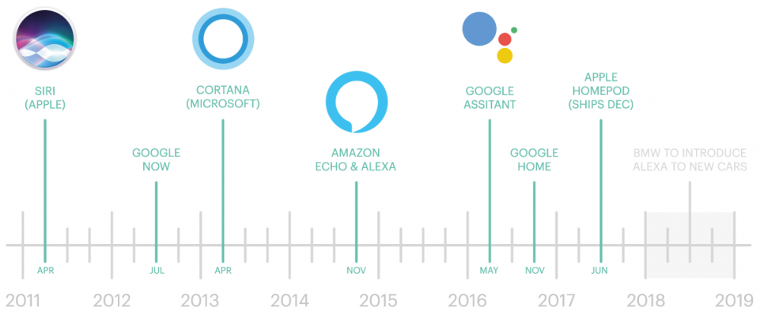
BRIEF HISTORY OF VOICE ASSISTANTS
Source: https://www.kdnuggets.com/2019/09/build-your-first-voice-assistant.html

Slide 8
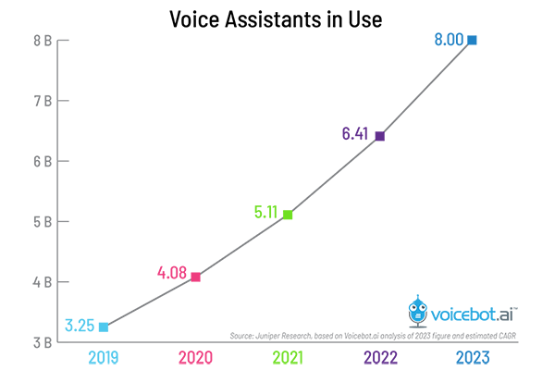
CONTINUED…
Juniper estimates 3.25 billion voice assistants are in use today and this is projected to increase.

Slide 9
WHAT DOES THIS MEAN FOR YOU?
As developers it means we get to work towards building the future of voice!

Slide 10
POPULAR PLATFORMS FOR VOICE APP DEVELOPMENT
Microsoft: “skills” for Cortana
Google: Dialogflow for building “Actions” on Google
Amazon: Building “Skills” for Alexa
Samsung: Build apps for “Bixby”
And many many more…

Slide 11
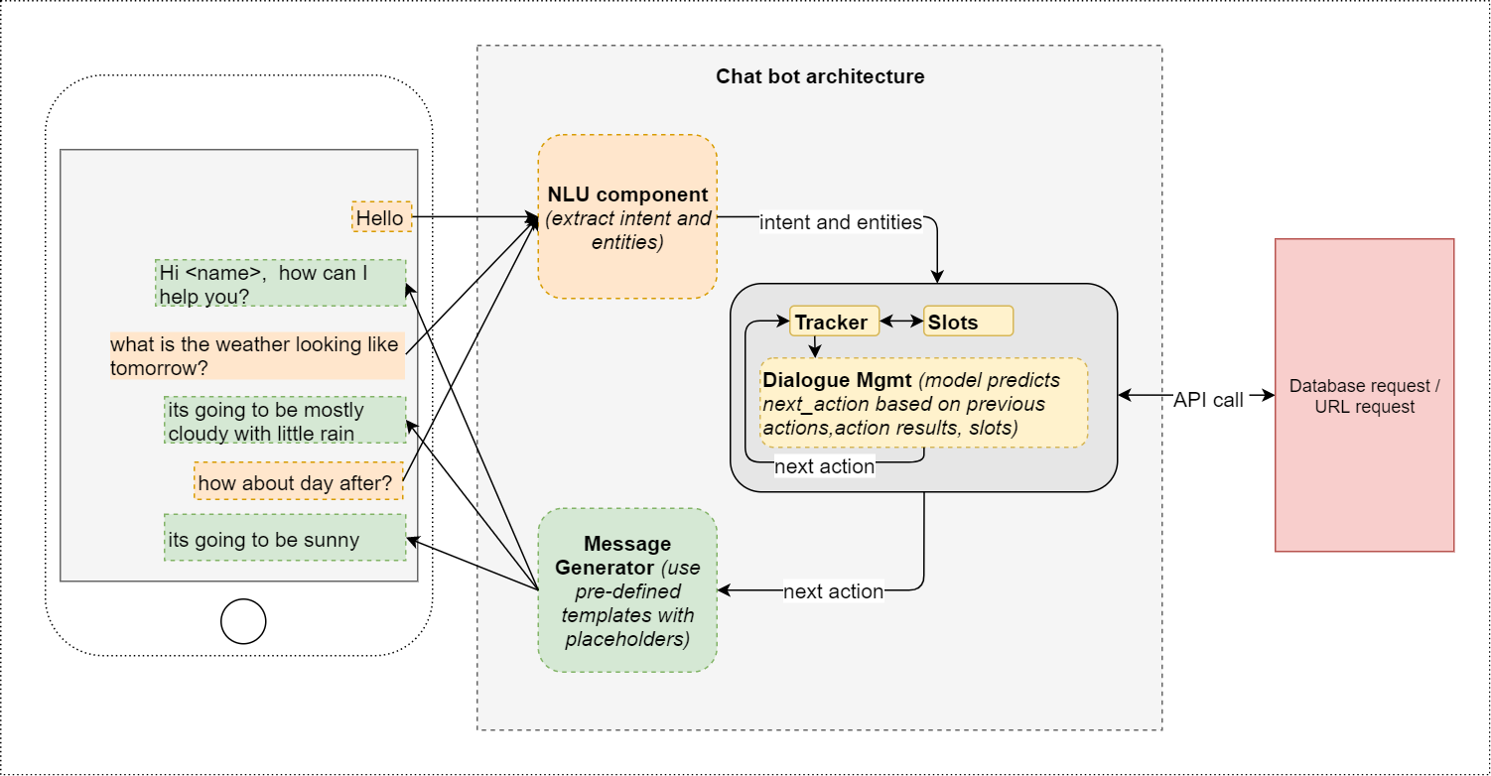
TYPICAL Conversational ui ARCHITECTURE
Source: https://towardsdatascience.com/architecture-overview-of-a-conversational-ai-chat-bot-4ef3dfefd52e

Slide 12
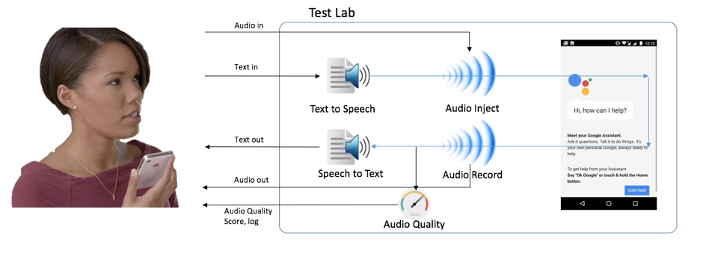
VUI FLOW
Source: https://chatbotslife.com/ensuring-quality-of-voice-first-chatbots-a174b4b79644

Slide 13
UNDERSTANDING INTENTS, UTTERANCES AND SLOTS
LETS UNDERSTAND THIS THROUGH AN EXAMPLE:
Intent Name: WhenConductWorkshopIntent, WhereConductWorkshopIntent
Utterances: what workshop will be conducted today, where is the React workshop being conducted
Slots: today, React

Slide 14
ENOUGH THEORY! TIME TO GET PRACTICAL!!
HEAD TO: https://github.com/priyankark/FacebookDevCHydConversationalAI
(shorturl.at/uBCJY)

