Slide 1
Manual Testing

Slide 2
What is testing?
Testing is a process where we ensure product/service is error free.
In software testing that product is a software.

Slide 3
What are different types of software?
Web Applications
Mobile Applications
Desktop Applications like notepad, antivirus, Microsoft ppt,excel
Gaming application

Slide 4
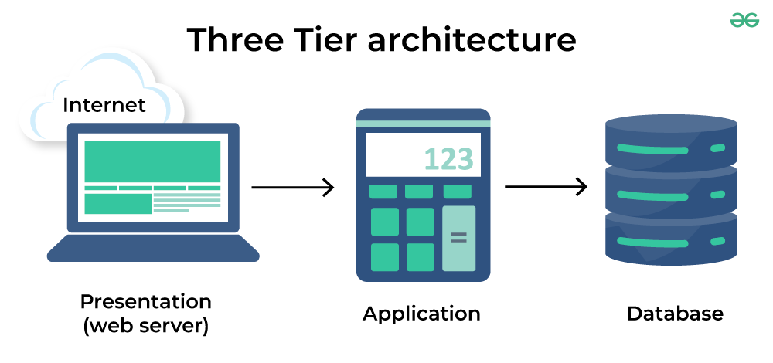
What is 3-tier architecture of a software?

Slide 5
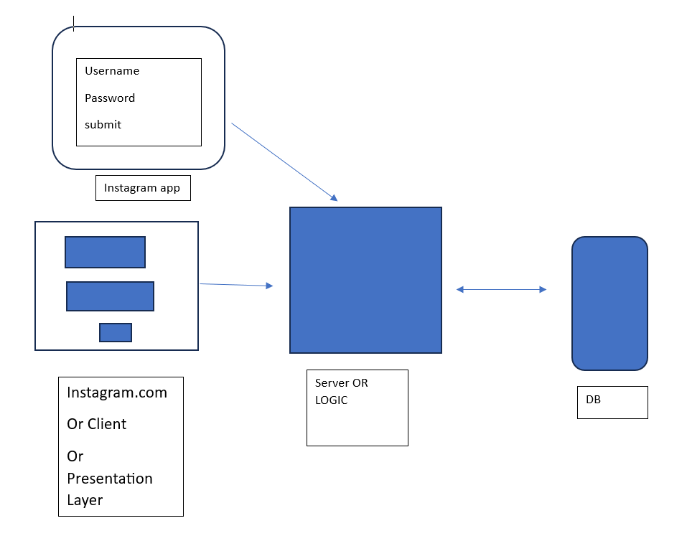
3-tier architecture

Slide 6
What is software testing
Software testing is a process of verifying and validation the software product.
Eg=Instagram application on my phone

Slide 7
Manual testing is the process of manually testing software for defects. It requires a tester to play the role of an end user where by they use most of the application's features to ensure correct behaviour.
Any new application must be manually tested before its testing can be automated. Manual Software Testing requires more effort but is necessary to check automation feasibility. Manual Testing concepts does not require knowledge of any testing tool. One of the Software Testing Fundamental is “100% Automation is not possible“. This makes Manual Testing imperative.

Slide 8
Product based vs service based companies
Product Based companies are the ones that produce high-end products in order to satisfy their customers’ requirements. These companies are focused on introducing or producing products that have a high market value. These are the companies that keep on improving their products and upgrading their technologies in order or be in the market. Some of the popular product-based companies are Amazon, HP, Microsoft, Facebook, Adobe, Intel, Informatica, Amdocs, CISCO, etc.
Service-based companies are the ones that do not have a particular product but their primary business is to provide services. If we talk more clearly then they work for other organizations or have client-based products. The services they provide are intangible and can be provided in the terms of expertise, amenities, or skills. These companies generally provide less salary compared to product-based companies. Some of the popular service-based companies are TCS, Infosys, Wipro, Tech Mahindra, etc.

Slide 9
Product Based Companies
Zomato
Paytm
Ola
Amazon
Google

Slide 10
Service Based Company
Infosys
Wipro
TCS
Cognizant
Accenture
Tech Mahindra

Slide 11
Duxcon.com-------------→Infosys
[3 months=10lakhs]
Infosys is a service based company
DPS an e-card through student attendance could be recorded
if fees is not paid not allow enter
--------→Infosys [20lakhs=6 months]

Slide 12
DPS----------→TCS 5 months=15lakh
TCS is a service based

Slide 13
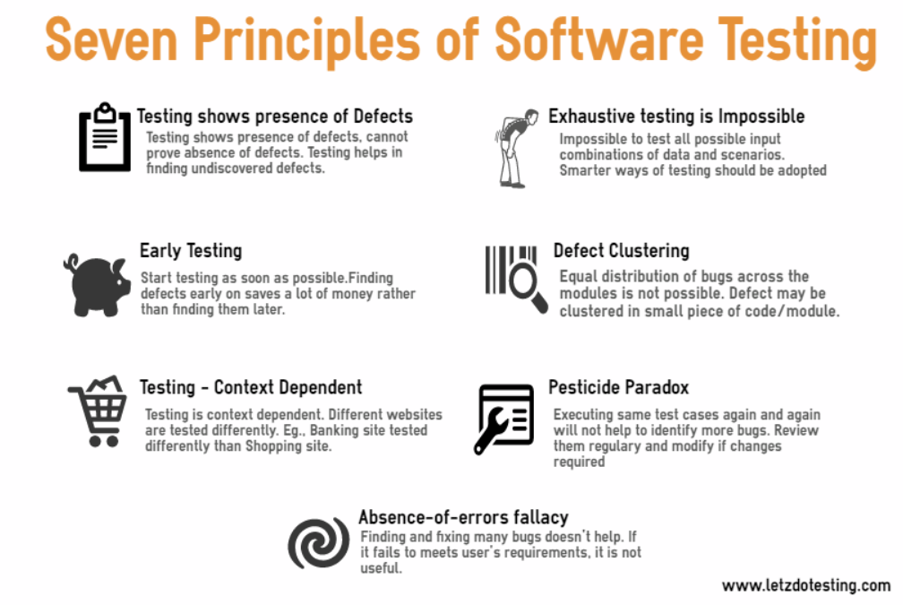
7 principle of software testing

Slide 14
1. Exhaustive testing is not possible
2. Early testing
3. defect clustering:90% of defects are in 10% of the modules
4. pesticide paradox:
5. testing shows presence of defect
6. testing is context dependent
7. absence of error fallacy: product would never be bug free

Slide 15
SDLC(Software Development Life Cycle)
SDLC is a systematic process for building software that ensures the quality and correctness of the software built. SDLC process aims to produce high-quality software that meets customer expectations. The system development should be complete in the pre-defined time frame and cost. SDLC consists of a detailed plan which explains how to plan, build, and maintain specific software.

Slide 16
SDLC phases
The entire SDLC process divided into the following SDLC steps:
SDLC Phases
Phase 1: Requirement collection and analysis
Phase 2: Design
Phase 3: Coding
Phase 4: Testing
Phase 5: Installation/Deployment
Phase 6: Maintenance

Slide 17
Requirement Gathering: Phase 1
Mr Roy[customer] would tell his requirement to Infosys[service provider] Project Manager =MBA. He doesn’t know coding.
Write all the requirements whatever needs
He will tell him the budget
He will also ensure deadline
SRS document [Software Requirement Specification ]document is prepared where all the requirements of customers are written and is signed by both PM and customer.

Slide 18
Phase 2: Designing
Technical Lead(6-8 yrs experience) architecture of the project

Slide 19
Phase 3: Development
Senior developers and junior developers would work together to develop the application

Slide 20
Phase 4 : Testing
Senior Tester and Junior testers would ensure that the product is bug -free

Slide 21
Phase 5: Deployment
Build is deployed on server from where everyone can access it is called deployment

Slide 22
Phase 6: Maintenance
After the site is delivered to the client. Client comes back to Infosys with additional change requests. And for this new budget is given to Infosys.

Slide 23
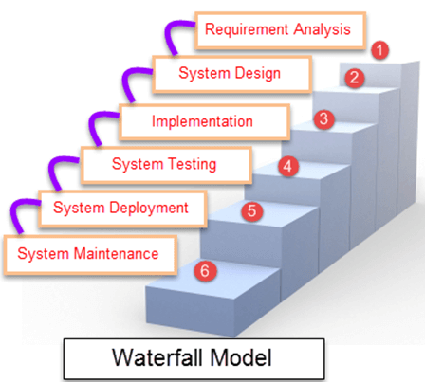
Waterfall model
Waterfall Model is a sequential model that divides software development into pre-defined phases. Each phase must be completed before the next phase can begin with no overlap between the phases. Each phase is designed for performing specific activity during the SDLC phase. It was introduced in 1970 by Winston Royce.

Slide 24
Spiral model
Spiral Model is a risk-driven software development process model. It is a combination of waterfall model and iterative model. Spiral Model helps to adopt software development elements of multiple process models for the software project based on unique risk patterns ensuring efficient development process.
Each phase of spiral model in software engineering begins with a design goal and ends with the client reviewing the progress. The spiral model in software engineering was first mentioned by Barry Boehm in his 1986 paper.

Slide 25
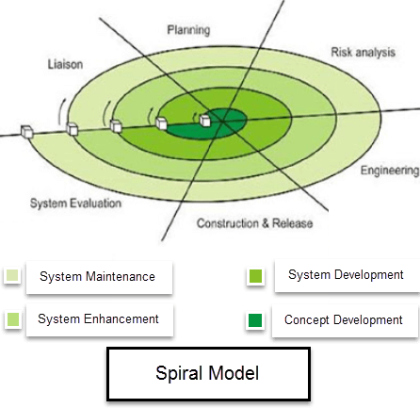

Slide 26
prototype
Prototyping Model is a software development model in which prototype is built, tested, and reworked until an acceptable prototype is achieved. It also creates base to produce the final system or software. It works best in scenarios where the project’s requirements are not known in detail. It is an iterative, trial and error method which takes place between developer and client.

Slide 27
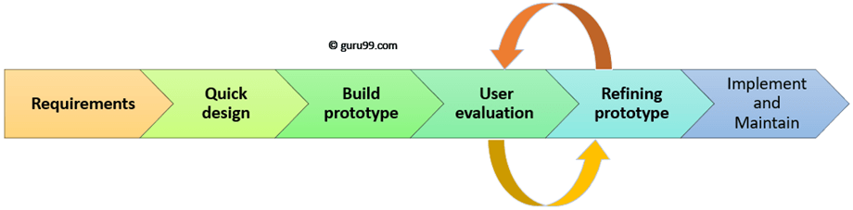

Slide 28
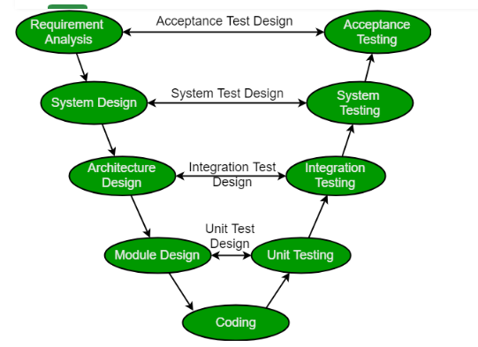
v&v model
The V-model is a type of SDLC model where process executes in a sequential manner in V-shape. It is also known as Verification and Validation model. It is based on the association of a testing phase for each corresponding development stage. Development of each step directly associated with the testing phase. The next phase starts only after completion of the previous phase i.e. for each development activity, there is a testing activity corresponding to it.

Slide 29
Verification: It involves static analysis technique (review) done without executing code. It is the process of evaluation of the product development phase to find whether specified requirements meet.
Validation: It involves dynamic analysis technique (functional, non-functional), testing done by executing code. Validation is the process to evaluate the software after the completion of the development phase to determine whether software meets the customer expectations and requirements.

Slide 30
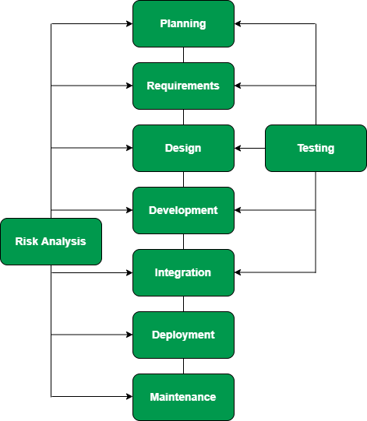
Hybrid model
A hybrid Model is a model which is developed by combining two traditional models of SDLC. The base models can be anyone like a spiral model, V&V model, prototype model, etc. and the selection of models are as per requirements. By collaborating two base models the resulting hybrid Model acquires its properties, process, and benefits which results in building a more powerful, flexible, and effective Model. The combination of traditional models can be like:

Slide 31
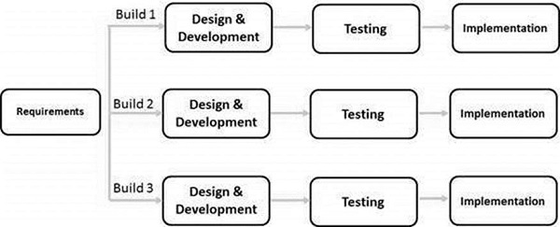
Iterative/incremental model

Slide 32
The RAD (Rapid Application Development) SDLC Model
The RAD (Rapid Application Development) SDLC Model is a type of software development lifecycle (SDLC) approach that emphasizes rapid prototyping and iterative delivery over extensive planning. It is best suited for projects that require quick development and frequent changes based on user feedback.
Key Features of RAD Model:
Iterative Development: Instead of following a rigid sequential approach, RAD involves multiple iterations and refinements.
User Involvement: Active participation of users ensures that the product meets actual needs.
Component-Based Construction: Uses reusable components and rapid prototyping to speed up development.

Slide 33
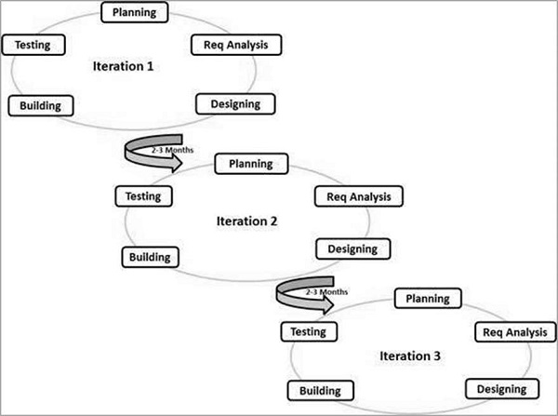
Agile methodology
agile methodology is built on top of iterative approach

Slide 34
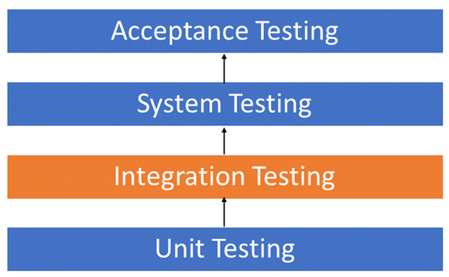
Levels of testing
Unit testing: Unit testing means testing one particular module of the application eg authentication module, payment module, admin panel etc.
Unit testing is done by developer.

Slide 35
integration testing
Integration Testing is defined as a type of testing where software modules are integrated logically and tested as a group. A typical software project consists of multiple software modules, coded by different programmers. The purpose of this level of testing is to expose defects in the interaction between these software modules when they are integrated

Slide 36
system testing
System Testing is a level of testing that validates the complete and fully integrated software product. The purpose of a system test is to evaluate the end-to-end system specifications. Usually, the software is only one element of a larger computer-based system. Ultimately, the software is interfaced with other software/hardware systems. System Testing is defined as a series of different tests whose sole purpose is to exercise the full computer-based system.

Slide 37
Acceptance Testing
Acceptance testing is done by the client, who is the owner of the product. Like in Duxcon case Mr Roy is going to do the acceptance testing.

