Slide 1
INNOVATION OF EARTHQUAKE PREDICTION
Name :S.Priyanka
Dept: CSE
Reg number:513521104039
Phase 2 Project

Slide 2
Introduction
Big data analytics is one of the most booming markets. When google search engine launched image search feature,it had indexed more than 300 million images. Big data refers collection of large datasets that are distrbuted, multi-dimensional and complex that it becomes difficult to processing on hand traditional on hand traditional data processing applications.

Slide 3
Related Work
The concept of earthquake early warning has been known for then a century, but the tools and procedures needed to implement it have just decades. To estimate the extent of damage done to building after an earthquake, it is possible to use machine learning. Such model can contribute to the fastest possible lifesaving and prove to be successful and affordable option. It can be further enhanced by include the distribution of goods like food, clothing, medical care, and money in accordance with the number of fatalities among people and the degree of structural damage.

Slide 4
METRICS
The problem addressed above is about binary classification, earthquake occur = 1 and Earthquake not occur =0 and with these predictions we try to locate co- ordinates corresponding to the predictions and display it on the google maps API web app more suitable metrics for binary classification problem are ROC, AUC, confusion matrix for precision, recall, accuracy and sensitivity.

Slide 5
DATASET
Real time data that updates every minute on https://earthquake.usgs.gov/earthquake/feed/v1.0/csv.php for 30 days.
Time : Time when the event occurred. Times are reported in milliseconds since the epoch
Latitude: Decimal degrees latitude. Negative values for southern longitudes
Longitude: Decimal degree latitude. Negative values for western longitudes
Depth: Depth of the event in kilometre
Mag: Magnitude of event occurred.
I'd: A unique identifier for the event
Place : named geographic region near to the event

Slide 6
CONCLUSION AND FUTURE SCOPE
I believe any work given always has some scope for improvement and in here we could also has we use RNN or LSTM for time series or rather event series forcasting. LSTMs bave hidden memory cells that help in remembering and handling time Series Or event series data well.
The model looks good with xgboost
Our main aim is to predict whether earthquake will happen or not at a given day and place We can allow false positive and more than false negative.

Slide 7
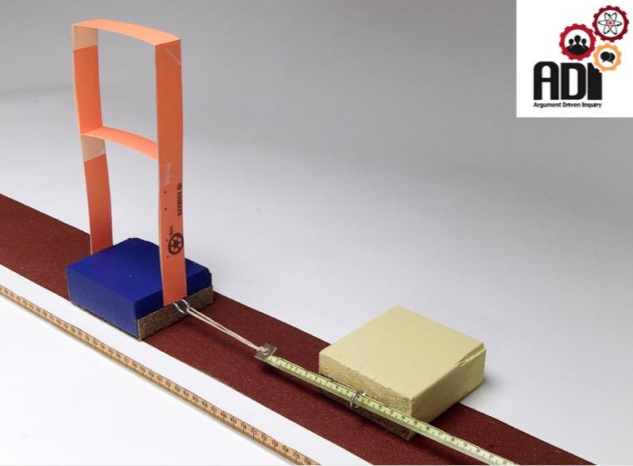
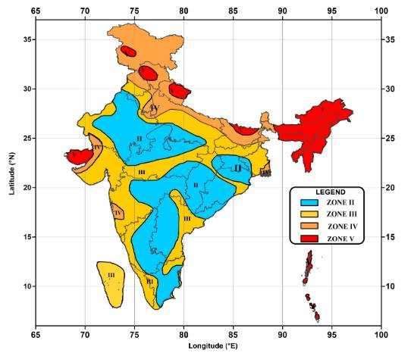

IMAGE S

Slide 8
THANK YOU

