Slide 1
DATATHON ’ 26
29.01.2026
E-Commerce Data Analysis & Business Insights
Team name: pioneer
Institute name: pioneer college of arts and science

Slide 2
What is E-Commerce?
Online buying & selling of goods & services
Operates 24/7, reaching global markets
Powered by data analytics, AI, and digital payments
Reduces cost & increases efficiency for businesses

Slide 3
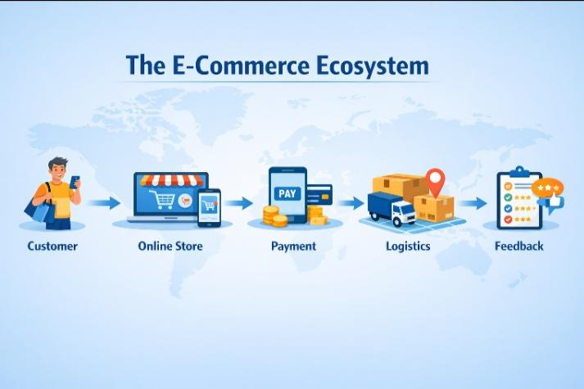

Slide 4
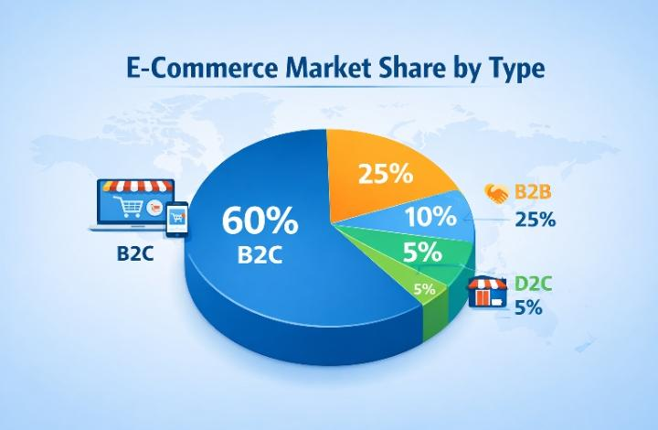
Types of E-Commerce
Type | Example | Key Feature
B2C | Amazon, Flipkart | Direct to consumers
B2B | Alibaba, IndiaMART | Bulk transactions, supply chain
C2C | OLX, eBay | Peer-to-peer trading
D2C | Brand Websites | Brand directly sells to customers

Slide 5
Dataset Overview
Attributes in a Typical E-Commerce Dataset:
Order ID, Customer ID, Product Category
Order Date, Quantity, Price
Payment Method, Delivery Status
Customer Ratings / Reviews

Slide 6
Order ID | Customer ID | Product Category | Order Date | Quantity | Price | Payment Method | Delivery Status | Rating
1001 | C001 | Electronics | 2026-01-05 | 1 | 25,000 | UPI | Delivered | 5
1002 | C002 | Fashion | 2026-01-06 | 2 | 3200 | Credit card | Delivered | 4
1003 | C003 | Groceries | 2026-01-07 | 5 | 1250 | Wallet | Delivered | 5
1004 | C004 | Home & Lifestyle | 2026-01-08 | 1 | 8500 | Cash on delivery | Pending | ..
1005 | C005 | Electronics | 2026-01-09 | 1 | 15,000 | UPI | Delivered | 4

Slide 7
Sales Trend Analysis
Monthly Sales Growth: Shows business momentum
Seasonal Peaks: Diwali, New Year, Black Friday
Revenue Insights: Helps allocate marketing budgets

Slide 8
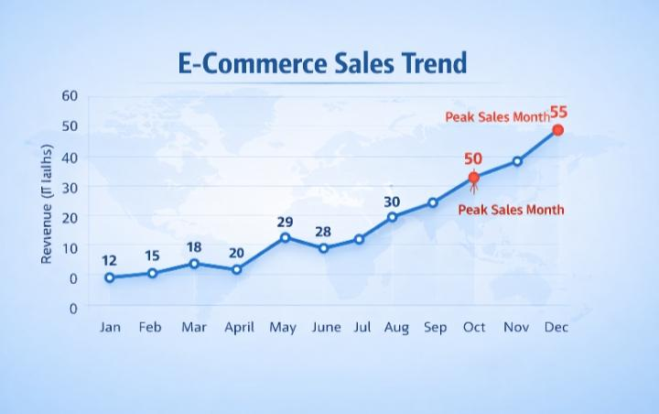
Product Category Performance
Electronics: Highest revenue & repeat purchases
Fashion: Trending products & high seasonal demand
Groceries: Frequent low-value purchases
Home & Lifestyle: Moderate growth

Slide 9
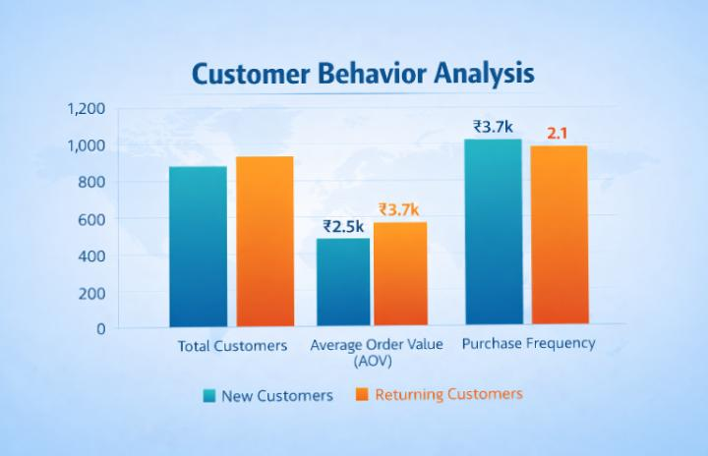
Customer Behaviour Analysis
New vs Returning Customers: Shows loyalty
Average Order Value (AOV): Identify profitable segments
Purchase Frequency: Weekly vs monthly shoppers

Slide 10
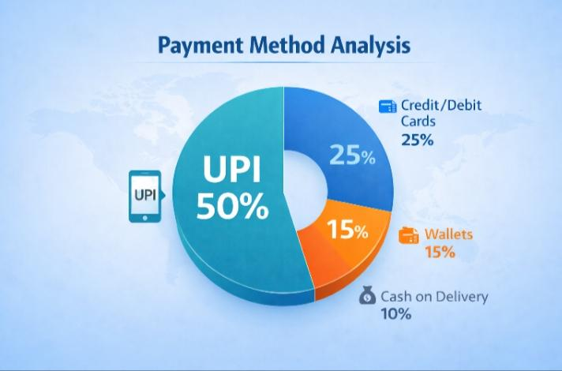
Payment Method Analysis
UPI: 50% transactions (most preferred)
Credit/Debit Cards: 25%
Wallets: 15%
Cash on Delivery: 10%

Slide 11
Key Quote
“Data is the new oil of the digital economy.”
— Clive Humby

Slide 12
Conclusion & Insights
Data-driven decisions → boost revenue & efficiency
Customer insights → improve retention & loyalty
AI & ML integration → personalized recommendations
Future of E-Commerce → hyper-personalized, predictive, and automated

Slide 13
Git hub link
Git hub link :https://github.com/priyankasanthosh016-ship-it/Datathon-26.git

