Slide 1

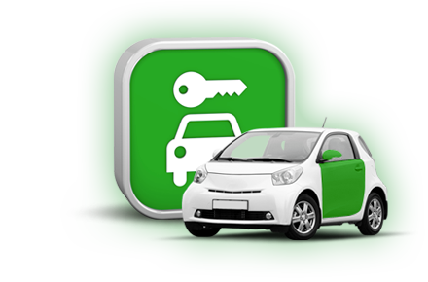

Car Rental System
ONLINE CAR PORTAL
Customize to suit your business

Slide 2
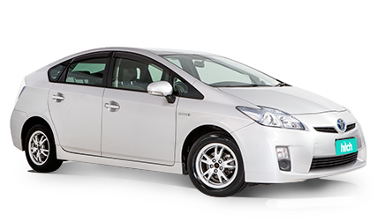
Introduction
Going digitally by making car rental business automatic & online is the key to efficient
management.
So prefer a system which operates in multiple language and streamline your business
efficiently.
So go for highly customized and cost effective car rental system that contain multiple
innovative features.
Due to this user maintain the entire fleet easily.

Slide 3
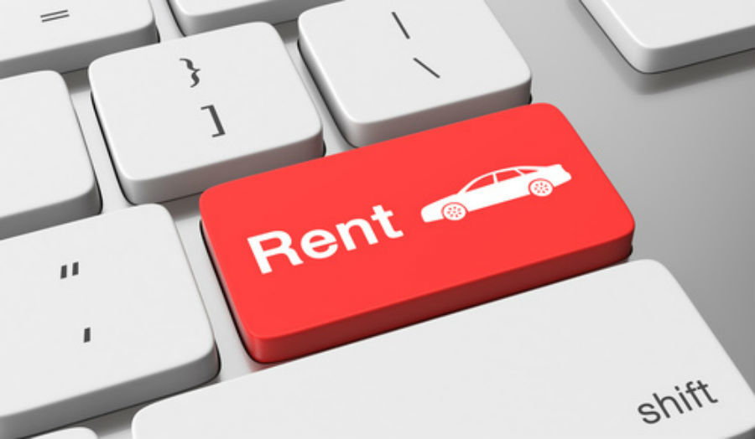
Car Rental System Overview
Record data
Give updates anytime
Highly integrated system
Cost effective online system
Supports multiple language
User Friendly

Slide 4

How To Make More Profit In Car Rental Business?
Analyse the competitors
Plan for overcoming the existing drawbacks
Excite customer with discounts and offers.
Make your system user friendly
Target your location

Slide 5

Benefits for Hiring a Car on Rent:
Highly flexible
Affordable
Comfort
Save money
Low cost travelling

Slide 6


Why You Need Car Rental System?
Features:
Handle multiple business location
Advance version easy to handle
Customize design & development
You may interact with free demo on just a click

Slide 7
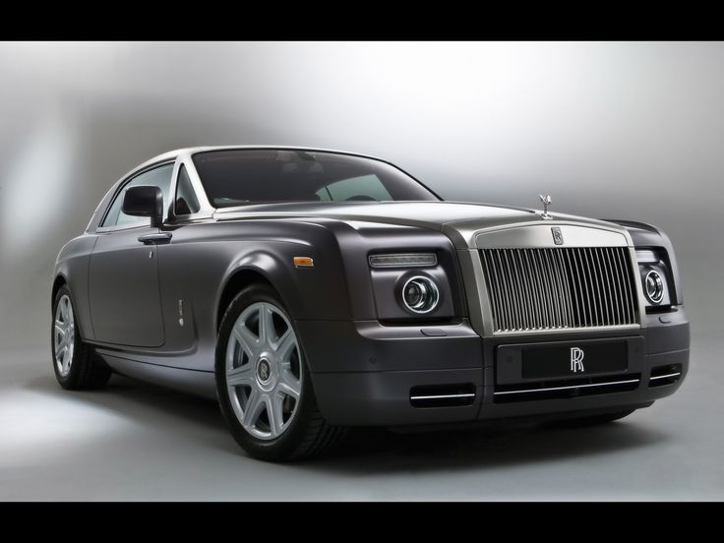
Few Things To Look Out In Car Rental System
Scalability and Performance
Should have built in specific features
Mobile apps and websites should be secure
Surge pricing based on demand

Slide 8
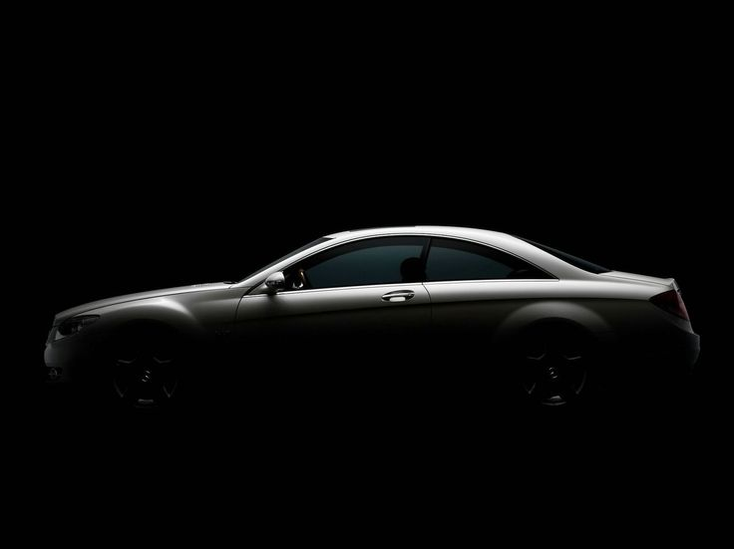
Book Car In Simple & Easy Way
Login for agents and recurring customers
Customizable auto responders in different languages
Instant booking confirmation through an email reminder
Single click quoting for entire fleet
Online payment for any location
Accepts payment by credit debit without any extra online charge.

Slide 9
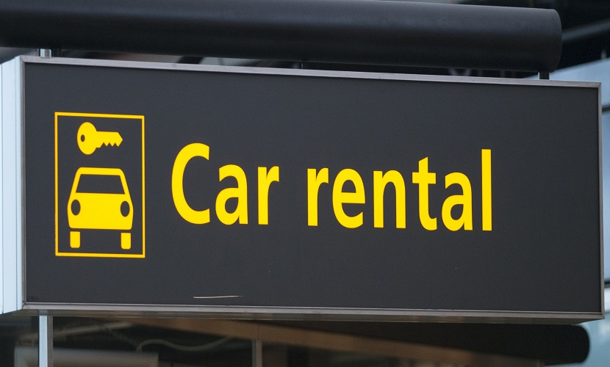
About Car Renting Solution
Custom built automated software
Simplifying the activity of the system.
Supports multiple language
User Friendly System
Easy way online booking system

Slide 10


