Slide 1

ISSS601-Analytics Framework & Business Context
Product Catalog Sorting
Presented By Group 2
Aakanksha Kumari
Kendrick Tan Kim Chwee
Priyanka Sharma
Shishir Nehete

Slide 2

Organization Overview
Zalora – Asia’s leading online fashion e-retailer
Over 200 Million Visits to Zalora website, 10% through mobile phones.
Over 500 Local & International brands
Over 30,000 Products available online
Product Categories: Clothing, Footwear, Accessories, Beauty Products
Functional Domain - Catalog Sorting
“what you show is what you sell” : One of the most important process in ecommerce

Slide 3
SWOT ANALYSIS
Strengths
Weaknesses
Helps to improve shoppers’ engagement and increase conversion rate and ultimately increase the revenue
Boost high profitability & best-selling products on top of the Catalog
Existing sorting process runs once a day & is not real time
Sorting is default for all customers (guests & logged-in customers)
Complexity in communication as there are too many stakeholders involved
S
W
O
T
Threats
Opportunities
Downtime if the process is broken on peak business days
Competitor might be engaging same strategy
If sorting doesn’t fit preference of customer, it might leads to increased bounce rate
personalize the sorting according to customer purchase and browsing behaviour
Improve Catalog sorting process- Visual sorting
Providing advertising services to brand partners

Slide 4
Solution Definition
Use Case | Process to optimize NMV by ensuring that best products appear on the front pages of the Catalog for customers, with minimum manual adjustment
Objectives | 1) Improving the existing Catalog display on the company website to show products as per customer preferences based on purchase history thereby improving the customer engagement on the website. 2) Improving Existing process in terms of visual consistency on Catalog to enhance usability and branding
Background / Current Business Challenge & Issues | Products are displayed on the website as per default sorting algorithm for all customers, which might lead to a higher bounce rate due to different preferences of different customers.
Benefit Category | Increase in revenue from Customers Increase Customer Engagement
KPI's Impacted and desired direction | 1) Conversion rate - UP 2) NMV (NMV/order) - UP
Success Criteria | 1) Conversion rate - to increase by 1pp (current rate is 1.3-1.5%) 2) NMV (NMV/order) - 10%
Scope | Implement Visual Consistency for all customers visiting the website & Personalized sorting for logged in customers
Dependencies (If Any) | Seasonality - Sale Season/Full-price Season, Trending/High selling products Stock availability of the products, Discount %, Lowest and Highest price-band SKU’s, Broken Size products - not all sizes available, Categories - Lingerie's, Swimwear's, Maternity products
Current Data Analytics Capabilities used | Rule-based non-statistical sorting algorithm is used, based on above factors & the following conversion metrics to predict the Net Merchandising Value over 1000 Impressions for each SKU: Impressions/order, Visits/order, Click Through Rate, No of times product is added to cart
Datasets Required | Browsing history/transaction history of the customer
Statistical Methods Used | Collaborative filtering based on similar items, categories, brands from browsing/purchase history of the customer; Clustering of items based on categories
Limitations/ Anticipated Issues | Complexity in communication as there are too many stakeholders involved

Slide 5
ECOSYSTEM DIAGRAM CATALOG SORTING
Buying Representative
Market Place Representative
Marketing Analytics
Boosting /De-boosting Requests
Boosting /De-boosting Requests
Country Representative
Brand Manager
Changes to Algorithm
Catalog Sorting Algorithm
Deployment
Website/Mobile App
Engagement
Customer

Slide 6
Solution Approach
Steps taken to leverage the business opportunity
Visual Sorting
This business requirement will cluster the products from same category and will help display this cluster of products in the same line of the product list view on the catalog.
Personalized catalog sorting
As soon as the user logs into the website, the sorting algorithm will modify the catalog according to the product preferences of the customer based on his choices of brands, categories blended with the seasonality and other dependencies explained in the use case.

Slide 7
What can Analytics Answer?
What happened?
What is happening now?
What will happen?
What’s the best that can happen?
What’s the next best action?
How and why did it happen?
Past
Present
Future
Organizational strategic objective focus on personalization
Non Statistical
Personalize sorting based on the preferences (categories, brands, etc.) of the customer and parameters
Increased customer engagement resulting uplift in key metrics
Non Real Time Methods for processing the Sorting order for the SKUs
Real time processing that will allow sorting based on customer preferences
Collaborative filtering and clustering methods
Sorting with rules based on parameters (seasonality, availability of products, discounts, sizes, etc.)
Visual sorting (item clusters)
Improved shopping experience, better NPS score
Information
Insights

Slide 8
Data Elements
WHO
The entity (performers) information
Actor | Data Items
Customer | Zalora User ID Name Gender Age Phone number Email | Billing address Delivery address Payment Info Last login Last purchase
Employee | Employee ID Employee Name Employee Designation | Access Rights for Algorithm Department Gender Age
WHAT
The task-related information
WHEN
Time-related timestamps
WHICH
Supporting data used

Slide 9
Data Elements
WHO
The entity (performers) information
Task | Data Items
Collaborative filtering | Item ID Item ratings User ratings Item sizes Item trends | Item colors Item category Item – SubCat Item – Brands Item quantity
Create clusters for Visual Sorting | Categories Sub-Categories Brands | Trends
Customer preferences | Categories Brands Trends | Colors Size Discount%
WHAT
The task-related information
WHEN
Time-related timestamps
WHICH
Supporting data used

Slide 10
Data Elements
WHO
The entity (performers) information
Time stamps | Data Items
Real time data | Zuid Time per visit Visit per item | Customer purchase timestamp Customer visit timestamps
Batch process | Time to run algorithms Clustering
WHAT
The task-related information
WHEN
Time-related timestamps
WHICH
Supporting data used

Slide 11
Data Elements
WHO
The entity (performers) information
Data group | Data Items
Country | Hot trends Seasonality | Sales Targets
Marketing Campaigns | Start Date End Date Target Audience | Items Coupons Channels (ATL/BTL)
Influencer | Item Trends Age | Gender Brands
WHAT
The task-related information
WHEN
Time-related timestamps
WHICH
Supporting data used

Slide 12
Data Acquisition & Uniqueness
Acquisition
For user specific data, real time as well as sales transaction data is required
Real time data includes the footprints of the customer in live session
Batch data includes the customer preferences as mentioned previously
Uniqueness
The most important part of personalization is being able to tag the customer across different platforms
Done using Zalora User ID that maps the user based on:
Cookie ID ( Multiple cookies for historical tagging )
Device ID
Mail ID
Phone Number

Slide 13
Implementation Approach
How?
Identify the user based on Zalora User ID
Get the data from both sources (browsing and sales)
Compute the scoring for the categories, subcategories, brands, trends according to the products browsed by the customer
Integrate the scoring along with the existing parameters such as
Seasonality
Stock availability of the products,
Discount %
Broken Size products - not all sizes available,
Categories - Lingerie's, Swimwear's, Maternity products
Display the products based on the scoring obtained from catalog

Slide 14
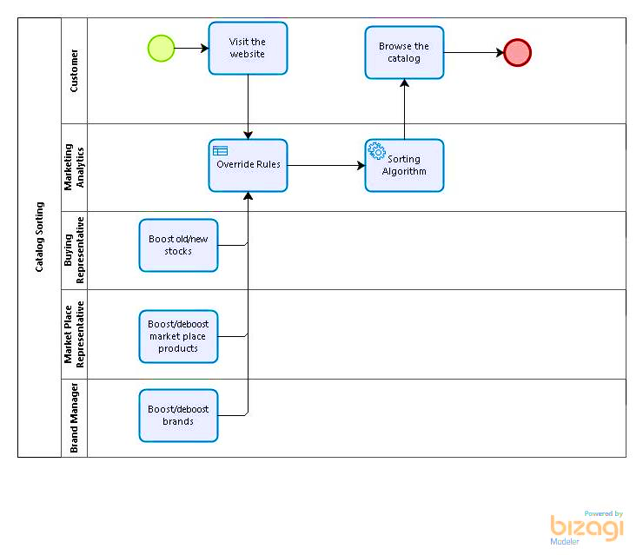
Business Process (As-Is)

Slide 15
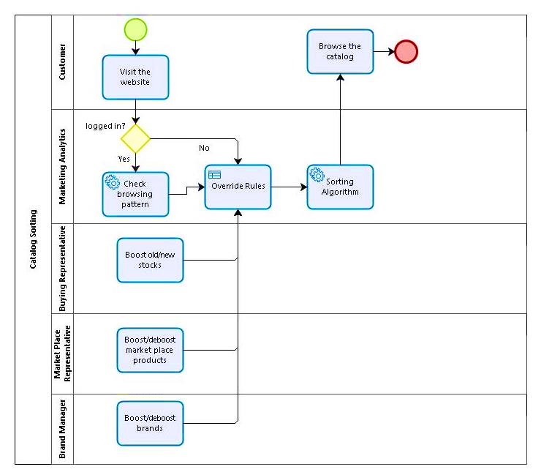
Business Process (To-Be)

Slide 16
Impacted Metrics/ KPIs
Conversion rate
The major KPI affected by the Catalog sorting process is the conversion rate
Catalog sorting process helps in providing better customer engagement on the website by showing relevant products to the customers
NMV uplift(NMV/order)
This KPI is directly affected by the above KPI which helps in driving high NMV per Order
If relevant products with high profitability are shown to the customer, then the uplift in NMV can be achieved
As per the Business opportunities defined, these KPIs can be improved substantially and the uplift can be evaluated by A/B testing.

Slide 17
Business Benefits
Reduced Communication and confusion among the stakeholders
Increase in the conversion rate
Increase in the uplift
Increase in Customer engagement
Increase in Customer Satisfaction
Increase in Customer Acquisition
Reduced Return Rate

Slide 18
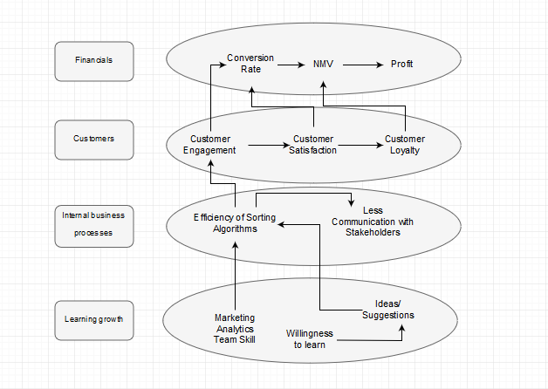
Balanced Scorecard Diagram (Causal Effects)

Slide 19
Balanced Scorecard (Contd.)
 | Objective | Measurement | Target | Initiative
Financial | Profitability | NMV | 10% increase | Personalized Catalog Sorting Visual Catalog Sorting
Customer | Customer Engagement Customer Satisfaction Customer Loyalty | Conversion Rate | 1pp increase | Improve Net Promoter Score via Customer Feedback
Internal business process | Efficiency of Sorting Algorithm Less Communication with Stakeholders | RMSE Number of De-boosting/Boosting Requests | < 0.3 1/Week (Current: 5/Week) | Optimization
Learning growth | Marketing Analytics Team Skills Willingness to learn Ideas/Suggestions | Certifications Acquiring Skills | >= 80% scores At least 1 Increase by 3% | Relevant Trainings Hiring Skilled Professionals
Notes:
Udemy Accounts for all employees

Slide 20
Ladder of Analytical Applications
Deploy inventory
products and
maintain efficiency
Planning
Institutional action
Increased Conversion rate
Predicting Customer Response
Predictive action
Create Personalized Scores for Products to be displayed
Visual Sorting
Catalog Sorting
Demographics, Geography, Browsing Patterns, Product Preferences.
Differentiated action
Customer Preferences
Key Targets
Detailed data on Customer Journey and Sales
Database
Data in Order
Notes:
Udemy Accounts for all employees

Slide 21
Quantifying Benefits
Conversion Rate
Visual Sorting: 3%
Personalized Sorting
Existing Customers: 5% uplift
New Customers: 3% uplift
Increase NPS by 10%
NMV
Personalized Sorting: 8% uplift
Visual Sorting: 2% uplift
Return Rate: 5% improvement
Profit: 5% uplift
Number of boosting/de-boosting requests: 1/Week

Slide 22
Thank You! Questions?

Slide 23
Appendix
SKU- Stock Keeping unit
NMV- Net Merchandise Value
Click-through Rate (CTR)- number of clicks that the ad receives divided by the number of times the ad is shown
Impression – Number of times the product being shown on the website
Price band- Categorisation of products based on pricing
Bucketing – SKUs from different brand tiers and age groups
Bounce rate- the percentage of visitors to a particular website who navigate away from the site after viewing only one page
NPS- Net Promoter Score – calculated using surveys
**Taken from dictionary.com
**Reference Website: https://www.zalora.sg/

