Slide 1

Big Data Tools and Techniques ISSS612 Architecture Proposal
Prepared by: Aakanksha Kumari Bhavya Mehta Diya Naresh Rao Nevil Bruno Pankhuri Dwivedi Priyanka Sharma

Slide 2
Appreciation of Situation
Customer Analytics:
The need for external data to fuse with internal data to create a 360 degree view of the customer.
The bank website and mobile app generates lot of customer interaction data which can be useful to model customer behavior and target customers with high conversion chance.
To capture the tweets and posts to help monitor the bank’s online presence and social reputation. It can also be used to for sentiment analysis regarding new products/schemes launched.
Operational Analytics:
System generated logs, when a transaction/purchase fails can be used to analyze health of system and find reasons why customer did not convert.
IT service logs to diagnose the blockage in services.
Risk Management :
Detection of fraudulent transaction and trade patterns
Compliance Reporting:
Improved response time to deliver compliance reports to the audit team.

Slide 3
Design Considerations and Assumptions
Aim
Focused on improving the system from the analytics perspective
Processing
Proposed architecture deals with both – structured as well as unstructured data separately and supports real-time and batch processing
System Integration
Aims to integrate the existing architecture with the big data architecture
Cost
The solution proposed is cost-effective, using open-source tools & existing tools
Security
Considering Hadoop’s Data governance & security policies
Data
Data is obtained from existing Campaign Management System, existing RDBMS, bank website and mobile app , Social Media & Call center logs

Slide 4
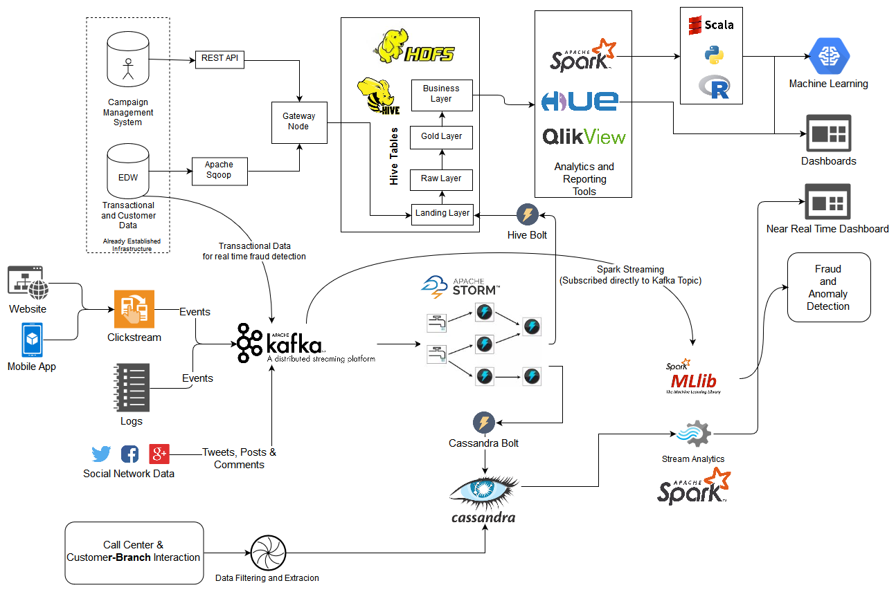
Place your screenshot here
Proposed Architecture

Slide 5
Technology Component Description
Data Ingestion and Storage | The data extracted to EDW using Apache Sqoop and CMS using REST calls can be added to HDFS, cluster using gateway node and landing (dumping layer). To allow to query this data in structured way, Apache Hive is used.
 | The real time data generated from social networking sites and clickstream can be ingested into the system using Kafka stream and messaging. The events raised by website/app/SNS will be entered as a message into Kafka stream.
 | The Kafka, messages will be picked up Apache Storm. Storm using bolts and spouts can be used to process the messages, extract useful information, all in near real time. Then using Hive bolt and Cassandra bolt, the processed result can be written to hive table (HDFS) and Cassandra table.
 | The data from call center and customer branch interaction, after performing suitable processing and extraction of information, can be written to Cassandra
Data Processing, Analysis and Visualization | We have two kinds of analysis. Hot data analysis (from streams, near real time) and Cold data analysis (form warehouse). Using Cassandra which is highly available and high throughput columnar database and using lightning fast Spark cluster computing, near real time dashboard can be developed
 | for planning, campaign management and other analysis task, Spark, Apache Hue, QlikView can be used. Each of these tools, easily connect Hive abstraction of Hadoop file system.

Slide 6
Benefits of Technology Components Used
Apache Hive
An open source data warehouse system built on top of Hadoop used for querying and analyzing large datasets stored in Hadoop files. It provides data summarization, query, and analysis in much easier manner. It is scalable, familiar, and extensible
Apache Cassandra
High throughput, low latency database and combined with Apache Spark high speed computing, near real time stream analysis can be achieved. Hive is basically SQL abstraction over MapReduce jobs, which are not suitable for real time analysis of data. Thus, there is need for high throughput database
Apache Storm
Suitable of real time stream processing and transformation. After the processing, it can easily connect to HDFS using hive bolt and Cassandra using Cassandra bolt to write the data.
Apache Kafka
Kafka is capable of handling high-velocity and high-volume data. Also, able to support message throughput of thousands of messages per second. It is capable of handling these messages with the very low latency of the range of milliseconds, demanded by most of the new use cases
Apache Sqoop
A tool designed for efficiently transferring bulk data between Apache Hadoop and structured datastores such as relational databases. Easy to use tool for data transferring
Apache Hue
A self-service open source tool for browsing, querying and visualizing data on HDFS/Hive interactively. Dashboards are easy to build, also help in viewing data catalogues in a glance.

Slide 7
THANK YOU
References
http://cassandra.apache.org/
https://www.educba.com/apache-storm-vs-kafka/

