Slide 1
ISSS603- CUSTOMER ANALYTICS & APPLICATIONS Speciality Store Online Retail
(Group -1)
CHRIS THNG
DIYA NARESH RAO
PANKHURI DWIVEDI
PRIYANKA SHARMA
LIAO YUNXIA
HU YUNXIA

Slide 2




Data Overview
Transactional data of a UK based Online Specialty Store
15K+ transactions of around 4K Customers
12 months Time-Series Data
Catalogue of over 3.5K Products

Slide 3

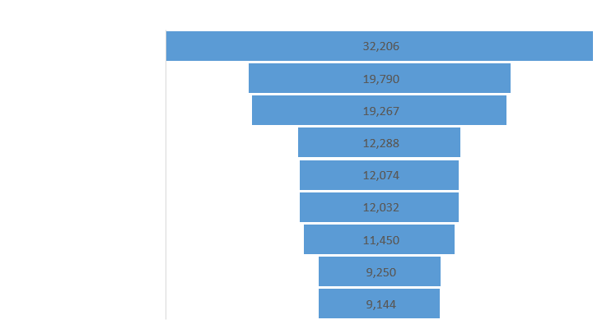
Bestsellers
Best Buyers
Spend Pattern

Slide 4
Seasonal Peak
Relatively Low Sales

Slide 5
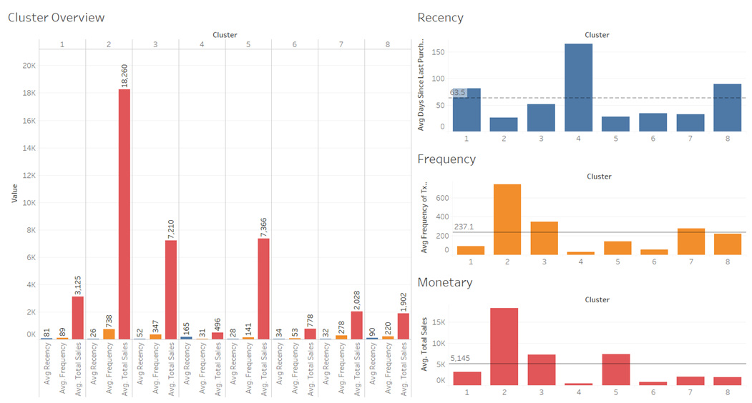
Segmentation Results

Slide 6
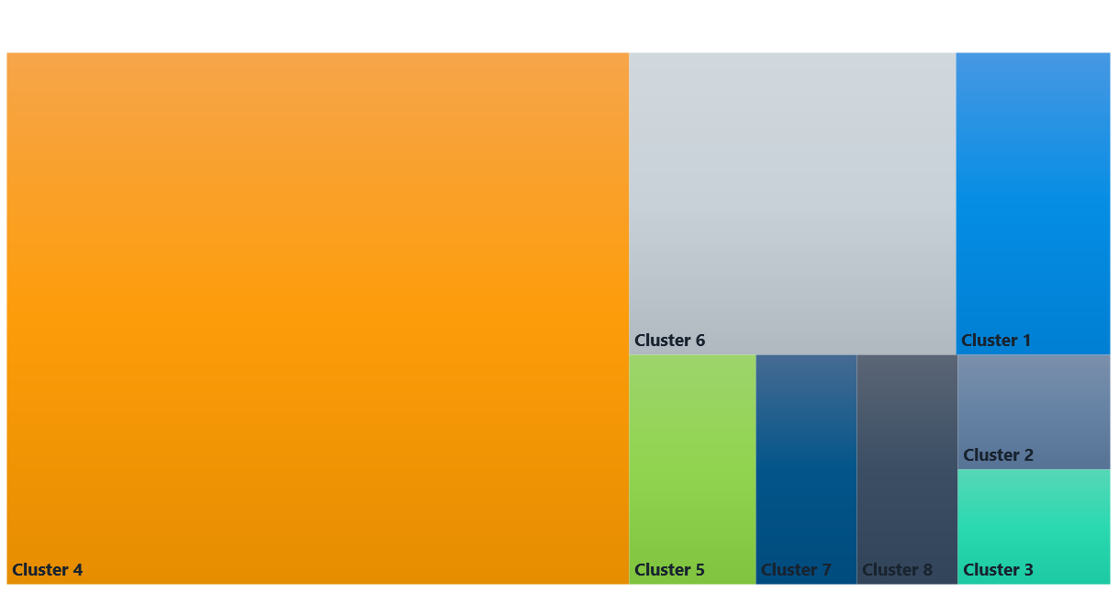
Mass Market
New Customers
Need Attention
New Customer
Champions
Mass Market
Second Largest Segment
High Recency, low frequency and Monetary.
Need to increase share of wallet.
Lure by incentivising purchases
‘We Miss You’ Discounts
Feedback mechanism to identify areas of improvement
Improve relations with personalised emails/offers
Provide good recommendations, attracting them to buy more
3% of all Customers
Most valuable customers
Highest number of transactions, biggest contributor to total sales.
Consider giving bulk buy discounts
Product bundles of high value products paired with low value ones
Extravagant
Worst RFM Segment
57% of All Customers
3rd largest contributor to Sales
Needs Development
Attractive Seasonal Product Bundles
Exclusive access to Preview Sale Offers
Loyalty Points
2nd largest contributor to total sales despite lowest number of transactions
Potential for growth.
5% of All Customers
High Net Worth individuals/corporations
Loyalist
High Frequency, low cost product buyers
Focus on upselling.
Incentivise for high frequency purchasing
Send personalized emails to reconnect.
recommend popular products / renewals at discount
High frequency buyers of the past.
Need to get back these customers
Champions
Extravagant
Potentials
Dormant
Loyalist

Slide 7
Market Basket Analysis
We performed Market Basket Analysis on the three identified clusters- 2, 4 & 5 since they have the most potential, capture a large customer base (63% of total) and contribute a significant share, roughly 50%, in revenue (top 3 in sales).
Kitchen Boxes, Bins and Containers -> Baking and Cake Accessories(63%, 6%)
Pans, Tins and Kitchen Accessories -> Baking and Cake Accessories (60%, 6%)
Doilies -> Baking and Cake Accessories(88% , 4%)
Star Decorations -> Heart Decorations (77%, 4%)
Photo Frames and Accessories, Decorations
->Candles, Tlights and Accessories (77%, 4%)
Stationary & Decorations -> Heart Decorations (61%, 5%)

Slide 8
Actionable Strategies
Mass Market Segment – Lure to buy more by incentivising purchases.
“With any purchase of Baking and Cake Accessories get a Set of Doilies Free”
“Get 10% off on your next purchase” or “Seasonal Offers – Buy a Christmas Tree and get decorations set at 10% discount”
“Get a chance to win an Oven with any purchases in our Baking and Cake Accessories segment”
“Limited period offers on Exclusive Festive Products”
Extravagant Buyers & Champion Segment
“Exclusive Access to Preview Sale”
Loyalty Points - “Earn more if you spend more”
Product Customisation – “Customise a gift for just £2”

Slide 9
Recommendation Engine
In order to enhance customer engagement on the website and to drive business revenues, the following two types of recommendation algorithms were implemented.
Collaborative Filtering
Latent-Factorization
Gives recommendations based on past user behaviors and identifying the products most likely to be preferred by the selected user
Item-Item Similarity
Gives recommendations based on the items most likely to be preferred by the user with respect to the selected item
http://127.0.0.1:8000/rec/

Slide 10




Other Marketing Strategies
Sale
Customer Journey
Clearance sales – to drive sales during non peak seasons
Most viewed products
Banner placement
Abandoned carts
Social Media
Offers
“Click a picture” campaigns
Influencer offers
Giveaways
Referral discounts
Offers with first time purchasing
Notes:
To change the image behind the Mock up.
Select the layer - > Right Click -> Send to Back -> Delete the image -> Drag & Drop your Own Picture -> Send to Back (again)

Slide 11

Thank You!

