Slide 1
ATLIQ HARDWARE Sales Insights FROM ad-hoc requests
Priyanka Sharma
March ,2023

Slide 2
INTRODUCTION
Atliq Hardware, one of the leading computer hardware producers in India with customers from across the globe, want to get insights on company products sales to make data-informed decisions.

Slide 3
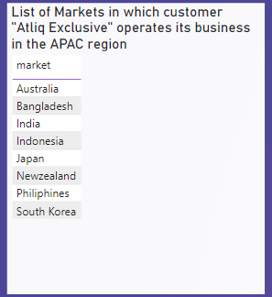
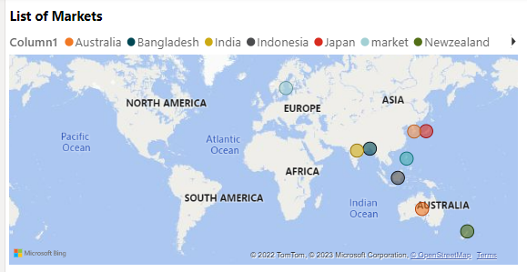
1.Provide the list of markets in which customer "Atliq Exclusive" operates its business in the APAC region.
Key Points
Atliq Exclusive operates its business in 8 countries of Asia pacific region

Slide 4
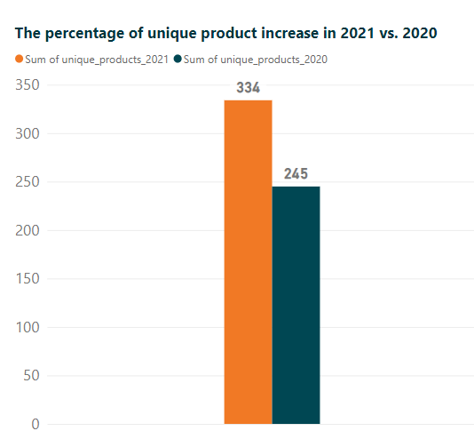

2. What is the percentage of unique product increase in 2021 vs. 2020?
Key Points
The number of unique products in 2020 were 245 but after a it increased by 36.33 percent which is significant incline.

Slide 5
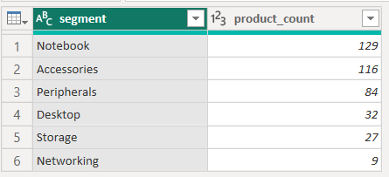
3. Provide a report with all the unique product counts for each segment and sort them in descending order of product counts.

Slide 6
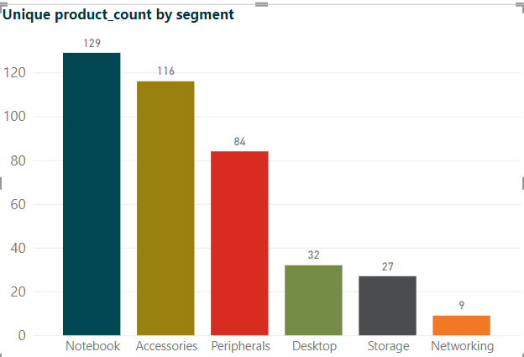
3. Provide a report with all the unique product counts for each segment and sort them in descending order of product counts.
Key Points
As we can see Notebook segment has the highest number of products followed by Accessories .
Networking has only 9 products

Slide 7
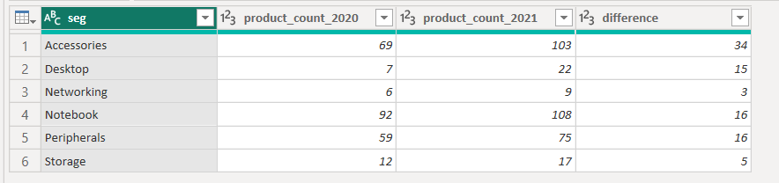
4.Which segment had the most increase in unique products in 2021 vs 2020?

Slide 8
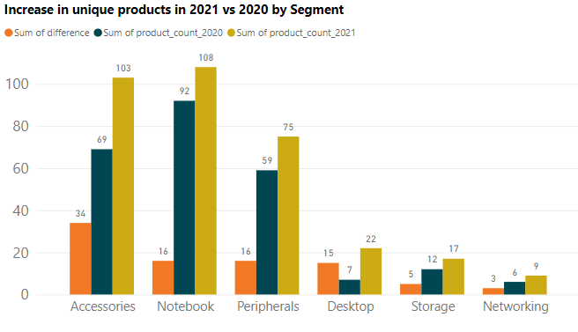
4.Which segment had the most increase in unique products in 2021 vs 2020?
Key Points
As it is depicted although Notebook segment had maximum number of projects in both the years but, the most increase in unique products can be seen in Accessories Segment.
Whereas, Networking segment showed negligible incline.

Slide 9
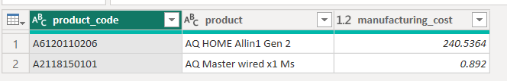
5. Get the products that have the highest and lowest manufacturing costs.

Slide 10
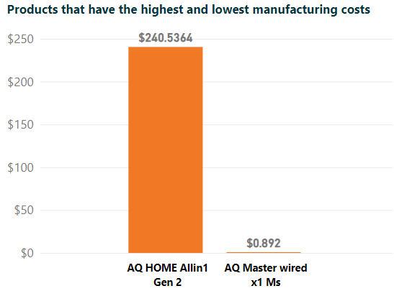
5. Get the products that have the highest and lowest manufacturing costs.
Key Points
AQ Home Allin 1 Gen 2 product which comes under Desktop category had the highest manufacturing cost.
AQ Master wired x1 Ms product is type of mouse had the lowest manufacturing cost.

Slide 11
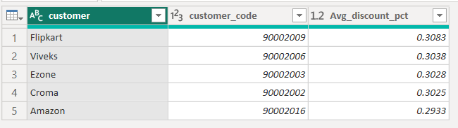
6. Generate a report which contains the top 5 customers who received an average high pre_invoice_discount_pct for the fiscal year 2021 and in the Indian market.

Slide 12
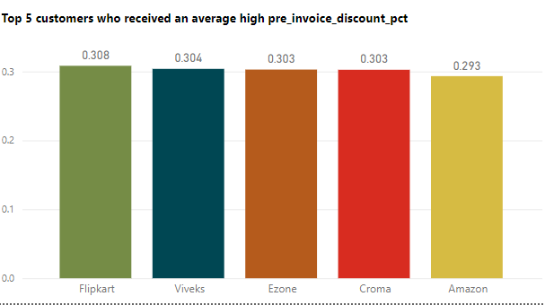
6. Generate a report which contains the top 5 customers who received an average high pre_invoice_discount_pct for the fiscal year 2021 and in the Indian market.
Key Points
Although all the top 5 customers almost 30% discount but Flipkart was the customer who received highest and Amazon received the lowest pre_invoice_discount in Indian market.

Slide 13
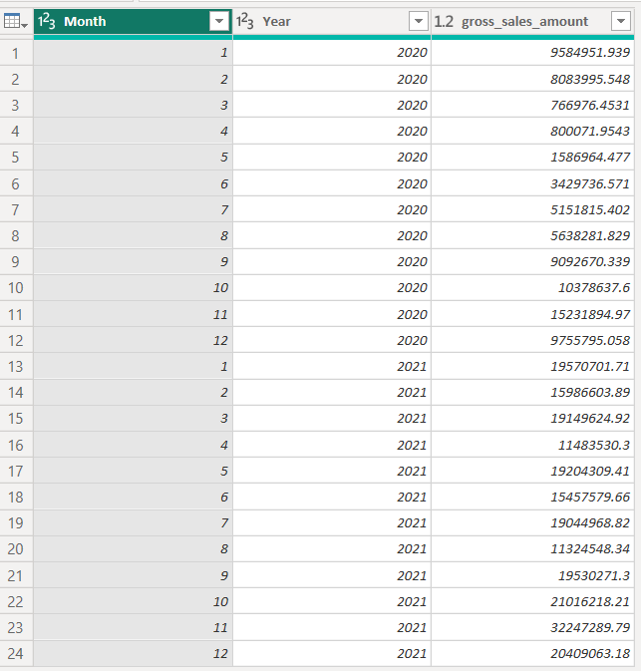
7.Get the complete report of the Gross sales amount for the customer “Atliq Exclusive” for each month. This analysis helps to get an idea of low and high-performing months and take strategic decisions.

Slide 14
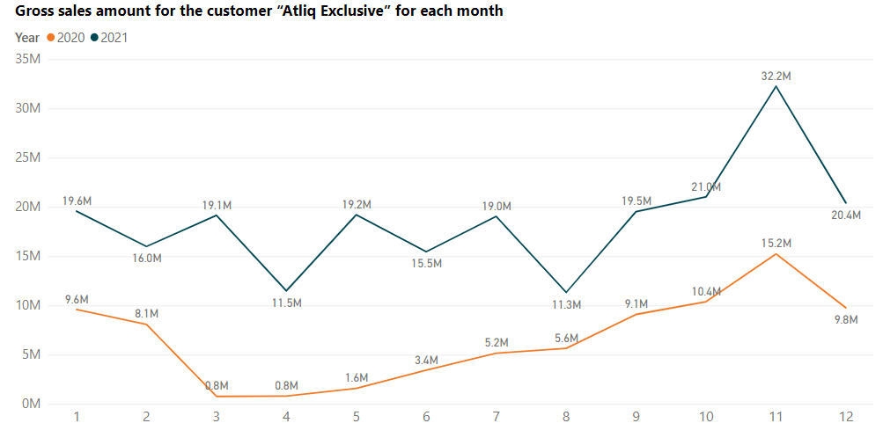
7.Get the complete report of the Gross sales amount for the customer “Atliq Exclusive” for each month. This analysis helps to get an idea of low and high-performing months and take strategic decisions.
Key Points
It is depicted form the graph that November was the most high-performing month in both the years.
The gross sales amount of 2020 was comparatively low than the 2021.
The fluctuations can be seen in the gross sales of 2021 whereas , after march the gross sales was continuously increasing in 2020.

Slide 15
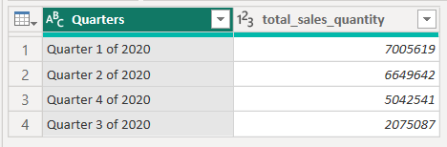
8. In which quarter of 2020, got the maximum total_sold_quantity?

Slide 16
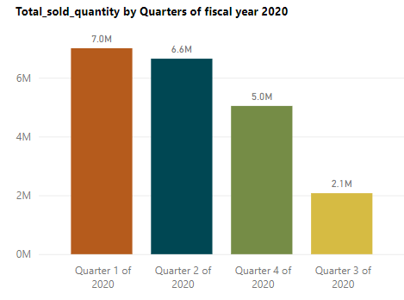
8. In which quarter of 2020, got the maximum total_sold_quantity?
Key Points
Most of the products were sold in first Quarter 1 of the 2020 (September, October, November) near about 7 million.
On the other hand, the total sales quantity sold in Quarter 3 was only 2 million.

Slide 17
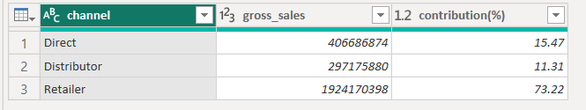
9. Which channel helped to bring more gross sales in the fiscal year 2021 and the percentage of contribution?

Slide 18
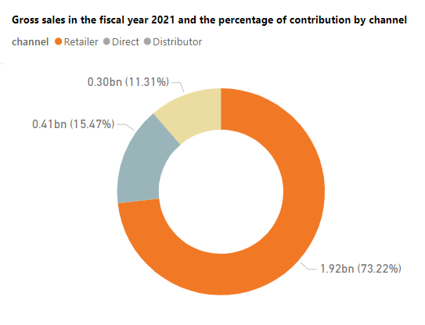
9. Which channel helped to bring more gross sales in the fiscal year 2021 and the percentage of contribution?
Key Points
Retailer channel contributed about nearly three quarters of the total gross sales which was about 1.92 billion.
Distributer contributed only 11 percent of the total gross sales.

Slide 19
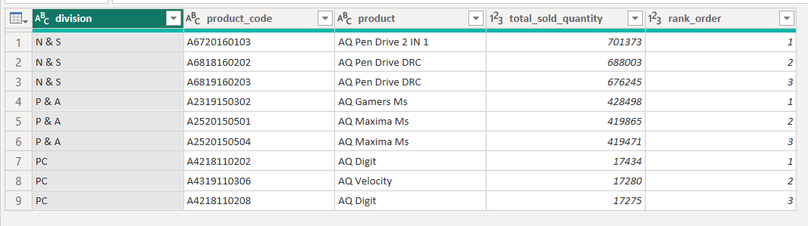
10. Get the Top 3 products in each division that have a high total_sold_quantity in the fiscal_year 2021?

Slide 20
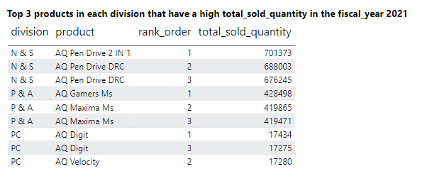
10. Get the Top 3 products in each division that have a high total_sold_quantity in the fiscal_year 2021?
Key Points
The top 3 maximum products sold to division N &S division are AQ pen drives
The top 3 products sold to division P & A are mouses.

Slide 21
Thank You

