Slide 1

WIPRO NGA Program – NMS Batch
Capstone Project Presentation – 24 July 2024
Compliance and Reporting Microservice
Presented by – NMS_24NAG0969_TeamD_Presentation
www.rpsconsulting.in

Slide 2


INTRODUCTION
PURPOSE: Ensure device configurations meet compliance standards
KEY COMPONENTS:
Compliance Rule Engine
Reporting Service
Analyze device configurations against set of predefined compliance rules
Generate reports on compliance status and offer insights into non-compliant configurations
2024 - RPS Consulting all rights reserved

Slide 3
What is compliance and reporting microservice?
A compliance and reporting microservice is a small, self-contained service that specifically handles tasks related to adhering to regulations and generating reports.
It essentially breaks down compliance and reporting functionalities into bite-sized, manageable pieces within a larger software application.
2024 - RPS Consulting all rights reserved

Slide 4
Breakdown of key aspects
Compliance: This microservice ensures the application meets industry standards and regulations. This might involve tracking specific data points, following data security protocols, or generating reports required by regulators.
Reporting: This microservice focuses on generating various reports that demonstrate compliance or provide insights into the application's activity. These reports can be for internal use or submitted to external regulatory bodies.
2024 - RPS Consulting all rights reserved

Slide 5
Benefits of using a compliance and reporting microservice
Increased Efficiency: By isolating compliance and reporting functions, developers can focus on core functionalities without getting bogged down by regulatory concerns.
Improved Scalability: Microservices are inherently scalable, allowing you to easily scale up the compliance and reporting service to handle increased reporting needs.
Enhanced Maintainability: Since it's a dedicated service, maintaining compliance and reporting logic becomes simpler.
2024 - RPS Consulting all rights reserved

Slide 6
Use Case: Check Device Compliance
Pre conditions:
Compliance rules are defined.
Device configuration is available.
Main Flow:
The administrator inputs compliance rules into the system.
The system stores these rules in the Compliance Database.
Device configuration details are provided to the system.
The system creates a configuration object from these details.
The system evaluates the configuration against the stored compliance rules.
The system generates a report based on the evaluation results.
Postconditions:
Compliance report is generated, highlighting compliant and non-compliant rules.
2024 - RPS Consulting all rights reserved

Slide 7
Define Compliance Rules
Start
Initialize Application
End
FLOW CHART
Create Configuration
Print Results
Analyze Compliance
Collect Non- Compliant Rules
2024 - RPS Consulting all rights reserved

Slide 8
Flow Chart Explanation
⁠ Start: The process begins.
⁠ ⁠Initialize the Application: This step likely involves setting up the application environment, loading necessary
resources, and getting it ready for analysis.
⁠ ⁠Define Compliance Rules: Here, the system establishes the criteria the application needs to follow. This could
involve loading predefined rules or allowing for user-defined checks.
⁠ ⁠Analyze Compliance: The application itself or its configuration is evaluated against the defined compliance rules.
This step performs the actual comparison.
Results: The flowchart ends by displaying the results.
This might involve:
a. Pass: If the application complies with all rules, a success message is shown.
b. Fail: If any non-compliant rules are found, the specific violations are displayed. (The flowchart
doesn't explicitly show this branch, but it's implied.)
2024 - RPS Consulting all rights reserved

Slide 9
DATA FLOW CHART
Administrator
Device Configuration
Define Rules
Create Configuration
Evaluate Compliance
Compliance Database
Generate Report
Report Generation
2024 - RPS Consulting all rights reserved

Slide 10
Data Flow Chart Explanation
Define Rules:
Input: Administrator inputs compliance rules.
Output: Rules are stored in the Compliance Database.
Create Configuration:
Input: Device configuration details.
Output: Configuration object created.
Evaluate Compliance:
Input: Configuration object and compliance rules.
Output: List of non-compliant rules (if any).
Generate Report:
Input: Compliance evaluation results.
Output: Compliance report (e.g., PDF).
2024 - RPS Consulting all rights reserved

Slide 11
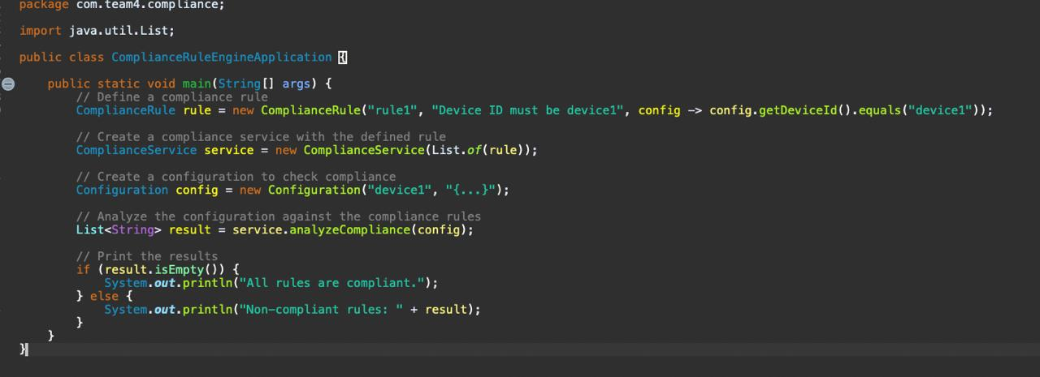
INITIALIZATION
Code Snippet
2024 - RPS Consulting all rights reserved

Slide 12
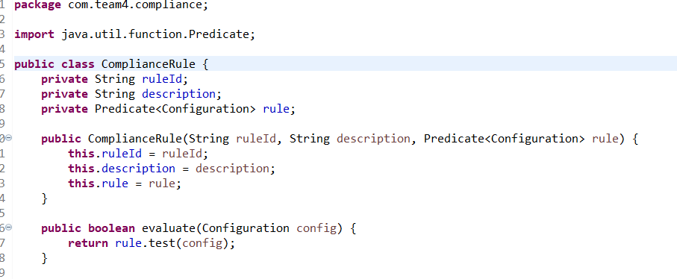
COMPLIANCE RULE
Purpose: Define and evaluate compliance rules
Core Class: ‘ComplianceRule’
Attributes: ruleId, description, rule (Predicate)
Methods: Constructor, evaluate, getters and setters
Code Snippet:
⁠
2024 - RPS Consulting all rights reserved

Slide 13
Explanation of Compliance Rule Java File
Compliance Rule Representation: This code defines a Compliance Rule class in Java to represent a single
compliance rule.
2. Rule Components: Each Compliance Rule has three key components:
ruleId: A unique identifier for the rule.
description: A human-readable explanation of the rule's purpose.
rule: A Predicate<Configuration> object defining the actual compliance check logic.
3. Predicate for Rule Logic: The Predicate<Configuration> interface allows for defining a custom function that takes
a Configuration object and returns true if the configuration complies with the rule, false
otherwise.
4. Evaluating Compliance: The evaluate(Configuration config) method takes a Configuration object and uses the
internal rule predicate to assess if the configuration complies with the defined rule.
5. Getters and Setters: Standard getters and setters are provided for accessing and modifying the ruleId, description,
and rule properties.
2024 - RPS Consulting all rights reserved

Slide 14

EXAMPLE COMPLIANCE RULE
Rule : Device Id must be ‘device1’
Code Snippet:
⁠
2024 - RPS Consulting all rights reserved

Slide 15
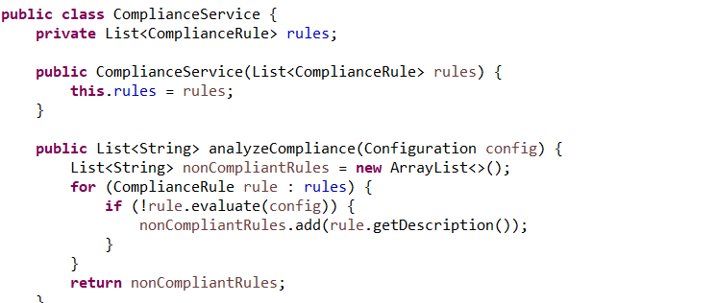
CONFIGURATION ANALYSIS
Purpose: Analyze configurations against compliance rules
Core Class: ‘ComplianceService’
Attributes: rules (List of ComplianceRule)
Methods: Constructor, analyzeCompliance
Code Snippet:
⁠
2024 - RPS Consulting all rights reserved

Slide 16
Explanation Compliance Service Java File
1. Rule Storage: The class has a private member rules which is a List<ComplianceRule>. This list stores
the collection of ComplianceRule objects used for compliance checks.
2. Constructor: The constructor takes a List<ComplianceRule> argument during object creation. This allows
the service to be initialized with the specific set of rules it needs to enforce.
3. Compliance Analysis Method: The analyzeCompliance(Configuration config) method is responsible for
evaluating the provided configuration against the defined rules.
4. Iterating Through Rules: The method iterates through each ComplianceRule in the internal rules list.
5. Evaluating and Collecting Non-Compliance: For each rule, it calls the evaluate(config) method of the
ComplianceRule. If the evaluation returns false (meaning the configuration is non-compliant with
that rule), the description of the non-compliant rule (obtained using rule.getDescription()) is added
to a List<String> named nonCompliantRules.
2024 - RPS Consulting all rights reserved

Slide 17
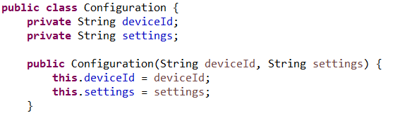
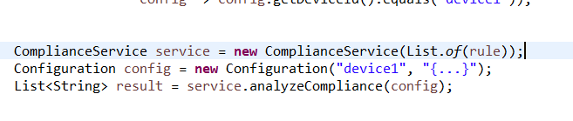
EXAMPLE CONFIGURATION ANALYSIS
Configuration Class:
Configuration Analysis example:
⁠
2024 - RPS Consulting all rights reserved

Slide 18
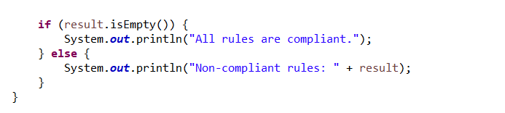
ANALYSIS OUTCOME
After analyzing configuration against set of rules
Prints result: All rules are compliant or list of non-compliant rules
Code Snippet:
⁠
2024 - RPS Consulting all rights reserved

Slide 19
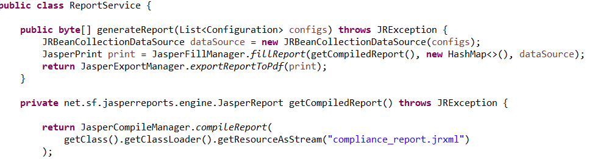
REPORT SERVICE
Class: ReportService
Purpose: Generate Compliance Report
Methods: generateReport, getCompiledReport
Code Snippet:
⁠
2024 - RPS Consulting all rights reserved

Slide 20
Explanation of Report Service Java File
1. Report Generation Method: The generateReport(List<Configuration> configs) method is responsible for creating a compliance
report based on a list of configurations. It throws a JRException to signal potential errors during report generation using the
JasperReports library.
2. Data Source Preparation: The method creates a JRBeanCollectionDataSource object using the provided configs list. This data
source allows the report to access data from the Configuration objects.
3. Report Filling: It calls JasperFillManager.fillReport with three arguments:
i. The compiled report template retrieved using getCompiledReport (explained later).
ii. An empty HashMap<> (potentially used for additional report parameters if needed).
iii. The JRBeanCollectionDataSource containing the configuration data.
4. Compiling Report Template (Private): The private getCompiledReport method retrieves the compiled report template. It uses the
class loader to access a resource named "compliance_report.jrxml" which is likely a Jasper Reports template file defining the
report layout and data binding logic.
5. Exporting Report to PDF: Finally, the method uses JasperExportManager.exportReportToPdf to convert the filled report
(JasperPrint object) into a PDF byte array. This byte array can then be saved to a file or streamed as needed.
2024 - RPS Consulting all rights reserved

Slide 21
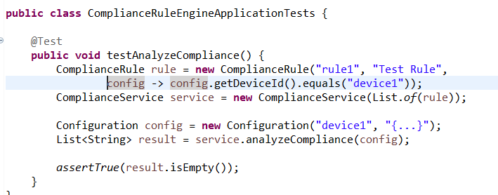
TEST CASES
TEST CASE 1: Testing Compliance Analysis
Purpose: Verify that the compliance rule engine correctly identifies compliant configurations.
Class: ComplianceRuleEngineApplicationTests
Methods: testAnalyzeCompliance
Code Snippet:
⁠
2024 - RPS Consulting all rights reserved

Slide 22
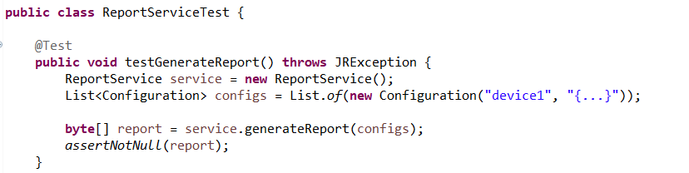
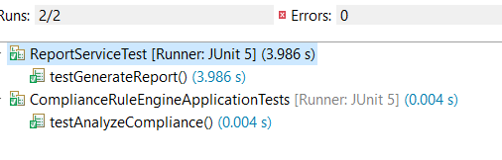
TEST CASES
TEST CASE 2 : Testing Report Generation
Purpose: Verify that the report generation functionality works correctly.
Class: ReportServiceTest
Methods: testGenerateReport
Code Snippet:
Test cases passed successfully:
⁠
2024 - RPS Consulting all rights reserved

Slide 23
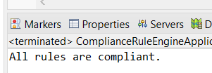

OUTPUT EXPLANATION
The system's output depends on the compliance evaluation results:
All Rules Compliant:
Output: "All rules are compliant."
Indicates that the device configuration meets all defined compliance standards.
Non-Compliant Rules:
Output: "Non-compliant rules: [Description of non-compliant rule]"
Lists any rules that the device configuration does not meet, allowing for corrective actions
2024 - RPS Consulting all rights reserved

Slide 24
TECHNOLOGIES USED
JAVA: Core Programming Language
ECLIPSE: Integrated Environment Development
SPRING: Application Development Framework
MAVEN: Project Management and build automation tool
JASPER-REPORTS: Report generation library
MYSQL: Database for storing configuration and compliance tool
2024 - RPS Consulting all rights reserved

Slide 25
CONCLUSION
Summary of the project's achievements:
Successful development of a compliance rule engine.
Automated analysis and reporting of device configurations.
Ensured configurations meet predefined standards.
FUTURE WORK
Adding more compliance rules to cover additional scenarios.
Improving reporting features with more detailed analytics and visualizations.
Integrating with other systems for better automation and monitoring.
Enhancing user interface for easier rule management and report generation.
2024 - RPS Consulting all rights reserved

Slide 26
THANK YOU
PRESENTERS:
Rijin Raj
Charuli Pramod Shirsath
Ravi Kumaran P
Rathod Sushma
Dhrubangshu Prabal Goswami
Punith N R
CHAITHANYA Ramesh R
DEEPIKA NAIK
Ragula Sagar
Priyanka Thakur
2024 - RPS Consulting all rights reserved

