Slide 1
NEXTHIKES IT SOLUTIONS
Exploratory Data Analysis of
Large-Scale Retail Transaction Data
Univariate, Bivariate & Multivariate Statistical Analysis of 100,000 Retail Transactions
Dataset: retail_large_dataset.csv · 100,000 rows · 18 columns
Tools: Python · Pandas · NumPy · Matplotlib · Seaborn · SciPy
Submission Date: 25th September, 2026

Slide 2
PROJECT ROADMAP
What This Analysis Covers
01
02
03
Dataset Overview
Univariate Analysis
Outlier Detection
Structure, quality, variable types
Distributions, skewness & kurtosis
IQR and Z-score methods
04
05
06
Correlation Analysis
Bivariate Analysis
Multivariate Analysis
Pearson relationships between variables
Numerical vs. categorical comparisons
Three-way interaction effects
07
Key Findings
What the data actually shows
NextHikes IT Solutions — Retail Transaction EDA
2

Slide 3
SECTION 01
Dataset Overview
100,000
18
6
0
Transaction Records
Columns Captured
Product Categories
Missing Values
Column Composition
Variables Used in This Analysis
Numerical: age, product_price, quantity, discount_percentage, final_price, delivery_days
Categorical: customer_segment, product_category, payment_method, shipping_type, return_status, gender, city, state
Excluded from statistics: customer_id, order_id (unique identifiers)
NextHikes IT Solutions — Retail Transaction EDA
3

Slide 4
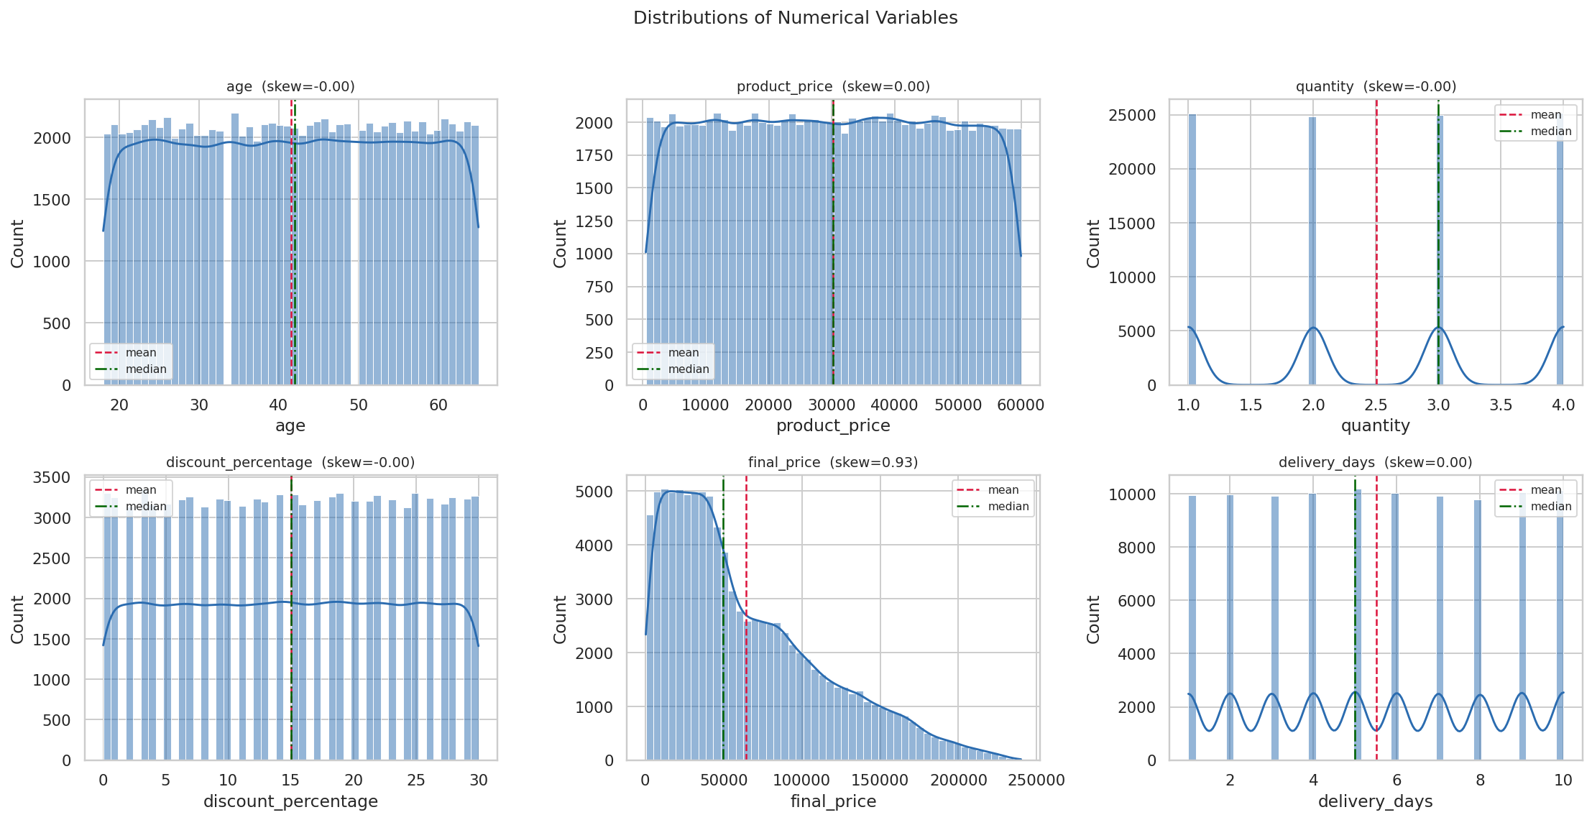
SECTION 02 · UNIVARIATE ANALYSIS
Distribution of Numerical Variables
Reading the Shape
5 of 6 variables
are flat / rectangular — the signature of a uniform distribution:
skew ≈ 0.00
excess kurtosis ≈ −1.2
(uniform's exact value)
Only final_price
is right-skewed (0.94) — because it's a product of the others, not an independent measurement.
NextHikes IT Solutions — Retail Transaction EDA
4

Slide 5
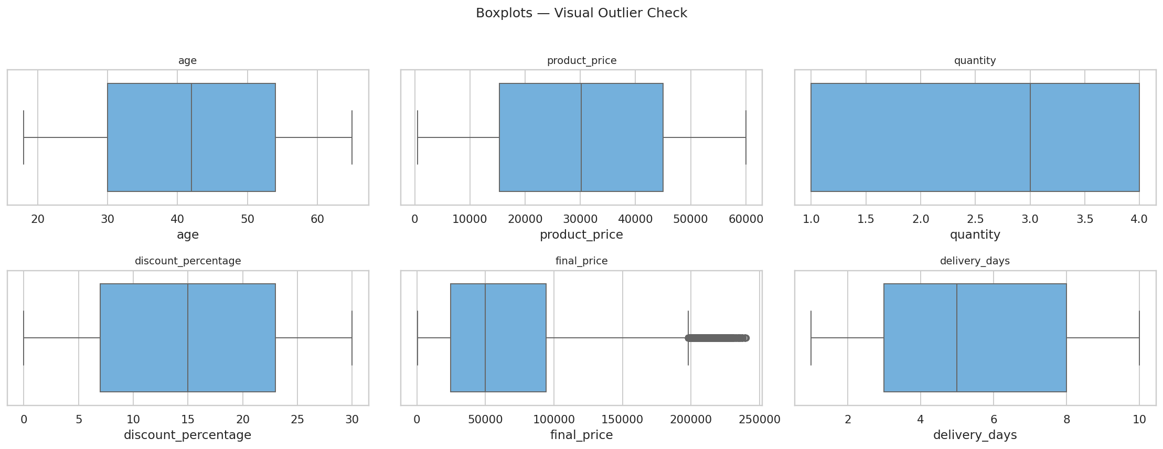
SECTION 03 · OUTLIER DETECTION
IQR & Z-Score Methods
IQR Method
Z-score (|z| > 3)
Decision
final_price only
final_price only
Outliers retained
high-value multi-item baskets, not errors
confirms IQR result independently
genuine premium/bulk transactions
NextHikes IT Solutions — Retail Transaction EDA
5

Slide 6
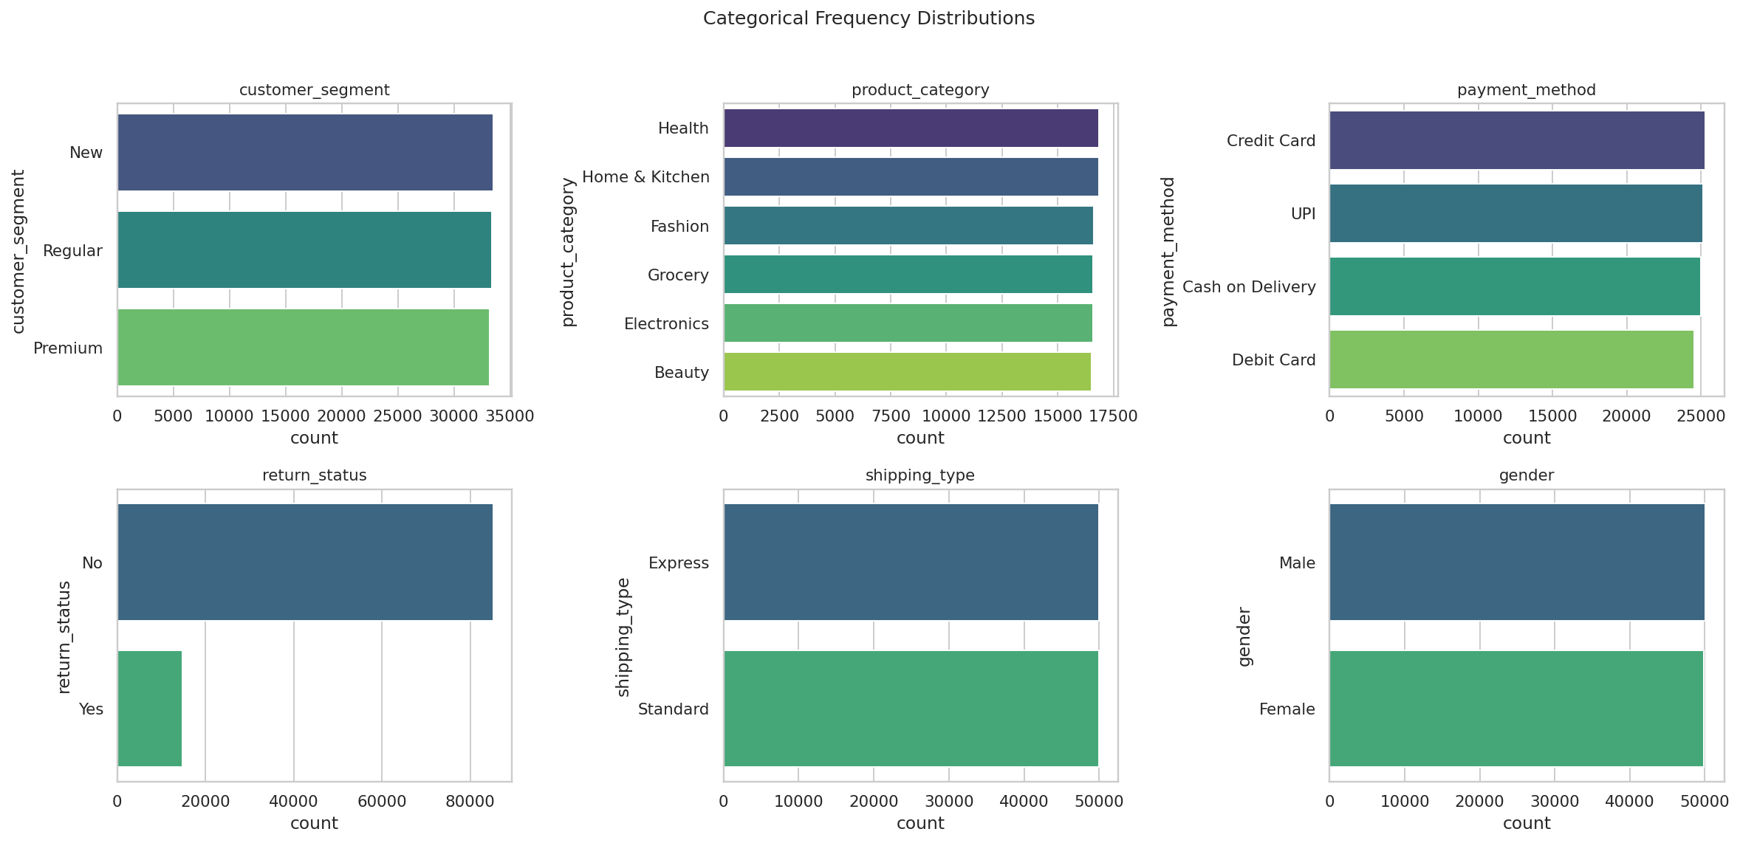
SECTION 02 · UNIVARIATE ANALYSIS
Categorical Variable Frequencies
Every category is
near-even
Segments: 33.5% / 33.4% / 33.2%
Categories: all 6 within 16.5–16.9%
Returns: 14.8% (matches brief's ~15%)
NextHikes IT Solutions — Retail Transaction EDA
6

Slide 7
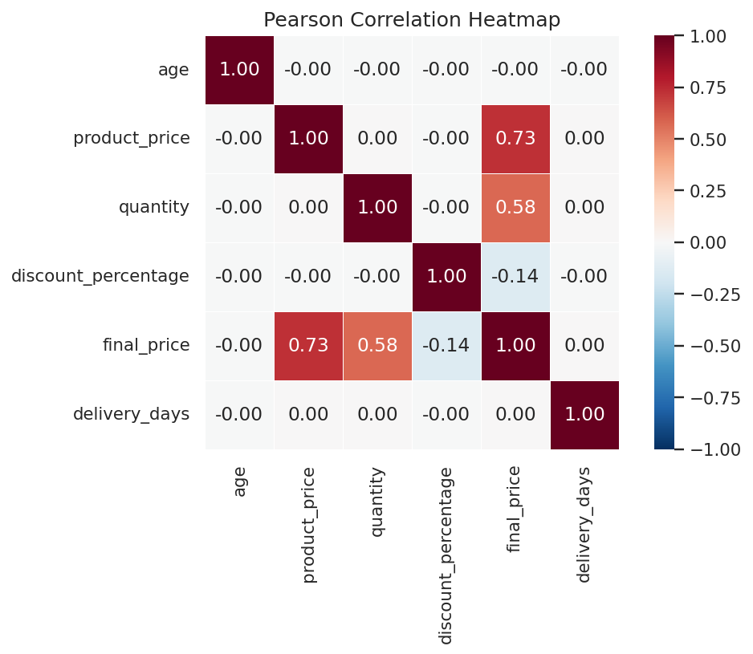
SECTION 04 · CORRELATION ANALYSIS
Pearson Correlation Between Numerical Variables
Correlation with final_price
product_price
+0.731
Strong positive
quantity
+0.575
Moderate–strong
discount_percentage
−0.137
Weak negative
age
−0.001
None
delivery_days
+0.004
None
NextHikes IT Solutions — Retail Transaction EDA
7

Slide 8
THE CENTRAL FINDING
final_price Is Not an Independent Measurement
final_price = product_price × quantity × (1 − discount_percentage / 100)
Verified exactly across all 100,000 rows (max deviation: 2.9 × 10⁻¹¹)
age, product_price, quantity, discount_percentage, and delivery_days are independent, uniformly-distributed random variables.
Every pairwise correlation among them is under ±0.01 — statistically indistinguishable from zero.
The only real relationships in this dataset flow from the pricing formula above — not from customer behaviour.
NextHikes IT Solutions — Retail Transaction EDA
8

Slide 9
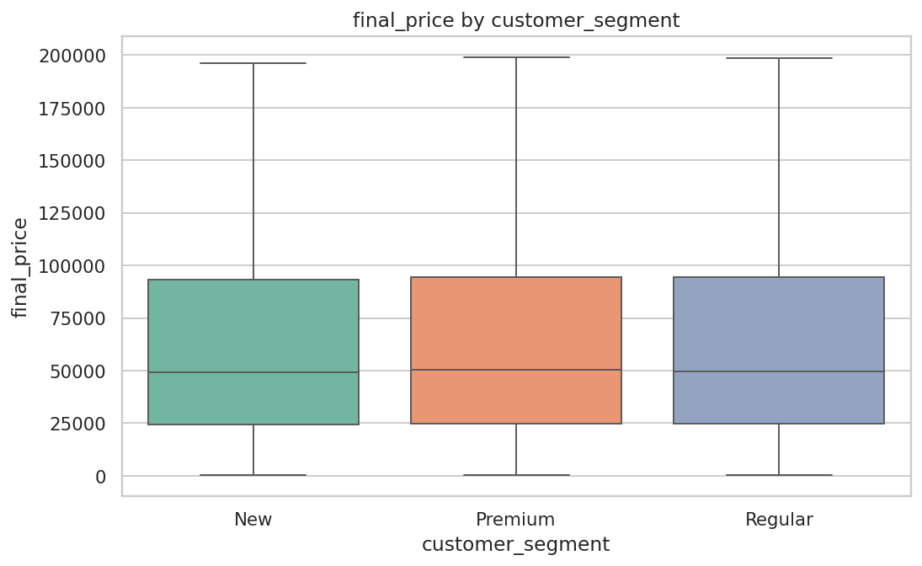
SECTION 05 · BIVARIATE ANALYSIS
Customer Segment vs. Spending
ANOVA Test
F = 1.659, p = 0.190
p > 0.05 → no statistically significant difference in spending across segments.
✗ Brief's Expected Insight
“Premium customers had higher average spending.”
Not supported by this data — mean final_price is statistically identical across New, Regular, and Premium segments.
NextHikes IT Solutions — Retail Transaction EDA
9

Slide 10
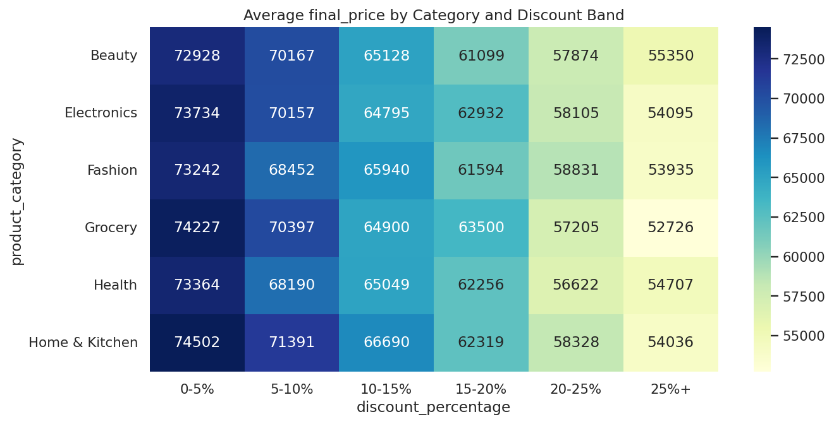
SECTION 06 · MULTIVARIATE ANALYSIS
Product Category × Discount Band × Revenue
Revenue falls steadily left to right in every row — expected, since discount is a direct factor in the price formula.
What's missing: no category row stands out from the others. Category has no independent effect.
NextHikes IT Solutions — Retail Transaction EDA
10

Slide 11
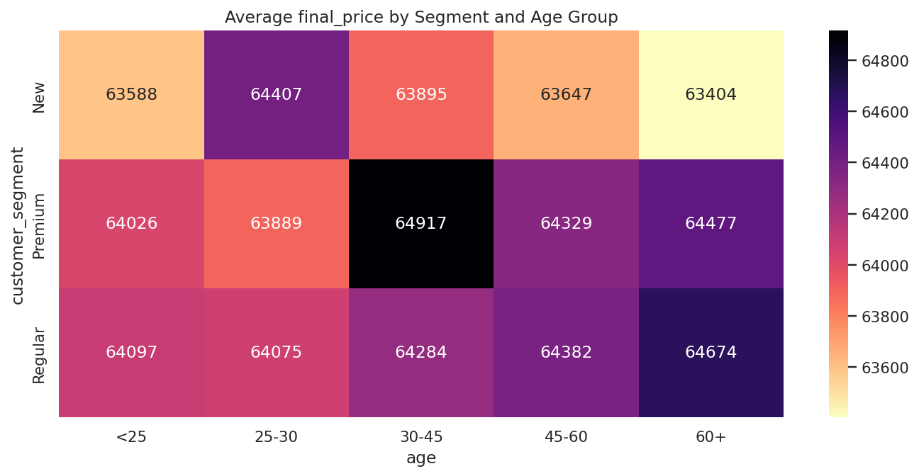
SECTION 06 · MULTIVARIATE ANALYSIS
Customer Segment × Age Group × Spending
Brief expected: “Premium customers aged 30–45 spent the most.”
Actual: values fluctuate randomly across every segment/age cell — no age group or segment stands out.
NextHikes IT Solutions — Retail Transaction EDA
11

Slide 12
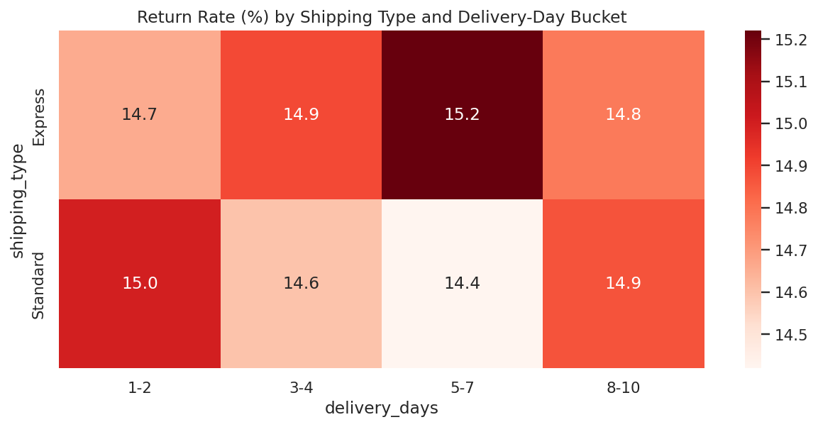
SECTION 06 · MULTIVARIATE ANALYSIS
Shipping Type × Delivery Days × Return Rate
Correlation Check
r = +0.001
between delivery_days and return status
Brief expected longer delivery → more returns. This dataset shows no such link.
NextHikes IT Solutions — Retail Transaction EDA
12

Slide 13
SECTION 07
Brief's Expected Insights vs. What the Data Shows
Brief's Claim
Result
Actual Finding
Discount uniform 0–30%
✓
Confirmed
Return rate ≈ 15%
✓
Confirmed — 14.8%
product_price positively skewed
✗
Symmetric (skew = 0.003)
final_price has heavy tails
✗
Near-normal (kurtosis = 0.17)
Majority “Regular” segment
✗
Even 3-way split (~33% each)
Electronics highest transactions
✗
All 6 categories ≈ 16.7%
Premium customers spend more
✗
ANOVA p = 0.19, no difference
Express shipping cuts delivery time
✗
5.50 vs 5.51 days, p = 0.37
Longer delivery → more returns
✗
r = +0.001, no relationship
NextHikes IT Solutions — Retail Transaction EDA
13

Slide 14
CONCLUSION
A Complete EDA — and an Honest Read of the Data
Techniques applied: univariate, bivariate & multivariate analysis · IQR/Z-score outlier detection · Pearson correlation · ANOVA · skewness & kurtosis
Main takeaway
Five of six numerical variables are independent, uniformly-distributed random data with no real relationships to spending, segment, or returns. final_price is the one exception — it is fully explained by a deterministic pricing formula, not by customer behaviour. Distinguishing what a dataset is expected to show from what it actually demonstrates is the core value of exploratory analysis.
NextHikes IT Solutions — Retail Transaction EDA
14

