Slide 1


Classification of driver's cognitive workload for the transfer of control of Autonomous Vehicles
Juhi Gupta, Priyanka Upadhyay, Urs Buschauer
AHMIAS Seminar winter 21/22,
Software Project Presentation, 03 February 2022
Advisor: Gulliermo Reyes Fuentes

Slide 2
Outline
Motivation
Introduction
Proposed Approach
Dataset
Levels of cognitive workload
Experiment setup
Feature Selection
Implementations
Evaluation
Future work
Conclusion
References
.

Slide 3
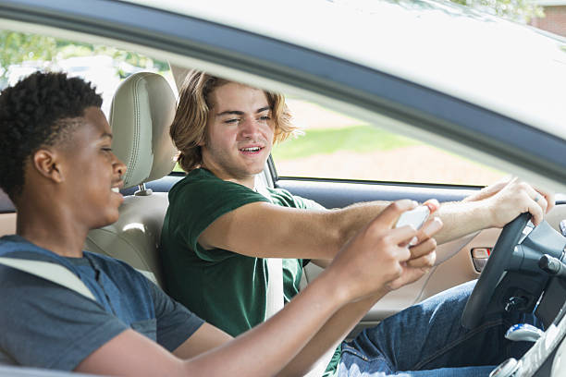
Motivation
Road crashes to human error ranges between 75% and 95% of the cases
Sources of driver Distractions: Visual, Manual & Cognitive
Cognitive: “mental” distractions take the driver’s mind off the task at hand (safe driving)
EU Council of Ministers mandated automakers to install advanced safety systems(2019)

Slide 4
Introduction
Goal: Estimate user's cognitive state to adapt an HMI system
Proposition: An autonomous system could
offer to take over the control
estimate when the driver take the control back from the vehicle.
Challenge: To come up with the best algorithm to decode mental workload from EEG signals from a training data set comprising several sessions

Slide 5
Proposed Approach
Initial proposed approach:
Step 01: Data Acquisition: Design and conduct a small experiment on a driving simulator using DFKI’s OpenDS1/Microsoft’s AirSim2
Step 02: Model Training: one or two experiments
Step 03: Demonstration in real-time
Under Covid restriction, Step 01 and Step 03 could not be performed.
Adapted approach:
Step 01: Using already available EEG dataset
Step 02: Multiple experiment on Model training using different features and different Classifier
Step 03: Reporting and evaluating the results

Slide 6
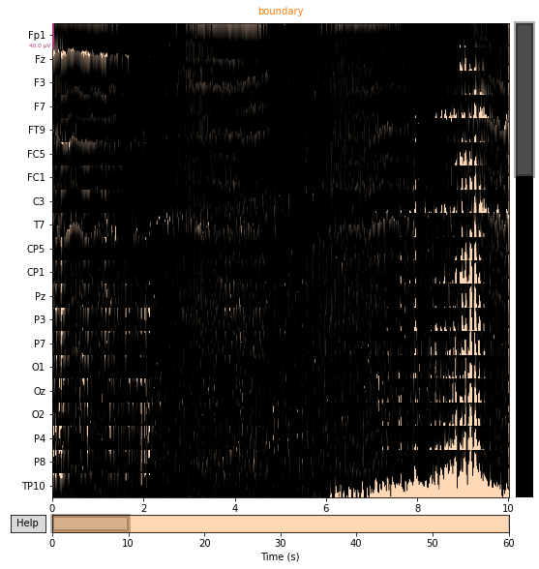
Dataset
Data acquisition was performed using a 62 actiChamp Electrode system
15 subjects (6 female; 9 average 25-year-old)
5 minutes per session
3 independent experimental sessions for each participant
Each session was separated by 7 days.
Dataset link: https://zenodo.org/record/5055046#.Yffe8OrMJPb
P01, S01, EEG signal

Slide 7
Levels of cognitive workload
To evaluate operator performance and workload: Multi-Attribute Task Battery (MATB-II) by NASA
3 levels of workload : MATBeasy, MATBmed, MATBdiff,
Easy
Track & System monitoring task
Medium
Difficult
Communication
Resource management task

Slide 8
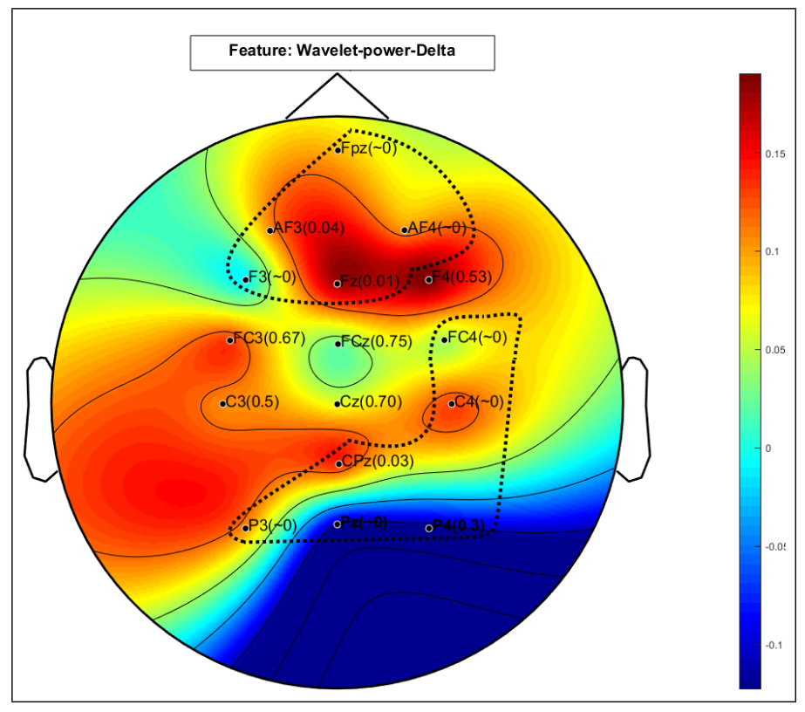
Experiment Setup
Possible Adjustments
Training
Per Participant
Over all Participants
Electrodes
Using Wavelet-power-Delta
Classes
(easy, med, diff)
(easy, med)
(easy, diff)
Classifier
Logistic Regression
SVM
​
.

Slide 9
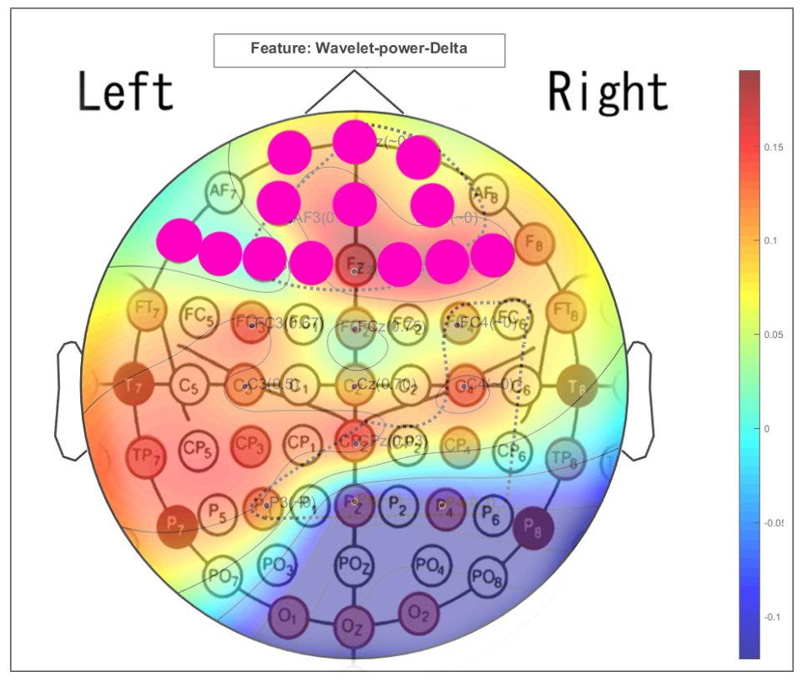
Feature Selection
​
Feature set0 (13 electrodes)
Used in Example Code (Average use case)
['F7',’F5’ ,'F3','F1','F2','F4','F6','AF3','AFz','AF4','FP1','FP2','FPz’]
Feature set1 (all 62 electrodes)

Slide 10
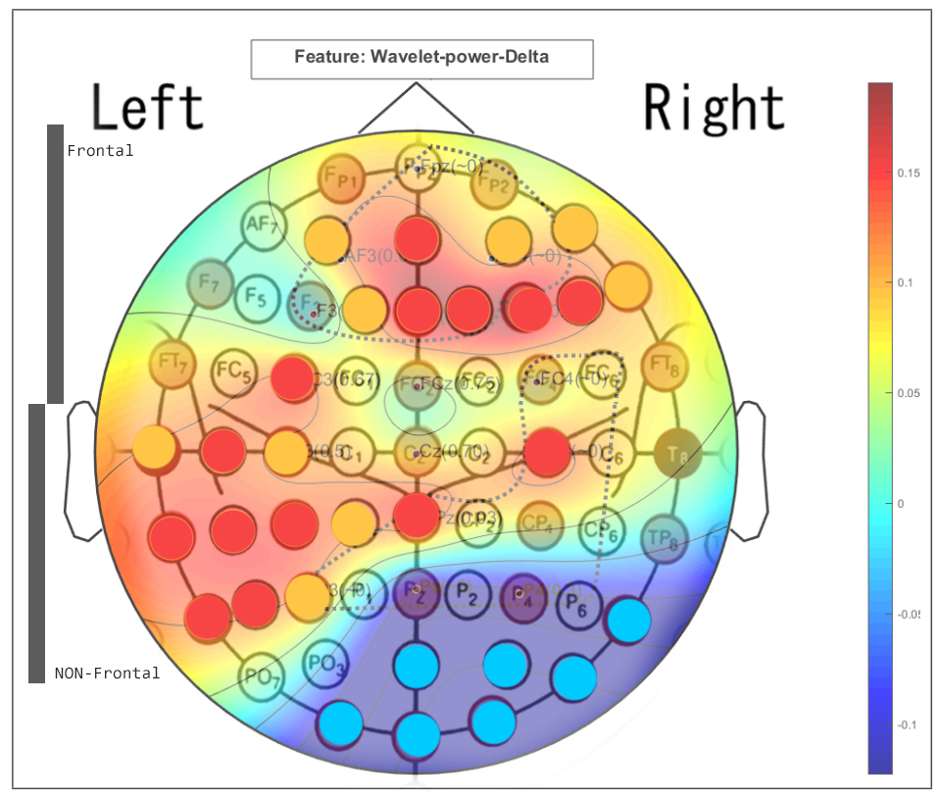
Feature Selection
Feature set2 (30 electrodes) + +
['AF3','AFz','AF4','AF8','F1','Fz','F2','F4','F6','F8','FC3','T7','C5','C3','C4','TP7','CP5','CP3','CP1','CPz','P7','P5','P3','P8','POz','PO4','PO8','O1','OZ','O2']
Feature set3 (11 electrodes): + (Frontal)
['AF3','AFz','AF4','AF8','F1','Fz','F2','F4','F6','F8','FC3']
Feature set4 (12 electrodes): + (Non-Frontal)
['T7','C5','C3','C4','TP7','CP5','CP3','CP1','CPz','P7','P5','P3']
​

Slide 11
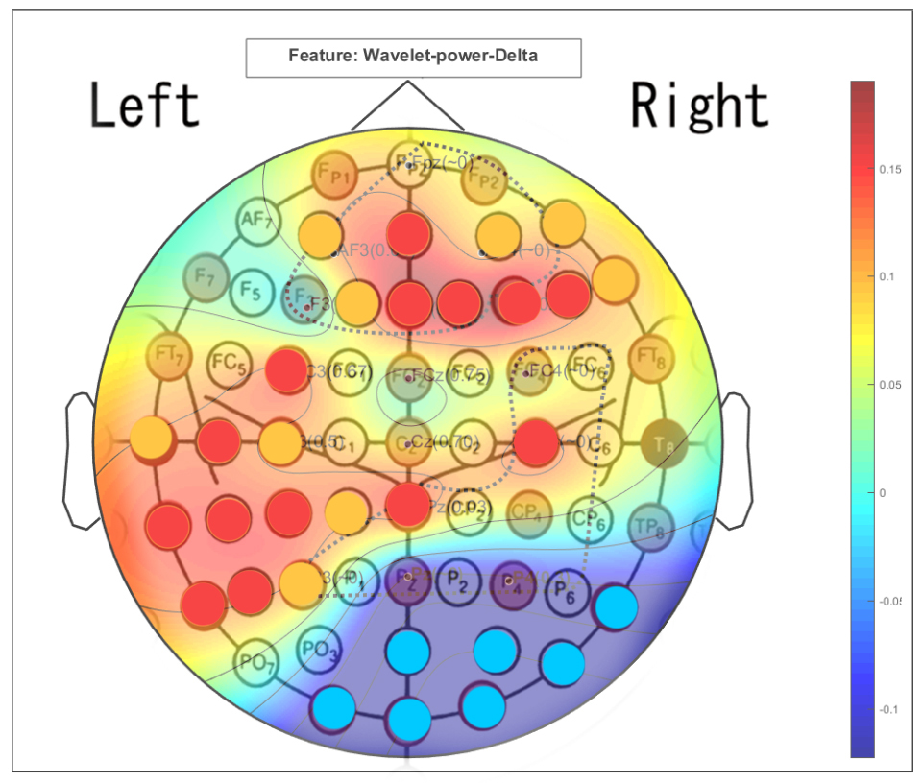
Feature Selection
Feature set5 (7 electrodes)
['P8','POz','PO4','PO8','O1','OZ','O2‘]
Feature set6 (14 electrodes)
['AFz','Fz','F2','F4','F6','FC3','C5','C4','TP7','CP5','CP3','CPz','P7','P5’]
Feature set7 (23 electrodes): +
['AF3','AFz','AF4','AF8','F1','Fz','F2','F4','F6','F8','FC3','T7','C5','C3','C4','TP7','CP5','CP3','CP1','CPz','P7','P5','P3']
​

Slide 12
Implementation: Experiment 1 - Classifier for individual Participant
Setup:
Per participant
Logistic Regression
Different electrode combinations
Different combinations of cognitive Levels
Goal:
Estimate impact of certain electrode groups
Estimate potential performance for different Scenarios
12
Notes:
These Classifiers were chosen because they are simple learners, they generate explicit interpretable models and they can be implemented as incremental learners (i.e. they can adjust the existing model and do not have to relearn from scratch when confronted with
new training data).

Slide 13
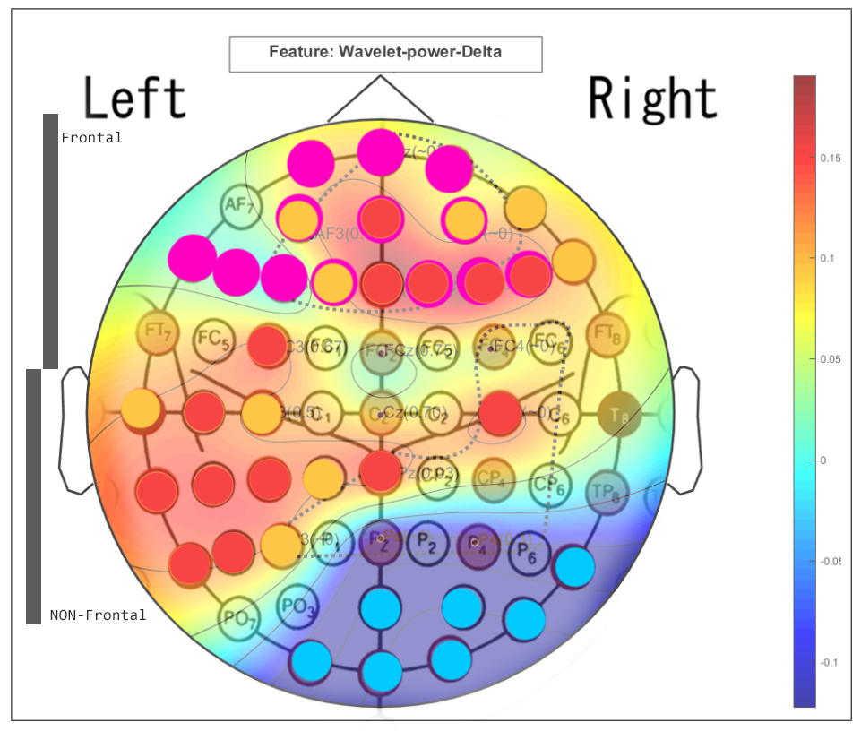
Results from Experiment1
Logistic Regression(C=1/10.) CV5 Mean​
Electrodes Features Setting | 3 Class [easy, med, diff] | 2 Class [easy, med] | 2 Class [easy, diff]
Feature set0 (13) | 72.34% | 83.04% | 85.96%
Feature set1 (62) | 92.56% | 95.53% | 97.43%
Feature set2 (30) | 90.99% | 94.36% | 96.98%
Feature set3 (11) (Frontal) | 74.64% | 85.52% | 87.36%
Feature set4 (12) (Non-Frontal) | 79.73% | 88.80% | 90.90%
Feature set5 (7) | 72.38% | 80.85% | 88.63%
Feature set6 (14) | 80.84% | 89.49% | 92.54%
Feature set7 (23) | 87.71% | 93.33% | 94.89%

Slide 14
Implementation: Experiment 2 - Classifier across Participants
Drawback of Experiment 1:
It is getting trained for specific dataset. Not good for real time scenario
Advantage of Experiment 2:
Model will learn multiple drivers' physiologically features to perform good in real time scenarios
Goal:
Find common features which can classify cognitive load automatically across individuals.
Different electrodes combinations
.
Notes:
Advantage of Experiment 2:
Model should learn how driver physiologically behave under elevated cognitive workload so model needs to learn multiple driver’s physiologically features to perform good in real time scenario Because each person physiologically behave very differently.

Slide 15
Results from Experiment2
Logistic Regression(C=1/10.) CV5
Electrodes Features Setting | 3 Class [easy, med, diff] | 2 Class [easy, med] | 2 Class [easy, diff]
Feature set0 (13) | 83.15% | 92.44% | 97.48%
Feature set1 (62) | 99.56% | 99.35% | 99.18%
Feature set2 (30) | 98.32% | 95.80% | 99.16%
Feature set3 (11) (Frontal) | 81.01% | 92.44% | 96.64%
Feature set4 (12) (Non-Frontal) | 85.96% | 84.10% | 98.32%
Feature set5 (7) | 71.51% | 74.79% | 87.50%
Feature set6 (14) | 91.10% | 89.92% | 98.23%
Feature set7 (23) | 96.11% | 94.12% | 99.14%
Notes:
We have results from Logistic regression classifier here with C (Inverse parameter = 1/10
I will first talk about results achieved taking 3 classes int0 consideration:
Set0 (average setting)
Set1: when we use all the electrodes, accuracy is above 99% which is best accuracy
Set2: above 98% (which means that even if we are using half of the electrodes , we are still getting best accuracy )
Set3 (WP>= 0.05): only frontal electrodes. Which has most of he cognitive load functioning (give very good results)
Set4 (WP>= 0.05):
Set5 (WP<= - 0.05): all non-frontal
Set6 (WP>= 0.01)all non-frontal: : these electrodes are those which has the highest
Set7 (WP>= 0.05): random combination

Slide 16
Implementation: Experiment 3 - SVM Classifier
Model Type: Classifier across participants
Approach: Using Support vector machine
Configurations: "one-versus-one" approach for multi-class classification
Results:
Kernel | Linear | RBF
F Score | 33.56 | 44.74
Accuracy | 33.88 | 47.30
Notes:
For SVM
RBF kernel gets the higher accuracy because we have given 3 classes in datasets and linear kernel wont do good

Slide 17
Evaluation
With all electrodes => Highest accuracy
Comparable accuracy with 30 electrodes & with 62 electrodes => Set of these 30 electrodes are vital
For Logistic Regression, Higher the C value => Higher the accuracy
Support Vector Machine has been widely used on EEG data. However, our implementation requires more exploration and testing to improve accuracy
Notes:
Point2; so if we have large dataset and we want to avoid large computation cost, 30 electrodes would do the good job

Slide 18
Future work
With additional measures:
More sensitive features sets
SVM classifier result analysis to get better results
Choose other classification algorithms.
Possibility to get similar or improved results by:
Train the algorithm on bigger dataset.
Train-test the model with random sessions to learn the different physiological scenario.
If time permits, verify a draft human machine interface that adapts on the transfer of the control of the autonomous vehicle (to be discussed)
.
Notes:
Train the model by providing random session from different participants instead of giving sessions in sequences. In such way model will get learn different physiological pattern and cognitive load combination from many participants which can perform better in real time scenario.

Slide 19
Conclusion
Classification accuracy depends on
Learning algorithm
Training data
Electrode's settings
Feature selection is the key
High accuracy can lead to:
better recognition of elevated cognitive load periods
can improve adaptive human interface performance
can help in transfer of control to autonomous vehicles
.
Notes:
Adaptive human interface can optimize user experience and safety during driving: The advantages of an adaptive user interface can be that it shows only relevant information based on the current demanded scenario. This creates less confusion for less experienced users and provides ease of access throughout a system which helps to optimize user experience
Find a way to increase accuracy → which can automatically identifying the elevated cognitive workload levels in drivers → evaluate and enhance the interface interaction ability to be more adaptive like in the figure
Classifier with higher accuracy – then how fast interface is responding → if interface is fast to interact and classifier gives higher accuracy for the normal and elevated CW then it is very good. Means if we have 90% accuracy means out of 10 times, 9 times classifiers is classifying correctly about normal and elevate CWL.

Slide 20


Slide 21
References
[1] Lei, S. & Welke, S. & Roetting, Matthias. (2009). Represenation of Driver's Mental Workload in EEG Data. Human Factors, Security and Safety. 285-294.
[2] Lyu N, Xie L, Wu C, Fu Q, Deng C. Driver's Cognitive Workload and Driving Performance under Traffic Sign Information Exposure in Complex Environments: A Case Study of the Highways in China. Int J Environ Res Public Health. 2017;14(2):203. Published 2017 Feb 17. doi:10.3390/ijerph14020203
[3] M. A. Almogbel, A. H. Dang and W. Kameyama, "Cognitive Workload Detection from Raw EEG-Signals of Vehicle Driver using Deep Learning," 2019 21st International Conference on Advanced Communication Technology (ICACT), 2019, pp. 1-6, doi: 10.23919/ICACT.2019.8702048.
[4] Distracted-Driver-MultiAction-Classification
[5] Daniele Pinotti, Giulio Francesco Bianchi Piccinini and Fabio Tango. Adaptive human machine interface based on the detection of driver’s cognitive state using machine learning approach
[6] The Impact of Secondary Tasks on Drivers During Naturalistic Driving: Analysis of EEG Dynamics . Vahid Alizadeh & Omid Dehzangi, University of Michigan, Dearborn, USA, November 2016
[7] Using Support Vector Machine on EEG for Advertisement Impact Assessment. Wei Zhen, Wu Chao, Wang Xiaoyi, Supratak Akara, Wang Pan, Guo Yike
.

