Slide 1


Classifying Driver Workload Using Physiological and Driving Performance Data: Two Field Studies Erin T. Solovey12, Marin Zec2, Enrique Abdon Garcia Perez2, Bryan Reimer2, Bruce Mehler2, 2014
Priyanka Upadhyay, Saarland University
2581714, s8prupad@stud.uni-Saarland.de
AHMIAS Seminar winter 21/22, 6 January 2022
Advisor: Gulliermo Reyes Fuentes

Slide 2
Outline
1. Motivation
2. Introduction
3. Approach
4. On-road data acquisition
5. Data Pre-processing
6. Implementations
7. Results and Evaluation
8. Conclusion
9. Discussion and Future work
References

Slide 3
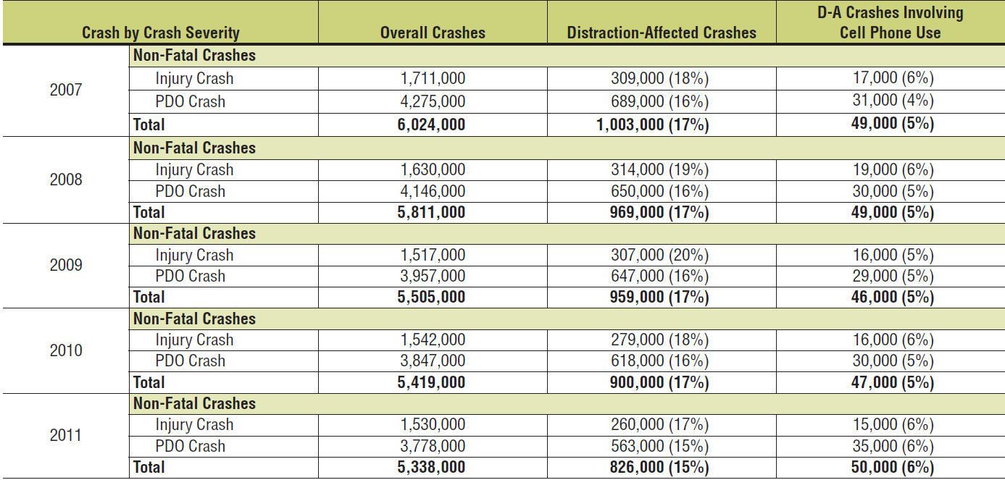
Motivation
Problem:
Major vehicle crashes involve distracted driving.
Goal:
Automatically detect driver’s cognitive workload (CW) through Machine Learning.
Evaluate in-vehicle interface performance
.
Motor Vehicle Traffic Crashes and Distraction-Affected Crashes by Year 2011

Slide 4
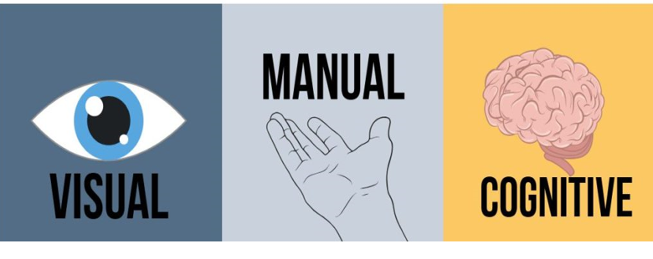
Introduction
How to achieve Goal
Driving is complex activity
It imposes varying levels of workload on the
driver.
.

Slide 5
Introduction
Understanding cognitive workload: help to reduce accidents.
Problem:
Understanding of how:
- evolving in-vehicle interface
- other device; mobile device, music on radio-box etc.
affect the driver cognitive load is extremely difficult task.
Solution:
- understand driver’s cognitive workload through physiological data.
- automatic detect elevated cognitive workload using physiology and vehicle data.
.

Slide 6
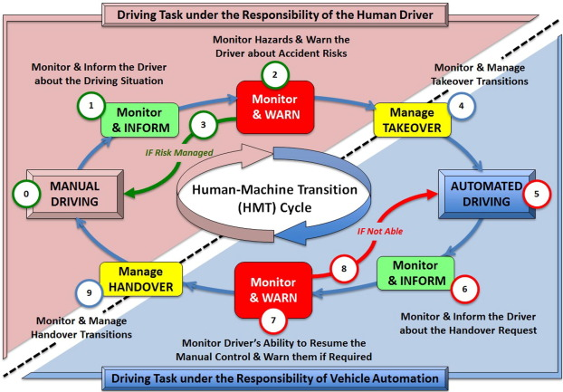
Connection to AHMIAS
Poorly designed in-vehicle user interfaces can lead to:
distraction
risky driving
Adaptive human interface can optimize user experience and safety during driving.
Find a way to increase classification accuracy
automatically identifying the elevated cognitive workload levels in drivers.
evaluate/enhance the interface interaction ability to be more adaptive
Automatically detect cognitive workload and transfer of control of autonomous vehicles

Slide 7
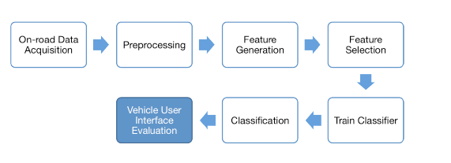
Approach
Classifying driver data for UI evaluation
Approach to evaluate/improve interface performance to automatically detect cognitive workload through Machine Learning.
Steps required for on-road cognitive state classification for vehicle user interface evaluation

Slide 8
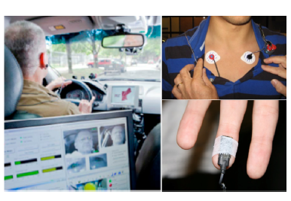
On-road data acquisition
Two types of data: Physiological data (HR, SCL) and Vehicle data (Vehicle speed and Steering wheel angle).
Heart rate(HR) and Skin conductance level (SCL): measure cognitive/mental load of drivers.
Vehicle speed and Steering wheel angle: measure driving performances.
Why HR
easy to use.
Give information about autonomic nervous system.
Why SCL
Very sensitive to arousal (flight-or-fight) and mental workload.
Recording of physiology during on-road driving. Electrocardiogram (top right) and skin conductance (bottom right) sensor placement are shown

Slide 9

On-road data acquisition
Vehicle data: measured during primary task Physiological data: measured during secondary task
How to induce cognitive load on drivers using secondary task
What is Secondary task?
an audio presentation – verbal response delayed digit recall task.
Perform in the form of “n-back task”.
What is n-back task?
0-back: same digit
1-back: digit 1-item back
2-back: digit 2-item back
How does n-back task work?
0-9 digits appears randomly with 2.5 second's gap.
After each digit, driver needs to say the digit out loud in n-back task sequence manner.
Auditory stimuli
Verbal responses
2-back secondary task performed during on-road driving

Slide 10
Data Pre-processing
For HR:
- In EKG signals QRS segments of heartbeat contains sharp spikes.
- EKG signal contain artifices and anomalies while data acquisition.
QRS detection algorithm used to identify heart beats in the signal.
For SCL:
- Wavelet transform used to remove high frequency noise from skin conductance recordings.
For driving performance:
- Steering wheel angle (gap) measure the stability of control while distraction with the help of steering wheel reversal rates.
After preprocessing, signals were resampled to 10 Hz.

Slide 11
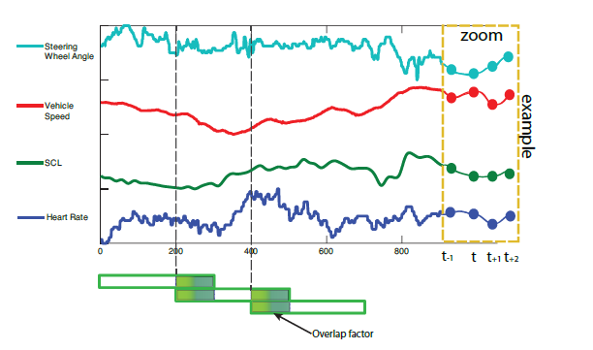
Implementation
Supervised approach
Features: heart rate (HR), skin conductance level (SCL), vehicle speed and steering wheel angle
Labels:
Elevated CW: n-back cognitive demand task period(secondary task)
Normal CW: driving only periods (primary task)
Hyper Parameters: window size and overlap factor.
Sequential sensor data can be broken into fixed length windows (green bars at bottom), which slide across the data. Within each window, we can calculate average, standard deviation, etc. The size of the window and the amount of overlap will affect the analysis.

Slide 12
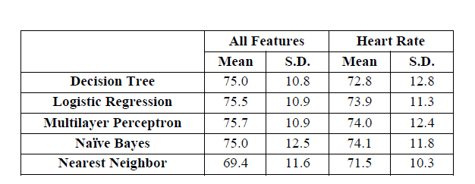
Implementation: Experiment 1: Automatic classification of elevated workload in individual drivers
20 subjects
Goal:
collect individual’s physiological and vehicle data.
build individual models to account for individual differences between drivers.
Classification results
Result discussion
24 observations for 48 minutes.
Training done on 43 minutes (90% of data), which is not ideal training time for real world dataset
Not ideal to build individual classifiers.
Mean and standard deviation for classification of elevated cognitive load from normal driving across 13 subjects using all features (20 subjects for heart rate only)

Slide 13
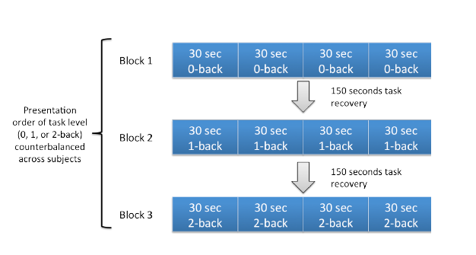
Implementation: Experiment 2: Establishing methods across individuals
99 subjects
Experiment 1 Drawback: bad performance even though built individual classifier.
Goal:
find common features and algorithms that reliably can classify cognitive load automatically across individuals and build one classifier only for all participants.
Protocol Procedure for Experiment 2.

Slide 14
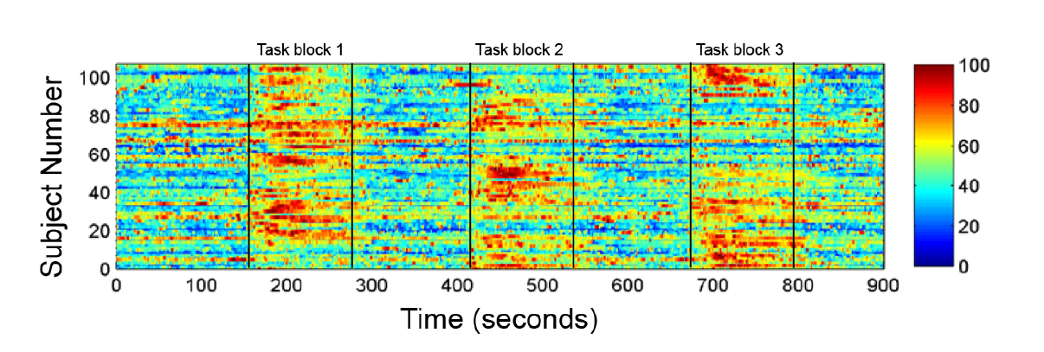
Implementation: Experiment 2: Establishing methods across individuals
Exploratory Analysis :
Heart rate and skin conductance level sensitive to changes in cognitive workload.
Figure shows that while giving metal load in each task block, we get Red spikes.
Red indicates maximum heart rate Blue indicates minimum heart rate

Slide 15
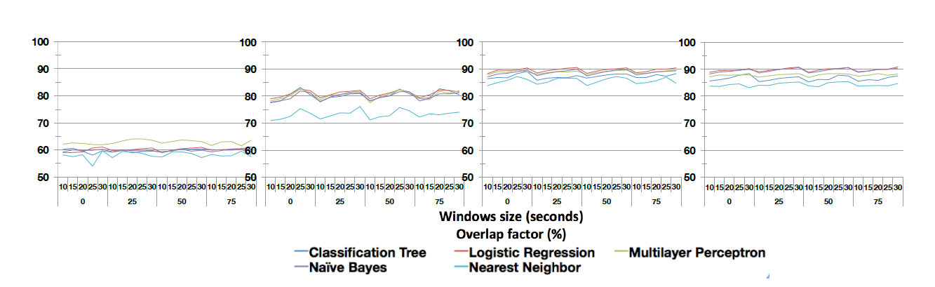
Results and Evaluation
Classification Results
(1) driving features only (2) heart rate features only (3) all physiology features (4) physiology and driving features
Classification accuracy (from left to right) using

Slide 16
Results and Evaluation
Result Analysis:
Hyper Parameters:
- increase windows size improved classification accuracy in all cases, except in first case
- overlap factor doesn’t have a significant impact on the classification accuracy.
Nearest neighbor performed worst, while the other classifiers had similar performance.
The best performance was found in 3 and 4 using physiological data.
(1) driving features only (2) heart rate features only (3) all physiology features (4) physiology and driving features

Slide 17
Conclusion
Summary:
Physiological data improves performance in order to automatically detect elevated cognitive workload.
2) Classification accuracy depends on
Learning algorithm
Training data
Sliding window size
Feature type
3) Feature selection is the key for any machine learning algorithms.
4) High accuracy can lead to:
better recognition of elevated cognitive load periods
can improve adaptive human interface.
can help in transfer of control to adaptive interfaces.

Slide 18
Discussion and Future work
Discussion:
To develop an automatic cognitive workload classifier to evaluate interfaces in real-world driving:
window size, classification accuracy and training data matters.
Trade off between window size and classifier accuracy.
Heart rate feature is a very powerful feature into this.
Future Work:
With additional measures:
- more sensitive physiological performance.
- other driving performance (velocity and both large and short steering wheel reversals)
There are chances to get similar or improved results.
Train the algorithm on bigger dataset.
Also include 0-back and 1-back to evaluate physiological measures with demand levels change.
Choose other classification algorithms.

Slide 19
Thank you!
Open for question

Slide 20
References
[1] Erin T. Solovey, et al. Classifying driver workload using physiological and driving performance data: two field studies. CHI, (2014).
[2] National Highway Traffic Safety Admin. Traffic Safety Facts: Distracted Driving. Washington, DC, (2011).
[3] Afergan, D., et al. Dynamic Difficulty Using Brain Metrics of Workload. Proc. CHI, (2014).
[4] Gopher, D. and Donchin, E. Workload: An examination of the concept. In K.R. Boof, L. Kaufman and J.P. Thomas, eds., Handbook of Perception and Human Performance. (1986), 41–1–41–49.
[5] Grimes, D., Tan, D.S., Hudson, S.E., Shenoy, P., and Rao, R.P.N. Feasibility and Pragmatics of Classifying Working Memory Load with an Electroencephalograph. Proc. CHI. (2008), 835–844.
[6] Haigney, D., Taylor, R., Westerman, S. Concurrent mobile (cellular) phone use and driving performance: task demand characteristics and compensatory processes. Transportation Research F 3, 3 (2000), 113–121.
[7] Mehler, B., Reimer, B., Wang, Y. A comparison of heart rate and heart rate variability indices in distinguishing single task driving and driving under secondary cognitive workload. Proc Driving Symposium on Human Factors in Driver Assessment, Training & Vehicle Design, (2011), 590–597.
[8] Miyaji, M., Danno, M., Kawanaka, H., and Oguri, K. Driver’s cognitive distraction detection using AdaBoost on pattern recognition basis. ICVES, (2008), 51–56.
[9] Li, X. & Meng, F. & Zheng, X. & Ren, Y. & Yan, J. & Wu, P. & Zhang, J.. (2018). Psychological Characteristics of Drivers in the Stress Scene Based on Heart Rate Variability. Shanghai Jiaotong Daxue Xuebao/Journal of Shanghai Jiaotong University. 52. 163-168. 10.16183/j.cnki.jsjtu.2018.02.006.
[10] Strayer, D.L., Cooper, J.M., Turrill, J. et al. Talking to your car can drive you to distraction. Cogn. Research 1, 16 (2016). https://doi.org/10.1186/s41235-016-0018-3
[11] Östlund, J., et al. Adaptive Integrated Driver-Vehicle Interface (AIDE): Driving performance assessment - methods and metrics. Gothenburg, Sweden, (2005).
[12] Zander T. O., Kothe C. Towards passive brain–computer interfaces: applying brain-computer interface technology to human–machine systems in general. J. Neural Eng. 8, (2011).

