Slide 1
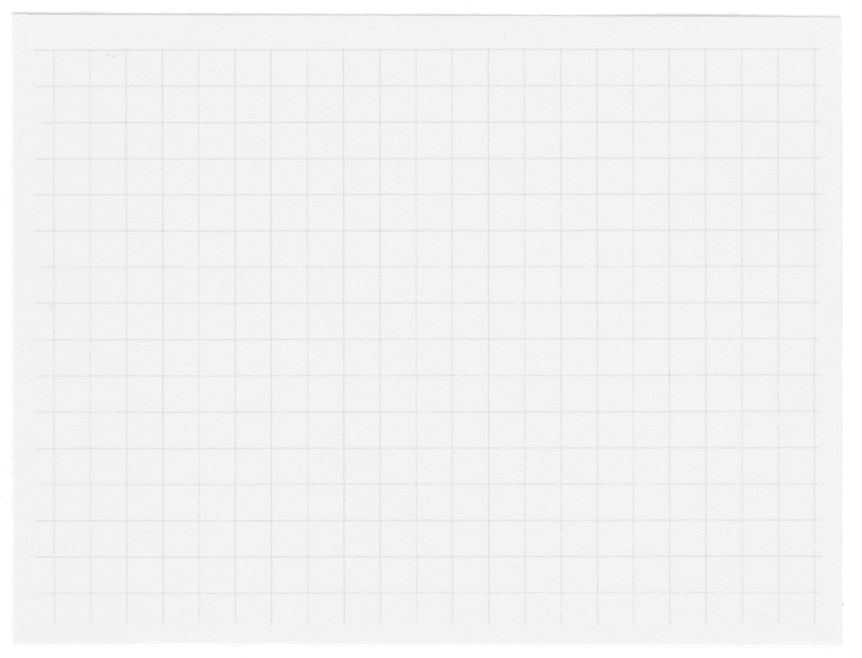





Capstone Project
FORECASTING FOOD DELIVERY DEMAND USING WEATHER & TIME
Presented by:
Priyank Patel-patel0938@saskpolytech.ca
Neel Patel- patel18401@saskpolytech.ca

Slide 2



01.
This project focuses on developing a predictive model to forecast food delivery demand based on weather conditions and time of day.
Project vision and mission
By integrating machine learning techniques, the project aims to optimize food delivery operations, enhancing business efficiency and customer satisfaction.
02.
Accurate demand forecasting will enable food delivery platforms to better allocate resources, staff up during high-demand times, and provide efficient service even during challenging weather conditions.
03.

Slide 3
Project Objectives
Develop a Comprehensive Dataset: Compile a dataset combining historical food delivery data with corresponding weather conditions and time-of-day information for accurate modeling.
Preprocess the Collected Data: Clean, encode, and normalize the data to ensure it is in a suitable format for machine learning, eliminating inconsistencies and enhancing model performance.
Train a Machine-Learning Model: Use a suitable algorithm to train the model on the preprocessed data, enabling accurate prediction of delivery demand.
Evaluate Model Performance: Assess the model’s effectiveness using statistical metrics like Mean Squared Error (MSE) and R-squared to ensure reliable predictions.
Visualize Predicted Demand: Create visual representations, such as bar graphs and line charts, to help users understand and compare predicted demand patterns. [3]
Create an Interactive User Interface: Develop a simple interface that allows users to input variables and receive real-time demand predictions, enhancing usability.

Slide 4
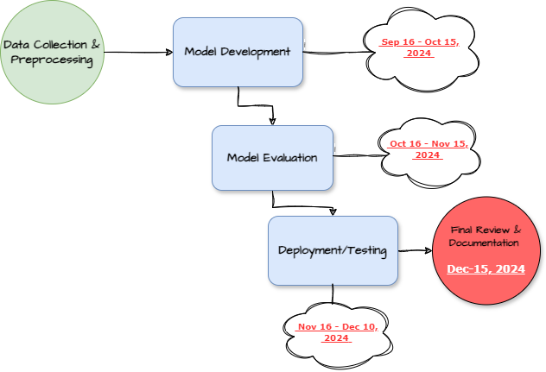
Project milestones

Slide 5
Technologies or Service
Programming Language: Python
Libraries: Pandas, NumPy, Scikit-learn, Matplotlib, Seaborn for data visualization
Tools: Google Colab
Dataset: Kaggle or other publicly available datasets (Food Delivery Dataset, n.d.) [1]

Slide 6

Input Layer:
Processing Layer:
Data (weather conditions, time of day)
Data preprocessing, feature engineering, model training
Architecture
Output Layer:
Interface:
Predicted number of deliveries for given weather and time of day
A user-friendly web interface to input variables and display predictions
[2]

Slide 7





Conclusion:
This project aims to build a predictive model to forecast food delivery demand based on weather the goal of this work is to use the weather and the hour of the day as inputs to the model, which is to predict demand for food delivery in the future.
Having machine learning incorporated with real-time weather information, this project has high potential in helping the logistics and food delivery sectors.

Slide 8

List of references:
Food Delivery Dataset. (n.d.). Retrieved from https://www.kaggle.com/datasets/gauravmalik26/food-delivery-dataset/data [1]
Food Delivery Time Prediction with LSTM Neural Network. (n.d.). Retrieved from Analytics Vidhya: https://www.analyticsvidhya.com/blog/2023/04/food-delivery-time-predictionwith-lstm-neural-network [2]
Food-Delivery-Time-Prediction-Model. (n.d.). Retrieved from https://github.com/SaloniJhalani/Food-Delivery-Time-Prediction-Model/tree/main/code [3]

Slide 9
Thank you very much!
Presented by:
Priyank Patel-patel0938@saskpolytech.ca
Neel Patel- patel18401@saskpolytech.ca

