Slide 1
ExpressJs

Slide 2
npm

Slide 3
Modules
Good authors divide their books into chapters and sections; good programmers divide their programs into modules.
Modules are highly self-contained units of code with distinct functionality, allowing them to be shuffled, removed, or added as necessary, without disrupting the system as a whole.
Modules provide:
Maintainability
Reusability
Namespacing

Slide 4
Modules
Modules are managed in your project using a package manager. For example:
Node Package Manager (npm) for Node.js and client applications
Bower for client applications
There are multiple standards for structuring JavaScript modules and loading them into applications.
CommonJS for Node.js
RequireJS for web applications

Slide 5
Node Modules
Node modules are managed using npm which is installed with node
npm can help manage the metadata that accumulates for a project in a file called package.json
For example, the package.json file will contain a list of dependencies for your application
In order for npm to manage your modules you must first initialize npm in your project folder:
npm init

Slide 6
package.json
{
"name": "first-in-class",
"version": "1.0.0",
"description": "Demonstrate express in class",
"main": "index.js",
"scripts": {
"test": "echo \"Error: no test specified\" && exit 1"
},
"author": "Ross",
"license": "ISC“
}
Basic initial package.json
When you add node modules to the project, the packages and versions can be listed as dependencies in the package.json file.
Other utilities such as Grunt use the package.json file to learn about your project. When you deploy the project to another computer, you don’t have to transfer all the module files. Just npm to install all the dependencies listed in the package.json file.

Slide 7
Node Modules
To install a node module in the current project folder use:
This install the module called express.js in a folder called node-modules
The –save option cause the module to be listed as a dependency in package.json
When you upload your application to GitHub you don’t want to upload the contents of the node-modules folder because that code can be installed using npm
If all your dependencies are saved into the package.json file then it’s simple to install all the require modules
ALWAYS USE –SAVE WHEN YOU INSTALL MODULES IN THIS CLASS
npm install express --save

Slide 8
Node Modules
To install a module globally use this:
This installs the files in the Program Files folder and adds it to the system path so you can execute it from anywhere
npm install mongoose -g

Slide 9
Dependencies in package.json
{
"name": "firstexpress",
"version": "1.0.0",
"description": "",
"main": "index.js",
"scripts": { "test": "echo \"Error: no test specified\" && exit 1" },
"author": "",
"license": "ISC",
"dependencies": {
"debug": "^2.2.0",
"express": "^4.14.0"}
}

Slide 10
Express.js

Slide 11
Express.js
Express is a minimal yet flexible web development framework for node.js
It adds a great deal of functionality to node to simplify the development of complex web applications
npm install express --save

Slide 12
First Express Server
var express = require('express');
var app = express();
app.get('/', function(req,res){
res.send('Hello World!');
});
app.listen(3300);
App object implements the server in express
Responds to GET requests with url /

Slide 13
Application object methods and properties
Property/Method | Function
app.set(name, value) | Sets app-specific properties
app.get(name) | Retrieves value of property
app.use([path], function) | Loads a middleware in the app
app.engine(ext, callback) | Registers a template engine for the app
app.[VERB](path, [callback…], callback) | Defines a route and handlers based on HTTP verbs
app.locals | An object to store variables accessible from views
app.render(view, [options], callback) | Renders a view from the app and sends it to the browser
app.routes | A list of routes defined in the app
app.listen() | Turns on the server

Slide 14
Configuring the PORT
var express = require('express');
var app = express();
app.set('port', process.env.PORT || 3000);
app.get('/',function(req,res){
res.send('Hello World!');
});
app.listen(app.get('port'), function(){
console.log('Express started on http://localhost:' + app.get('port'));
});
Looks for environment variable and if it isn’t set, sets the port to 3000
Retrieves the port variable and tells server to listen on that port
Adds a callback function to run once server has started

Slide 15
Middleware
Express works by using middleware to process incoming requests
Each middleware installed can make changes to the request and response objects before passing them on to the next middlware
Any middleware can end the chain by sending a response back to the client
app.use(function(req, res, next){
console.log(‘Request from: ‘ + req.ip); next();
});

Slide 16
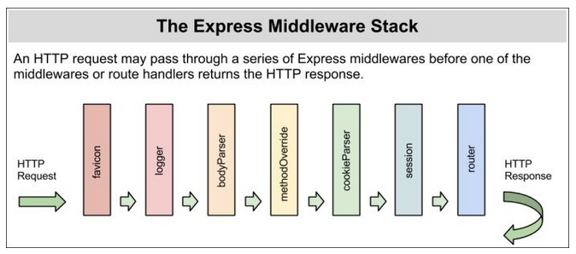

Slide 17
Middleware
Middleware is loaded using the app.use() method
var http = require('http');
var express = require('express');
var app = express();
app.use(function(req, res, next){
console.log('Request from ' + req.ip);
next();
});
app.get('/',function(req,res){
res.send('Hello World!');
});
http.createServer(app).listen(3000, function(){
console.log('Express server listening on port ' + 3000);
})
req – request object
res – response object
next – reference to the next middleware in line

Slide 18
Middleware
var http = require('http');
var express = require('express');
var app = express();
app.use(function(req, res){
console.log('Request from ' + req.ip);
});
app.get('/',function(req,res){
res.send('Hello World!');
});
http.createServer(app).listen(3000, function(){
console.log('Express server listening on port ' + 3000);
})
Now try it like this

Slide 19
Adding Error Handlers
Insert this after the app.get() function.
The first will be called if no other route is found
and will send the 404 not found message
The second will be called if an error is encountered by any other middleware
The app.use() syntax is used to configure middleware.
Each middleware module configured is processed, in turn, and results like err objects are passed from on to another.
The order in which middleware and routes are added is significant.
app.use(function(req, res){
res.type('text/plan');
res.status(404);
res.send('404 Not Found');
});
app.use(function(err, req, res, next){
console.error(err.stack);
res.type('text/plan');
res.status(500);
res.send('500 Sever Error');
});

Slide 20
Adding More Routes
app.get('/about', function(req, res){
res.send('About Us!');
});
To add more routes, add them before the 404 handler.

Slide 21
Route Order
app.get('/about', function(req, res){
Console.log(‘about’);
res.send('About Us!');
});
app.get('/about/directions', function(req, res){
res.send('About Us!');
});
This route will never be matched because the /about route comes first.
The more specific routes should come first.

Slide 22
nodemon

Slide 23
nodemon
While working on an application you often make frequent small changes and it can be tedious to have to manually restart the application after every change
nodemon is a program that watches for changes to application files and restarts the application automagically after every change
To start the application use:
To stop the application use ctrl-c
npm install nodemon -g
npm install nodemon --save
nodemon <app entry file>

Slide 24
Static Web Server

Slide 25
Static Server
Var path = require(‘path’);
…
app.use(express.static(path.normalize(__dirname) + '/public'));
To serve static assets (i.e. html files) all we have to do is indicate the folder where they are located.
This statement comes before any other routes.
__dirname (two underscores) provides the directory of the file in which it is used.

Slide 26
Reorganizing

Slide 27
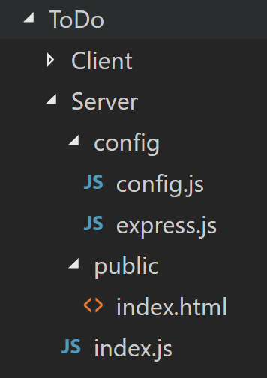
Organization of project so far
The config folder contains code that configures the server
config.js contains configuration data
express.js contains most of the server configuration code
The public folder contains static assets
index.js contains the bare minimum code required to bootstrap the application

Slide 28
index.js
Loads the express.js file to configure the server and passes the express app object to it
var express = require('express');
var app = express();
var port = process.env.port || 3000
require('./config/express')(app);
require('http').createServer(app).listen(port, function () {
console.log('info',"HTTP Server listening on port: %s, in %s mode", port, app.get('env'));
});

Slide 29
config.js
var path = require('path'),
rootPath = path.normalize(__dirname + '/..'),
env = process.env.NODE_ENV || 'development';
var config = {
development: {
root: rootPath,
app: { name: 'ToDo' },
port: 5000,
},
production: {
root: rootPath,
app: { name: 'ToDo' },
port: 80, }
};
module.exports = config[env];
The configuration will use either the development or production configuration based on the NODE_ENV
environment variable
Exports the config determined by the env variable

Slide 30
express.js
var express = require('express');
module.exports = function (app, config) {
app.use(function (req, res, next) {
console.log('Request from ' + req.connection.remoteAddress);
next();
});
app.use(express.static(config.root + '/public'));
app.use(function (req, res) {
res.type('text/plan');
res.status(404);
res.send('404 Not Found');
});
app.use(function (err, req, res, next) {
console.error(err.stack);
res.type('text/plan');
res.status(500);
res.send('500 Sever Error');
});
console.log("Starting application");
};

Slide 31
index.js
var express = require('express');
var app = express()
var config = require('./config/config');
require('./config/express')(app, config);
console.log("Creating HTTP server on port: " + config.port);
require('http').createServer(app).listen(config.port, function () {
console.log("HTTP Server listening on port: " + config.port + ", in " + app.get('env') + " mode");
});

