Slide 1
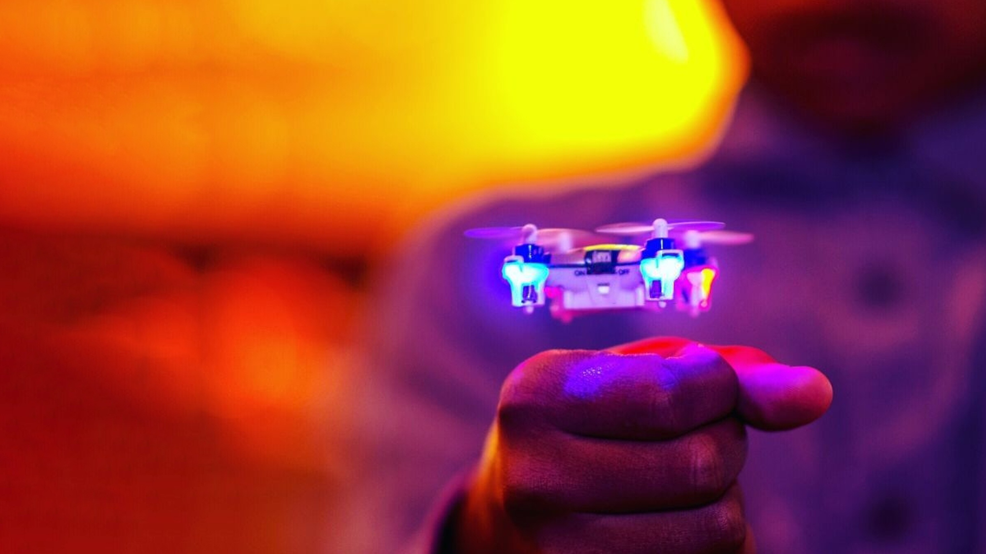

Accenture Innovation Challenge
Blaze the path to new realities

Slide 2
Team name and member details
Team name | Member names | Education institute name
TEAM ULTRON | Aasawari Saprey (Team Leader) | GYAN GANGA INSTITUTE OF TECHNOLOGY AND SCIENCES,JABALPUR
 | Garima Khatri | GYAN GANGA INSTITUTE OF TECHNOLOGY AND SCIENCES,JABALPUR
 | Priyank Namdeo | GYAN GANGA INSTITUTE OF TECHNOLOGY AND SCIENCES,JABALPUR
 | Chitra Upadhyay | GYAN GANGA INSTITUTE OF TECHNOLOGY AND SCIENCES,JABALPUR

Slide 3
Problem statement
Statement
Develop a web application to help small business owners promote their shops and businesses and giving it a boost by providing a platform for selling their products in addition to provide one-to-one interaction to customers and business owner as well.
Description
As we know that a lot small business and small shops suffered huge losses in this pandemic so it is necessary that they get maximum exposure and get to make new connections easily to increase their business

Slide 4
Solution / your big Idea
Our Solution To The business problem will include a web application based prototype.
Establishing A Local for vocal solution for enriching the small local shops to gain one to one owner, customer experience through a single platform.
The technology stack to be used for web application will include Angular for front end Development , My SQL for database management and Node Js for backend management.
There’ll be personalized delivery from your Bakery.
Instant push notification for client and customer.
Feedback and review rating option.
Multiple Payment options.

Slide 5
Impact
Establishing A Local for vocal solution for enriching the small local shops to gain one to one owner, customer experience through a single platform.
The pandemic has really affected the small shop owners in many ways and therefore to help them regain their business and get it back on the track.
Also it will increase clientele of the business by improving their communication with customers and help them with task such as delivery.

Slide 6
How is the solution innovative?
We will customize the web app, taking it from a functional state to a production-ready state. This will involve finding and handling error cases, adding accessibility features, allowing for localization, mediator free service etc.
There’ll be vouchers and coupons for repetitive customers as well as first time customers.
Customer and owner will have their own encrypted accounts and encrypted payment linking options cause privacy and security are a must.
Multiple Payment options.
Aim to Customize / personalize your order.
Hyperlink and enrich username to make business grow and add hash tags in your bio.

Slide 7
Testimony
The idea is not published externally and it has not been patented yet.
IS THE IDEA/INNOVATION PUBLISHED EXTERNALLY AND REFERENCEABLE ? Yes/No
Video Testimony Link OR External publication Links if any

Slide 8

Elevator pitch video (1-2 min)
Watch our elevator pitch on youtube:
https://www.youtube.com/watch?v=stGdufyHNew
Insert the video on this slide or send it separately

Slide 9
Thank you!

