Slide 1
CS 542 : Computer Networks I
Link State Routing Protocol Simulator
Prof. Dr. Michael Y Choi
Name: Priyank P SHAH
CWID: A20344797
E-mail:pshah104@hawk.iit.edu
Seat No: 115 (Section: 03)

Slide 2
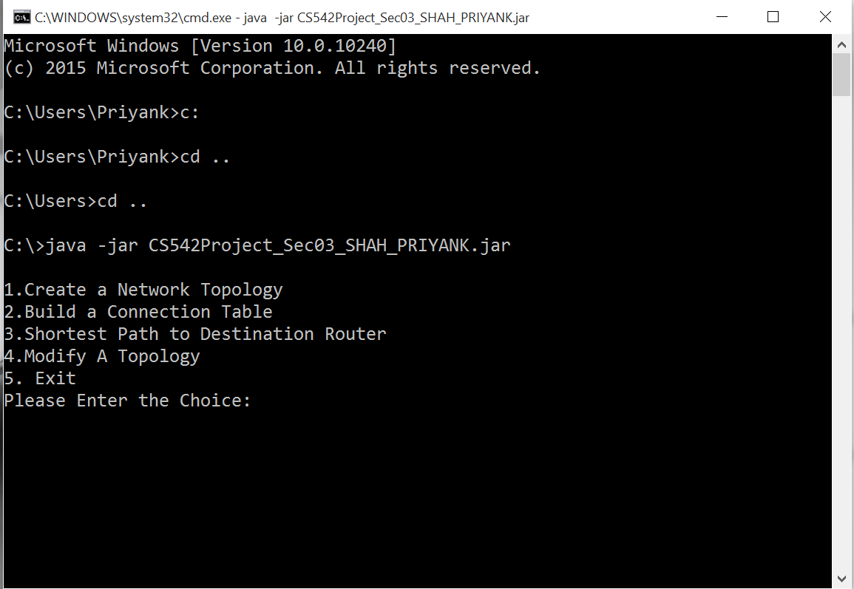
Project Screen-Shots: Welcome Screen

Slide 3
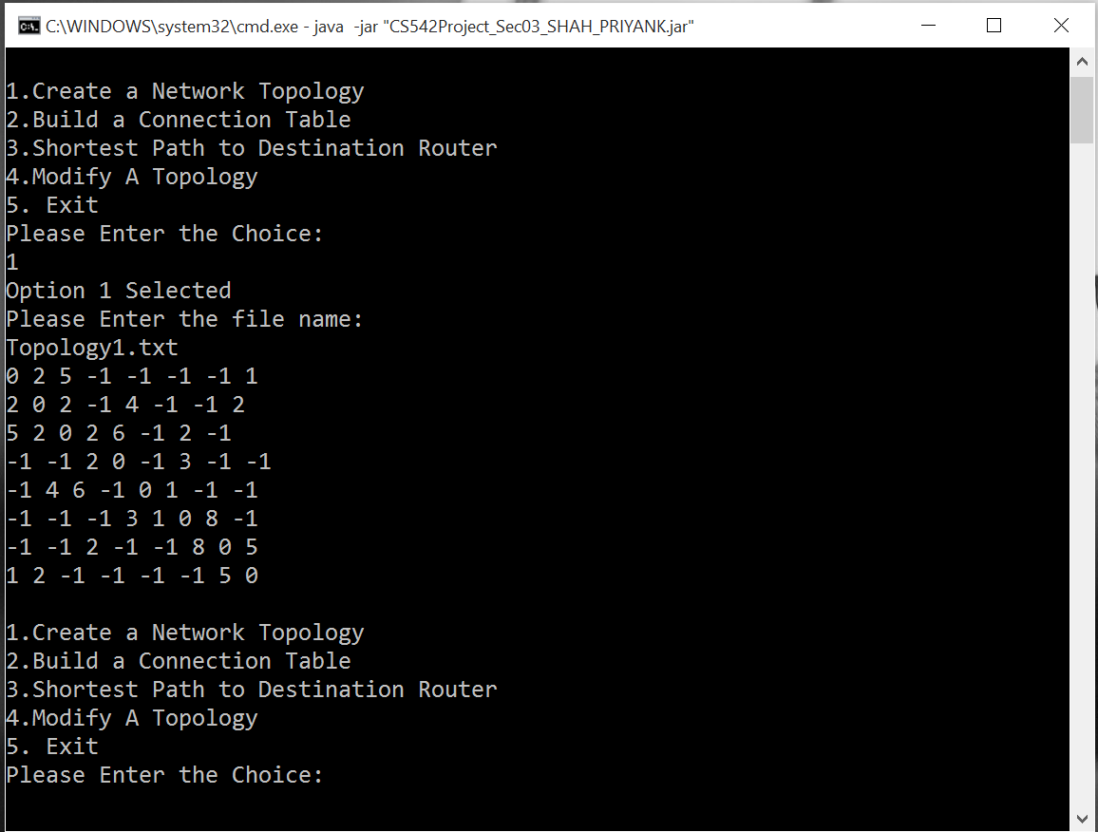
Project Screen-Shots Topology file Input(Option 1)

Slide 4
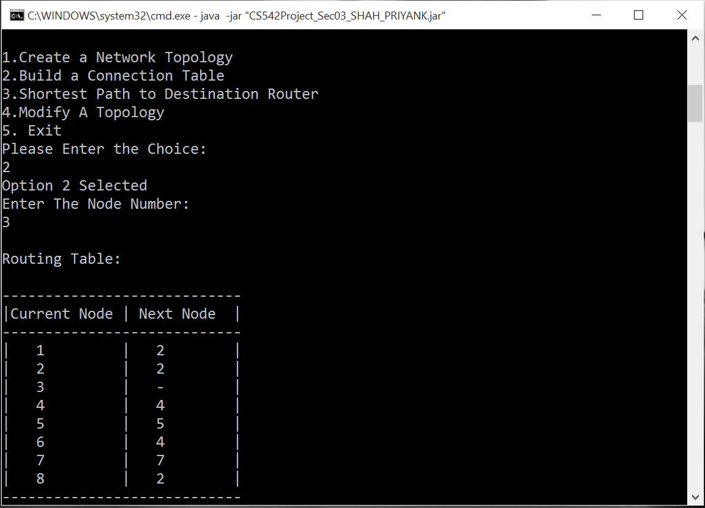
Project Screen-Shots Connection Table Generate(Option 2)

Slide 5
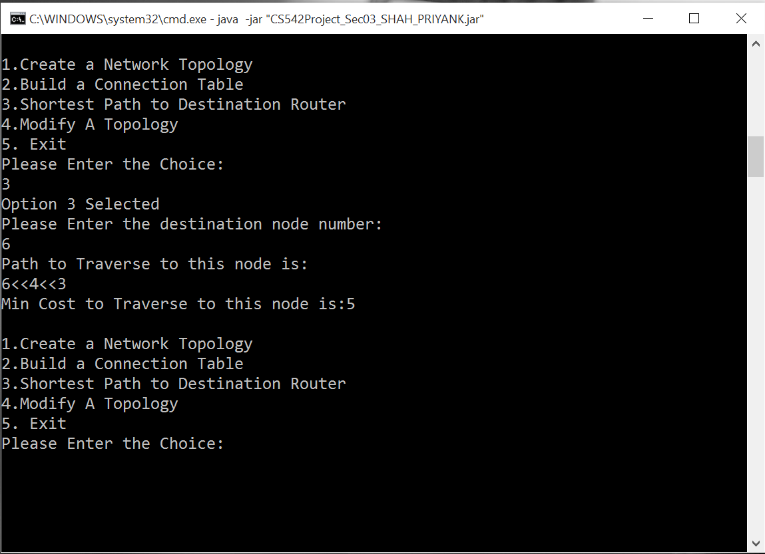
Project Screen-Shots Destination Node Input/Route-Path Print (Option 3)

Slide 6
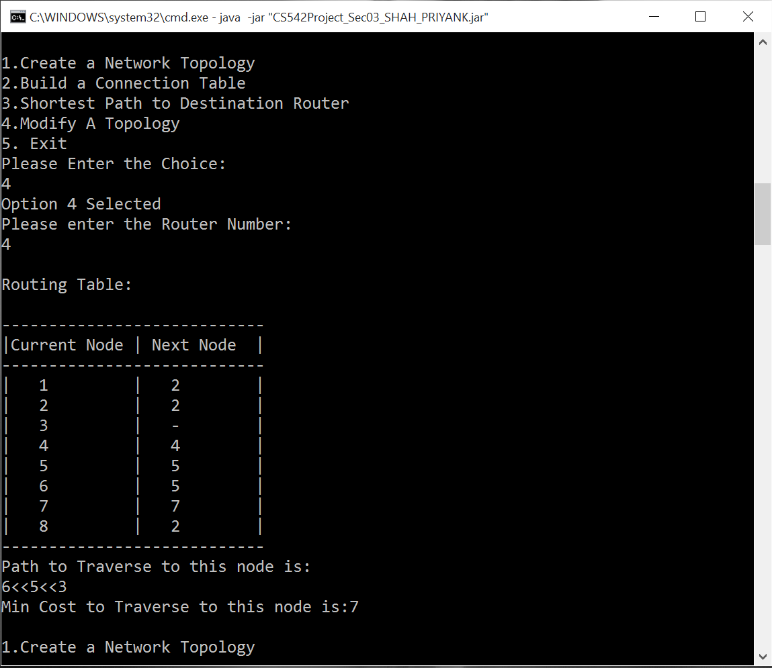
Project Screen-Shots Router Down(Option 4)

Slide 7
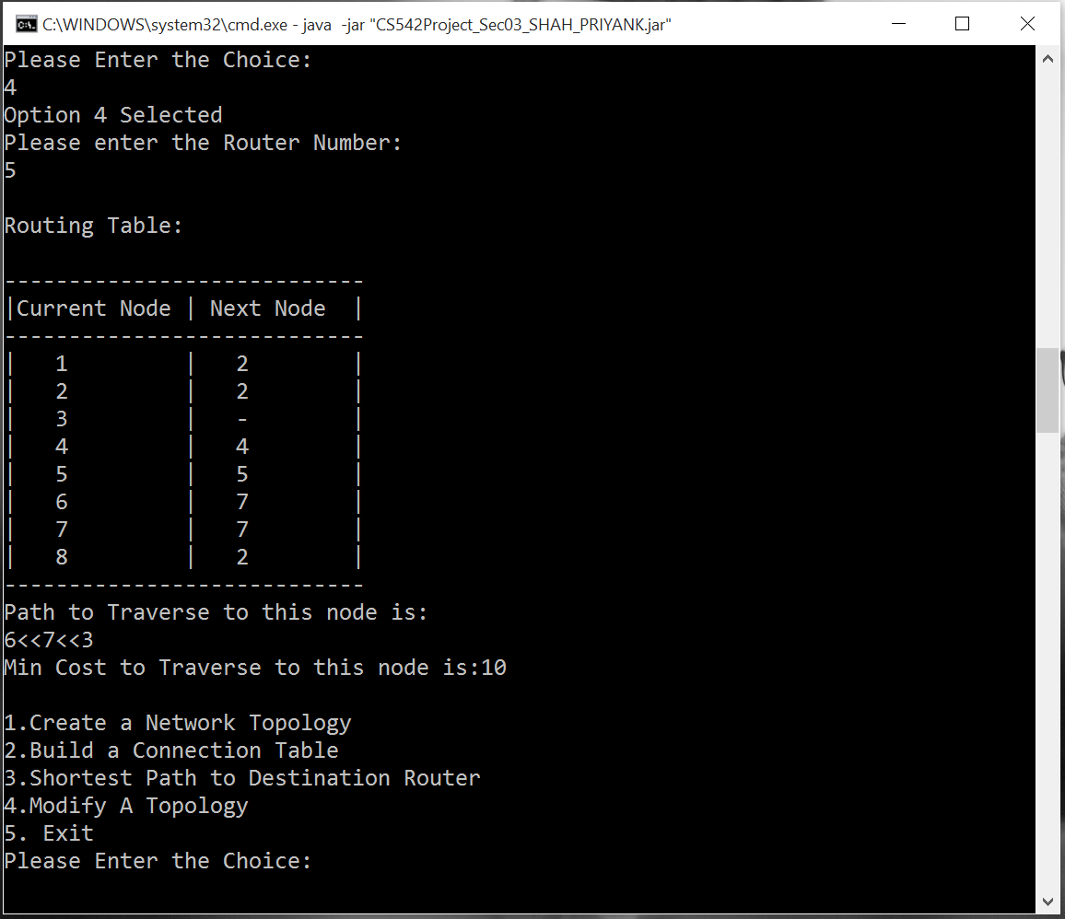
Project Screen-Shots Router Down(Option 4) Cont..

Slide 8
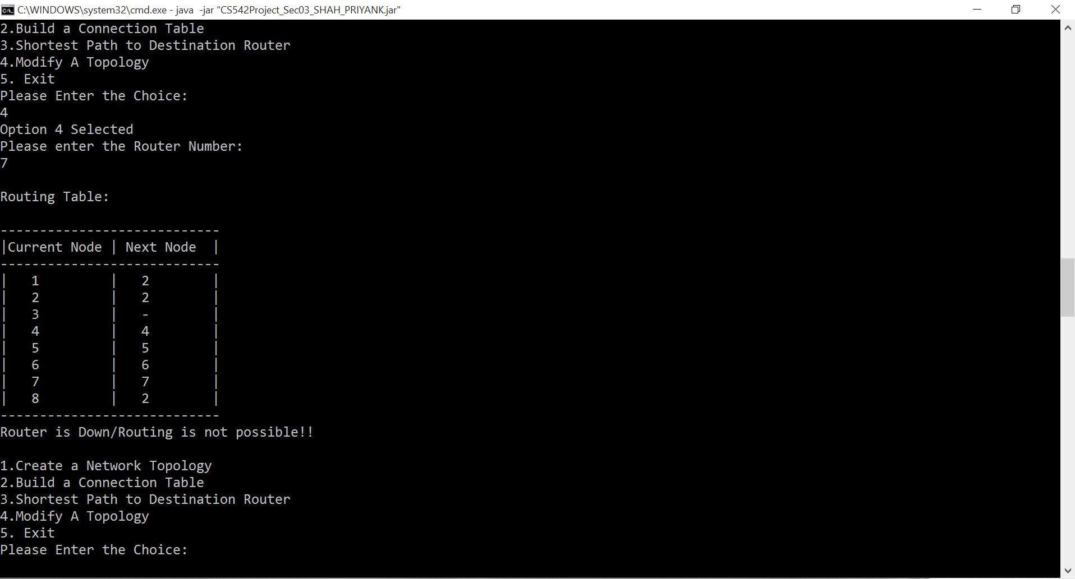
Project Screen-Shots Router Down(Option 4) Cont..

Slide 9
Link State Routing Protocol
Link State Routing Protocol Follows the Dijakstra’s Algorithm to find the shortest path between two nodes/routers.
In the first phase each router find the shortest path to the nearest node and store it in the routing table. If a node in same routing network is not directly connected to the source node than source stores the cost as infinite until it find the relative neighbor node to it.
At Each Iteration, through its neighbor node it will discover the relative neighbor node and add cost of traversal in its routing table while comparing it with the available alternative path. One with the minimum weight will be stored in Routing table.
This Process will Continue until it discovers all the nodes in network.

Slide 10
Link State Routing Protocol (Cont..)
If the topology is modified then routing table will be quickly update its value by same procedure as mentioned above.
If the router gets down than protocol will try to find the alternate route, if route is not found then it will drop the packet for router that is disconnected from the network.
Link State Routing Protocol Converge more Quickly and they are less prone to routing loops as compared to distance vector algorithm.
On the Other Hand it requires more CPU power and memory.
OSPS(Open Shortest Path First) is an example of Link State Routing Protocol.

Slide 11
Thank You

