Slide 1





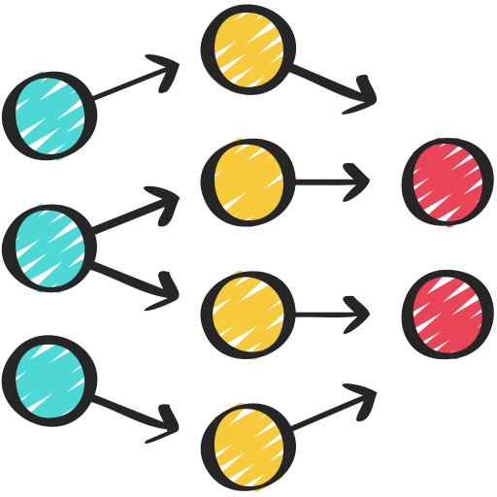

System Architecture
Chunks of the text
Pdf file
Text content
Ans.: Concepts of Biology
Embeddings created with all-MiniLM-L6-v2
Input text created with question + context
FAISS Vector Database
Top k matching embeddings
Input to the model
LLM: T5-large (google)
Search in Database
Ques.: What is this document about?
Gradio UI
Question embedding

Slide 2
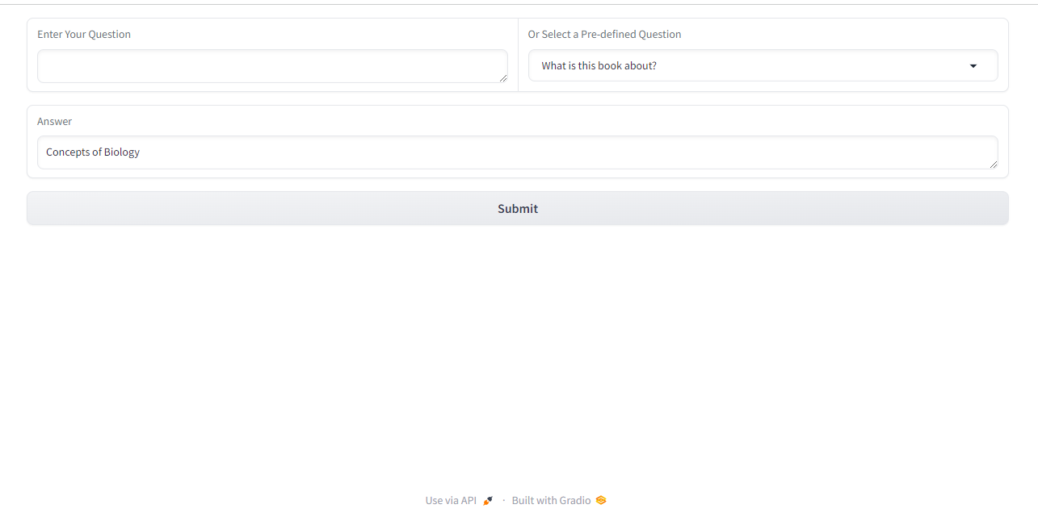
Gradio Interface

Slide 3
Assumptions:
We’re using a chunk size of 50 words, so the Sentence Transformer is a good choice for creating embeddings.
With a 50-word chunk size, an overlap of 10 words between chunks should work well.
We’ve set the max token length to 512 because our input will always be less than this.
FAISS is being used as the vector database because it’s fast and does a good job with similarity searches.
We are using T5-large for answer generation because of its ability to generate high quality and contextually relevant text.
Future Scope:
We might try using the Universal Sentence Encoder for creating embeddings.
We could explore the llama 2 model for better retrieval results.
Trying different chunk sizes and chunking methods, like recursive or semantic chunking, could be beneficial.
It could be worth experimenting with other vector databases, like Annoy, HNSWLib, or Milvus.

