Slide 1
Deep contextualized word representations (elmo)

Slide 2
Before elmo there were pretrained word embeddings (word2vec, glove)
King - man + woman = queen
(1,4) - (1,0) + (4,1) = (4,5)
king
man
queen
woman

Slide 3
Before elmo there were pretrained word embeddings (word2vec, glove)
A word has only one embedding
Word can have multiple meanings
present
present
now
gift

Slide 4
ELMO provides contextualized embedding
Here is your birthday present
present
now
gift

Slide 5
ELMO provides contextualized embedding
Live in present not past
present
now
gift

Slide 6
ELMO provides contextualized embedding
I read a book
read
now
past

Slide 7
ELMO provides contextualized embedding
I read a book yesterday
read
now
past

Slide 8
ELMO is a function providing contextualized embedding
ELMO (Here is your birthday present)
= [1,8] [2,1] [3,7] [10,2] [10,7]
ELMO (Live in present not past)
= [1,8] [2,1] [5,4] [4,2] [5,7]

Slide 9
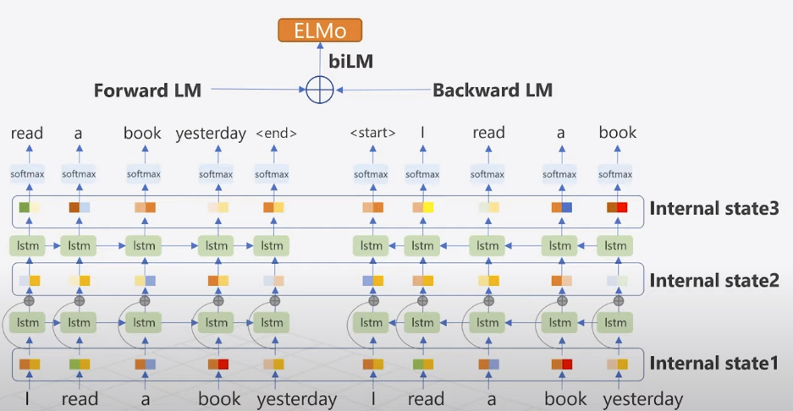
ELMO is a function providing contextualized embedding

Slide 10
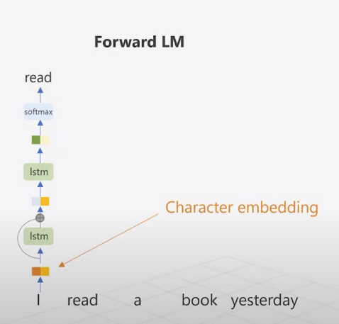
How forward LM works

Slide 11
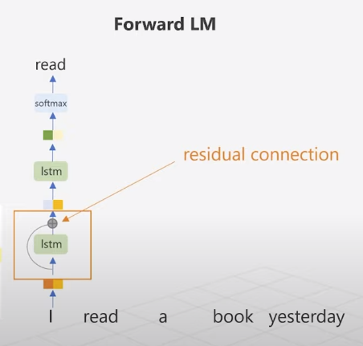
How forward LM works

Slide 12
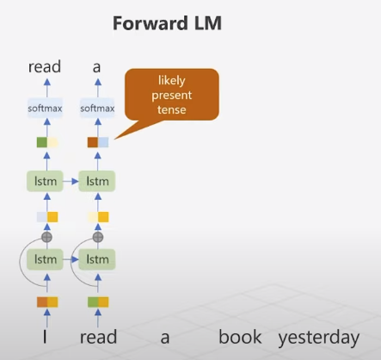
How forward LM works

Slide 13
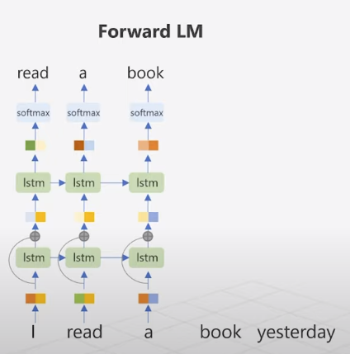
How forward LM works

Slide 14
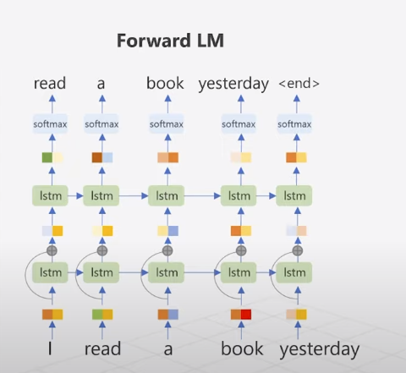
How forward LM works

Slide 15
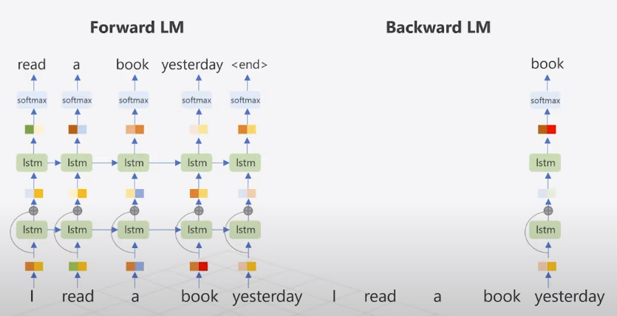
How backward LM works

Slide 16
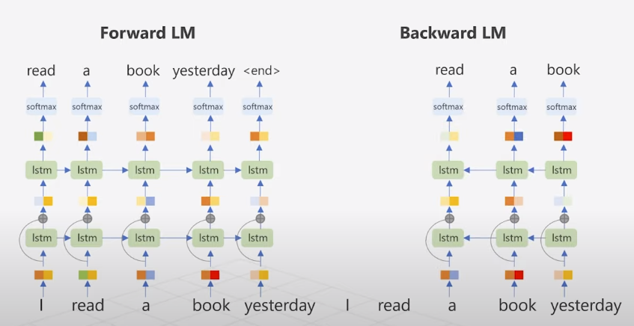
How backward LM works

Slide 17
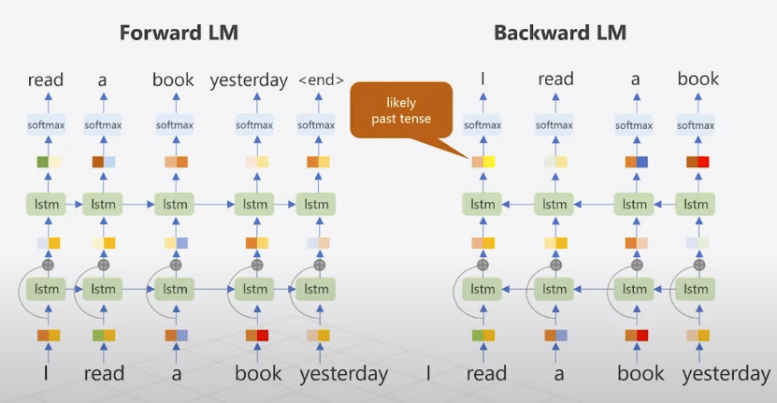
How backward LM works

Slide 18
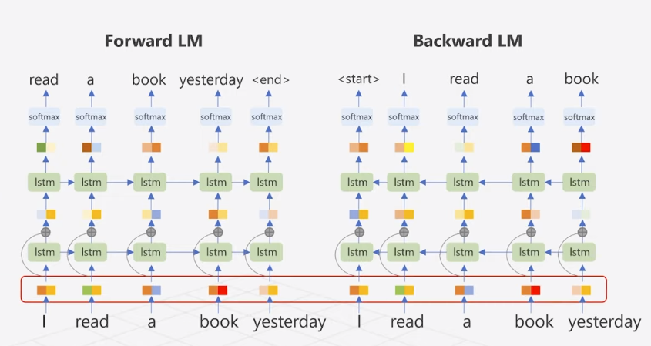
Input embedding is character embedding by CNN

Slide 19
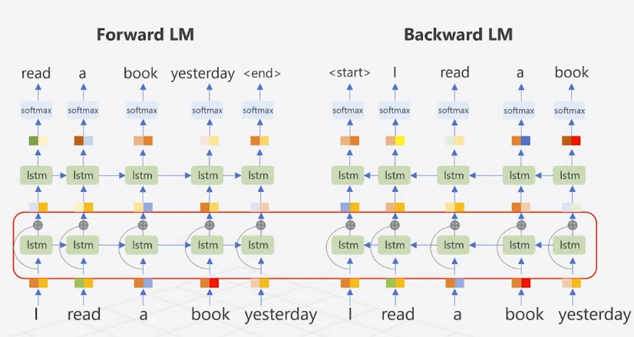
Residual connections between lstm layers

Slide 20
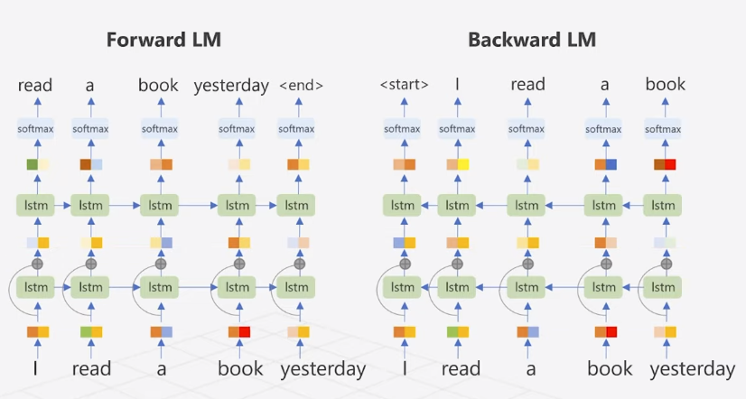
How “read” embedding generated by elmo

Slide 21
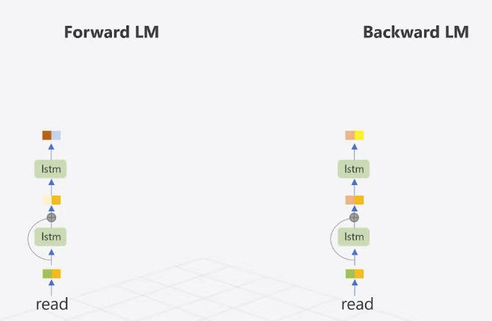
How “read” embedding generated by elmo

Slide 22
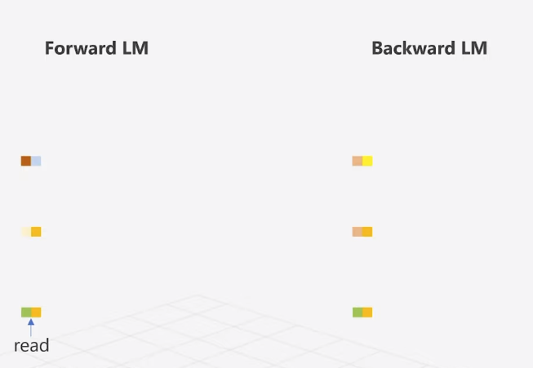
Concatenate two LM’s embeddings

Slide 23
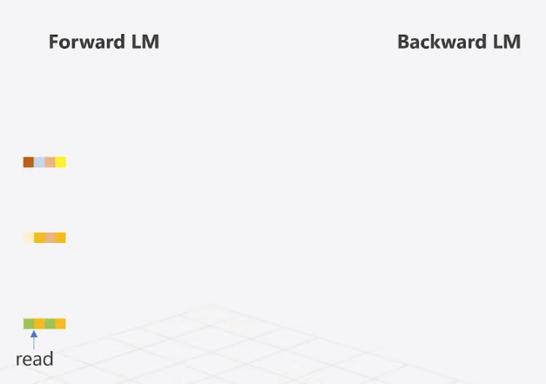
Concatenate two LM’s embeddings

Slide 24
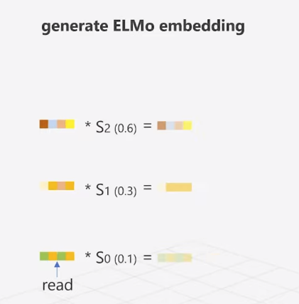
Concatenate two LM’s embeddings

Slide 25
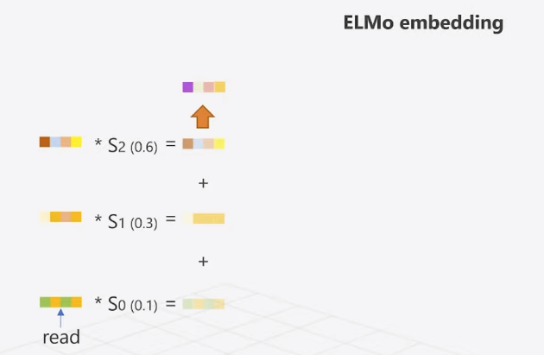
Concatenate two LM’s embeddings

Slide 26
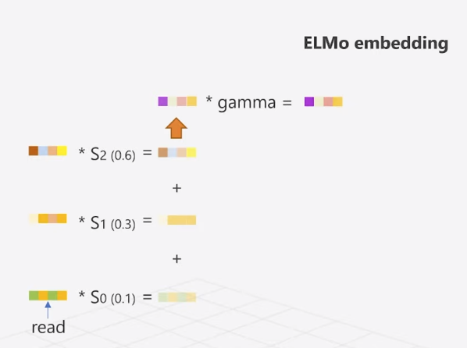
Concatenate two LM’s embeddings

Slide 27
References
Peters M. E., Neumann M., Uyyer M., Gardner M., Clark C., Lee K., Zettlemoyer L.. Deep contextualized word representations. 2018. https://arxiv.org/pdf/1802.05365.pdf
ELMo (Deep contextualized word representations) https://www.youtube.com/watch?v=YZerhaFMPTw&ab_channel=MinsukHeo%ED%97%88%EB%AF%BC%EC%84%9D
https://www.analyticsvidhya.com/blog/2019/03/learn-to-use-elmo-to-extract-features-from-text/

Slide 28
THANK YOU

