Slide 1


🏋
CS2307 – INTERNET PROGRAMMING LAB | MINI PROJECT
FitZone Gym
Membership Management System
A dynamic, database-driven website built with HTML, CSS, JavaScript, PHP and MySQL
HTML5
CSS3
PHP
Roll No: 24UCS191
Name: K.Priyan Kumar
Register No: 920424104306
JavaScript
MySQL
Submitted for the CS2307 Internet Programming Lab Mini Project

Slide 2
01 — OVERVIEW
Abstract
Manual, register-based tracking of gym memberships is slow, error-prone, and gives no real-time picture of active/expired members or revenue.
FitZone Gym is a dynamic, database-driven website that automates this entire process end to end.
Front end: HTML5 + CSS3 for structure/styling, JavaScript for client-side interactivity (form validation, live UI feedback).
Back end: PHP processes form submissions, manages sessions, and performs full CRUD operations against a MySQL database.
Supports two roles — Admin and Member — each with a dedicated dashboard.
Demonstrates secure password hashing, session-based auth, prepared statements, and server-computed business logic (auto expiry).
2
User Roles
4
DB Tables
5
Tech Stack Layers
GYM Membership Management System
2

Slide 3
02 — OVERVIEW
Introduction
Technology Stack
Fitness centers need an efficient way to manage registrations, subscription plans, renewals, and payments.
Paper registers / spreadsheets do not scale, are hard to search, and cannot proactively flag expiring memberships.
A web-based Membership Management System centralizes all member data in MySQL, accessible securely from any browser.
This mini project showcases the complete internet-programming stack: HTML structuring, CSS design, JS behaviour, and PHP + MySQL dynamic data handling.
A gym domain was chosen because it naturally needs classic dynamic-web features — registration, authentication, role-based dashboards, and CRUD — making it an ideal full-stack demonstration.
Presentation
HTML + CSS
Interactivity
JavaScript
Application Logic
PHP (Server-side)
Data
MySQL Database
GYM Membership Management System
3

Slide 4
03 — PLANNING
Objectives of the Project
🌐
Responsive multi-page website using HTML5 and CSS3 for a fitness/gym business.
⚙
Client-side interactivity and form validation using JavaScript.
🔒
Secure registration & login using PHP sessions and bcrypt password hashing.
🗃
Normalized MySQL schema for users, plans, members, and payments.
✏
Full CRUD functionality for membership records, restricted to Admin role.
🔄
Dynamic rendering of plans, member lists & stats directly from the database.
⏳
Automatic active/expired status computed from plan duration & current date.
☁
Deployment of the static front end to Netlify as a public live demo.
GYM Membership Management System
4

Slide 5
04 — ARCHITECTURE
Modules Description
🏠
📋
📝
🔑
Public Website
Membership Plans
Registration
Authentication
Home, About & Contact pages with a client-side validated contact form.
Reads the plans table live from MySQL and renders Basic/Standard/Premium/Annual cards.
Creates linked rows in users & members; computes expiry date from plan duration.
Verifies credentials with password_verify() and starts a PHP session; role-based redirect.
📊
👤
🗄
Admin Dashboard
Member Dashboard
Database
Live stats (total/active/expired/revenue), search, and full CRUD on member records.
Logged-in member views their own plan, dates & status with an expiry warning.
MySQL schema gym_db: users, plans, members, payments — linked via foreign keys.
GYM Membership Management System
5

Slide 6
05 — DEVELOPMENT PROCESS
Methodology / Approach
1
2
3
4
›
›
›
Requirement Analysis
Database Design
UI Design
Client-side Scripting
Identified the core dynamic feature: registration + login + DB-backed membership CRUD.
Designed a normalized 4-table schema and wrote gym_db.sql to create & seed it.
Built static pages and a shared stylesheet with a consistent, responsive layout.
Added script.js for form validation and UX feedback.
5
6
7
›
›
Server-side Scripting
Testing
Deployment
PHP + mysqli with prepared statements and session-based access control.
Ran the full app on a live MySQL-backed server; tested every dynamic feature end-to-end.
Published the static site to Netlify; packaged full source for local PHP/MySQL hosting.
GYM Membership Management System
6

Slide 7
06 — IMPLEMENTATION
Implementation Code
Database schema and authentication logic (full source provided separately)
sql/gym_db.sql
php/login.php (excerpt)
CREATE TABLE members (
member_id INT AUTO_INCREMENT PRIMARY KEY,
user_id INT NOT NULL,
plan_id INT NOT NULL,
join_date DATE NOT NULL,
expiry_date DATE NOT NULL,
status ENUM('active','expired') DEFAULT 'active',
FOREIGN KEY (user_id) REFERENCES users(user_id),
FOREIGN KEY (plan_id) REFERENCES plans(plan_id)
);
INSERT INTO plans (plan_name, duration_months, price)
VALUES ('Premium', 6, 4499.00);
$stmt = $conn->prepare(
"SELECT user_id, password, role
FROM users WHERE email = ?");
$stmt->bind_param("s", $email);
$stmt->execute();
if (password_verify($password, $user['password'])) {
$_SESSION['user_id'] = $user['user_id'];
$_SESSION['role'] = $user['role'];
header("Location: " . ($user['role']
=== 'admin' ? 'admin_dashboard.php'
: 'member_dashboard.php'));
}
GYM Membership Management System
7

Slide 8
06 — IMPLEMENTATION
Implementation Code (contd.)
Admin dashboard query logic and client-side validation
php/admin_dashboard.php (excerpt)
js/script.js (excerpt)
// Auto-update expired memberships
$conn->query("UPDATE members
SET status='expired'
WHERE expiry_date < CURDATE()
AND status='active'");
$activeMembers = $conn->query(
"SELECT COUNT(*) AS c FROM members
WHERE status='active'")
->fetch_assoc()['c'];
function validateContactForm() {
const email = document
.getElementById("cemail").value;
const pattern = /^[^\s@]+@[^\s@]+\.[^\s@]+/;
if (!pattern.test(email)) {
showStatus(status,
"Please enter a valid email.", "error");
return false;
}
return true;
}
GYM Membership Management System
8

Slide 9

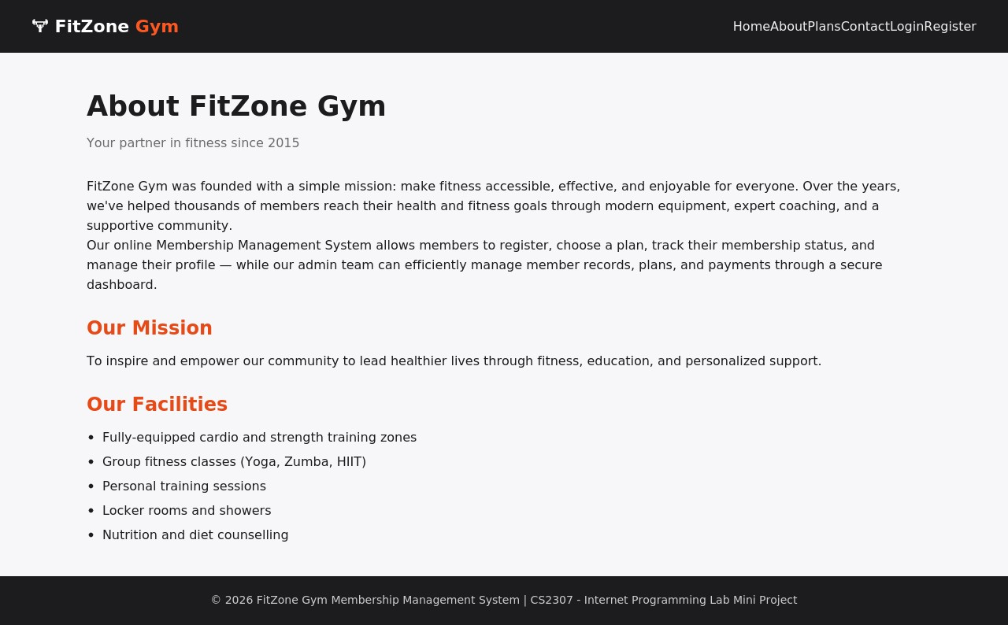
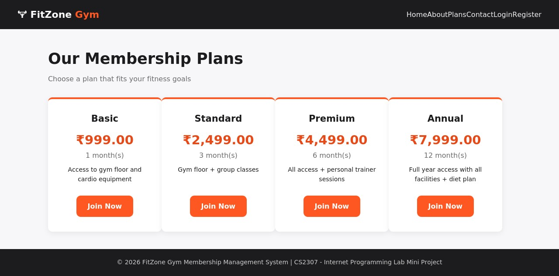
07 — LIVE DEMO
Screenshots — Public Pages
Membership Plans (dynamic from DB)
About Page
Home Page
GYM Membership Management System
9

Slide 10
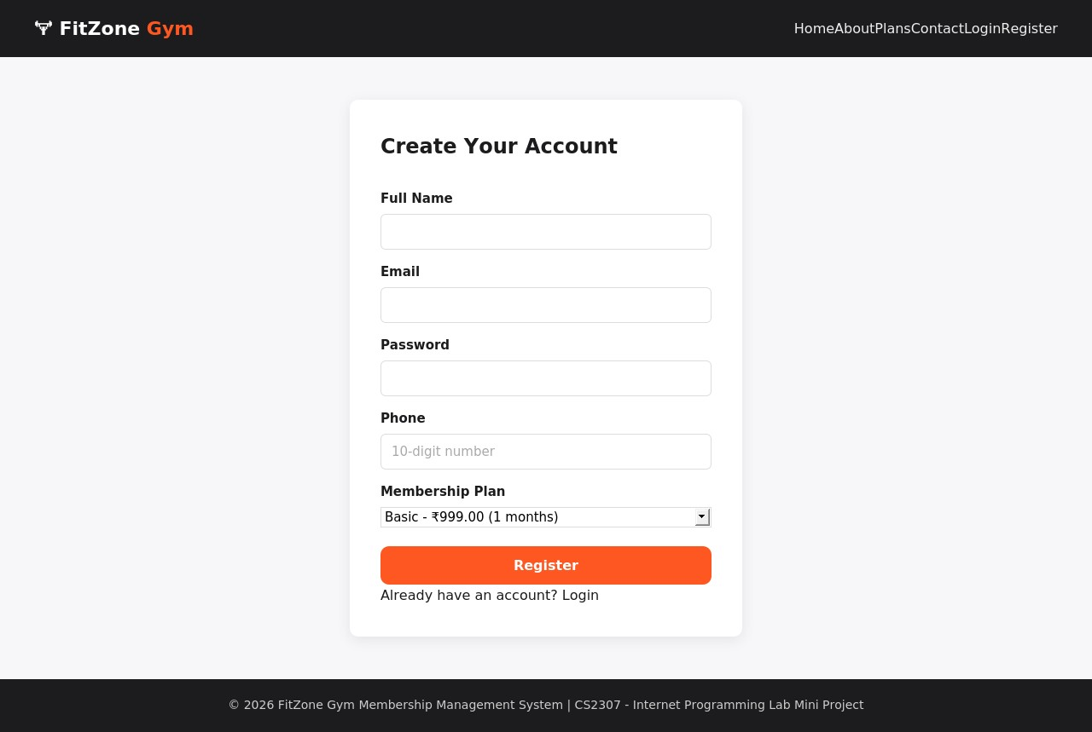
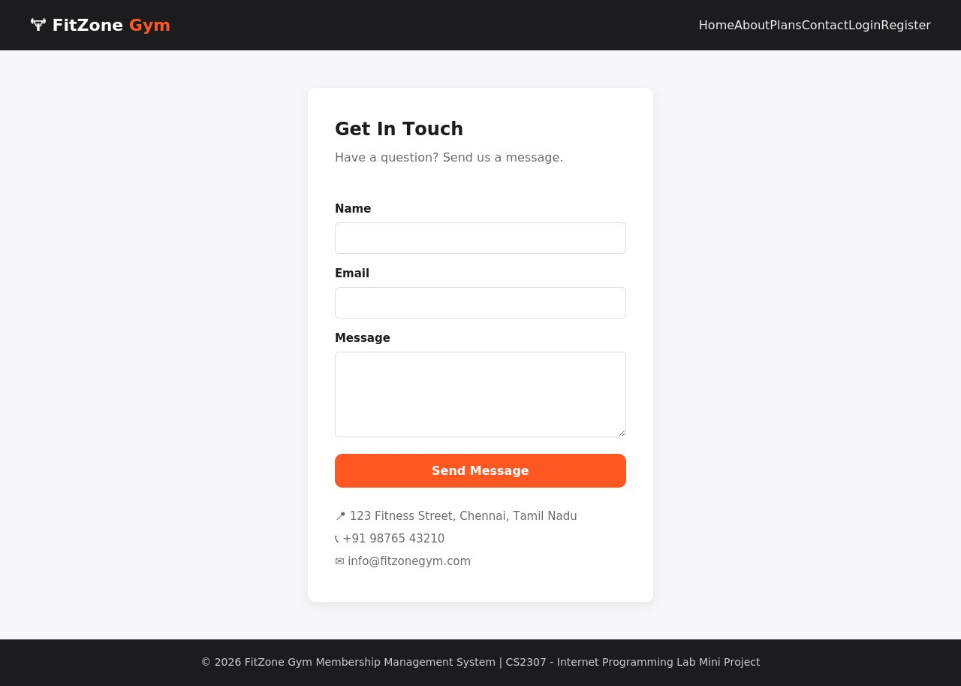
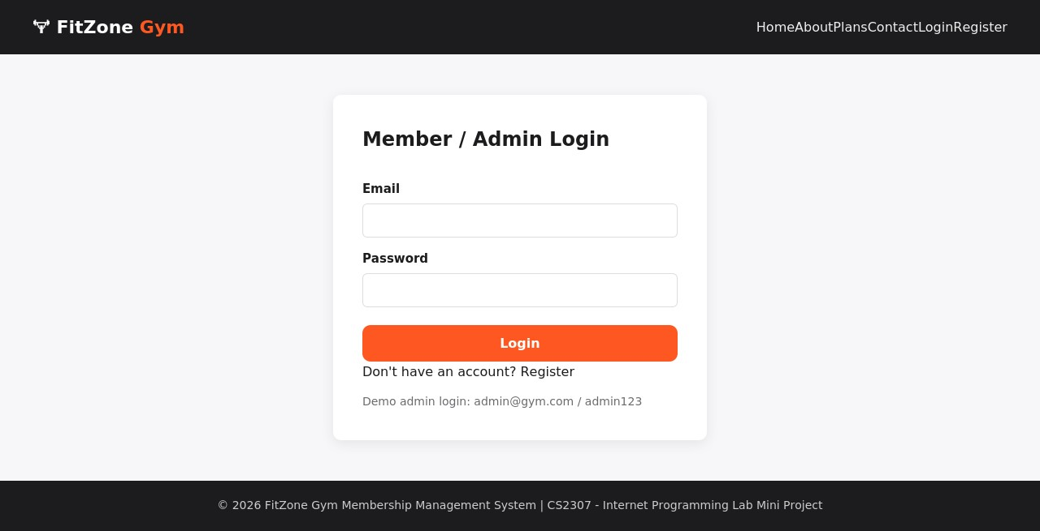
07 — LIVE DEMO
Screenshots — Registration & Login
Login Page
Registration Page
Contact Page
GYM Membership Management System
10

Slide 11
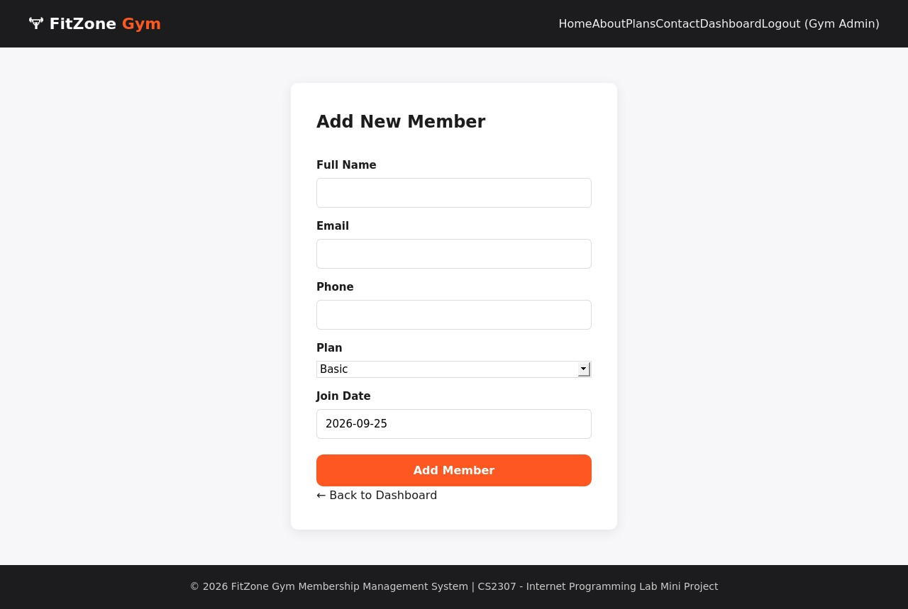
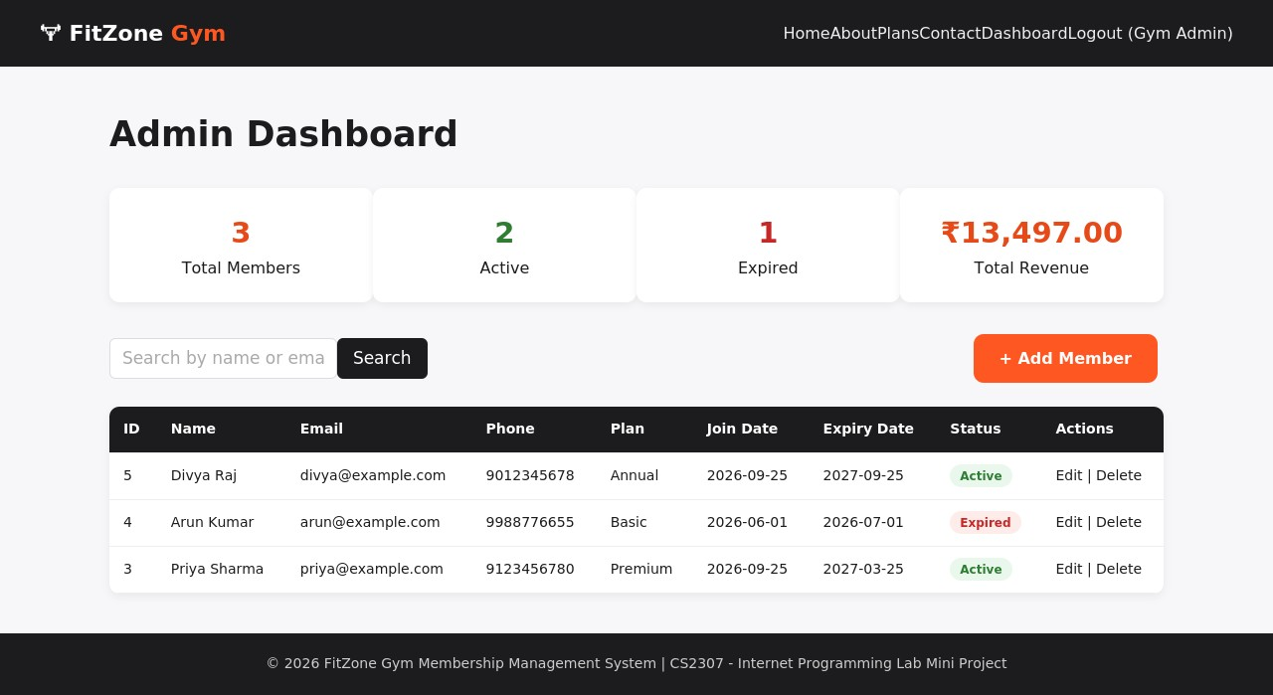
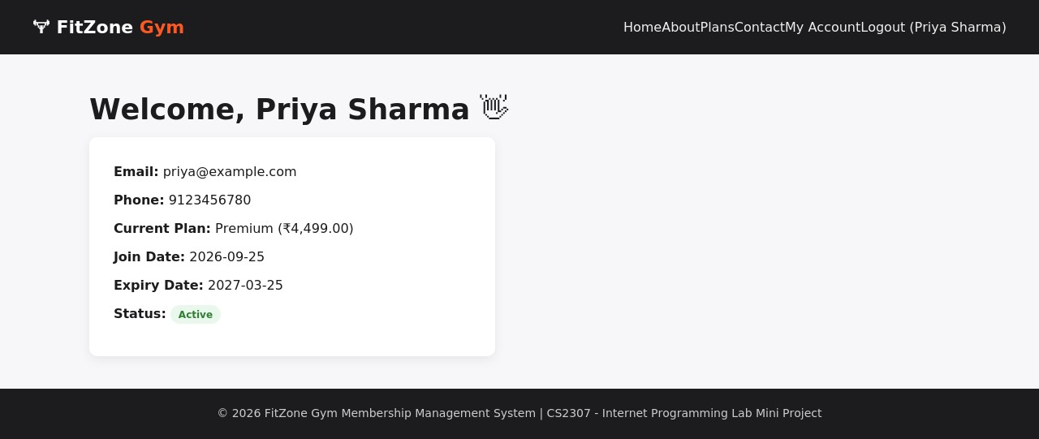
07 — LIVE DEMO
Screenshots — Admin & Member Dashboards
Member Dashboard
Admin Dashboard — stats & CRUD
Admin — Add Member
GYM Membership Management System
11

Slide 12
08 — SOURCES
References
PHP Official Documentation — https://www.php.net/docs.php
MySQL 8.0 Reference Manual — https://dev.mysql.com/doc/
MDN Web Docs (HTML, CSS, JavaScript) — https://developer.mozilla.org/
W3Schools PHP & MySQL Tutorials — https://www.w3schools.com/php/
Netlify Documentation — https://docs.netlify.com/
CS2307 — Internet Programming Lab, Course Manual, Department of CSE.
📚
Further Reading
Official documentation and course materials used throughout development and testing.
GYM Membership Management System
12

Slide 13
09 — CLOSING
Conclusion
Demonstrates a complete dynamic web application built with HTML, CSS, JavaScript, PHP and MySQL.
Covers the full IP Lab spectrum: static design, client-side scripting, server-side processing, session auth, and relational DB connectivity with full CRUD.
Automates a real workflow — gym membership registration, tracking, and renewal — replacing manual record-keeping with a searchable, role-based dashboard.
All dynamic features were tested end-to-end against a live MySQL database and verified in the screenshots.
Future scope: payment gateway integration, SMS/email renewal reminders, QR/biometric attendance, and a REST API for a mobile app.
Delivered
✓
Full source code (HTML/CSS/JS/PHP/SQL)
✓
Working registration & login
✓
Admin + Member dashboards
✓
Live Netlify demo (static pages)
✓
Tested screenshots

Slide 14
10 — CURRICULUM MAPPING
SDG Mapping
Sustainable Development Goals addressed by this project
SDG 3
SDG 9
SDG 8
Good Health & Well-Being
Industry, Innovation & Infrastructure
Decent Work & Economic Growth
Makes gym membership management seamless, encouraging consistent access to fitness facilities and healthier lifestyles.
Builds a resilient, practical software solution using a standard internet-programming stack (PHP/MySQL) as reusable digital infrastructure.
Digitizes a small/medium fitness business's operations — improving efficiency, record-keeping, and revenue visibility.
GYM Membership Management System
14

Slide 15
10 — CURRICULUM MAPPING
PO & PSO Mapping
Programme Outcomes (PO) and Programme Specific Outcomes (PSO) demonstrated — verify exact wording against your department's OBE document
Code
Outcome
How This Project Demonstrates It
PO1
Engineering Knowledge
Applied web engineering, database design and software architecture principles.
PO2
Problem Analysis
Analyzed the real-world problem of manual gym-membership tracking and derived functional requirements.
PO3
Design & Development of Solutions
Designed and implemented a full-stack CRUD application with a normalized database schema.
PO5
Modern Tool Usage
Used HTML5, CSS3, JavaScript, PHP, MySQL and deployment tools (XAMPP, Netlify) to build and test the system.
PO12
Life-long Learning
Hands-on exposure to the current full-stack web development ecosystem motivates continued self-learning.
PSO1
Software Design & Development
Designed, developed and tested a complete PHP/MySQL-based web application meeting defined requirements.
PSO2
Data & Database Management
Applied relational database design and CRUD operations to build an efficient, data-driven computing solution.
GYM Membership Management System
15

Slide 16
🏋
Thank You
GYM Membership Management System — CS2307 Internet Programming Lab Mini Project

