Slide 1

Seasonal Agriculture Performance Analysis
-PRIYANKA
HMR INSTITUE OF TECHNOLOGY AND MANAGEMENT
AICTE STU ID : STU66b7a3e35e1f01723311075

Slide 2

PROBLEM STATEMENT
Agricultural activities are influenced by seasonal variations in environmental conditions, farming practices, resource availability and market conditions.
As a result, agricultural performance may differ from one season to another.
Raw agricultural data does not clearly show how crop yield, production, profitability, and resource usage vary between seasons.
The problem is to analyse the given agricultural dataset and investigate seasonal differences in agricultural performance.
This is done by identifying meaningful patterns, trends, relationships and variations within the available data.

Slide 3
Project Description
The dataset represents agricultural activities carried out across different seasons, geographical areas and farming conditions. It holds information on farming practices, environmental conditions, crop production, resource usage and economic performance.
This project is a focused Data Analytics study rather than a generic exploration of the whole dataset. The analysis is structured in five stages:
Explore and understand the dataset, then clean and prepare it for analysis.
Examine how agricultural performance varies across seasons and identify seasonal patterns and trends.
Investigate relationships between seasonal environmental conditions and agricultural outcomes.
Compare relevant groups within each season and flag significant differences or unusual patterns.
Interpret the findings from evidence in the data and develop conclusions and recommendations.

Slide 4

WHY THIS PROBLEM MATTERS
Understand variations in agricultural performance between seasons.
Identify important seasonal trends hidden in raw operational data.
Compare performance across different periods on a like-for-like basis.
Understand changing environmental conditions and their effect on output.
Examine differences in resource usage across seasons.
Identify areas that require further investigation.
Support evidence-based agricultural planning and decision making.

Slide 5
OBJECTIVES
Analyse agricultural data from different seasons and identify meaningful patterns, trends, relationships and differences in performance.
Explore, clean and prepare the dataset for reliable analysis.
Examine how agricultural performance varies across seasons.
Investigate relationships between seasonal conditions and agricultural outcomes.
Compare relevant groups within different seasons and identify significant or unusual differences.
Apply appropriate statistical and visualization techniques.
Interpret findings from evidence and develop data-driven conclusions and recommendations.

Slide 6
WHO ARE THE END USERS?
Farmers and farm managers - planning sowing, irrigation and input use season by season.
Agricultural cooperatives and agribusinesses - comparing performance across regions and periods.
Government and policy planners - shaping seasonal agricultural policy from evidence.
Agronomists and researchers - studying links between environmental conditions and yield.
Supply chain and market analysts - anticipating seasonal variation in production and economic outcomes.
Students and data analysts - as a worked example of a focused real-world analytics problem.

Slide 7

Technology Used
Language: Python 3
Environment: Jupyter Notebook
Data handling: pandas, NumPy
Visualization: Matplotlib, Seaborn
Statistics: SciPy / statsmodels - descriptive statistics, correlation and group comparison
Dataset format: CSV / Excel agricultural records
Version control: Git and GitHub

Slide 8
KEY ANALYTICAL QUESTIONS
How does agricultural performance vary across seasons, and which characteristics change between them?
What major seasonal patterns can be observed in the data?
Are there noticeable variations in resource usage across seasons?
Are there relationships between seasonal environmental conditions and agricultural performance?
How do economic outcomes vary across seasons?
Are seasonal patterns consistent across different regions or categories?
Are there unusual or unexpected seasonal patterns, and what can they tell us?
How could the findings support better seasonal agricultural planning?

Slide 9
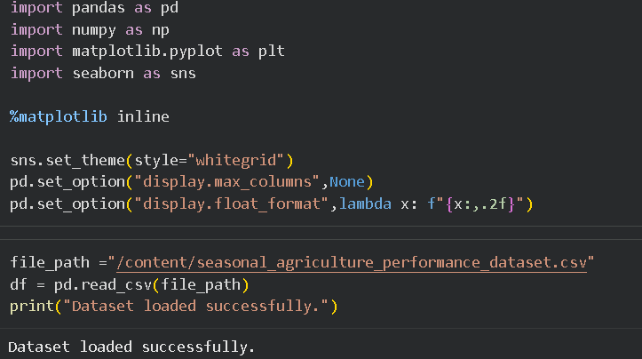
RESULTS - 1
Dataset loading overview
[ Paste the screenshot of your data loading, .info() / .describe() and missing-value handling here ]
Paste your screenshot here

Slide 10
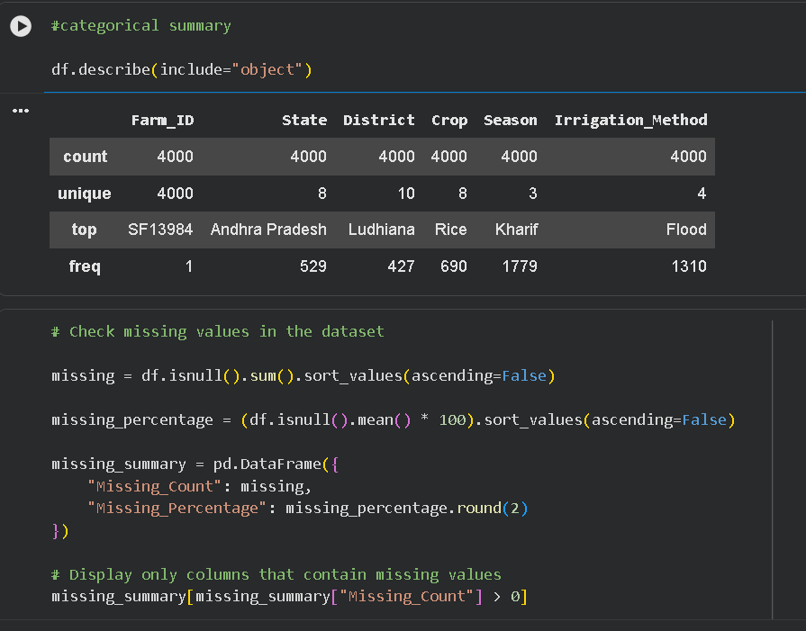
RESULTS - 2
Categorical Summary
[ Paste the screenshot of your season-wise comparison chart and its output here ]
Paste your screenshot here

Slide 11
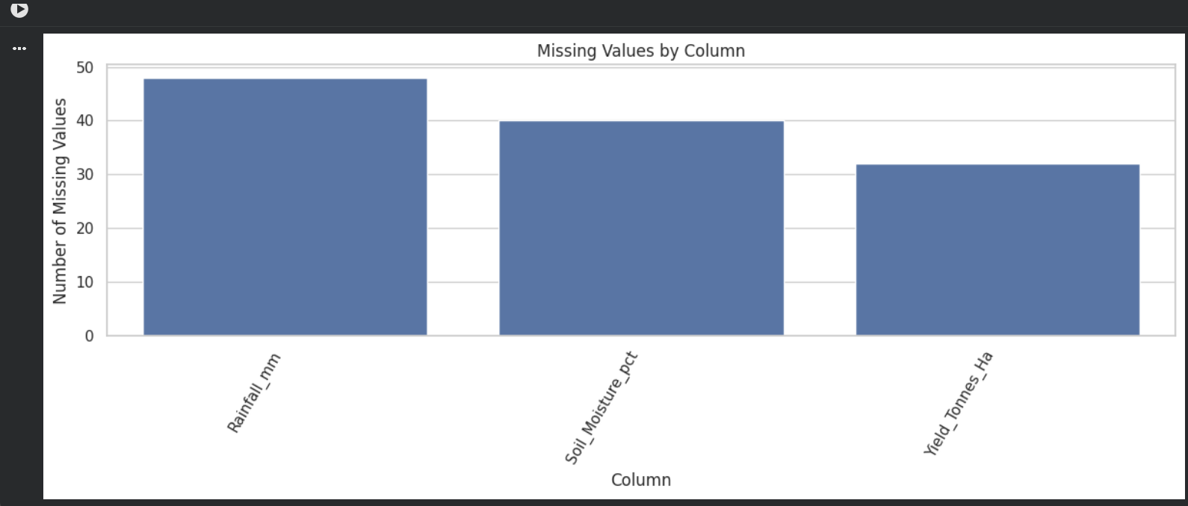
RESULTS - 3
Missing Values

Slide 12
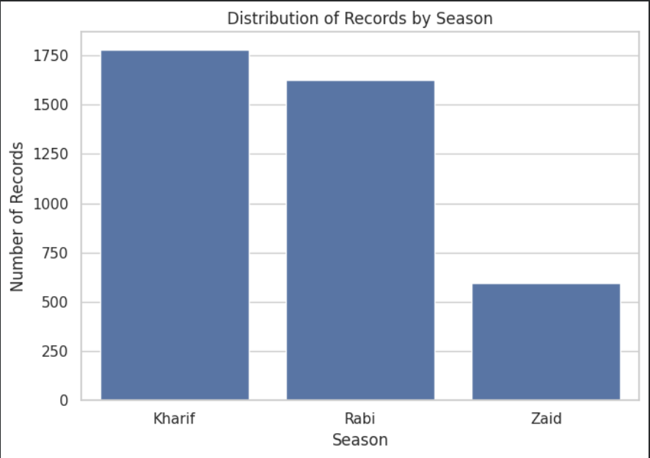
RESULTS - 4
Season Distribution

Slide 13
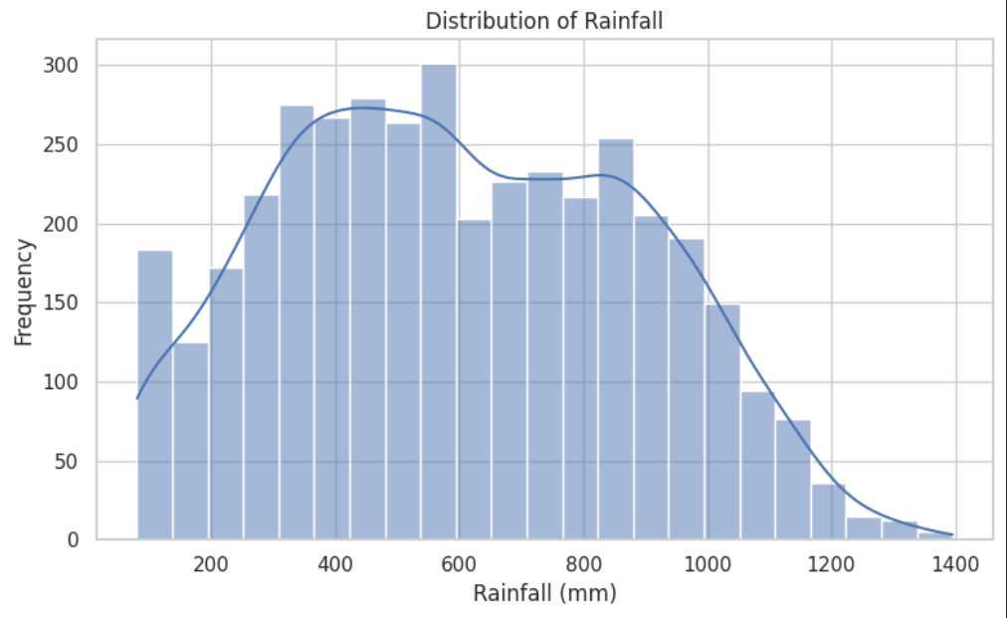
RESULTS - 5
Rainfall Distribution

Slide 14
FUTURE SCOPE
Extend the analysis with multi-year data to separate genuine seasonal effects from year-to-year variation.
Add region-wise and crop-wise segmentation to test whether seasonal patterns hold across categories.
Build predictive models to forecast yield and economic outcomes from seasonal conditions.
Integrate live weather and market feeds so the analysis updates through the season.
Present the findings as an interactive dashboard for non-technical stakeholders.
Translate the insights into a practical seasonal planning guide for farmers and planners.

Slide 15
GITHUB LINK
Repository link:
https://github.com/priyannnkkka/Seasonal_Agriculture_Perfomance_Data_Analysis.git
Notebook file:
https://colab.research.google.com/drive/1a5NCNHA_0NWYS0cHa095WANO0f1tM6dY?usp=sharing

Slide 16

VOIS Course completion certificate -
Course name- Data Visualization

Slide 17
Thank you
.
.

