Slide 1

CHAPTER 3
Mahābhārata: What's and What Nots
Strategic Lessons from Mahābhārata
Teaching deck · Book pages 35 to 39
Notes:
Teacher's script for the whole chapter (summary):
An Itihāsa conveys universal truth as stories about humans and non-humans. Mahābhārata, one of the greatest Itihāsas, expresses eternal truths about human nature, including how truth can be experienced, communicated, understood and verified. These truths come from thousands of years of observation, study and analysis by Ṛṣis, who are called mantra-draṣṭās: those who have experienced the truth. They did not create the aphorisms; they verbalised what they experienced in meditation. All of these expressions were combined, classified and edited by Kṛṣṇa Dvaipāyana, so he became known as Veda Vyāsa, the editor of the Vedas.
Each Veda is classified into four texts: Saṃhitā, Āraṇyaka, Brāhmaṇa and Upaniṣad. Across them there are three types of statements. Praśasti Vākyas are decorative statements praising or blaming a deity, event, person or experience. Because they involve fame and infamy, they rest on the speaker's likes and dislikes, which affects veracity; the book therefore says the Saṃhitā statements are Praśasti Vākyas and not statements of truth. Vidhi Vākyas are the dos and don'ts, which change with context: what is expected in one situation may not be in another. These two kinds are compiled in the Brāhmaṇas and Āraṇyakas. The third kind, the statement of truth, is like an equation: changing the word order does not change the meaning, as 2+2=4 equals 4=2+2, and as 'Aham Brahmāsmi' equals 'Brahma aham asmi', and 'tat tvam asi' equals 'asi tat tvam'. The Upaniṣads mainly consist of such statements.
Brahma Sūtra is a text on the Vedānta system, derived from the Vedas by taking statements of truth and arranging them systematically. The Gītā shows how ancient lessons are applied practically. So the Vedas and Upaniṣads are the sourcebooks, Brahma Sūtra is the text, and the Bhagavadgītā is the technology by which the lessons are enacted. Mahābhārata contains this technology of Vedānta, which is why Vyāsa called it the fifth Veda.
Why a fifth Veda? Learning the Veda needs two things: eligibility and competence. For example, passing a degree makes one eligible for civil service, but not everyone is competent. Likewise, in Indian thought all beings, human and non-human, are eligible for mokṣa, the ultimate aim. Heaven is not the final destination because it is impermanent: when merit is exhausted, one returns to earth. But not all humans are competent to learn the Vedas, which demands strict rules, vratas and systematic training. Mahābhārata expresses lofty ideas in simple language and offers those who are eligible but not competent a distinctive means to mokṣa: the multifaceted life experiences of its characters. Its principal purpose is to show how Dharma operates in countless contexts.
Vyāsa says the essence of Dharma is Niṣkāma Karma, the central theme of every anecdote. It means performing karma without the touch of karmic elements: serving others while controlling the sense organs and mind. The 'presumed intelligentsia' wrongly confine it to the Bhagavadgītā; in fact it is found everywhere in the universe. The human body is dynamic, so action and reaction are unavoidable and complete inaction is inconceivable. One should act with the benefit of all in mind. As social beings, everyone must at some point commit to Niṣkāma Karma. One is responsible for one's action or inaction and cannot blame external forces; one must think about pros and cons and control the senses and manas. Mahābhārata teaches this through its characters' life stories.

Slide 2
What students will learn
Itihāsa conveys universal truths through stories of humans and non-humans; the truths come from Ṛṣis' experience (mantra-draṣṭā).
1
Kṛṣṇa Dvaipāyana compiled and classified the Vedic aphorisms, hence Veda Vyāsa.
2
Three kinds of Vedic statements: Praśasti, Vidhi, Jñāna Vākya (statement of truth).
3
Hierarchy: Vedas/Upaniṣads = sourcebooks; Brahma Sūtra = text; Bhagavadgītā = technology.
4
Eligibility vs competence explains the need for the fifth Veda; Niṣkāma Karma = essence of Dharma.
5
Notes:
Core idea: Why Mahābhārata is the fifth Veda: it turns the Veda's abstract truths into lived 'technology' for people who are eligible for mokṣa but not competent for rigorous Vedic study, and its essence of Dharma is Niṣkāma Karma.
Full chapter summary:
An Itihāsa conveys universal truth as stories about humans and non-humans. Mahābhārata, one of the greatest Itihāsas, expresses eternal truths about human nature, including how truth can be experienced, communicated, understood and verified. These truths come from thousands of years of observation, study and analysis by Ṛṣis, who are called mantra-draṣṭās: those who have experienced the truth. They did not create the aphorisms; they verbalised what they experienced in meditation. All of these expressions were combined, classified and edited by Kṛṣṇa Dvaipāyana, so he became known as Veda Vyāsa, the editor of the Vedas.
Each Veda is classified into four texts: Saṃhitā, Āraṇyaka, Brāhmaṇa and Upaniṣad. Across them there are three types of statements. Praśasti Vākyas are decorative statements praising or blaming a deity, event, person or experience. Because they involve fame and infamy, they rest on the speaker's likes and dislikes, which affects veracity; the book therefore says the Saṃhitā statements are Praśasti Vākyas and not statements of truth. Vidhi Vākyas are the dos and don'ts, which change with context: what is expected in one situation may not be in another. These two kinds are compiled in the Brāhmaṇas and Āraṇyakas. The third kind, the statement of truth, is like an equation: changing the word order does not change the meaning, as 2+2=4 equals 4=2+2, and as 'Aham Brahmāsmi' equals 'Brahma aham asmi', and 'tat tvam asi' equals 'asi tat tvam'. The Upaniṣads mainly consist of such statements.
Brahma Sūtra is a text on the Vedānta system, derived from the Vedas by taking statements of truth and arranging them systematically. The Gītā shows how ancient lessons are applied practically. So the Vedas and Upaniṣads are the sourcebooks, Brahma Sūtra is the text, and the Bhagavadgītā is the technology by which the lessons are enacted. Mahābhārata contains this technology of Vedānta, which is why Vyāsa called it the fifth Veda.
Why a fifth Veda? Learning the Veda needs two things: eligibility and competence. For example, passing a degree makes one eligible for civil service, but not everyone is competent. Likewise, in Indian thought all beings, human and non-human, are eligible for mokṣa, the ultimate aim. Heaven is not the final destination because it is impermanent: when merit is exhausted, one returns to earth. But not all humans are competent to learn the Vedas, which demands strict rules, vratas and systematic training. Mahābhārata expresses lofty ideas in simple language and offers those who are eligible but not competent a distinctive means to mokṣa: the multifaceted life experiences of its characters. Its principal purpose is to show how Dharma operates in countless contexts.
Vyāsa says the essence of Dharma is Niṣkāma Karma, the central theme of every anecdote. It means performing karma without the touch of karmic elements: serving others while controlling the sense organs and mind. The 'presumed intelligentsia' wrongly confine it to the Bhagavadgītā; in fact it is found everywhere in the universe. The human body is dynamic, so action and reaction are unavoidable and complete inaction is inconceivable. One should act with the benefit of all in mind. As social beings, everyone must at some point commit to Niṣkāma Karma. One is responsible for one's action or inaction and cannot blame external forces; one must think about pros and cons and control the senses and manas. Mahābhārata teaches this through its characters' life stories.

Slide 3
Warm-up: think first
What is an Itihāsa trying to convey, according to this chapter?
?
Discuss with your partner for 2 minutes. We will return to this at the end of the lesson.
Notes:
Give students 2 minutes (think-pair-share) before revealing.
Model answer: Universal truths about human nature, narrated as stories of humans and non-humans, including how truth is experienced, communicated, understood and verified.

Slide 4
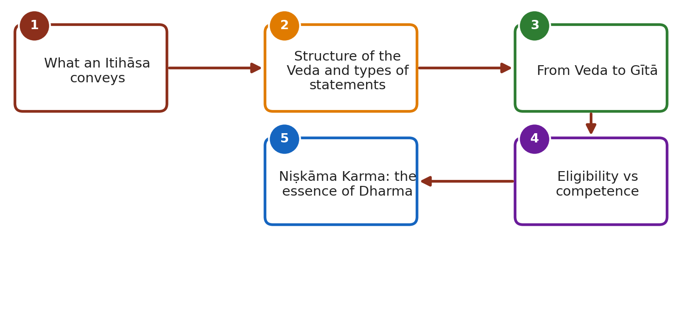
Lesson roadmap
Notes:
Walk through the storyline of the chapter in this order. Each numbered box is one teaching slide.

Slide 5
What an Itihāsa conveys
IN THIS CHAPTER
A
A What an Itihāsa conveys
Universal truth as stories of humans and non-humans.
Themes: how truth is experienced, communicated, understood and verified.
Truths = fruit of thousands of years of observation by Ṛṣis.
Ṛṣis are mantra-draṣṭā ('one who has experienced it'), not creators of aphorisms.
Kṛṣṇa Dvaipāyana combined, classified and edited them: Veda Vyāsa.
B Structure of the Veda and …
C From Veda to Gītā
D Eligibility vs competence
E Niṣkāma Karma: the essence…
Notes:
A. What an Itihāsa conveys
- Universal truth as stories of humans and non-humans.
- Themes: how truth is experienced, communicated, understood and verified.
- Truths = fruit of thousands of years of observation by Ṛṣis.
- Ṛṣis are mantra-draṣṭā ('one who has experienced it'), not creators of aphorisms.
- Kṛṣṇa Dvaipāyana combined, classified and edited them: Veda Vyāsa.
Check for understanding: What is an Itihāsa trying to convey, according to this chapter?
Model answer: Universal truths about human nature, narrated as stories of humans and non-humans, including how truth is experienced, communicated, understood and verified.

Slide 6
Structure of the Veda and types of statements
IN THIS CHAPTER
B
A What an Itihāsa conveys
Each Veda has 4 texts: Saṃhitā, Āraṇyaka, Brāhmaṇa, Upaniṣad.
Praśasti Vākya: decorative statements of fame/infamy; based on likes/dislikes; Saṃhitā statements are of this type.
Vidhi Vākya: dos and don'ts; context-dependent and variable.
Praśasti + Vidhi compiled in Brāhmaṇas and Āraṇyakas.
Jñāna Vākya (statement of truth): like an equation, order-independent: 2+2=4 / 4=2+2; Aham Brahmāsmi / Brahma aham asmi; tat tvam asi / asi tat tvam.
Upaniṣads mainly hold statements of truth.
B Structure of the Veda and …
C From Veda to Gītā
D Eligibility vs competence
E Niṣkāma Karma: the essence…
Notes:
B. Structure of the Veda and types of statements
- Each Veda has 4 texts: Saṃhitā, Āraṇyaka, Brāhmaṇa, Upaniṣad.
- Praśasti Vākya: decorative statements of fame/infamy; based on likes/dislikes; Saṃhitā statements are of this type.
- Vidhi Vākya: dos and don'ts; context-dependent and variable.
- Praśasti + Vidhi compiled in Brāhmaṇas and Āraṇyakas.
- Jñāna Vākya (statement of truth): like an equation, order-independent: 2+2=4 / 4=2+2; Aham Brahmāsmi / Brahma aham asmi; tat tvam asi / asi tat tvam.
- Upaniṣads mainly hold statements of truth.
Check for understanding: Who are the mantra-draṣṭās and what is their role?
Model answer: Ṛṣis who experienced truths in meditation. They did not create the aphorisms but expressed what they experienced. Kṛṣṇa Dvaipāyana compiled, classified and edited them and so became Veda Vyāsa.

Slide 7
From Veda to Gītā
IN THIS CHAPTER
C
A What an Itihāsa conveys
Brahma Sūtra: Vedānta text built by arranging statements of truth in order.
Gītā: practical application of ancient lessons in real life circumstances.
Vedas/Upaniṣads = sourcebooks; Brahma Sūtra = text; Bhagavadgītā = technology.
Mahābhārata holds the technology of Vedānta: hence fifth Veda.
B Structure of the Veda and …
C From Veda to Gītā
D Eligibility vs competence
E Niṣkāma Karma: the essence…
Notes:
C. From Veda to Gītā
- Brahma Sūtra: Vedānta text built by arranging statements of truth in order.
- Gītā: practical application of ancient lessons in real life circumstances.
- Vedas/Upaniṣads = sourcebooks; Brahma Sūtra = text; Bhagavadgītā = technology.
- Mahābhārata holds the technology of Vedānta: hence fifth Veda.
Check for understanding: Name and explain the three types of statements in the Vedas.
Model answer: Praśasti Vākya: decorative statements of fame or infamy, based on likes and dislikes. Vidhi Vākya: dos and don'ts that vary with context. Jñāna Vākya: statements of truth, like equations where word order does not change meaning.

Slide 8
Eligibility vs competence
IN THIS CHAPTER
D
A What an Itihāsa conveys
Analogy: a degree makes one eligible for civil service, not necessarily competent.
All beings are eligible for mokṣa; heaven is not final (impermanent; one returns).
Vedic study demands rigorous vratas and training; many humans fall short.
Mahābhārata: lofty ideas in simple words; teaches through life experiences.
Principal purpose: show how Dharma operates in numerous contexts.
B Structure of the Veda and …
C From Veda to Gītā
D Eligibility vs competence
E Niṣkāma Karma: the essence…
Notes:
D. Eligibility vs competence
- Analogy: a degree makes one eligible for civil service, not necessarily competent.
- All beings are eligible for mokṣa; heaven is not final (impermanent; one returns).
- Vedic study demands rigorous vratas and training; many humans fall short.
- Mahābhārata: lofty ideas in simple words; teaches through life experiences.
- Principal purpose: show how Dharma operates in numerous contexts.
Check for understanding: Why are Saṃhitā statements called Praśasti Vākyas and not statements of truth?
Model answer: Because they narrate fame or infamy, which involves acts of commission and omission based on likes and dislikes, reducing veracity.

Slide 9
Niṣkāma Karma: the essence of Dharma
IN THIS CHAPTER
E
A What an Itihāsa conveys
Vyāsa: essence of Dharma = Niṣkāma Karma, the theme of every anecdote.
Meaning: karma without the touch of karmic elements; service to others with controlled senses and mind.
Misconception: that it belongs only to the Bhagavadgītā.
Logic: body is dynamic; inaction is inconceivable; act for everyone's benefit.
Humans are social; everyone must commit to it at some time.
Take responsibility for action or inaction; do not blame external forces; weigh pros and cons; control senses and manas.
B Structure of the Veda and …
C From Veda to Gītā
D Eligibility vs competence
E Niṣkāma Karma: the essence…
Notes:
E. Niṣkāma Karma: the essence of Dharma
- Vyāsa: essence of Dharma = Niṣkāma Karma, the theme of every anecdote.
- Meaning: karma without the touch of karmic elements; service to others with controlled senses and mind.
- Misconception: that it belongs only to the Bhagavadgītā.
- Logic: body is dynamic; inaction is inconceivable; act for everyone's benefit.
- Humans are social; everyone must commit to it at some time.
- Take responsibility for action or inaction; do not blame external forces; weigh pros and cons; control senses and manas.
Check for understanding: Give examples of order-independent truth statements.
Model answer: 2+2=4 and 4=2+2; Aham Brahmāsmi / Brahma aham asmi; tat tvam asi / asi tat tvam.

Slide 10
Key terms to know (1/2)
Term | Meaning and why it matters
Mantra-draṣṭā (Dṛṣṭakāl in the book) | Ṛṣi who has experienced the truth; not an author of aphorisms.
Veda Vyāsa | Kṛṣṇa Dvaipāyana, called so because he compiled, classified and edited the Vedas.
Saṃhitā, Āraṇyaka, Brāhmaṇa, Upaniṣad | The four texts into which each Veda is classified.
Praśasti Vākya | Decorative statement of fame or infamy, reflecting likes and dislikes; not a statement of truth.
Vidhi Vākya | Statement of dos and don'ts; depends on context.
Jñāna Vākya (statement of truth) | Order-independent, equation-like statement, as in the Upaniṣads.
Brahma Sūtra | Systematic Vedānta text derived from statements of truth.
Notes:
Ask students to explain each term in their own words before showing the meaning.

Slide 11
Key terms to know (2/2)
Term | Meaning and why it matters
Bhagavadgītā as 'technology' | The practical method by which Vedic lessons are applied in life.
Eligibility vs competence | Everyone is eligible for mokṣa; not everyone is competent for rigorous Vedic learning.
Mokṣa | Ultimate purpose of every living being; heaven is not the final goal.
Niṣkāma Karma | Selfless action without karmic attachment; essence of Dharma.
Manas | Mind, to be controlled along with the sense organs.
Notes:
Ask students to explain each term in their own words before showing the meaning.

Slide 12
Numbers and facts at a glance
Texts per Veda
Types of Vedic statements
Tiers of knowledge
Equation example
4 (Saṃhitā, Āraṇyaka, Brāhmaṇa, Upaniṣad)
3 (Praśasti, Vidhi, Jñāna/truth)
3: sourcebooks (Vedas/Upaniṣads), text (Brahma Sūtra), technology (Gītā)
2+2=4 equals 4=2+2
Truth sentences
Aham Brahmāsmi / Brahma aham asmi; tat tvam asi / asi tat tvam
Notes:
Students should memorise these figures; they are frequently asked in exams.

Slide 13
Key people, places and texts
K
Kṛṣṇa Dvaipāyana (Veda Vyāsa)
Editor of the Vedas, composer of the fifth Veda.
Ṛ
Ṛṣis
Experiencers of truth through meditation.
B
Bhagavadgītā
Practical application of Vedic teaching within Mahābhārata.
B
Brahma Sūtra
Systematic text of Vedānta.
Notes:
Point out each name on the map of the story; ask who/what/why.

Slide 14
Ślokas, sayings and sources
Aham Brahmāsmi / Brahma aham asmi
Examples of statements of truth: meaning does not change when words are reordered.
Tat tvam asi / asi tat tvam
Same: order-independent statement of truth.
Notes:
Read the Sanskrit aloud slowly; students repeat; then discuss the meaning.

Slide 15
Three kinds of Vedic statements
Type | Nature | Where compiled
Praśasti Vākya | Praise/blame, based on likes and dislikes; not a pure truth statement | Brāhmaṇas and Āraṇyakas
Vidhi Vākya | Dos and don'ts; vary with context | Brāhmaṇas and Āraṇyakas
Jñāna Vākya (truth) | Equation-like; meaning fixed whatever the order | Upaniṣads
Notes:
Use this table for a compare-and-contrast discussion.

Slide 16
Source, text and technology
Level | Work | Role
Sourcebooks | Vedas and Upaniṣads | Origin of truths
Text | Brahma Sūtra | Systematic arrangement of truths
Technology | Bhagavadgītā (in Mahābhārata) | Applies the lessons in real situations
Notes:
Use this table for a compare-and-contrast discussion.

Slide 17
Eligibility vs competence
Aspect | Eligibility | Competence
For mokṣa | All beings, human and non-human | Needs suitable means
For Vedic study | Humans are eligible | Requires rigorous vratas and training
Role of MB | Offers a path through life-experiences to the eligible but incompetent
Notes:
Use this table for a compare-and-contrast discussion.

Slide 18
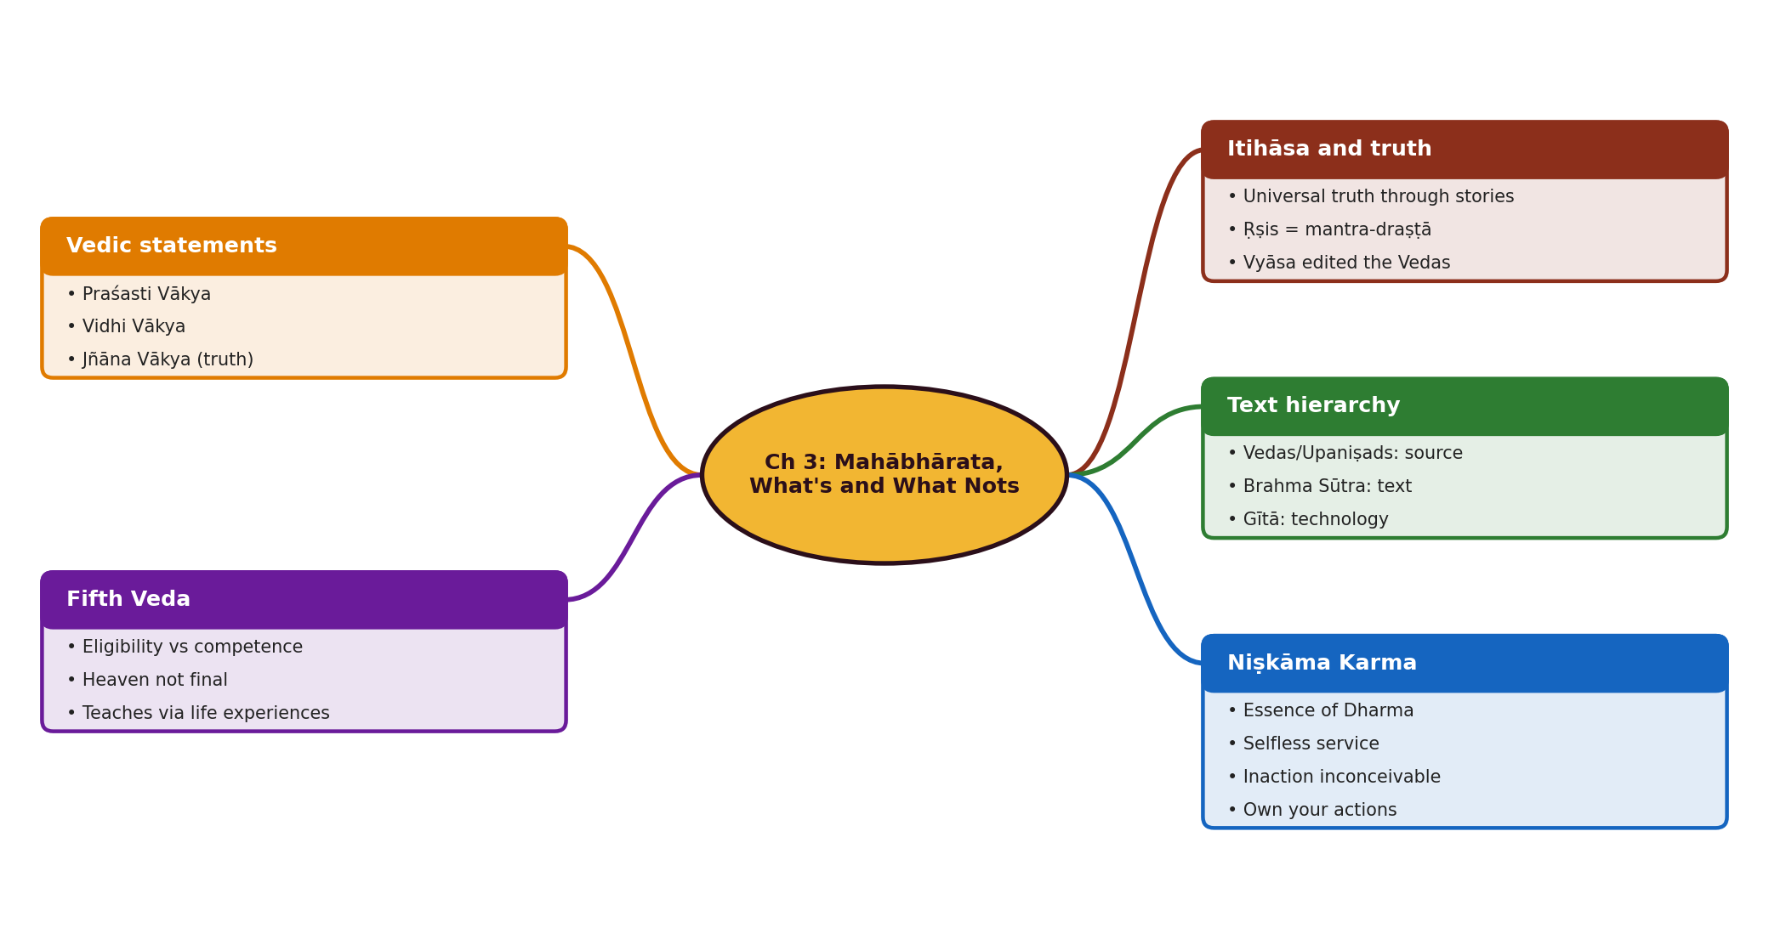
Mind map of the chapter
Notes:
Use this as a revision sheet: ask students to redraw it from memory.

Slide 19
Memory aids
P-V-J = Praśasti, Vidhi, Jñāna: the 3 statements.
S-A-B-U = Saṃhitā, Āraṇyaka, Brāhmaṇa, Upaniṣad.
1
2
Source, Text, Technology = Vedas/Upaniṣads, Brahma Sūtra, Gītā.
E vs C: Everyone is Eligible, but not everyone is Competent.
3
4
Truth is like an equation: reorder the words, the meaning stays.
Niṣkāma Karma is not only a Gītā idea; it is in every anecdote.
5
6
Notes:
Let students invent their own mnemonics too.

Slide 20
Quick quiz (Q1 to Q5)
Q1. What is an Itihāsa trying to convey, according to this chapter?
Q2. Who are the mantra-draṣṭās and what is their role?
Q3. Name and explain the three types of statements in the Vedas.
Q4. Why are Saṃhitā statements called Praśasti Vākyas and not statements of truth?
Q5. Give examples of order-independent truth statements.
Notes:
Answers:
Q1. Universal truths about human nature, narrated as stories of humans and non-humans, including how truth is experienced, communicated, understood and verified.
Q2. Ṛṣis who experienced truths in meditation. They did not create the aphorisms but expressed what they experienced. Kṛṣṇa Dvaipāyana compiled, classified and edited them and so became Veda Vyāsa.
Q3. Praśasti Vākya: decorative statements of fame or infamy, based on likes and dislikes. Vidhi Vākya: dos and don'ts that vary with context. Jñāna Vākya: statements of truth, like equations where word order does not change meaning.
Q4. Because they narrate fame or infamy, which involves acts of commission and omission based on likes and dislikes, reducing veracity.
Q5. 2+2=4 and 4=2+2; Aham Brahmāsmi / Brahma aham asmi; tat tvam asi / asi tat tvam.

Slide 21
Quick quiz (Q6 to Q10)
Q6. Explain how Vedas, Brahma Sūtra and the Gītā relate.
Q7. Explain eligibility and competence with the book's example.
Q8. Why is heaven not the final goal in Indian thought?
Q9. How does Mahābhārata help those who are eligible but not competent?
Q10. What is Niṣkāma Karma and why is it the essence of Dharma?
Notes:
Answers:
Q6. Vedas and Upaniṣads are sourcebooks, Brahma Sūtra is the systematic text, and the Bhagavadgītā is the technology to apply them. Mahābhārata holds this technology, so it is the fifth Veda.
Q7. A degree makes one eligible for civil service, but not all graduates are competent. Similarly all beings are eligible for mokṣa, yet not all humans are competent to follow the rigorous training for Vedic study.
Q8. It is not permanent; once the time is over a being may return to earth. Mokṣa is the ultimate purpose.
Q9. It presents lofty ideas in simple words and offers a distinctive means through the many life experiences it illustrates, showing how Dharma operates in varied contexts.
Q10. Performing karma without karmic attachment, serving others while controlling the senses and mind. Vyāsa says it is the central topic of every anecdote of Mahābhārata.

Slide 22
Quick quiz (Q11 to Q12)
Q11. Why does the chapter say inaction is inconceivable?
Q12. What personal responsibility does Niṣkāma Karma imply?
Notes:
Answers:
Q11. The human body is dynamic; whatever is dynamic acts and reacts, so one is always engaged in some action and must keep it beneficial to all.
Q12. One is responsible for one's actions or inaction, cannot blame external forces, must weigh pros and cons and control the sense organs and manas.

Slide 23
Answer key (1/3)
Q1. What is an Itihāsa trying to convey, according to this chapter?
Universal truths about human nature, narrated as stories of humans and non-humans, including how truth is experienced, communicated, understood and verified.
Q2. Who are the mantra-draṣṭās and what is their role?
Ṛṣis who experienced truths in meditation. They did not create the aphorisms but expressed what they experienced. Kṛṣṇa Dvaipāyana compiled, classified and edited them and so became Veda Vyāsa.
Q3. Name and explain the three types of statements in the Vedas.
Praśasti Vākya: decorative statements of fame or infamy, based on likes and dislikes. Vidhi Vākya: dos and don'ts that vary with context. Jñāna Vākya: statements of truth, like equations where word order does not change meaning.
Q4. Why are Saṃhitā statements called Praśasti Vākyas and not statements of truth?
Because they narrate fame or infamy, which involves acts of commission and omission based on likes and dislikes, reducing veracity.
Notes:
Reveal after students attempt each question.

Slide 24
Answer key (2/3)
Q5. Give examples of order-independent truth statements.
2+2=4 and 4=2+2; Aham Brahmāsmi / Brahma aham asmi; tat tvam asi / asi tat tvam.
Q6. Explain how Vedas, Brahma Sūtra and the Gītā relate.
Vedas and Upaniṣads are sourcebooks, Brahma Sūtra is the systematic text, and the Bhagavadgītā is the technology to apply them. Mahābhārata holds this technology, so it is the fifth Veda.
Q7. Explain eligibility and competence with the book's example.
A degree makes one eligible for civil service, but not all graduates are competent. Similarly all beings are eligible for mokṣa, yet not all humans are competent to follow the rigorous training for Vedic study.
Q8. Why is heaven not the final goal in Indian thought?
It is not permanent; once the time is over a being may return to earth. Mokṣa is the ultimate purpose.
Notes:
Reveal after students attempt each question.

Slide 25
Answer key (3/3)
Q9. How does Mahābhārata help those who are eligible but not competent?
It presents lofty ideas in simple words and offers a distinctive means through the many life experiences it illustrates, showing how Dharma operates in varied contexts.
Q10. What is Niṣkāma Karma and why is it the essence of Dharma?
Performing karma without karmic attachment, serving others while controlling the senses and mind. Vyāsa says it is the central topic of every anecdote of Mahābhārata.
Q11. Why does the chapter say inaction is inconceivable?
The human body is dynamic; whatever is dynamic acts and reacts, so one is always engaged in some action and must keep it beneficial to all.
Q12. What personal responsibility does Niṣkāma Karma imply?
One is responsible for one's actions or inaction, cannot blame external forces, must weigh pros and cons and control the sense organs and manas.
Notes:
Reveal after students attempt each question.

Slide 26
Rapid-fire recall
Fourfold Vedic texts = ?
Gītā's role = ?
Saṃhitā, Āraṇyaka, Brāhmaṇa, Upaniṣad.
Technology of Vedānta.
Essence of Dharma = ?
Is heaven final?
Niṣkāma Karma.
No, it is impermanent.
Notes:
Ask the left part aloud; students answer; reveal the right part.

Slide 27
Remember and revise
Itihāsa conveys universal truths through stories of humans and non-humans; the truths come from Ṛṣis' experience (mantra-draṣṭā).
Kṛṣṇa Dvaipāyana compiled and classified the Vedic aphorisms, hence Veda Vyāsa.
Three kinds of Vedic statements: Praśasti, Vidhi, Jñāna Vākya (statement of truth).
Hierarchy: Vedas/Upaniṣads = sourcebooks; Brahma Sūtra = text; Bhagavadgītā = technology.
Eligibility vs competence explains the need for the fifth Veda; Niṣkāma Karma = essence of Dharma.
HOMEWORK
Redraw the mind map from memory.
Answer Q1 and Q2 of the quiz in writing.
Learn the numbers slide by heart.
Prepare one question to ask the class tomorrow.
Notes:
Return to the warm-up question and let students answer it now.
Model answer: Universal truths about human nature, narrated as stories of humans and non-humans, including how truth is experienced, communicated, understood and verified.

