Slide 1
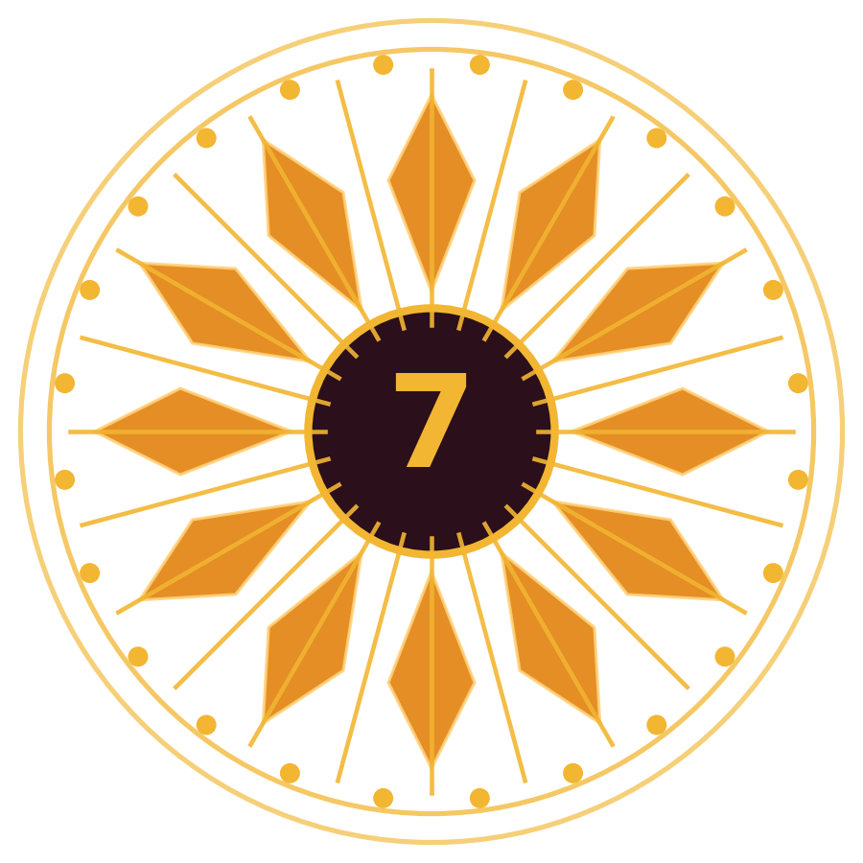
CHAPTER 7
Pratijñā (The Vow)
Strategic Lessons from Mahābhārata
Teaching deck · Book pages 83 to 94
Notes:
Teacher's script for the whole chapter (summary):
Reading Mahābhārata feels like meeting the divine: devas thunder 'Bhīṣma, Bhīṣma' at Devavrata's vow and shower flowers when the Pāṇḍavas are born, while a donkey brays at Duryodhana's birth. The chapter opens with Maharṣi Aṇīmāṇḍavya, wrongly taken for a thief, impaled on a spear; the thieves died but he lived, and the spear could not be removed even after the king released him. When he reached Yama's abode, he cursed Yama-Dharma for misinterpreting Dharma. Even Dharmadeva is not above Dharma. The Itihāsa gives complex logic, contexts and emotions, forcing the student to churn heart and mind, and that churning itself builds understanding of Dharma.
Bhīṣma Pratijñā (Ādi Parva): Devavrata, the appointed yuvarāja, learns of his father Śantanu's love for Satyavatī. Her father's condition was that her son be the next king; Śantanu rejected it, but Devavrata accepted on his own, without counsel, taking a lifelong vow of brahmacarya and giving up the throne. He earned the name Bhīṣma and the power to choose the time of death. The book questions it: his father's life, the kingdom and his own life did not depend on it; it only served his father's kāma. As yuvarāja he had a duty to seek permission and counsel, and no one could be sure Satyavatī's sons would be morally and intellectually fit kings. Her sons died childless (Vicitravīrya left widows Ambikā and Ambālikā). Satyavatī asked Bhīṣma both to father heirs (niyoga) and to take the throne; he refused both. Vyāsa fathered Dhṛtarāṣṭra and Pāṇḍu, and Vidura (born to a maid); the blind Dhṛtarāṣṭra and the sons of the maid could not be king, Pāṇḍu ruled well but died soon, and the throne was empty again. Stable kingship came only after the war, in which 18 akṣauhiṇīs died.
Nuance: the vow was a feat impossible for most men. Even Arjuna could not keep his twelve years of brahmacarya in exile after entering when Yudhiṣṭhira and Draupadī were together, and Śantanu (Mahābhiṣa, born as Śantanu on Brahmā's instruction) was drawn to Gaṅgā and Satyavatī. So Bhīṣma is the brahmacarya archetype. But bound by his vow, he became powerless before a blind king and his son. Is he the archetype of Dharma or of Pratijñā? When vows contradict Dharma, what then? The chapter studies vows of Gāndhārī, Arjuna and Bhīma.
Gāndhārī, daughter of Subala of Gāndhāra, was married to the blind Dhṛtarāṣṭra after Bhīṣma's proposal. On learning this, she blindfolded herself, resolving never to experience more than her husband. Praised widely, but was it right? Modern scholars ask whether marriage needs equality or compatibility, and complementing each other. The hasty vow blinded her to Duryodhana's stubbornness and ego; improper parenting contributed to unprincipled characters, and keeping her eyes closed also means turning a blind eye to her sons' deeds. Had she instead been her husband's eyes, things might differ. Amma: motherhood is as vast as the universe, and with it a woman can influence the world; Gāndhārī failed to influence her children. Her vow came from an instant emotion at a young age, not clarity.
Arjuna's vow: after Abhimanyu was killed on day 13, he swore to kill Jayadratha before sunset the next day. Droṇa had built the Cakravyūha; Jayadratha's interference stopped the other Pāṇḍava warriors from following Abhimanyu in; Abhimanyu broke in, killed Duryodhana's son and many princes, but was attacked by many warriors together against dharmayuddha ethics and killed by a final blow from Duḥśāsana's son. Duryodhana and Droṇa arranged three vyūhas to shield Jayadratha. Bhīma, Sātyaki and Arjuna tore through, but Jayadratha hid behind Droṇa and sunset was near. Kṛṣṇa's Sudarśana cakra masked the sun; Jayadratha came out; Kṛṣṇa withdrew the cakra and Arjuna killed him with the Pāśupatāstra using his Gāṇḍīva. The vow came from anger, not clear thought, and succeeded only by Kṛṣṇa's intervention.
Bhīma's vows: after the dice game and Draupadī's humiliation he vowed to kill Duḥśāsana, tear open his chest and drink his blood; when Duryodhana gestured Draupadī to sit on his thigh, he vowed to break it. Yet in Udyoga Parva, when Kṛṣṇa consulted all the Pāṇḍavas and Draupadī before the peace mission, Bhīma favoured peace, willing to forgo his vows. In war he killed Duḥśāsana without conflict with Dharma. In the final mace duel (Duryodhana chose Bhīma; the Kaurava side then had Duryodhana, Aśvatthāmā, Kṛpa and Kṛtavarmā), Bhīma tired and Kṛṣṇa signalled him to strike the thigh; so the thigh-blow followed Kṛṣṇa's instruction, not merely his vow. Though taken in anger, his vows did not cloud his judgement.
Summary: all three vows were emotional. Gāndhārī's blinded her to her children's adharma, ending in bloodshed; Arjuna's could have trapped him; Bhīma's was tempered by Dharma. We too make vows in emotion ('I won't talk to him', silent treatment). Ask: (1) was it made from intellectual clarity or spontaneous outburst? (2) if from emotion, after seeing the bigger picture, is it still beneficial for us or society? If yes, keep it; otherwise drop it. Kṛṣṇa too vowed not to take up arms: he joined one side unarmed while his Yādava army went to Duryodhana. When Bhīṣma took a counter-vow to make him break it and Arjuna's reverence held him back, Kṛṣṇa rushed at Bhīṣma with a chariot wheel; Arjuna's promise to fight fully pacified him. Kṛṣṇa told Bhīṣma he misused his boon of choosing the hour of death against warriors without such protection. Kṛṣṇa was not held back by his vow and acted with clarity for Dharma: the true Pratijñā archetype, unlike Bhīṣma who trapped himself.

Slide 2
What students will learn
Bhīṣma is the Brahmacarya archetype, but his Pratijñā served only his father's kāma and left the throne empty; Kṛṣṇa is the Pratijñā archetype.
1
Gāndhārī's blindfold: noble-looking but hasty; she could not correct Duryodhana.
2
Arjuna's vow to kill Jayadratha before sunset was saved by Kṛṣṇa's Sudarśana cakra (sunset illusion).
3
Bhīma took two vows in rage but still chose Dharma (approved peace; fought fairly; thigh-strike on Kṛṣṇa's signal).
4
Test any vow: was it made in clarity or outburst? is it still beneficial? If not, drop it.
5
Notes:
Core idea: Vows made in emotion can bind or blind us: Bhīṣma (brahmacarya), Gāndhārī (blindfold), Arjuna (Jayadratha) and Bhīma (Duḥśāsana and Duryodhana) show how to examine a vow, while Kṛṣṇa is the Pratijñā archetype who is never trapped by his vow.
Full chapter summary:
Reading Mahābhārata feels like meeting the divine: devas thunder 'Bhīṣma, Bhīṣma' at Devavrata's vow and shower flowers when the Pāṇḍavas are born, while a donkey brays at Duryodhana's birth. The chapter opens with Maharṣi Aṇīmāṇḍavya, wrongly taken for a thief, impaled on a spear; the thieves died but he lived, and the spear could not be removed even after the king released him. When he reached Yama's abode, he cursed Yama-Dharma for misinterpreting Dharma. Even Dharmadeva is not above Dharma. The Itihāsa gives complex logic, contexts and emotions, forcing the student to churn heart and mind, and that churning itself builds understanding of Dharma.
Bhīṣma Pratijñā (Ādi Parva): Devavrata, the appointed yuvarāja, learns of his father Śantanu's love for Satyavatī. Her father's condition was that her son be the next king; Śantanu rejected it, but Devavrata accepted on his own, without counsel, taking a lifelong vow of brahmacarya and giving up the throne. He earned the name Bhīṣma and the power to choose the time of death. The book questions it: his father's life, the kingdom and his own life did not depend on it; it only served his father's kāma. As yuvarāja he had a duty to seek permission and counsel, and no one could be sure Satyavatī's sons would be morally and intellectually fit kings. Her sons died childless (Vicitravīrya left widows Ambikā and Ambālikā). Satyavatī asked Bhīṣma both to father heirs (niyoga) and to take the throne; he refused both. Vyāsa fathered Dhṛtarāṣṭra and Pāṇḍu, and Vidura (born to a maid); the blind Dhṛtarāṣṭra and the sons of the maid could not be king, Pāṇḍu ruled well but died soon, and the throne was empty again. Stable kingship came only after the war, in which 18 akṣauhiṇīs died.
Nuance: the vow was a feat impossible for most men. Even Arjuna could not keep his twelve years of brahmacarya in exile after entering when Yudhiṣṭhira and Draupadī were together, and Śantanu (Mahābhiṣa, born as Śantanu on Brahmā's instruction) was drawn to Gaṅgā and Satyavatī. So Bhīṣma is the brahmacarya archetype. But bound by his vow, he became powerless before a blind king and his son. Is he the archetype of Dharma or of Pratijñā? When vows contradict Dharma, what then? The chapter studies vows of Gāndhārī, Arjuna and Bhīma.
Gāndhārī, daughter of Subala of Gāndhāra, was married to the blind Dhṛtarāṣṭra after Bhīṣma's proposal. On learning this, she blindfolded herself, resolving never to experience more than her husband. Praised widely, but was it right? Modern scholars ask whether marriage needs equality or compatibility, and complementing each other. The hasty vow blinded her to Duryodhana's stubbornness and ego; improper parenting contributed to unprincipled characters, and keeping her eyes closed also means turning a blind eye to her sons' deeds. Had she instead been her husband's eyes, things might differ. Amma: motherhood is as vast as the universe, and with it a woman can influence the world; Gāndhārī failed to influence her children. Her vow came from an instant emotion at a young age, not clarity.
Arjuna's vow: after Abhimanyu was killed on day 13, he swore to kill Jayadratha before sunset the next day. Droṇa had built the Cakravyūha; Jayadratha's interference stopped the other Pāṇḍava warriors from following Abhimanyu in; Abhimanyu broke in, killed Duryodhana's son and many princes, but was attacked by many warriors together against dharmayuddha ethics and killed by a final blow from Duḥśāsana's son. Duryodhana and Droṇa arranged three vyūhas to shield Jayadratha. Bhīma, Sātyaki and Arjuna tore through, but Jayadratha hid behind Droṇa and sunset was near. Kṛṣṇa's Sudarśana cakra masked the sun; Jayadratha came out; Kṛṣṇa withdrew the cakra and Arjuna killed him with the Pāśupatāstra using his Gāṇḍīva. The vow came from anger, not clear thought, and succeeded only by Kṛṣṇa's intervention.
Bhīma's vows: after the dice game and Draupadī's humiliation he vowed to kill Duḥśāsana, tear open his chest and drink his blood; when Duryodhana gestured Draupadī to sit on his thigh, he vowed to break it. Yet in Udyoga Parva, when Kṛṣṇa consulted all the Pāṇḍavas and Draupadī before the peace mission, Bhīma favoured peace, willing to forgo his vows. In war he killed Duḥśāsana without conflict with Dharma. In the final mace duel (Duryodhana chose Bhīma; the Kaurava side then had Duryodhana, Aśvatthāmā, Kṛpa and Kṛtavarmā), Bhīma tired and Kṛṣṇa signalled him to strike the thigh; so the thigh-blow followed Kṛṣṇa's instruction, not merely his vow. Though taken in anger, his vows did not cloud his judgement.
Summary: all three vows were emotional. Gāndhārī's blinded her to her children's adharma, ending in bloodshed; Arjuna's could have trapped him; Bhīma's was tempered by Dharma. We too make vows in emotion ('I won't talk to him', silent treatment). Ask: (1) was it made from intellectual clarity or spontaneous outburst? (2) if from emotion, after seeing the bigger picture, is it still beneficial for us or society? If yes, keep it; otherwise drop it. Kṛṣṇa too vowed not to take up arms: he joined one side unarmed while his Yādava army went to Duryodhana. When Bhīṣma took a counter-vow to make him break it and Arjuna's reverence held him back, Kṛṣṇa rushed at Bhīṣma with a chariot wheel; Arjuna's promise to fight fully pacified him. Kṛṣṇa told Bhīṣma he misused his boon of choosing the hour of death against warriors without such protection. Kṛṣṇa was not held back by his vow and acted with clarity for Dharma: the true Pratijñā archetype, unlike Bhīṣma who trapped himself.

Slide 3
Warm-up: think first
Explain the Bhīṣma Pratijñā and the chapter's critique of it.
?
Discuss with your partner for 2 minutes. We will return to this at the end of the lesson.
Notes:
Give students 2 minutes (think-pair-share) before revealing.
Model answer: Devavrata took a lifelong vow of brahmacarya and gave up the throne so Śantanu could marry Satyavatī, earning the name Bhīṣma and the boon of choosing his death. The chapter notes no life or kingdom depended on it, it only served his father's kāma, he did not consult, and it led to an unstable throne and the war.

Slide 4
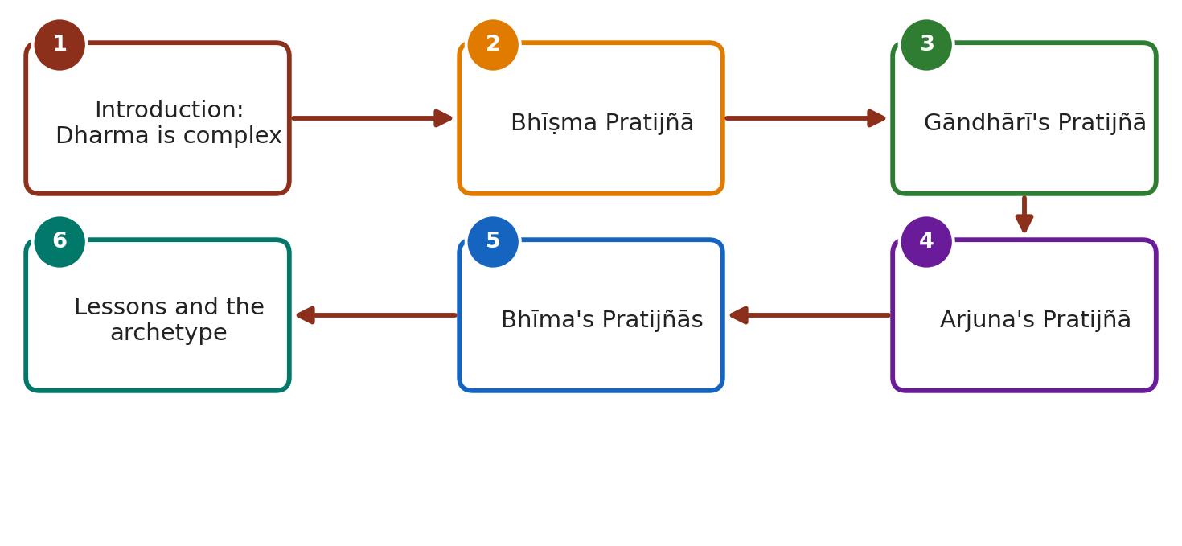
Lesson roadmap
Notes:
Walk through the storyline of the chapter in this order. Each numbered box is one teaching slide.

Slide 5
Introduction: Dharma is complex
IN THIS CHAPTER
A
A Introduction: Dharma is co…
Devas shout 'Bhīṣma' at Devavrata's vow; flowers at Pāṇḍavas' birth; donkey brays at Duryodhana's birth.
Aṇīmāṇḍavya: impaled by mistake, lived with the spear; cursed Yama-Dharma for misinterpreting Dharma: Dharmadeva is not above Dharma.
MB gives complex logic, contexts and emotions: studying it means 'churning', which builds understanding of Dharma.
B Bhīṣma Pratijñā
C Gāndhārī's Pratijñā
D Arjuna's Pratijñā
E Bhīma's Pratijñās
F Lessons and the archetype
Notes:
A. Introduction: Dharma is complex
- Devas shout 'Bhīṣma' at Devavrata's vow; flowers at Pāṇḍavas' birth; donkey brays at Duryodhana's birth.
- Aṇīmāṇḍavya: impaled by mistake, lived with the spear; cursed Yama-Dharma for misinterpreting Dharma: Dharmadeva is not above Dharma.
- MB gives complex logic, contexts and emotions: studying it means 'churning', which builds understanding of Dharma.
Check for understanding: Explain the Bhīṣma Pratijñā and the chapter's critique of it.
Model answer: Devavrata took a lifelong vow of brahmacarya and gave up the throne so Śantanu could marry Satyavatī, earning the name Bhīṣma and the boon of choosing his death. The chapter notes no life or kingdom depended on it, it only served his father's kāma, he did not consult, and it led to an unstable throne and the war.

Slide 6
Bhīṣma Pratijñā
IN THIS CHAPTER
B
A Introduction: Dharma is co…
Devavrata = yuvarāja; Satyavatī's father's condition: her son to be king; Śantanu refused; Devavrata accepted without counsel.
Vow: lifelong brahmacarya + renounced throne; name Bhīṣma; boon: choose time of death.
Critique: did not save father's life, kingdom or his own life; served father's kāma; no notice or consultation.
Satyavatī's sons Citrāṅgada and Vicitravīrya died childless; widows Ambikā, Ambālikā; Bhīṣma refused niyoga and kingship.
Vyāsa fathered Dhṛtarāṣṭra, Pāṇḍu, Vidura; throne unstable until end of war; 18 akṣauhiṇīs died.
Strength: feat impossible for most (even Arjuna failed 12-year brahmacarya); Śantanu = Mahābhiṣa; Bhīṣma = Brahmacarya archetype, not Dharma archetype; powerless before blind king and son.
B Bhīṣma Pratijñā
C Gāndhārī's Pratijñā
D Arjuna's Pratijñā
E Bhīma's Pratijñās
F Lessons and the archetype
Notes:
B. Bhīṣma Pratijñā
- Devavrata = yuvarāja; Satyavatī's father's condition: her son to be king; Śantanu refused; Devavrata accepted without counsel.
- Vow: lifelong brahmacarya + renounced throne; name Bhīṣma; boon: choose time of death.
- Critique: did not save father's life, kingdom or his own life; served father's kāma; no notice or consultation.
- Satyavatī's sons Citrāṅgada and Vicitravīrya died childless; widows Ambikā, Ambālikā; Bhīṣma refused niyoga and kingship.
- Vyāsa fathered Dhṛtarāṣṭra, Pāṇḍu, Vidura; throne unstable until end of war; 18 akṣauhiṇīs died.
- Strength: feat impossible for most (even Arjuna failed 12-year brahmacarya); Śantanu = Mahābhiṣa; Bhīṣma = Brahmacarya archetype, not Dharma archetype; powerless before blind king and son.
Check for understanding: Why does the chapter call Bhīṣma the brahmacarya archetype but not the Pratijñā or Dharma archetype?
Model answer: His self-control was extraordinary, unlike Arjuna's or Śantanu's, yet bound by the vow he was powerless before a blind king and his son and could not respond to adharma. Kṛṣṇa is the Pratijñā archetype.

Slide 7
Gāndhārī's Pratijñā
IN THIS CHAPTER
C
A Introduction: Dharma is co…
Daughter of Subala, Gāndhāra; blindfolded herself on hearing of the match with blind Dhṛtarāṣṭra.
Praised, but hasty and emotional; equality vs compatibility in marriage.
Result: Duryodhana's ego uncorrected; 'turned a blind eye' to sons' acts.
Alternative: be her husband's eyes. Amma: motherhood's power to influence the world.
B Bhīṣma Pratijñā
C Gāndhārī's Pratijñā
D Arjuna's Pratijñā
E Bhīma's Pratijñās
F Lessons and the archetype
Notes:
C. Gāndhārī's Pratijñā
- Daughter of Subala, Gāndhāra; blindfolded herself on hearing of the match with blind Dhṛtarāṣṭra.
- Praised, but hasty and emotional; equality vs compatibility in marriage.
- Result: Duryodhana's ego uncorrected; 'turned a blind eye' to sons' acts.
- Alternative: be her husband's eyes. Amma: motherhood's power to influence the world.
Check for understanding: What was Satyavatī's request to Bhīṣma after Vicitravīrya died and why did it matter?
Model answer: She asked him to father heirs with the widows and to take the throne. His refusal meant the vow had no remaining purpose, yet he kept it, and Vyāsa fathered Dhṛtarāṣṭra, Pāṇḍu and Vidura.

Slide 8
Arjuna's Pratijñā
IN THIS CHAPTER
D
A Introduction: Dharma is co…
Vow: kill Jayadratha before sunset (after Abhimanyu died on day 13).
Droṇa's Cakravyūha; Jayadratha blocked others; Abhimanyu killed by many together (adharma); final blow by Duḥśāsana's son.
Kaurava defence: three vyūhas; Jayadratha hid behind Droṇa.
Kṛṣṇa's Sudarśana cakra masked the sun; Jayadratha emerged; Pāśupatāstra with Gāṇḍīva.
Born of anger; saved only by Kṛṣṇa.
B Bhīṣma Pratijñā
C Gāndhārī's Pratijñā
D Arjuna's Pratijñā
E Bhīma's Pratijñās
F Lessons and the archetype
Notes:
D. Arjuna's Pratijñā
- Vow: kill Jayadratha before sunset (after Abhimanyu died on day 13).
- Droṇa's Cakravyūha; Jayadratha blocked others; Abhimanyu killed by many together (adharma); final blow by Duḥśāsana's son.
- Kaurava defence: three vyūhas; Jayadratha hid behind Droṇa.
- Kṛṣṇa's Sudarśana cakra masked the sun; Jayadratha emerged; Pāśupatāstra with Gāṇḍīva.
- Born of anger; saved only by Kṛṣṇa.
Check for understanding: Discuss Gāndhārī's Pratijñā.
Model answer: She blindfolded herself on hearing she would marry the blind Dhṛtarāṣṭra. Praised, but it was hasty; she could not guide Duryodhana, 'turned a blind eye' to her sons' deeds, and could have been her husband's eyes instead.

Slide 9
Bhīma's Pratijñās
IN THIS CHAPTER
E
A Introduction: Dharma is co…
Vow 1: kill Duḥśāsana, tear chest, drink blood. Vow 2: break Duryodhana's thigh (after thigh-sit gesture).
Udyoga Parva: he approved peace, ready to drop vows.
Killed Duḥśāsana without conflicting Dharma.
Mace duel: Kṛṣṇa signalled him to hit the thigh: act followed Kṛṣṇa's instruction.
Took vows in anger but did not let it cloud judgement.
B Bhīṣma Pratijñā
C Gāndhārī's Pratijñā
D Arjuna's Pratijñā
E Bhīma's Pratijñās
F Lessons and the archetype
Notes:
E. Bhīma's Pratijñās
- Vow 1: kill Duḥśāsana, tear chest, drink blood. Vow 2: break Duryodhana's thigh (after thigh-sit gesture).
- Udyoga Parva: he approved peace, ready to drop vows.
- Killed Duḥśāsana without conflicting Dharma.
- Mace duel: Kṛṣṇa signalled him to hit the thigh: act followed Kṛṣṇa's instruction.
- Took vows in anger but did not let it cloud judgement.
Check for understanding: Narrate Arjuna's Pratijñā and its fulfilment.
Model answer: After Abhimanyu's death on day 13, he vowed to kill Jayadratha before sunset. Droṇa's three vyūhas protected him; Kṛṣṇa masked the sun with the Sudarśana cakra, Jayadratha came out, the sun reappeared and Arjuna killed him with the Pāśupatāstra.

Slide 10
Lessons and the archetype
IN THIS CHAPTER
F
A Introduction: Dharma is co…
Gāndhārī's vow = blinded; Arjuna's = could trap; Bhīma's = Dharma first.
Daily vows: 'I won't talk to him', silent treatment.
Q1: clarity or outburst? Q2: still beneficial to self/society? Keep or drop.
Kṛṣṇa's vow: unarmed; Bhīṣma's counter-vow; Kṛṣṇa ran with chariot wheel; Arjuna's promise calmed him; Kṛṣṇa not tied by vow.
Kṛṣṇa = Pratijñā archetype; Bhīṣma = trapped by his vow.
B Bhīṣma Pratijñā
C Gāndhārī's Pratijñā
D Arjuna's Pratijñā
E Bhīma's Pratijñās
F Lessons and the archetype
Notes:
F. Lessons and the archetype
- Gāndhārī's vow = blinded; Arjuna's = could trap; Bhīma's = Dharma first.
- Daily vows: 'I won't talk to him', silent treatment.
- Q1: clarity or outburst? Q2: still beneficial to self/society? Keep or drop.
- Kṛṣṇa's vow: unarmed; Bhīṣma's counter-vow; Kṛṣṇa ran with chariot wheel; Arjuna's promise calmed him; Kṛṣṇa not tied by vow.
- Kṛṣṇa = Pratijñā archetype; Bhīṣma = trapped by his vow.
Check for understanding: Why were Abhimanyu's circumstances adharmic?
Model answer: Jayadratha blocked the other Pāṇḍavas from entering the Cakravyūha, and many powerful warriors attacked Abhimanyu at once, breaking dharmayuddha ethics.

Slide 11
Key terms to know (1/2)
Term | Meaning and why it matters
Pratijñā | A solemn vow or promise.
Bhīṣma Pratijñā | Devavrata's lifelong vow of brahmacarya and renunciation of the throne.
Yuvarāja | Crown prince; Devavrata's post.
Brahmacarya | Celibacy/chastity; Bhīṣma is its archetype.
Niyoga | Widow bearing a child through a suitable surrogate (Vedic tradition).
Cakravyūha | Deadly circular military formation of Droṇa.
Sudarśana cakra | Kṛṣṇa's discus, used to mask the sun.
Dharmayuddha | Righteous war; Abhimanyu's multi-attacker killing broke its ethics.
Notes:
Ask students to explain each term in their own words before showing the meaning.

Slide 12
Key terms to know (2/2)
Term | Meaning and why it matters
Akṣauhiṇī | Large army unit; 18 died in the war.
Archetype | Model character who best represents a quality (Bhīṣma: brahmacarya; Kṛṣṇa: pratijñā).
Kāma (here) | The father's desire that the vow served.
Notes:
Ask students to explain each term in their own words before showing the meaning.

Slide 13
Numbers and facts at a glance
Akṣauhiṇīs that died
Arjuna's exile brahmacarya
Day Abhimanyu was killed
Vyūhas protecting Jayadratha
18
12 years (he could not keep it)
13th day
3
Pratijñās studied
Last Kauravas in mace duel
Questions to test a vow
Bhīṣma, Gāndhārī, Arjuna, Bhīma (2 vows), Kṛṣṇa
Duryodhana, Aśvatthāmā, Kṛpa, Kṛtavarmā
2
Notes:
Students should memorise these figures; they are frequently asked in exams.

Slide 14
Key people, places and texts
D
Devavrata / Bhīṣma
Brahmacarya archetype; vow trapped him.
Ś
Śantanu / Satyavatī
Father whose desire prompted the vow / mother of Citrāṅgada and Vicitravīrya.
A
Aṇīmāṇḍavya
Muni on a spear; cursed Yama.
G
Gāndhārī and Subala
Blindfolded queen / her father, king of Gāndhāra.
Notes:
Point out each name on the map of the story; ask who/what/why.

Slide 15
Key people, places and texts
A
Arjuna, Abhimanyu, Jayadratha, Droṇa
Vow, fallen son, target, Cakravyūha maker.
B
Bhīma, Duḥśāsana, Duryodhana
Vow-maker and the two targets.
K
Kṛṣṇa
Pratijñā archetype; Sudarśana cakra; chariot-wheel charge.
V
Vyāsa
Fathered Dhṛtarāṣṭra, Pāṇḍu, Vidura.
Notes:
Point out each name on the map of the story; ask who/what/why.

Slide 16
Ślokas, sayings and sources
'Bhīṣma... Bhīṣma...' from the skies
Gods' cry at Devavrata's vow, giving the name.
'Dharmadeva is not above Dharma'
Lesson from Aṇīmāṇḍavya's curse on Yama.
Amma: 'The principle of motherhood is as vast and powerful as the universe...'
A mother can influence the world; Gāndhārī failed to.
Notes:
Read the Sanskrit aloud slowly; students repeat; then discuss the meaning.

Slide 17
The vows compared
Vow-maker | Vow | Motive | Outcome / lesson
Bhīṣma | Lifelong celibacy, no throne | Father's desire; spontaneous | Empty throne, powerless before adharma; brahmacarya archetype
Gāndhārī | Blindfold for life | Instant emotion | Blind to children's adharma; bloodshed
Arjuna | Kill Jayadratha before sunset | Anger at Abhimanyu's death | Fulfilled only by Kṛṣṇa's help
Bhīma | Kill Duḥśāsana; break Duryodhana's thigh | Rage at Draupadī's insult | Dharma stayed first; fulfilled within Dharma
Kṛṣṇa | Not to take up arms | Neutral commitment | Not bound; acts with clarity; Pratijñā archetype
Notes:
Use this table for a compare-and-contrast discussion.

Slide 18
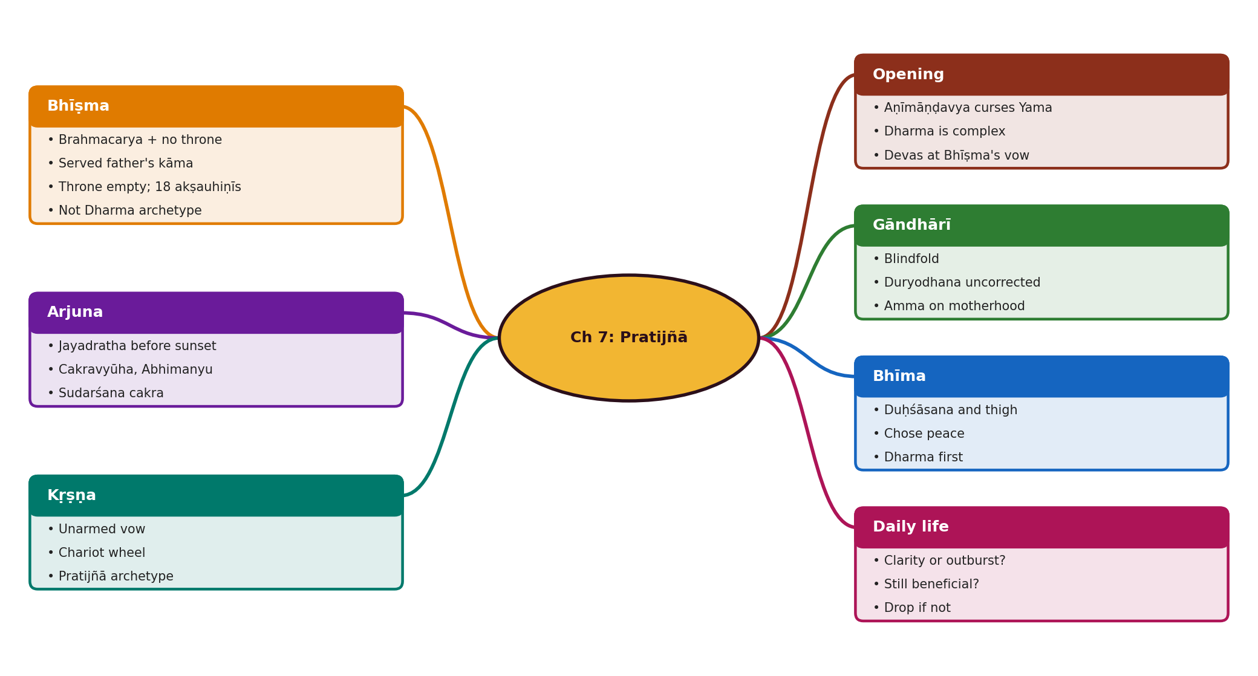
Mind map of the chapter
Notes:
Use this as a revision sheet: ask students to redraw it from memory.

Slide 19
Memory aids
Archetypes: Bhīṣma = Brahmacarya; Kṛṣṇa = Pratijñā.
Vows in order: Bhīṣma (celibacy), Gāndhārī (blindfold), Arjuna (sunset), Bhīma (chest, thigh).
1
2
3 vyūhas, 13th day, 18 akṣauhiṇīs.
Test a vow: Clarity? Benefit? (C-B)
3
4
Aṇīmāṇḍavya: Dharmadeva is not above Dharma.
Thigh blow = Kṛṣṇa's signal.
5
6
Notes:
Let students invent their own mnemonics too.

Slide 20
Quick quiz (Q1 to Q5)
Q1. Explain the Bhīṣma Pratijñā and the chapter's critique of it.
Q2. Why does the chapter call Bhīṣma the brahmacarya archetype but not the Pratijñā or Dharma archetype?
Q3. What was Satyavatī's request to Bhīṣma after Vicitravīrya died and why did it matter?
Q4. Discuss Gāndhārī's Pratijñā.
Q5. Narrate Arjuna's Pratijñā and its fulfilment.
Notes:
Answers:
Q1. Devavrata took a lifelong vow of brahmacarya and gave up the throne so Śantanu could marry Satyavatī, earning the name Bhīṣma and the boon of choosing his death. The chapter notes no life or kingdom depended on it, it only served his father's kāma, he did not consult, and it led to an unstable throne and the war.
Q2. His self-control was extraordinary, unlike Arjuna's or Śantanu's, yet bound by the vow he was powerless before a blind king and his son and could not respond to adharma. Kṛṣṇa is the Pratijñā archetype.
Q3. She asked him to father heirs with the widows and to take the throne. His refusal meant the vow had no remaining purpose, yet he kept it, and Vyāsa fathered Dhṛtarāṣṭra, Pāṇḍu and Vidura.
Q4. She blindfolded herself on hearing she would marry the blind Dhṛtarāṣṭra. Praised, but it was hasty; she could not guide Duryodhana, 'turned a blind eye' to her sons' deeds, and could have been her husband's eyes instead.
Q5. After Abhimanyu's death on day 13, he vowed to kill Jayadratha before sunset. Droṇa's three vyūhas protected him; Kṛṣṇa masked the sun with the Sudarśana cakra, Jayadratha came out, the sun reappeared and Arjuna killed him with the Pāśupatāstra.

Slide 21
Quick quiz (Q6 to Q10)
Q6. Why were Abhimanyu's circumstances adharmic?
Q7. How did Bhīma handle his vows?
Q8. What two questions should we ask about vows we take?
Q9. Describe Kṛṣṇa's vow and why he is the Pratijñā archetype.
Q10. What does Aṇīmāṇḍavya's story teach?
Notes:
Answers:
Q6. Jayadratha blocked the other Pāṇḍavas from entering the Cakravyūha, and many powerful warriors attacked Abhimanyu at once, breaking dharmayuddha ethics.
Q7. He took them in rage but preferred peace in Udyoga Parva, killed Duḥśāsana in battle within Dharma, and broke Duryodhana's thigh only on Kṛṣṇa's signal in a mace duel.
Q8. Was it from intellectual clarity or a spontaneous outburst? If emotional, after seeing the bigger picture, is it still beneficial for us or society? If not, drop it.
Q9. He vowed not to bear arms in the war. When Bhīṣma's resolve threatened the Pāṇḍavas and Arjuna held back, Kṛṣṇa charged with a chariot wheel, not held by his vow, and told Bhīṣma he was misusing his boon.
Q10. He cursed Yama for misinterpreting Dharma: even Dharmadeva is not above Dharma; Dharma is complex and needs reflection.

Slide 22
Answer key (1/3)
Q1. Explain the Bhīṣma Pratijñā and the chapter's critique of it.
Devavrata took a lifelong vow of brahmacarya and gave up the throne so Śantanu could marry Satyavatī, earning the name Bhīṣma and the boon of choosing his death. The chapter notes no life or kingdom depended on it, it only served his father's kāma, he did not consult, and it led to an unstable throne and the war.
Q2. Why does the chapter call Bhīṣma the brahmacarya archetype but not the Pratijñā or Dharma archetype?
His self-control was extraordinary, unlike Arjuna's or Śantanu's, yet bound by the vow he was powerless before a blind king and his son and could not respond to adharma. Kṛṣṇa is the Pratijñā archetype.
Q3. What was Satyavatī's request to Bhīṣma after Vicitravīrya died and why did it matter?
She asked him to father heirs with the widows and to take the throne. His refusal meant the vow had no remaining purpose, yet he kept it, and Vyāsa fathered Dhṛtarāṣṭra, Pāṇḍu and Vidura.
Notes:
Reveal after students attempt each question.

Slide 23
Answer key (2/3)
Q4. Discuss Gāndhārī's Pratijñā.
She blindfolded herself on hearing she would marry the blind Dhṛtarāṣṭra. Praised, but it was hasty; she could not guide Duryodhana, 'turned a blind eye' to her sons' deeds, and could have been her husband's eyes instead.
Q5. Narrate Arjuna's Pratijñā and its fulfilment.
After Abhimanyu's death on day 13, he vowed to kill Jayadratha before sunset. Droṇa's three vyūhas protected him; Kṛṣṇa masked the sun with the Sudarśana cakra, Jayadratha came out, the sun reappeared and Arjuna killed him with the Pāśupatāstra.
Q6. Why were Abhimanyu's circumstances adharmic?
Jayadratha blocked the other Pāṇḍavas from entering the Cakravyūha, and many powerful warriors attacked Abhimanyu at once, breaking dharmayuddha ethics.
Q7. How did Bhīma handle his vows?
He took them in rage but preferred peace in Udyoga Parva, killed Duḥśāsana in battle within Dharma, and broke Duryodhana's thigh only on Kṛṣṇa's signal in a mace duel.
Notes:
Reveal after students attempt each question.

Slide 24
Answer key (3/3)
Q8. What two questions should we ask about vows we take?
Was it from intellectual clarity or a spontaneous outburst? If emotional, after seeing the bigger picture, is it still beneficial for us or society? If not, drop it.
Q9. Describe Kṛṣṇa's vow and why he is the Pratijñā archetype.
He vowed not to bear arms in the war. When Bhīṣma's resolve threatened the Pāṇḍavas and Arjuna held back, Kṛṣṇa charged with a chariot wheel, not held by his vow, and told Bhīṣma he was misusing his boon.
Q10. What does Aṇīmāṇḍavya's story teach?
He cursed Yama for misinterpreting Dharma: even Dharmadeva is not above Dharma; Dharma is complex and needs reflection.
Notes:
Reveal after students attempt each question.

Slide 25
Rapid-fire recall
Who is the Brahmacarya archetype?
Pratijñā archetype?
Bhīṣma.
Kṛṣṇa.
Who masked the sun?
Whose blindfold?
Kṛṣṇa's Sudarśana cakra.
Gāndhārī.
Notes:
Ask the left part aloud; students answer; reveal the right part.

Slide 26
Remember and revise
Bhīṣma is the Brahmacarya archetype, but his Pratijñā served only his father's kāma and left the throne empty; Kṛṣṇa is the Pratijñā archetype.
Gāndhārī's blindfold: noble-looking but hasty; she could not correct Duryodhana.
Arjuna's vow to kill Jayadratha before sunset was saved by Kṛṣṇa's Sudarśana cakra (sunset illusion).
Bhīma took two vows in rage but still chose Dharma (approved peace; fought fairly; thigh-strike on Kṛṣṇa's signal).
Test any vow: was it made in clarity or outburst? is it still beneficial? If not, drop it.
HOMEWORK
Redraw the mind map from memory.
Answer Q1 and Q2 of the quiz in writing.
Learn the numbers slide by heart.
Prepare one question to ask the class tomorrow.
Notes:
Return to the warm-up question and let students answer it now.
Model answer: Devavrata took a lifelong vow of brahmacarya and gave up the throne so Śantanu could marry Satyavatī, earning the name Bhīṣma and the boon of choosing his death. The chapter notes no life or kingdom depended on it, it only served his father's kāma, he did not consult, and it led to an unstable throne and the war.

