Slide 1
Intro to C++ Language
Scalar Variables, Operators
and
Control Structures

Slide 2
Structure of a C++ Program
A C++ program is a collection of definitions and declarations:
  data type definitions
  global data declarations
  function definitions (subroutines)
  class definitions
  a special function called main() (where the action starts).

Slide 3
Procedural vs. Object Oriented
Procedural languages express programs as a collection of procedures (subroutines).
Object Oriented languages express programs as a collection of object types (classes).
C++ is both!
We will start with procedural and build up to Object Oriented

Slide 4
Hello World++
// Hello World program
#include <iostream.h>
int main() {
cout << "Hello World\n";
return 0;
}
comment
Allows access to an I/O library
Starts definition of special function main()
output (print) a string
Program returns a status code (0 means OK)

Slide 5
C++ Development Environment
Program is
created using the
Editor and
stored on Disk.
Phase 1 :
Editor
Disk
Preprocessor
program
processes the
code.
Phase 2 :
Preprocessor
Disk
Compiler
creates object
code and stores
it on Disk.
Phase 3 :
Compiler
Disk
Phase 4 :
Linker
Linker links object
code with libraries,
creates a.out and
stores it on Disk
Disk

Slide 6
C++ Development Environment
Primary
Memory
Phase 5 :
Loader
Loader puts
Program in
Memory
:
.
Primary
Memory
Phase 6 :
C P U (execute)
CPU takes each
instruction and
executes it, storing
new data values as
the program executes.
:
.

Slide 7
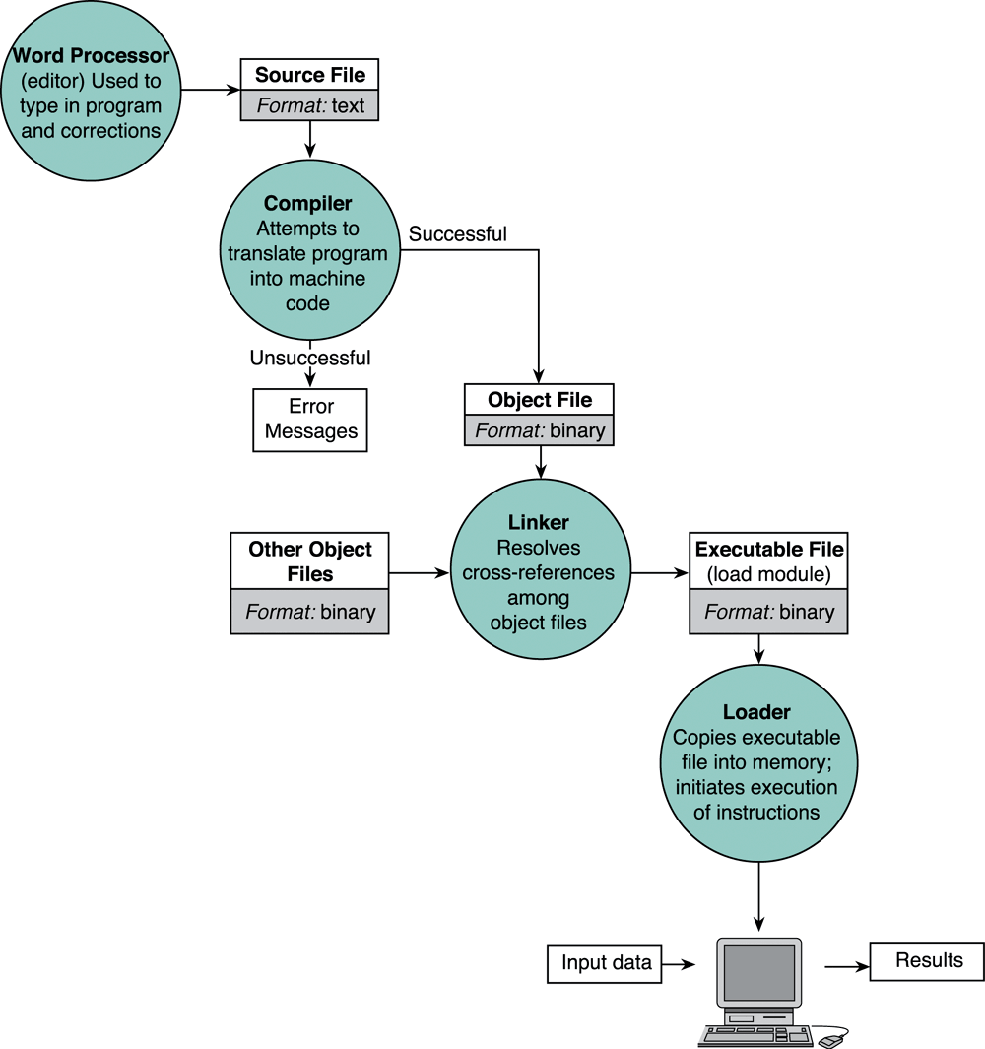
Entering, translating, and running a High-Level Language Program

Slide 8
Comments
Comments contain text that is not converted to machine language (it's just there for humans).
Everything after "//" is ignored by the compiler.
Everything between "/*" and "*/" is ignored.

Slide 9
Comment Example
// Dave's Homework #1
// This program is awesome!
#include <iostream.h>
/* This program computes the
coefficient of expansion of the
universe to 27 decimal places.
*/
int main() {
cout << 1.0000000000000000000001;
}

Slide 10
Includes
The statement: #include <foo.h> inserts the contents of the file foo.h inside your file before the compiler starts.
Definitions that allow your program to use the functions and classes that make up the standard C++ library are in these files.
You can include your own file(s):
  #include "myfile.h"

Slide 11
C++ Preprocessor
C++ Compilers automatically invoke a preprocessor that takes care of #include statements and some other special directives.
You don't need to do anything special to run the preprocessor - it happens automatically.

Slide 12
Preprocessing
Temporary file
(C++ program)
C++
Preprocessor
C++
Compiler
C++ Program
Executable
Program

Slide 13
The Preprocessor
Lines that start with the character '#' are special to instruct to a preprocessor.
The preprocessor can replace the line with something else:
  include: replaced with contents of a file
Other directives tell the preprocessor to look for patterns in the program and do some fancy processing.

Slide 14
Preprocessor
1. File Inclusion (#include): This directive is used to insert the content of specified header files into the current source file. This allows for code reusability and access to declarations of functions, classes, and variables defined in other files.
#include <iostream> // Includes the iostream standard library header
#include "my_header.h" // Includes a user-defined header file

Slide 15
Some common includes
Basic I/O: iostream.h
I/O manipulation: iomanip.h
Standard Library: stdlib.h
Time and Date support: time.h

Slide 16
#define (macro) Example
#define allows you to define macros, which are essentially text substitutions. When the preprocessor encounters a defined macro, it replaces it with its corresponding replacement text.
#define square(a) (a * a)
y = square(x);
z = square(y*x);
becomes y = (x * x);
becomes z = (y*x * y*x);

Slide 17
Macro
#define PI 3.14159 // Defines a constant macro
#define MAX(a, b) ((a) > (b) ? (a) : (b))

Slide 18
Others
#undef is used to remove a previously defined macro.
Conditional Compilation (#if, #ifdef, #ifndef, #else, #elif, #endif): These directives allow you to conditionally compile parts of your code based on certain conditions. This is useful for:
Including or excluding code based on build configurations (e.g., debug vs. release).
Adapting code for different operating systems or platforms.
Preventing multiple inclusions of header files (using #ifndef and #define with include guards).

Slide 19
Error Directives (#error, #warning):
These directives are used to generate custom error or warning messages during the preprocessing phase, which can be helpful for debugging or enforcing coding standards.
Pragma Directives (#pragma):
These directives provide a way to give specific instructions to the compiler, often related to compiler-specific features or optimizations. A common example is #pragma once for ensuring a header file is included only once.

Slide 20
Another C++ Program
// C++ Addition of integers
#include <iostream.h>
int main() {
int integer1, integer2, sum;
cout << "Enter first integer\n";
cin >> integer1;
cout << "Enter second integer\n";
cin >> integer2;
sum = integer1 + integer2;
cout << "Sum is " << sum << endl;
return 0;
}

Slide 21
Variables
The program now uses variables:
int integer1, integer2, sum;
Variables are just names for locations in memory.
In C++ all variables must have a type (not all languages require this).
In C++ all variables must be declared before they can be used.

Slide 22
Variables (cont.)
C++ variables are declared like this:
type var_name;
type indicates what kind of variable.
C++ built in types include:
int char float double bool
You can also create new types!

Slide 23
Variable Names
C++ variable names:
  made up of letters, digits and underscore.
  Must start with a non-digit.
  Case sensitive
    foo is not the same name as Foo
Can be any length
Good variable names tell the reader what the variable is used for!

Slide 24
Literals (Constants)
Literals are fixed values used by a program.
Some examples of literals:
  22 3.14159 0x2A
  false "Hi Dave" 'c'
You can initialize a variable in the declaration by assigning it a value:
  int foo = 17;
  double PI = 3.14159;
  char newline = '\n';

Slide 25
Expressions
C++ expressions are used to express computation.
Expressions include operations and the operands on which the operations are applied.
Operands can be variables, literals or function calls.

Slide 26
Math Expressions
Mathematical expressions have numeric values when evaluated.
Some examples:
  1+2
  (fahr - 32)*(5/9)
  1*(2*(3*(4*5)))

Slide 27
Mathematical Operators
+ - * / %
Operators have rules of precedence and associativity that control how expressions are evaluated.
What is the value of this C++ expression ?:
  2 / 3 / 4 + 5
Answer: You can't tell unless you know the rules.

Slide 28
Associativity
The associativity of an operator control the order of evaluation of expressions involving the same operator, for example:
  3 / 4 / 5
Associativity can be:
  left-to-right: the leftmost operator is applied first.
  Right-to-left: the rightmost operator is applied first.

Slide 29
Precedence
Precedence controls the order of evaluation of operators.
  A high precedence means an operator is evaluated (applied) before any lower precedence operators.
Operators that have the same precedence can happen in either order, but in C++ the one on the left is evaluated first.

Slide 30
Operators
An operator is a symbol that tells the computer to perform certain manipulations.
An expression is a sequence of operands and operators that reduces to a single value.
C operators can be classified into a number of categories.
  Arithmetic operators
  Relational operators
  Logical operators
  Assignment operators
  Increment and decrement operators
  Conditional operators
  Bitwise operators
  Special operators

Slide 31
Arithmetic operators
The arithmetic operators in C
Operator | meaning
+ | Addition or unary plus
- | Subtraction or unary minus
* | Multiplication
/ | Division
% | modulo division

Slide 32
Arithmetic operators
Note:,
  Integer division truncates remainder
  The % operator cannot be applied to a float or double.
  The precedence of arithmetic operators
    Unary + or -
    * / %
    + -
Notes:
注意：
整数除法舍去余数；
%运算符只能用于整数
算术运算符的优先级

Slide 33
Arithmetic expressions
An arithmetic expression is a combination of variables, constants, and operators.
For example,
a*b-c → a*b-c
(m+n)(x+y) → (m+n)*(x+y)
ax²+bx+c → a*x*x+b*x+c

Slide 34
Shortcut Assignment Operators
Operator Example Equivalent
+= i+=8 i = i+8
-= f-=8.0 f = f-8.0
*= i*=8 i = i*8
/= i/=8 i = i/8
%= i%=8 i = i%8

Slide 35
Relational Operators
The relational operators in C are :
Operator | Meaning
< | less that
<= | less than or equal to
> | greater than
>= | greater than or equal to
== | equal to
!= | not equal to

Slide 36
Relational Operators
A relational expression yields a value of 1 or 0.
  5 < 6 1
  -34 + 8 > 23 - 5 0
  if a=3, b=2, c =1; then a > b > c is ?
the associativity of relational operators is
left → right

Slide 37
Bitwise operators
Operator | Meaning
& | Bitwise AND
| | Bitwise OR
^ | Bitwise Exclusive
<< | Shift left
>> | Shift right

Slide 38
Result of logical Bitwise Operation
op1 | op2 | op1&op2 | op1|op2 | op1^op2
1 | 1 | 1 | 1 | 0
1 | 0 | 0 | 1 | 1
0 | 1 | 0 | 1 | 1
0 | 0 | 0 | 0 | 0

Slide 39
Example
Bitwise AND
x - - -> 0000 0000 0000 1101
y - - -> 0000 0000 0001 1001
x&y- - -> 0000 0000 0000 1001
Bitwise OR
x - - - > 0000 0000 0000 1101
y - - -> 0000 0000 0000 1001
x|y - - -> 0000 0000 0001 1101

Slide 40
Bitwise Exclusive OR
x - - -> 0000 0000 0000 1101
y - - -> 0000 0000 0001 1001
x^y - - -> 0000 0000 0001 0100

Slide 41
Bitwise shift operators
Left shift
  op<<n
Eg. 0100 1001 1100 1011
x<<3 0100 1110 0000
Right shift
op>>n

Slide 42
Bitwise Complement Operators
~ one’s complement operator is a unary operator.

Slide 43
Logical operators
Operator | Meaning
&& | Logical AND
|| | Logical OR
! | Logical NOT

Slide 44
Examples
Logical AND (&&)
a > b && x = = 10
Logical OR (||)
a < m || a < n
Logical NOT (!)
! (x >= y)

Slide 45
Assignment Operators
In addition, C has a set of shorthand assignment operators of the form.
var oper = exp;
Example
x = a + b

Slide 46
Increment and Decrement
syntax:
1. ++variable name
2. variable name++
3. – –variable name
4. variable name– –
x= 5;
y = ++x; (prefix)
In this case the value of y and x would be 6
x= 5;
y = x++; (post fix)
Then the value of y will be 5 and that of x will be 6.

Slide 47
Special operators
Comma operator
Size of operator
Pointer operators (& and *)
Member selection operators (. and ->).

Slide 48
Comma operator
Link related expressions together
Expressions are evaluated left to right
for e.g.
value = (x = 10, y = 5, x + y);
for (n=1, m=10, n <=m; n++, m++)

Slide 49
The sizeof Operator
Gives size of bytes occupied in the memory.
To determine the lengths of arrays and structures when their sizes are not known to the programmer
for e.g.
x = sizeof (sum);
y = sizeof (long int);
z= sizeof (235L);

Slide 50
Precedence and Associativity
Precedence rules decides the order in which different operator are applied.
Associativity rule decides the order in which multiple occurrences of the same level operator are applied.

Slide 51
Summary of C operator
Description | Operator | Rank | Associativity
Function call Array element reference | ( ) [] | 1 | Left to right
Unary plus Unary minus Increment Decrement Logical negation Ones complement Address Size of an object | + - ++ -- ! ~ & Sizeof | 2 | Right to left
Multiplication Division Modulus | * / % | 3 | Left to right
Addition Subtraction | + - | 4 | Left to right
Left shift Right shift | << >> | 5 | Left to right
Less than Less than equal to Greater than Greater than equal to | < <= > >= | 6 | Left to right
Equality Inequality | = = |= | 7 | Left to right

Slide 52
Continue….
Bitwise AND | & | 8 | Left to right
Bitwise XOR | ^ | 9 | Left to right
Bitwise OR | | | 10 | Left to right
Logical AND | && | 11 | Left to right
Logical OR | || | 12 | Left to right
Conditional operator | ?: | 13 | Right to left
Assignment operator | = *=/=%= +=-=&= ^=|= << = >>= | 14 | Right to left
Commas operator | , | 15 | Left to right

Slide 53
Another Program
#include <iostream.h>
int main()
{
double fahr,celcius;
cout << "Enter Temperature in Fahrenheit\n";
cin >> fahr;
celcius = (fahr - 32.0)*5/9;
cout << fahr << " fahrenheit is " << celcius << " Celcius" << endl;
return 0;
}

Slide 54
const
You can add the const modifier to the declaration of a variable to tell the compiler that the value cannot be changed:
  const double factor = 5.0/9.0;
  const double offset = 32.0;
  celcius = (fahr - offset)*factor;

Slide 55
What if you try to change a const?
The compiler will complain if your code tries to modify a const variable:
  const foo = 100;
  …
  foo = 21;
Error: l-value specifies const object

Slide 56
Why use const?
Const tells the compiler that a variable should never be changed.
You already know the variable should never be changed!
But - let the compiler save you from yourself (you might forget that it shouldn't be changed).

Slide 57
Integer vs. floating point math
How does C++ know whether to use floating point or integer math operators?
If either operand is floating point, a floating point operation is done (the result is a floating point value).
If both operand are integer the result is an integer (even division).

Slide 58
Conditional operator
a ternary operator pair “? : ” is available in C to construct conditional expressions of the form
expr1 ? expr2 : expr3
the expression expr1 is evaluated first. If it is non-zero (true), then the expression expr2 is evaluated, and that is the value of the conditional expression. Otherwise expr3 is evaluated, and that is the value. Only one of expr2 and expr3 is evaluated.
Notes:
条件运算符是C语言中唯一的三目运算符

Slide 59
Special operators
1. The Comma Operator
The comma operator can be used to link the related expressions together. A comma-linked list of expressions is evaluated left to right and the value of right-most expression is the value of the combined expression. For example, the statement
value = (x=10, y=5, x+y);
first assigns the value 10 to x, then assigns 5 to y, and finally assigns 15 to value. Since comma operator has the lowest precedence of all operators, the parentheses are necessary.
Notes:
逗号运算符的运算顺序是从左到右，表达式的值为最右端表达式的值
逗号运算符的优先级最低

Slide 60
Math Operator Quiz
What are the values printed?
const int five = 5;
int i = 7;
float x = 7.0;
cout << five + i/2 << endl;
cout << five + x/2 << endl;

Slide 61
Control Structures
Unless something special happens a program is executed sequentially.
When we want something special to happen we need to use a control structure.
Control Structures provide two basic functions: selection and repetition

Slide 62
Selection
A Selection control structure is used to choose among alternative courses of action.
There must be some condition that determines whether or not an action occurs.
C++ has a number of selection control structures:
  if if/else switch

Slide 63
Repetition Control Structures
Repetition control structures allow us to repeat a sequence of actions (statements).
C++ supports a number of repetition control structures:
while for do/while

Slide 64
if
The if control structure allows us to state that an action (sequence of statements) should happen only when some condition is true:
if (condition)
  action;

Slide 65
Conditions
The condition used in an if (and other control structures) is a Boolean value - either true or false.
In C++:
  the value 0 is false
  anything else is true

Slide 66
if examples
if (1)
cout << "I am true!\n";
if (1-1)
cout << "I am false!\n";

Slide 67
Relational and Equality Operators and Conditions
Typically a condition is built using the C++ relational and equality operators.
These operators have the values true (1) and false (0).
So the expression x==x has the value true.
and 7 <= 3 has the value false.

Slide 68
More ifs
if (foo)
cout << "foo is not zero\n";
if (grade>=90)
lettergrade = 'A';
if (lettergrade == 'F')
cout << "The system has failed you\n"

Slide 69
Common Mistake
It is easy to mix up the assignment operator "=" with the equality operator "==".
What's wrong with this:
if (grade=100)
  cout << "your grade is perfect - RPI has decided to give you your degree today!\n";

Slide 70
Compound Statements
Inside an if you can put a single statement or a compound statement.
A compound statement starts with "{", ends with "}" and can contain a sequence of statements (or control structures)
if (grade>=90) {
  cout << "Nice job - you get an A\n";
  acnt = acnt+1;
}

Slide 71
A word about style
C++ doesn't care about whitespace (including newlines), so you can arrange your code in many ways.
There are a couple of often-used styles.
All that is important is that the code is easy to understand and change!

Slide 72
Some common styles
if (foo>10) {
x=y+100;
cout << x;
}
if (foo>10)
{
x=y+100;
cout << x;
}
if(foo>10){x=y+100;cout<<x;}

Slide 73
if else Control Structure
The if else control structure allows you to specify an alternative action:
    if ( condition )
    action if true
    else
      action if false

Slide 74
if else example
if (grade >= 90)
lettergrade = 'A';
else
lettergrade = 'F';

Slide 75
Another example
if (grade >= 99)
lettergrade = 'A';
else if (grade >= 98)
lettergrade = 'B';
else if (grade >= 97)
lettergrade = 'C';
else if (grade >= 96)
lettergrade = 'D';
else
lettergrade = 'F';

Slide 76
while Control Structure
The while control structure supports repetition - the same statement (or compound statement) is repeated until the condition is false.
while (condition)
  do something;
the inside is called
the "body of the loop"

Slide 77
while dangers
The body of the loop must change something that effects the condition!
if not - the loop could never end
  or the loop would never end
    or the loop would never end
      or the loop would never end
        or the loop would never end
        …….

Slide 78
while example
lettergrade = 'A';
cutoff = 90;
while (grade < cutoff) {
lettergrade = lettergrade + 1;
cutoff = cutoff - 10;
}
if (lettergrade > 'F')
lettergrade = 'F';

Slide 79
Off topic - increment and decrement operators
You can increment an integer variable like this:
// same as lettergrade = lettergrade + 1;
lettergrade++;
You can also decrement:
// same as lettergrade = lettergrade - 1;
lettergrade--;

Slide 80
More off topic - special assignment operators
This C++ statement:
  foo += 17;
  is shorthand for this:
  foo = foo + 17;
You can also use:
-= *= /=

Slide 81
while example modified
lettergrade = 'A';
cutoff = 90;
while (grade < cutoff) {
lettergrade++;
cutoff -= 10;
}
if (lettergrade > 'F')
lettergrade = 'F';

Slide 82
do while
The do while control structure also provides repetition, this time the condition is at the bottom of the loop.
  the body is always executed at least once
do
  somestuff;
while ( condition );

Slide 83
do example
i=1;
do
cout << "i is " << i++ << endl;
while (i <= 10);

Slide 84
for loops
The for control structure is often used for loops that involve counting.
You can write any for loop as a while (and any while as a for).
for (initialization; condition; update)
  dosomething;

Slide 85
for (initialization; condition; update)
initialization is a statement that is executed at the beginning of the loop (and never again).
the body of the loop is executed as long as the condition is true.
the update statement is executed each time the body of the loop has been executed (and before the condition is checked)

Slide 86
for example
for (i=1; i<10; i++)
cout << "i is " << i << endl;
for (i=10; i>=0; i--)
cout << "i is " << i << endl;

Slide 87
another for
initialization
for (lettergrade = 'A', cutoff = 90;
grade < cutoff; lettergrade++;)
cutoff -= 10;
if (lettergrade > 'F')
lettergrade = 'F';
condition
update

Slide 88
Yet another odd example
for (i=1; i<100;i++) {
cout << "Checking " << i << endl;
if ( i%2 )
cout << i << " is odd" << endl;
else
cout << i << " is even" << endl;
}

Slide 89
More about for
You can leave the initialization, condition or update statements blank.
If the condition is blank the loop never ends!
      for (i=0; ;i++)
        cout << i << endl;

Slide 90
Complex Conditions
You can build complex conditions that involve more than one relational or equality operator.
The && (means "and") and ||(means "or") operators are used to create complex conditions.
More operators means another precedence table...

Slide 91
Updated Precedence Table
Operators Precedence
() highest (applied first)
++ --
* / %
+ -
< <= > >=
== !=
&&
||
= lowest (applied last)

Slide 92
&& Operator
&& is a boolean operator, so the value of an expression is true or false.
( cond1 && cond2 )
is true only if both cond1 and cond2 are true.

Slide 93
&& Example
lettergrade = 'A';
cutoff = 90;
while ((grade<cutoff) && (lettergrade!='F')) {
lettergrade++;
cutoff -= 10;
}

Slide 94
|| Operator
|| is a boolean operator, so the value of an expression is true or false.
( cond1 || cond2 )
is true if either of cond1 or cond2 is true.

Slide 95
|| Example
if ((test1==0) || (test2==0))
cout << "You missed a test!\n";
if ((hw1==0) || (hw2==0))
cout << "You missed a homework!\n";

Slide 96
The ! operator
The ! operator is a unary boolean operator
  unary means it has only 1 operand.
! negates it's operand.
! means "not".
(! condition)
is true only when condition is false

Slide 97
! example
bool done = false;
int i=1;
while (! done) {
cout << "i is " << i << endl;
i++;
if (i==100) done=true;
}

