Slide 1
CSS
Cascading Style Sheets

Slide 2
Contents
Introduction of CSS?
Cascading Order
Examples of Properties
Limitations
CSS variations

Slide 3
CSS
CSS stands for Cascading Style Sheets
CSS is a style sheet language used to determine the formatting of an HTML document.
Styles define how to display (X)HTML elements
Styles are normally stored in Style Sheets
Multiple style definitions will cascade into one

Slide 4
Why to use Styles?
Documents written with CSS are
more flexible
short
clear
CSS can control the fonts, text, colors, backgrounds, margins, and layout
Redesign your site more quickly
Build more diverse websites

Slide 5
Style Sheet Languages
Style sheet is a document that contains style information written in a specified format about one or more documents written in markup language.

Slide 6
CSS Introduction
A style sheet language that specifies how to incorporate style information in a style sheet.
Separates the presentation from the content.
Reduces the development time.
Speeds up overall response time.

Slide 7
How to Add CSS
There are 3 ways to specify the style information in a document.
External
Written in a separate file and referenced from an HTML document.
Useful when same style is applied on different documents.
Internal
Style information is placed under one style tag in the head section of an HTML page.
<style>Write style rules here</style>
Inline
Style information is incorporated directly into HTML tags using style attribute.
<p style=“color: red;”>Hello World</p>

Slide 8
Cascading Rule
multiple external style sheets can be referenced inside a single HTML document.
Cascading Order:
Browser default (Lowest Priority)
External style sheet
Internal style sheet (in the head section)
Inline style (inside an HTML element) (highest Priority)

Slide 9
CSS SYNTAX

Slide 10
Basic Syntax
Made up of three parts:
selector { property: value }
The selector is normally the HTML element/tag we want to define
The property is the attribute we wish to change
Every property has the value

Slide 11
Syntax
If the value is multiple words, put quotes around the value
p {font-family: “Times new roman"}

Slide 12
Example
p
{
text-align: center;
color: black;
font-family: arial
}

Slide 13
Grouping multiple styles
h1,h2,h3,h4,h5,h6
{
color: green
}
By above command all header elements will be displayed in green text color
This is header h1
This is header h2
This is header h3
This is header h4

Slide 14
The class Selector
The class Selector
The class selector is used to specify a style for a group of elements.
It is used to set a particular style for many HTML elements with the same class.
The class selector uses the HTML class attribute, and is defined with a "."

Slide 15
Example
<!DOCTYPE html>
<html>
<head>
<style>
p.center
{
text-align:center;
}
</style>
</head>
<body>
<h1 class="center">This heading will not be affected</h1>
<p class="center">This paragraph will be center-aligned.</p>
</body>
</html>

Slide 16
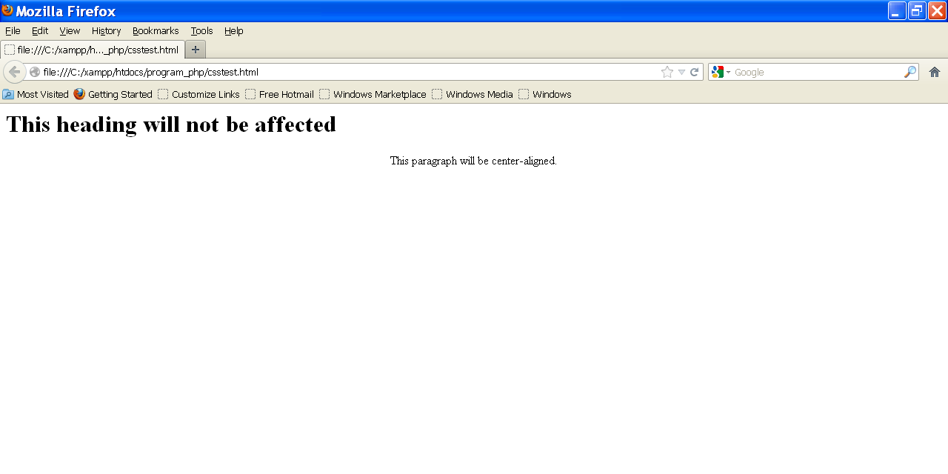
Output

Slide 17
{ Text color
This is header 1
This is header 2
This is a paragraph
<html><head>
<style type="text/css">
h1 {color: green}
h2 {color: #dda0dd}
p {color: rgb(0,0,255)}
</style>
</head>
<body>
<h1>This is header 1</h1>
<h2>This is header 2</h2>
<p>This is a paragraph</p>
</body>
</html>

Slide 18
INSERTING OF STYLE SHEET
CSS

Slide 19
Inserting style sheet
Three Ways to Insert CSS
External style sheet
Internal style sheet
Inline style

Slide 20
External style sheet
An external style sheet can be written in any text editor.
The file should not contain any html tags.
Style sheet should be saved with a .css extension.

Slide 21
Mystyle.css
hr {color:sienna;}
p {margin-left:20px;}
body {background-image:url("images/brick.gif");}

Slide 22
External Style Sheet
<head>
<link rel="stylesheet" type="text/css" href="mystyle.css" />
</head>

Slide 23
Internal Style Sheet
Should be used when a single document has a unique style.
Defined in the head section by using the <style> tag

Slide 24
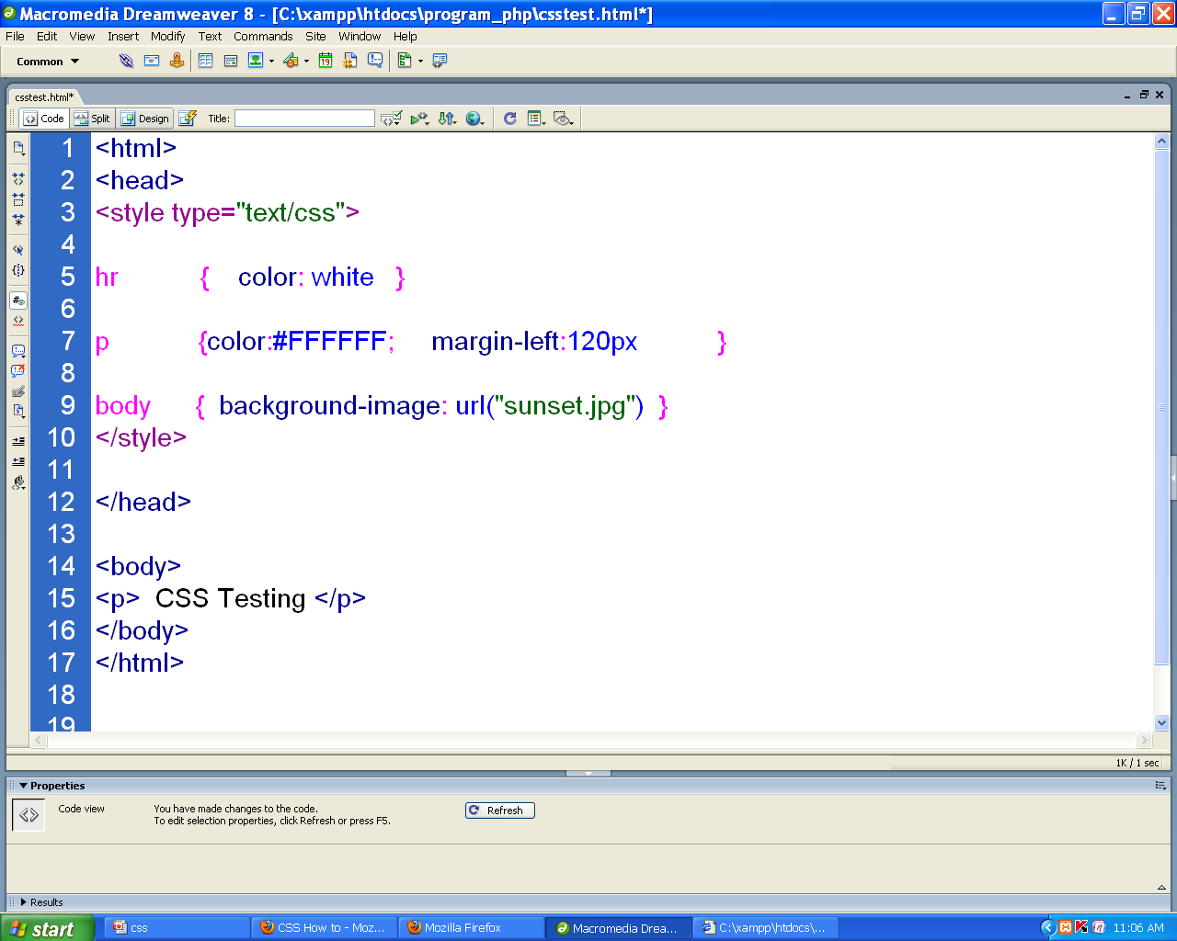
Example (internal style sheet)

Slide 25
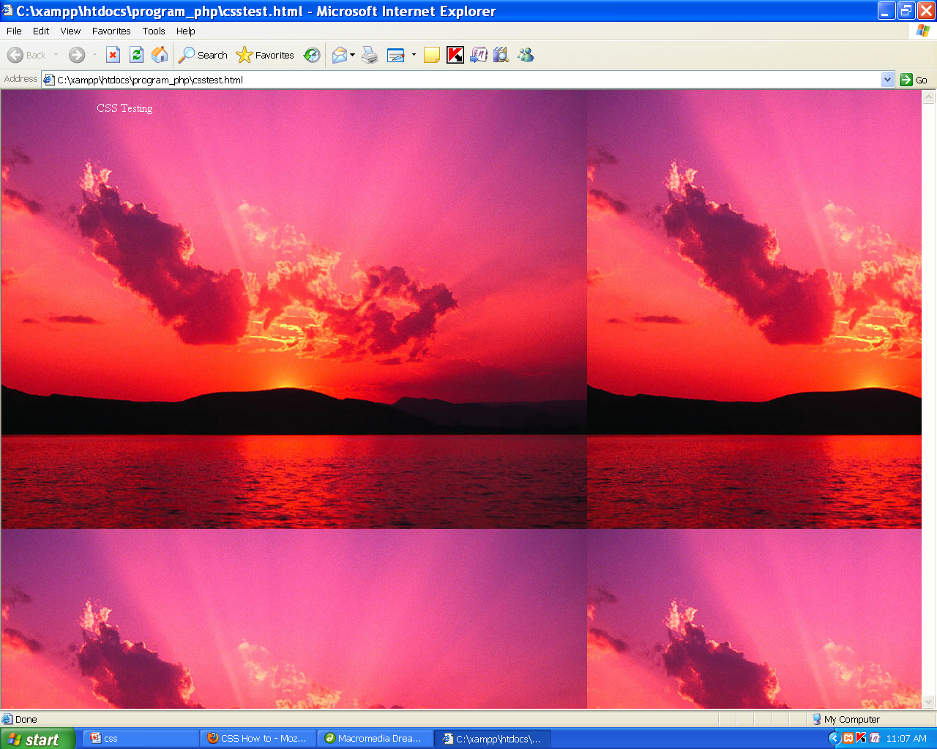
Output

Slide 26
Multiple Style Sheets
Multiple Style Sheets
If some properties have been set for the same selector in different style sheets, the values will be inherited from the more specific style sheet.

Slide 27
Multiple style sheet
Suppose an external style sheet has these properties for the h3 selector:
H3 { color:red; text-align:left; font-size:8pt; }
And an internal style sheet has these properties for the h3 selector:
H3 { text-align:right; font-size:20pt; }

Slide 28
Multiple style sheet
So if the page with the internal style sheet also links to the external style sheet then the properties for h3 will be:
color:red; text-align:right; font-size:20pt;

Slide 29
EXAMPLES
CSS Properties & values

Slide 30
Background:
Control over the background color of an element
set an image as the background,
Repeat a background image

Slide 31
CSS Background Properties
Property | Description
background | Sets all the background properties in one declaration
background-attachment | Sets whether a background image is fixed or scrolls with the rest of the page
background-color | Sets the background color of an element

Slide 32
CSS Background Properties
Property | Description
background-image | Sets the background image for an element
background-position | Sets the starting position of a background image
background-repeat | Sets how a background image will be repeated

Slide 33
Background-properties
background-color
background-image
background-repeat
background-attachment
background-position

Slide 34
Background-color
With CSS, a color is most often specified by:
a HEX value - like "#ff0000"
an RGB value - like "rgb(255,0,0)"
a color name - like "red"

Slide 35
Example
<html>
<head>
<style type="text/css">
h1 {background-color:#6495ed;}
p {background-color:#e0ffff;}
div {background-color:#b0c4de;}
</style> </head>
<body>
<h1> CSS Heading</h1>
<p> CSS paragragh </p>
</body> </html>

Slide 36
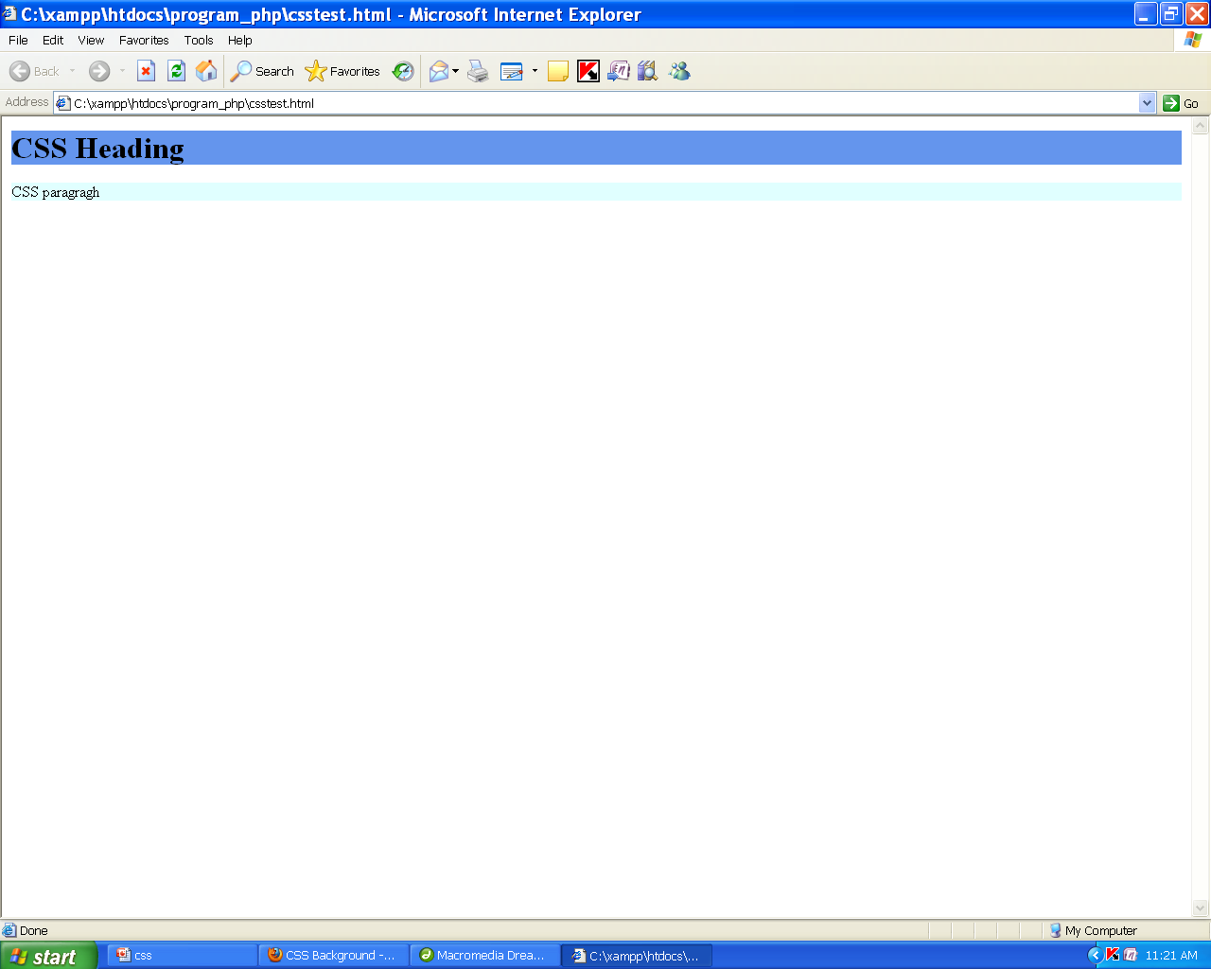
Output

Slide 37
background-image
Example
body { background-image: url(“one.gif"); }
By default, the image is repeated so it covers the entire element.

Slide 38
background-repeat
background-repeat
repeat repeat-x repeat-y no-repeat

Slide 39
Example
<html>
<head>
<style>
body
{
background-image : url('sunset.jpg');
background-repeat:no-repeat;
}
</style>
</head>
<body>
<h1>Hello World!</h1>
</body>
</html>

Slide 40
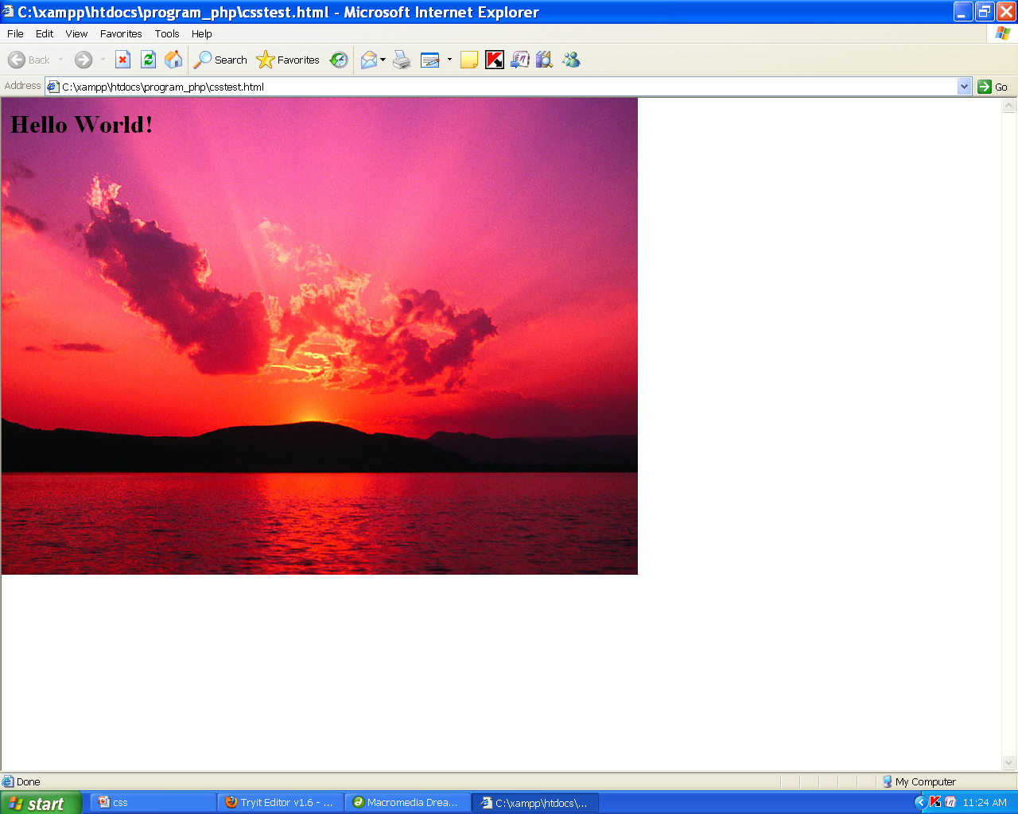
Output

Slide 41
Backgroundexample.html
<!DOCTYPE html>
<html lang="en">
<head>
<meta charset="UTF-8">
<meta name="viewport" content="width=device-width, initial-scale=1.0">
<title>Background Properties Example</title>
<link rel="stylesheet" href="style.css">
</head>
<body>
<div class="background-example">
<h2>Welcome to the Background Properties Example</h2>
<p>This <strong>div</strong> demonstrates different CSS background properties.</p>
</div>
</body>
</html>

Slide 42
style.css
body {
margin: 0;
padding: 0;
font-family: Arial, sans-serif;
}
.background-example {
width: 100%;
height: 400px;
padding: 20px;
text-align: center;
color: white;
font-size: 18px;
font-weight: bold;
background-color: rgba(0, 0, 0, 0.5); /* semi-transparent black */
background-image: url('https://via.placeholder.com/800x600'); /* Image URL */
background-repeat: no-repeat; /* Don't repeat the background image */
background-attachment: fixed; /* Keeps the background fixed during scrolling */
background-position: center center; /* Centers the background image */
}

Slide 44
CSS Text

Slide 45
font-family:
Specifies the font type. For example, the heading uses 'Times New Roman', and the paragraph uses 'Verdana'.
font-size:
Specifies the size of the text. For example, the heading is larger (36px), and the paragraph is smaller (18px).
font-weight:
Sets the weight of the font (bold, normal, etc.). The heading is bold, while the paragraph is normal weight.
text-transform:
Controls the capitalization of the text. In the heading, uppercase is used to make the text all capital letters, and in the paragraph, capitalize is used to capitalize the first letter of each word.
letter-spacing:
Adjusts the spacing between letters. In the heading, it’s set to 2px, and in the paragraph, it’s 1px.
text-shadow:
Adds a shadow effect to the text. The heading has a shadow with a 2px horizontal and vertical offset and a blur of 4px, using rgba(0, 0, 0, 0.3) for the shadow color.
color:
Defines the color of the text. The heading is a dark blue (#2c3e50), and the paragraph is a lighter grey-blue (#34495e).
line-height:
Adjusts the line spacing in the paragraph to make the text more readable (set to 1.8 here).
text-align:
Controls the alignment of the text. The heading is centered by default, and the paragraph is justified to create even margins.
text-decoration:
Adds a decoration to the text, such as underline. The paragraph will be underlined when hovered over (text-decoration: underline;).
text-align: justify:
Justifies the text in the paragraph so it aligns evenly on both the left and right margins.

Slide 46
CSS Text Properties
Property | Description
color | Sets the color of text
direction | Specifies the text direction/writing direction
letter-spacing | Increases or decreases the space between characters in a text
line-height | Sets the line height
text-align | Specifies the horizontal alignment of text
text-decoration | Specifies the decoration added to text

Slide 47
CSS Text Properties
Property | Description
text-decoration | Specifies the decoration added to text
text-indent | Specifies the indentation of the first line in a text-block
text-shadow | Specifies the shadow effect added to text
text-transform | Controls the capitalization of text

Slide 48
CSS Text Properties
Property | Description
vertical-align | Sets the vertical alignment of an element
white-space | Specifies how white-space inside an element is handled
word-spacing | Increases or decreases the space between words in a text

Slide 49
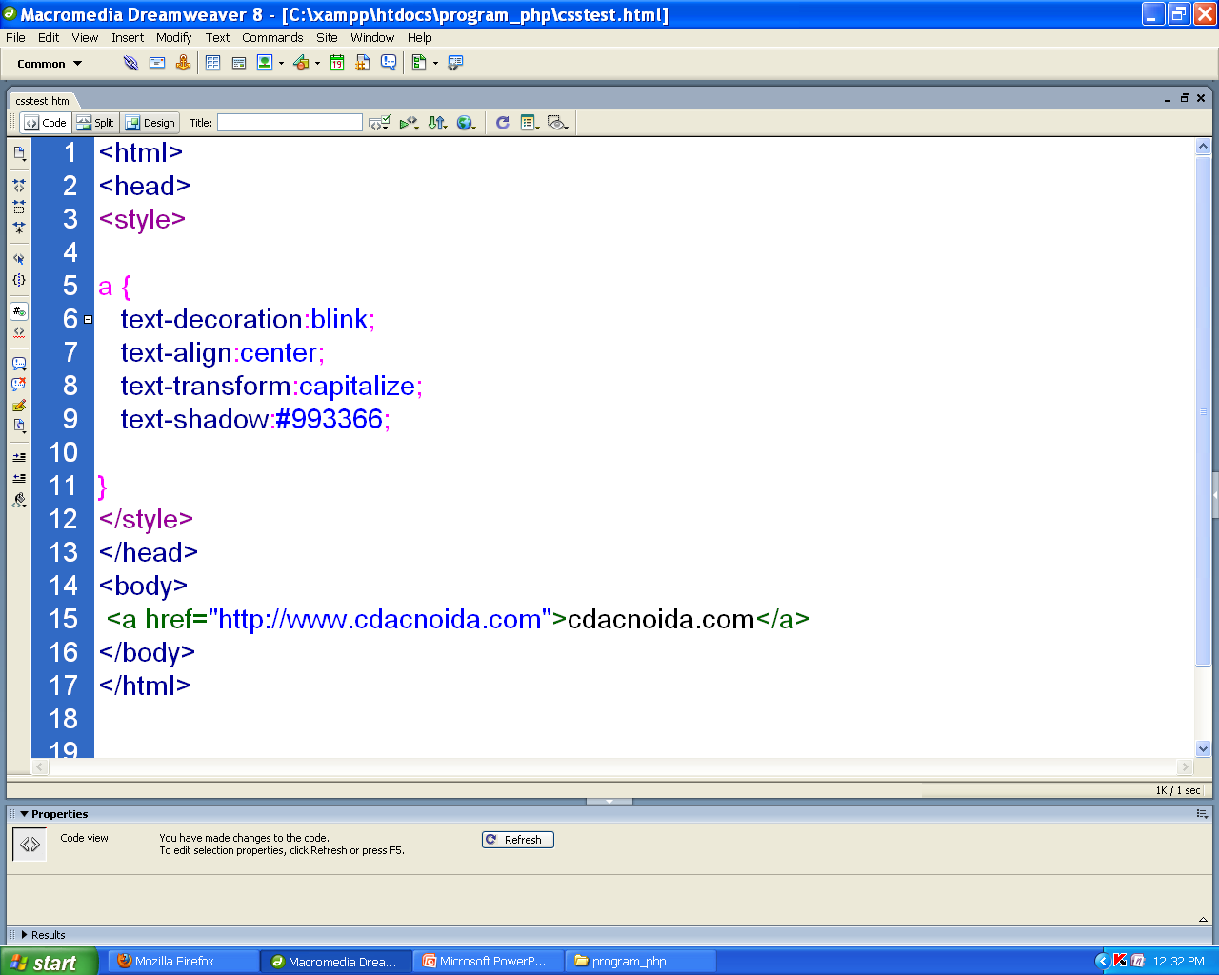
Example

Slide 50
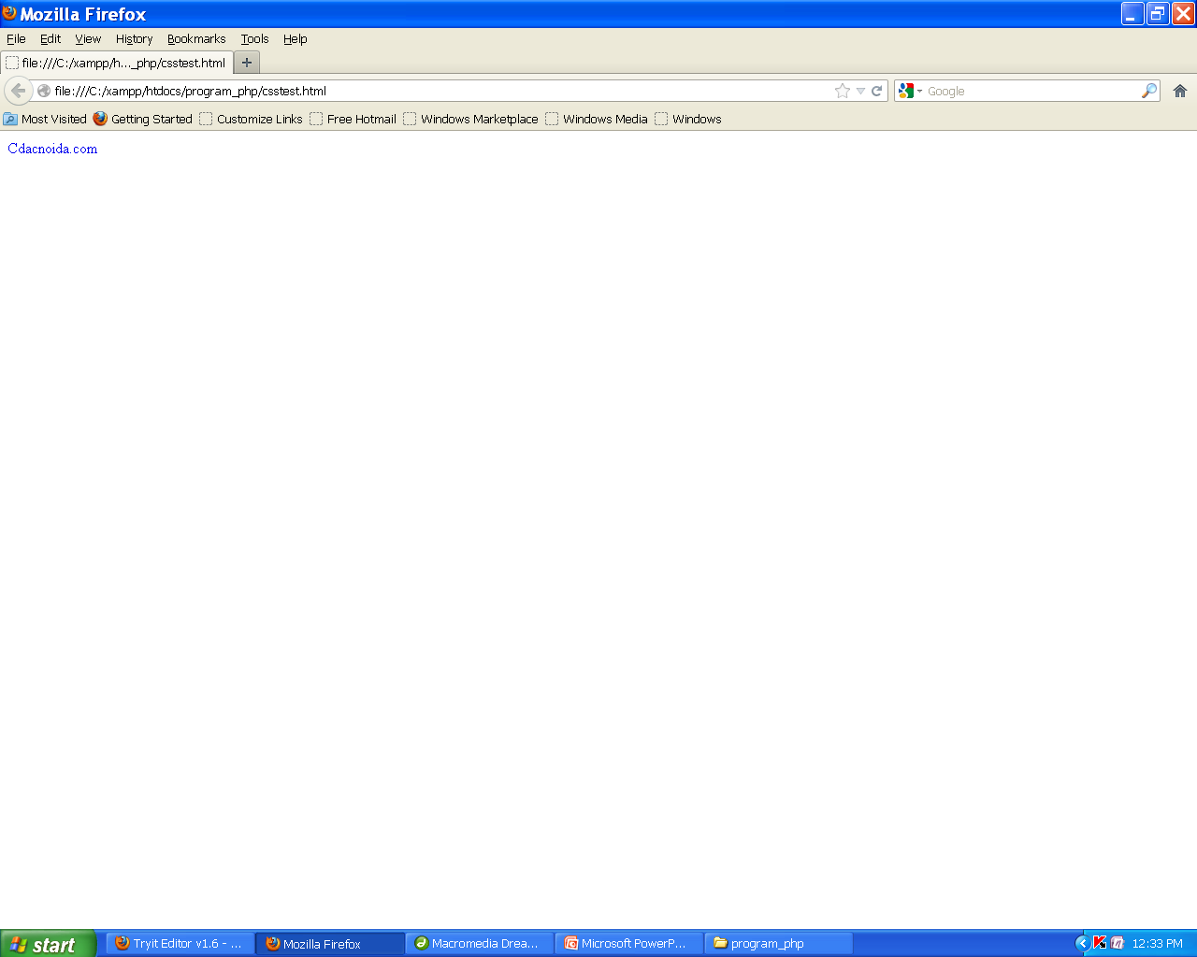
Output

Slide 51
Text.html
<!DOCTYPE html>
<html lang="en">
<head>
<meta charset="UTF-8">
<meta name="viewport" content="width=device-width, initial-scale=1.0">
<title>CSS Text Properties Example</title>
<link rel="stylesheet" href="style.css">
</head>
<body>
<div class="text-example">
<h1>Styled Text Example</h1>
<p>This paragraph demonstrates various CSS text properties.</p>
</div>
</body>
</html>

Slide 52
Text.css

Slide 53
/* Basic body styling */
body {
font-family: Arial, sans-serif;
margin: 0;
padding: 0;
background-color: #f4f4f4;
}
/* Text example div */
.text-example {
width: 80%;
margin: 50px auto;
padding: 20px;
background-color: #fff;
box-shadow: 0px 4px 8px rgba(0, 0, 0, 0.1);
text-align: center;
}

Slide 54
/* Heading styling */
.text-example h1 {
font-family: 'Times New Roman', serif;
font-size: 36px; /* Font size */
font-weight: bold; /* Font weight */
text-transform: uppercase; /* Uppercase text */
color: #2c3e50; /* Text color */
letter-spacing: 2px; /* Letter spacing */
margin-bottom: 20px;
}
/* Hover effect for paragraph */
.text-example p:hover {
color: #e74c3c; /* Change text color on hover */
text-decoration: underline; /* Underline text on hover */
}

Slide 55
CSS Font:

Slide 56
CSS font properties
Property | Description
font | Sets all the font properties in one declaration
font-family | Specifies the font family for text
font-size | Specifies the font size of text
font-style | Specifies the font style for text
font-variant | Specifies whether or not a text should be displayed in a small-caps font
font-weight | Specifies the weight of a font

Slide 57
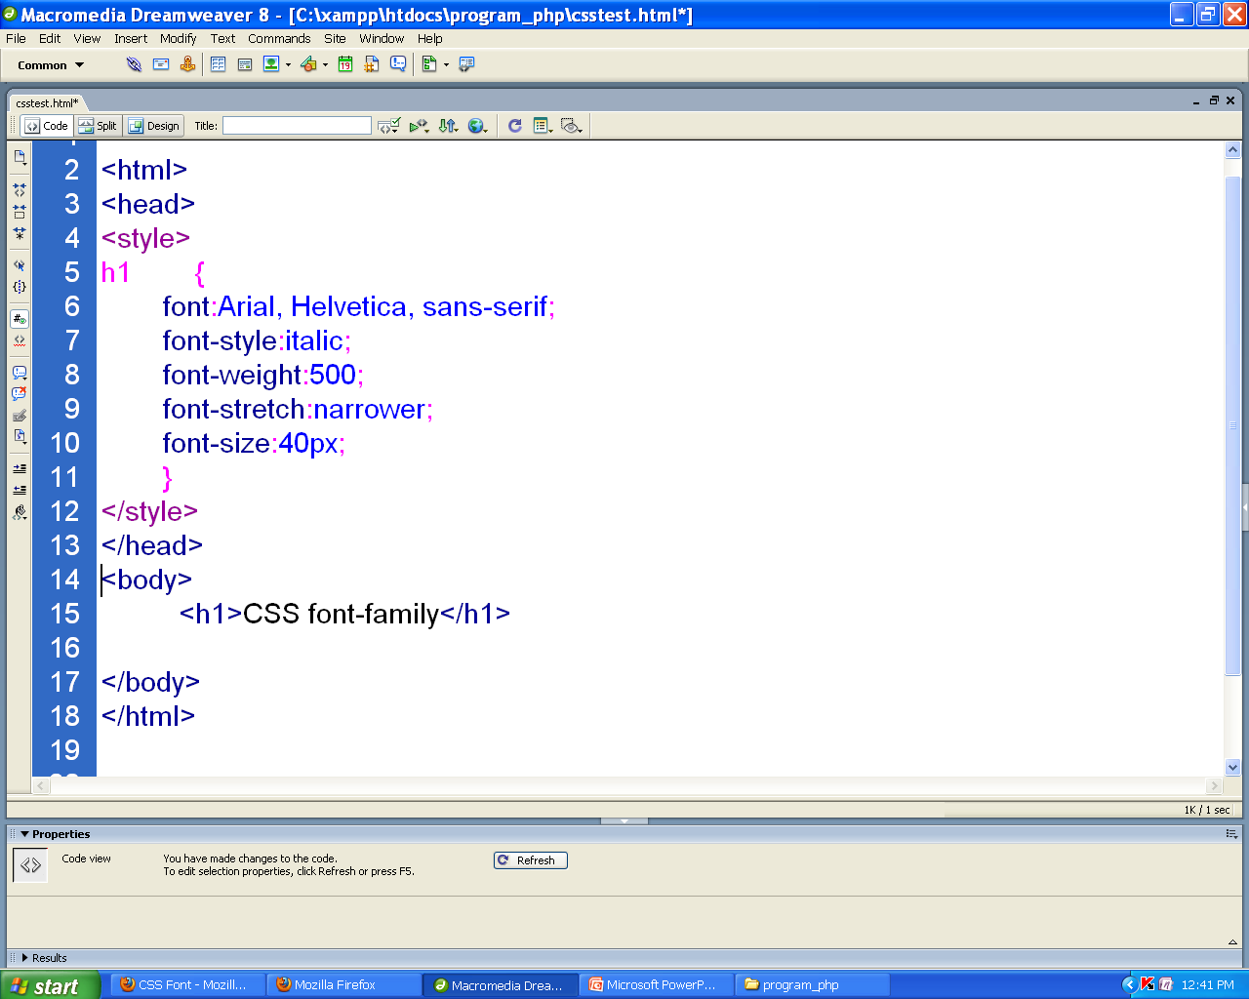
Example

Slide 58
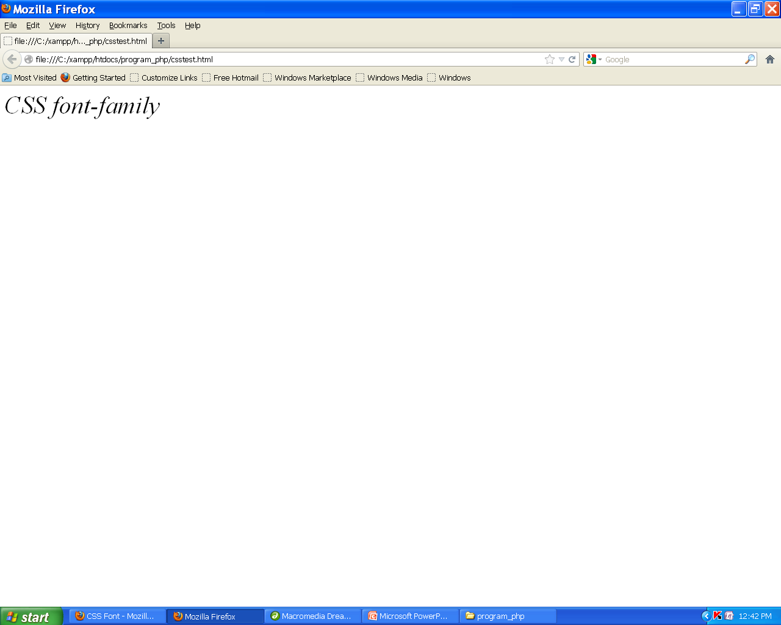
Output

Slide 59
CSS Lists
The CSS list properties allow you to:
Set different list item markers for ordered lists
Set different list item markers for unordered lists
Set an image as the list item marker

Slide 60
An Image as The List Item Marker
<style>
ul
{ list-style-image:url('bullet1.gif'); }
</style> </head>
<body>
<ul>
<li>one</li>
<li>two</li>
</ul>

Slide 61
listing.html
<!DOCTYPE html>
<html lang="en">
<body>
<div class="course-list-container">
<h1>Available Courses</h1>
<!-- Unordered list of courses -->
<ul class="course-list">
<li>Web Development</li>
<li>Data Science</li>
<li>Machine Learning</li>
<li>Cloud Computing</li>
<li>Cyber Security</li>
</ul>
<!-- Ordered list of courses -->
<h2>Popular Courses (Ordered)</h2>
<ol class="course-list-ordered">
<li>Artificial Intelligence</li>
<li>Blockchain Technology</li>
<li>Python Programming</li>
<li>Digital Marketing</li>
<li>UX/UI Design</li>
</ol>
</div>
</body>
</html>

Slide 62
listing.css

Slide 63
/* General body styling */
body {
font-family: Arial, sans-serif;
background-color: #f4f4f9;
margin: 0;
padding: 0;
}
/* Container for course list */
.course-list-container {
width: 80%;
margin: 50px auto;
padding: 20px;
background-color: #ffffff;
box-shadow: 0px 4px 10px rgba(0, 0, 0, 0.1);
border-radius: 8px;
}
/* Styling for course list heading */
h1 {
text-align: center;
color: #2c3e50;
font-size: 2rem;
}
/* Unordered list styling */
.course-list {
list-style-type: none; /* Remove default bullet points */
padding-left: 0;
}

Slide 64
.course-list li {
background-color: #3498db; /* Blue background for each item */
color: #fff; /* White text color */
padding: 10px;
margin-bottom: 10px; /* Space between list items */
border-radius: 5px; /* Rounded corners for each list item */
font-size: 1.2rem;
transition: all 0.3s ease; /* Smooth transition on hover */
}
.course-list li:hover {
background-color: #2980b9; /* Darker blue when hovering */
transform: translateY(-5px); /* Slight lift effect on hover */
}
/* Styling for ordered list */
.course-list-ordered {
list-style-type: decimal; /* Default numbering style */
padding-left: 20px; /* Indentation for ordered list */
}
.course-list-ordered li {
background-color: #2ecc71; /* Green background for each item */
color: #fff; /* White text color */
padding: 10px;
margin-bottom: 10px; /* Space between list items */
border-radius: 5px; /* Rounded corners for each list item */
font-size: 1.2rem;
transition: all 0.3s ease; /* Smooth transition on hover */
}
.course-list-ordered li:hover {
background-color: #27ae60; /* Darker green when hovering */
transform: translateY(-5px); /* Slight lift effect on hover */
}

Slide 65
CSS Box Model

Slide 66
The CSS Box Model
All HTML elements can be considered as boxes.
"box model" is used when talking about design and layout.
It allows us to put a border around elements and space elements in relation to other elements.

Slide 67
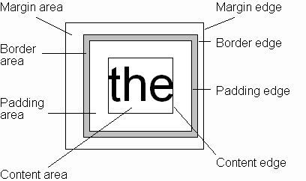
CSS Box Model
Every rendered element occupies a box:
(or outer edge)
(or inner edge)

Slide 68
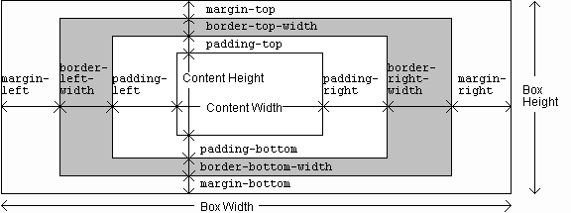
CSS Box Model

Slide 69
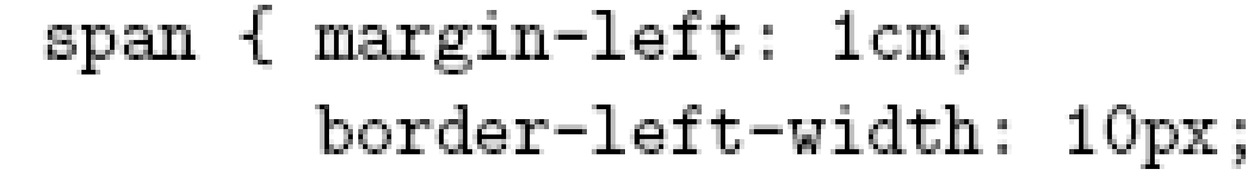
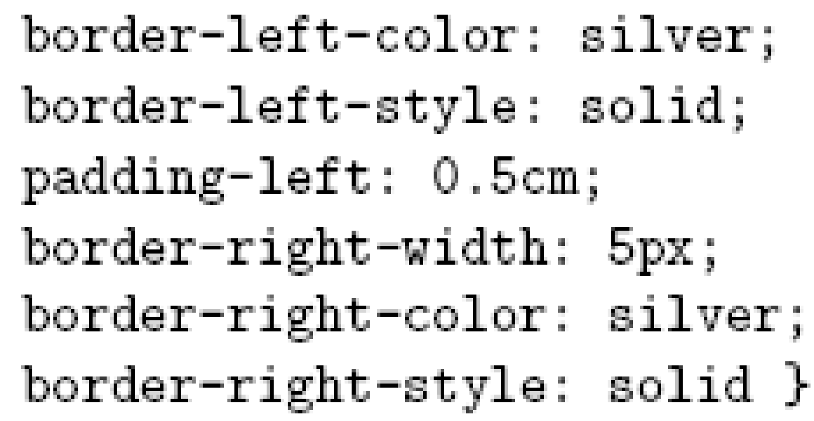
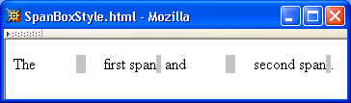
CSS Box Model

Slide 70
CSS Box Model

Slide 71
CSS Box Model

Slide 72
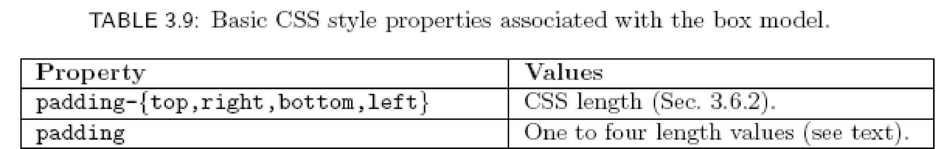
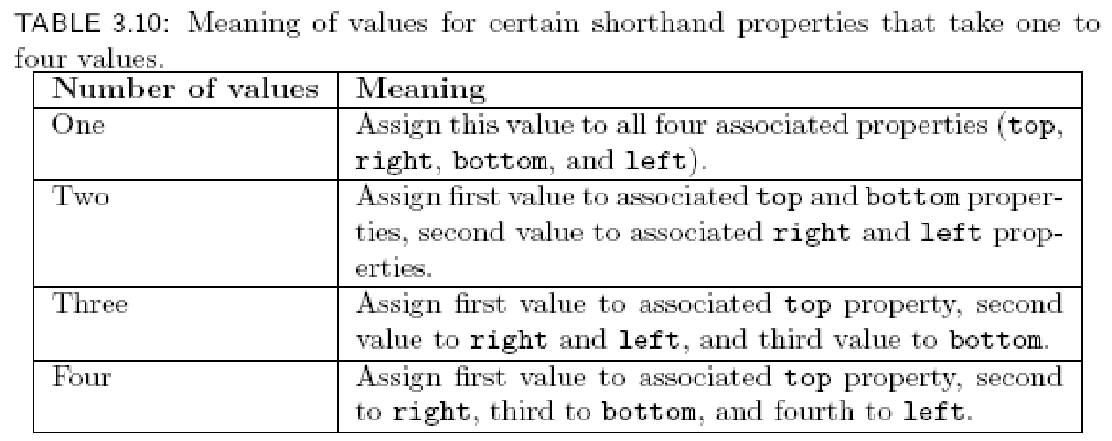
CSS Box Model

Slide 73
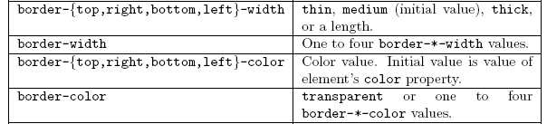
CSS Box Model

Slide 74
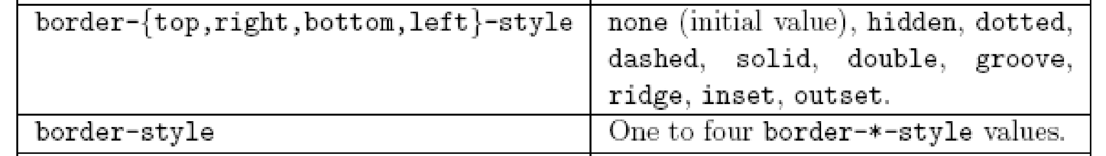
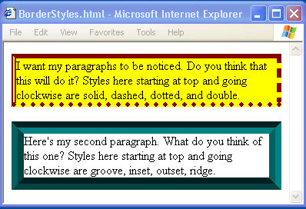
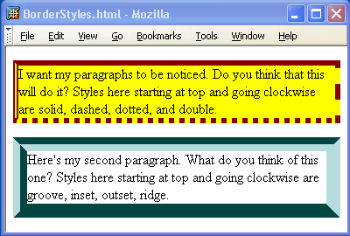
CSS Box Model

Slide 75
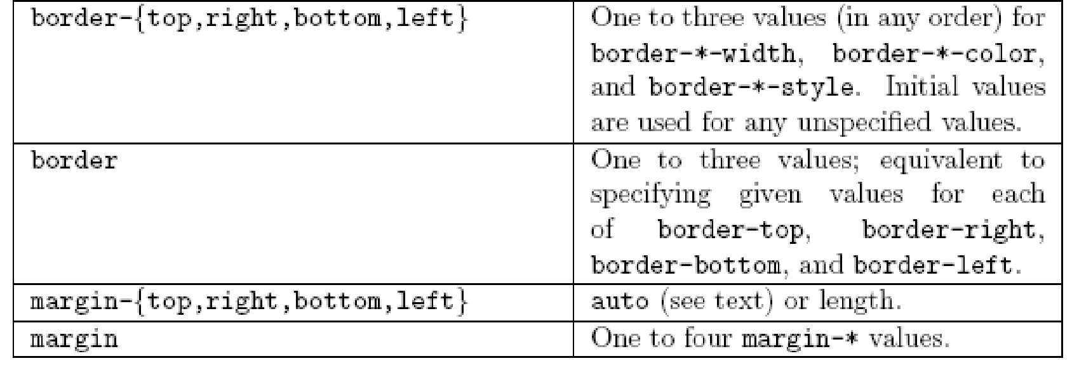
CSS Box Model

Slide 76
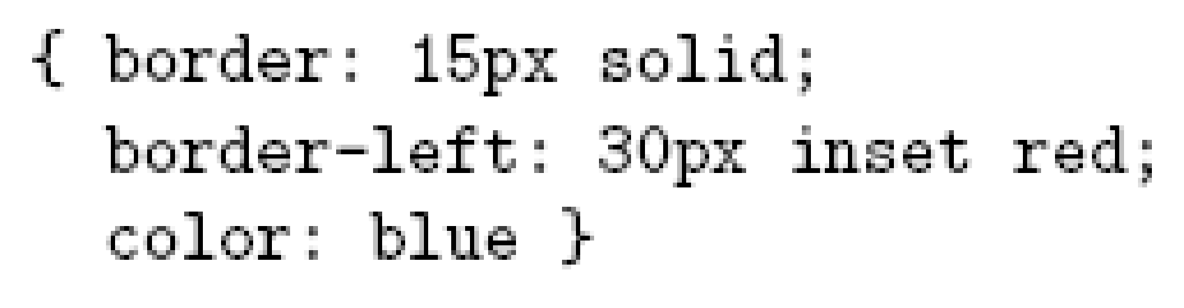
CSS Box Model
If multiple declarations apply to a property, the last declaration overrides earlier specifications
Left border is 30px wide,
inset style, and red

Slide 77
CSS Dimension
The CSS dimension properties allow you to control the height and width of an element.
<style>
img
{
width:200px;
height:200px;}
</style>

Slide 78
CSS Positioning
Allow you to position an element.
It can also place an element behind another, and specify what should happen when an element's content is too big.
Elements can be positioned using the top, bottom, left, and right properties. However, these properties will not work unless the position property is set first. They also work differently depending on the positioning method.
There are four different positioning methods.
Static Positioning: HTML elements are positioned static by default.
Fixed Positioning: An element with fixed position is positioned relative to the browser window. It will not move even if the window is scrolled:
Example: p {position: fixed; top: 30px; right:5px;}

Slide 79
Continued…
Relative Positioning:
A relative positioned element is positioned relative to its normal position.
Example: h2 { position: relative; left:-20px; }
Absolute Positioning:
An absolute position element is positioned relative to the first parent element that has a position other than static. If no such element is found, the containing block is <html>
Example: h2 { position: absolute; left:100px; top:150px; }
Overlapping Elements
The z-index property specifies the stack order of an element.
Example: img{position:absolute;left:0px;top:0px;z-index:-1; }

Slide 80
Attributes
Margin - Clears an area around the border. The margin does not have a background color, it is completely transparent
Border - A border that goes around the padding and content. The border is affected by the background color of the box

Slide 81
Attributes
Padding - Clears an area around the content. The padding is affected by the background color of the box
Content - The content of the box, where text and images appear

Slide 82
Sample css
body {
font-family: "Times New Roman", Times, serif;
font-size: 14px;
background-image: url("wall1.jpg");
color:#CC0000;
}
h1 {
text-align: center;
color: light red;
text-shadow: 5px 5px 5px #FF0000;
}
h2 {
text-align: left;
color: red;
}
p {
text-align: center;
color: red;
}

Slide 83
table, th, td {
border: 1px solid black;
background-color: #CCCCCC;
width: 100%;
}
th{
text-align: center;
height: 50px;
vertical-align: middle;
}
form {
position: relative;
background-image:url(wall1.jpg);
width : 200px;
height : 298px;
border: solid;
border-color: #FF2E2E;
}

Slide 84
a {
display: block;
width: 60px;
}
li {
height:20px;
width: 200px;
float: left;
color:#FFFFFF;
text-shadow: 5px 5px 5px #FF0000;
background: -moz-linear-gradient(50deg, red, yellow); /* For Firefox 3.6 to 15 */
padding:10px;
}

Slide 85
Css id attribute
<!DOCTYPE html>
<html>
<head>
<style>
p#p01 {
color: blue;
}
</style>
</head>
<body>
<p>This is a paragraph.</p>
<p>This is a paragraph.</p>
<p>This is a paragraph.</p>
<p id="p01">I am different.</p>
</body>
</html>

Slide 86
Css class attribute
<!DOCTYPE html>
<html>
<head>
<style>
p.error {
color:red;
}
</style>
</head>
<body>
<p>This is a paragraph.</p>
<p>This is a paragraph.</p>
<p class="error">I am different.</p>
<p>This is a paragraph.</p>
<p class="error">I am different too.</p>
</body>
</html>

Slide 87
css form design
<!DOCTYPE html>
<html lang="en">
<head>
<meta charset="UTF-8">
<meta name="viewport" content="width=device-width, initial-scale=1.0">
<title>Styled Form</title>
<style>
/* Form container */
form {
max-width: 400px;
margin: 50px auto;
padding: 20px;
background: #f9f9f9;
border-radius: 12px;
box-shadow: 0px 4px 8px rgba(0,0,0,0.1);
font-family: Arial, sans-serif;
}

Slide 88
/* Form labels */
label {
display: block;
margin-bottom: 8px;
font-weight: bold;
color: #333;
}
/* Input fields */
input[type="text"],
input[type="email"],
input[type="password"],
textarea,
select {
width: 100%;
padding: 10px;
margin-bottom: 15px;
border: 1px solid #ccc;
border-radius: 8px;
font-size: 14px;
transition: border 0.3s;
}
/* Focus effect */
input:focus,
textarea:focus,
select:focus {
border-color: #007bff;
outline: none;
}

Slide 89
Display
Common Display Types
display: block;
Takes up the full width of its parent (unless width is set).
Always starts on a new line.
You can set width, height, margin, padding.
Examples: <div>, <p>, <h1> … are block by default.
display: inline;
Does not start on a new line.
Only takes up as much width as the content.
You cannot set width/height directly.
Examples: <span>, <a>, <strong> are inline by default.

Slide 90
display: inline-block;
Behaves like inline (sits side by side).
But allows setting width, height, margin, padding (like block).
Very useful for buttons, menus, grids.
display: flex;
Turns an element into a flex container.
Its children become flex items, which can be aligned, spaced, and ordered easily.
Great for responsive layouts.
display: none;
Hides the element completely (it won’t take up space).
Different from visibility: hidden; (which hides it but still takes space).

Slide 91
/* Submit button */
input[type="submit"], button {
width: 100%;
padding: 12px;
background: #007bff;
color: white;
border: none;
border-radius: 8px;
font-size: 16px;
cursor: pointer;
transition: background 0.3s;
}
input[type="submit"]:hover, button:hover {
background: #0056b3;
}
</style>
</head>
<body>
Other useful cursor values:
default → normal arrow
text → text selection (I-beam cursor)
wait → loading spinner/hourglass
not-allowed → 🚫 symbol (disabled)
grab / grabbing → hand for draggable items

Slide 92
<form>
<h2>Sign Up</h2>
<label for="name">Full Name</label>
<input type="text" id="name" name="name" placeholder="Enter your full name">
<label for="email">Email Address</label>
<input type="email" id="email" name="email" placeholder="Enter your email">
<label for="password">Password</label>
<input type="password" id="password" name="password" placeholder="Enter a password">
<label for="message">Message</label>
<textarea id="message" name="message" rows="3" placeholder="Write something..."></textarea>
<input type="submit" value="Register">
</form>
</body>

