Slide 1

IILM UNIVERSITY, GREATER NOIDA
School of Computer Science and Engineering
SUMMER INTERNSHIP PRESENTATION
PBL Nexus
A Smart Web-Based Project & Task Management System for Project-Based Learning
STUDENT NAME
ENROLLMENT NO.
PROGRAM & SEMESTER
Priyanshu Dixit
CS-2341902
B.Tech CSE — 7th Semester
BATCH
ORGANIZATION
2023 – 2027
Qveto Technologies

Slide 2
OVERVIEW
What We'll Cover
01
About the Organization
02
Problem & Objectives
Qveto Technologies & the internship track
Why PBL Nexus was built, and its goals
03
Tech Stack & Architecture
04
Product Walkthrough
The tools and design behind the system
Login, Admin & Student experiences
05
Methodology & Outcomes
06
How it was built, and what it achieves
PBL Nexus — Internship Presentation
2

Slide 3
THE ORGANIZATION
Qveto Technologies
Qveto Technologies is a technology solutions and training organization offering industry-oriented internship and training programs, focused on building practical, deployable software products rather than purely theoretical assignments.
INTERNSHIP SNAPSHOT
Domain:
Web Development
1
Full-Stack Product Shipped
6
Core Pages / Modules Built
Mode:
Project-Based Remote Internship
2
User Roles Supported
PBL Nexus — Internship Presentation
3

Slide 4
THE CHALLENGE
Problem Statement
Academic institutions running Project-Based Learning programs largely rely on manual, fragmented methods — spreadsheets, emails, in-person follow-ups — to assign tasks, track progress, collect submissions and record grades.
!
!
!
Time-Consuming
Error-Prone
No Visibility
Manual coordination eats into learning and mentoring time.
Spreadsheets and email threads lose track of status and files.
Neither students nor instructors get real-time progress insight.
PBL Nexus — Internship Presentation
4

Slide 5
GOALS
Project Objectives
1
Design a secure, role-based login system distinguishing Admin and Student users.
2
Enable admins to add users, assign tasks with due dates, and manage the workflow.
3
Allow students to view tasks, update progress, and submit files with notes.
4
Build a grading module for reviewing submissions, marks, and feedback.
5
Provide real-time dashboards summarizing task and submission status.
6
Deploy the system as a live, cloud-hosted application accessible anywhere.
PBL Nexus — Internship Presentation
5

Slide 6
UNDER THE HOOD
Technologies & Tools Used
Frontend
Backend
Deployment
HTML5 · CSS3 · Vanilla JavaScript
Node.js REST API (Express-style routes)
Railway (cloud hosting)
Typography & UI
File Handling
Client State
Playfair Display · DM Sans · dark theme
multipart/form-data uploads via FormData API
Browser localStorage for session & role routing
PBL Nexus — Internship Presentation
6

Slide 7
HOW IT WORKS
System Architecture
Frontend (Client)
REST API (Node.js)
Database / File Storage
Login · Admin & Student Dashboards · Add User · Assign Task · Submission
/login /users /tasks /submit /grade — JSON over HTTPS
Users · Tasks · Submissions · Grades + uploaded project files
Hosted on Railway · fetch() / async-await drives every client-server exchange · role-based redirect after login (admin / student)
PBL Nexus — Internship Presentation
7

Slide 8
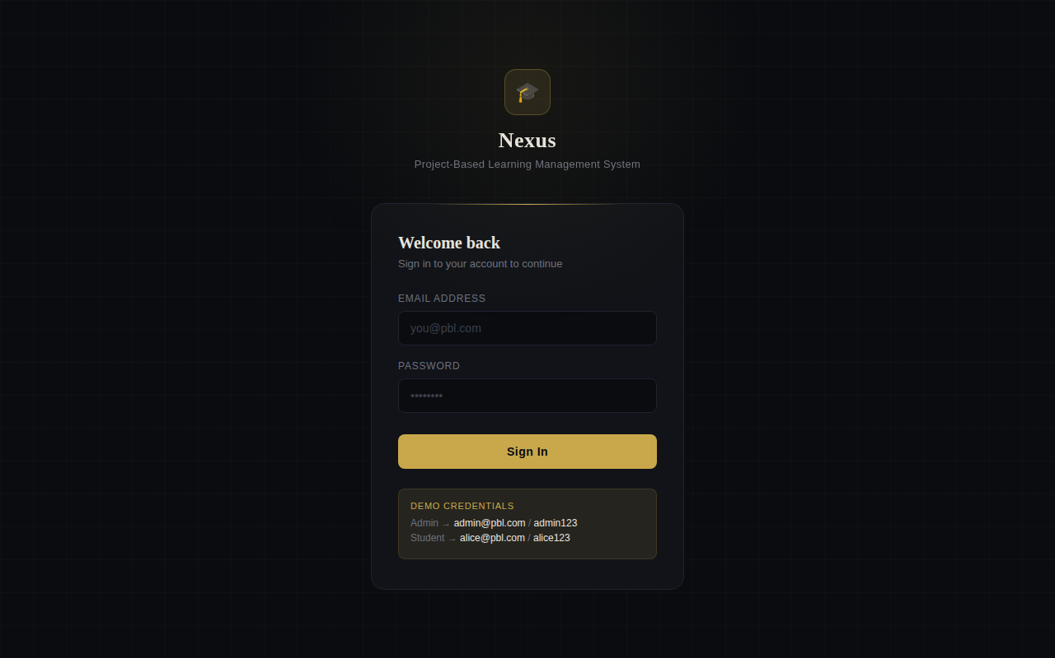
WALKTHROUGH
Secure Role-Based Login
A single entry point that authenticates users and routes them by role.
Unified Auth
One login screen for Admin & Student roles.
Session Handling
Role stored client-side, drives redirects.
Clean UI
Dark, distraction-free academic theme.
PBL Nexus — Internship Presentation
8

Slide 9
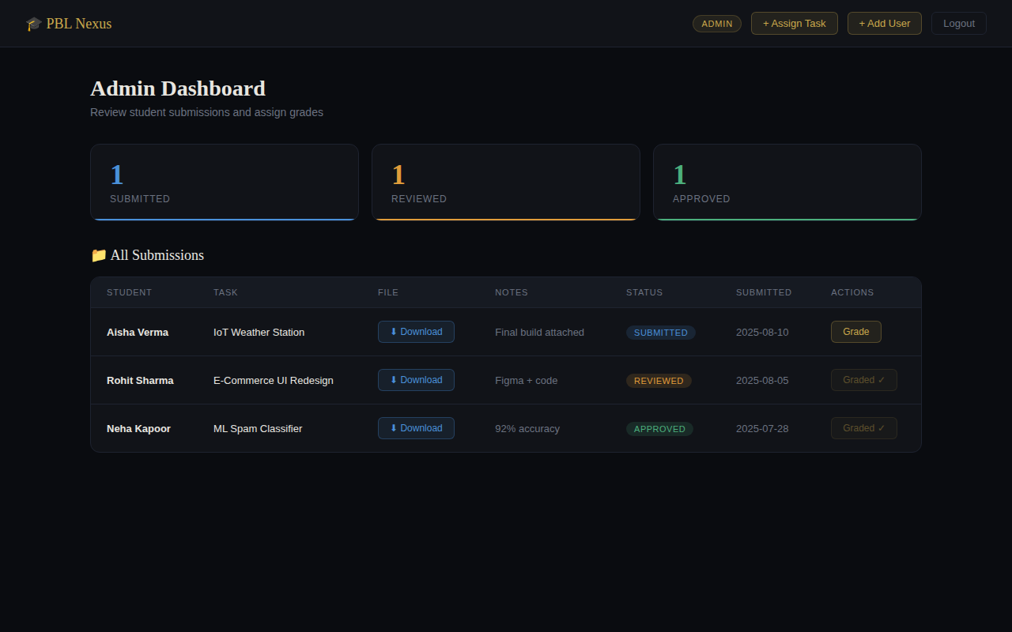
WALKTHROUGH
Admin Dashboard
Full visibility and control over every student submission.
Live Stats
Submitted / Reviewed / Approved at a glance.
File Access
One-click download of student submissions.
Grading
Assign marks & feedback directly from the table.
PBL Nexus — Internship Presentation
9

Slide 10
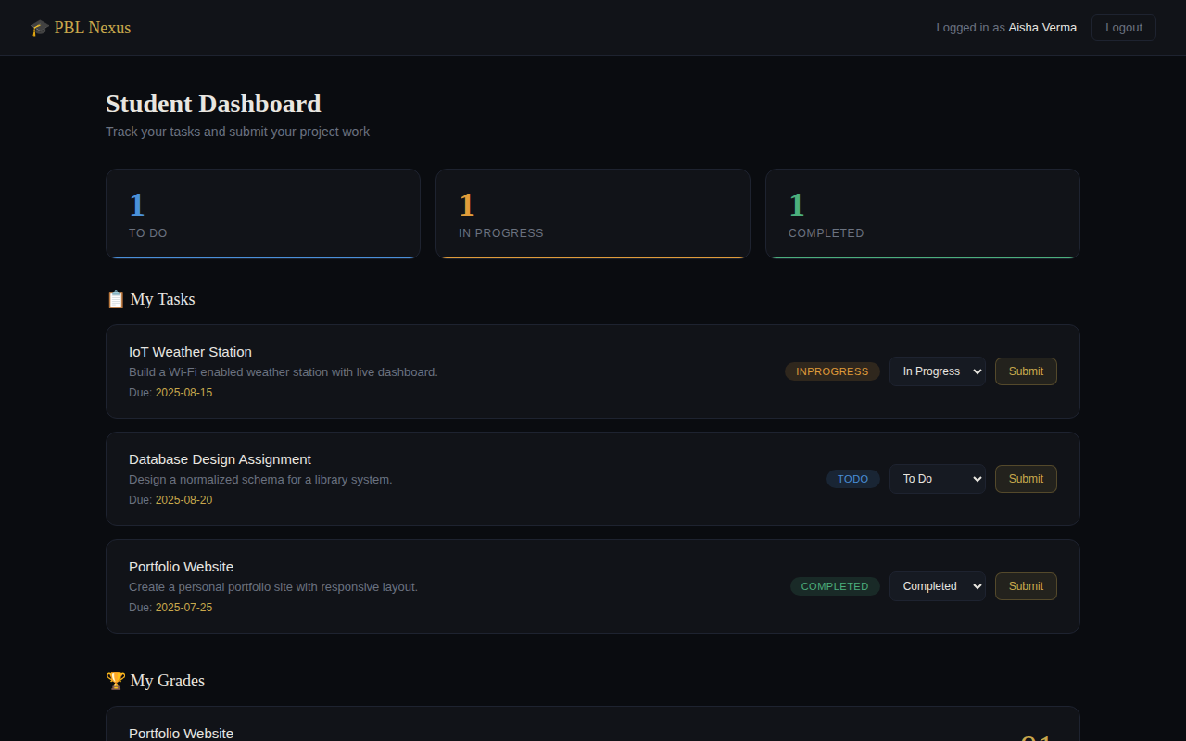
WALKTHROUGH
Student Dashboard
A single place for students to track tasks and submit work.
Task Tracking
To Do / In Progress / Completed at a glance.
Status Control
Students self-update progress in real time.
Grades
Marks and instructor feedback shown per task.
PBL Nexus — Internship Presentation
10

Slide 11
PROCESS
Development Methodology
1
2
3
4
5
6
Requirement Analysis
UI/UX Design
Iterative Build
API Integration
Testing
Deployment
Identified user roles and core workflows.
Built a consistent, reusable dark component system.
Developed each module independently, then integrated.
Connected every page to the live backend via Fetch.
Manually tested the full assign → submit → grade flow.
Shipped the backend to Railway; verified end-to-end.
PBL Nexus — Internship Presentation
11

Slide 12
RESULTS
Expected Outcomes & Learnings
By the end of the internship, PBL Nexus was delivered as a working full-stack web application — with authentication, role-based dashboards, task tracking, file submissions, and a grading workflow with feedback.
Frontend UI/UX design with a real design system
Consuming REST APIs asynchronously (fetch, async/await)
Handling file uploads (multipart/form-data)
Role-based access & client-side session handling
Cloud deployment of a live backend (Railway)
End-to-end product thinking: idea → build → ship
PBL Nexus — Internship Presentation
12

Slide 13
Thank You
Questions & Discussion
Priyanshu Dixit · CS-2341902 · B.Tech CSE, 7th Semester · IILM University, Greater Noida

